Slide 1
Acute & Chronic Pancreatitis MBChB IV
Dr. Linda Gathara
MBChB(UoN), MMED(IMED)(Wits),FCP(SA),FCP(ECSA)
Consultant Physician & Gastroenterologist

Slide 2
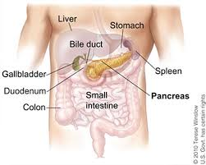
Pancreas - Anatomy
Elongated and tapered organ .
A pale grey gland weighing about 60 grams and about 12-15 cm long.
Situated in the epigastric and left hypochondriac regions of the abdominal cavity

Slide 3
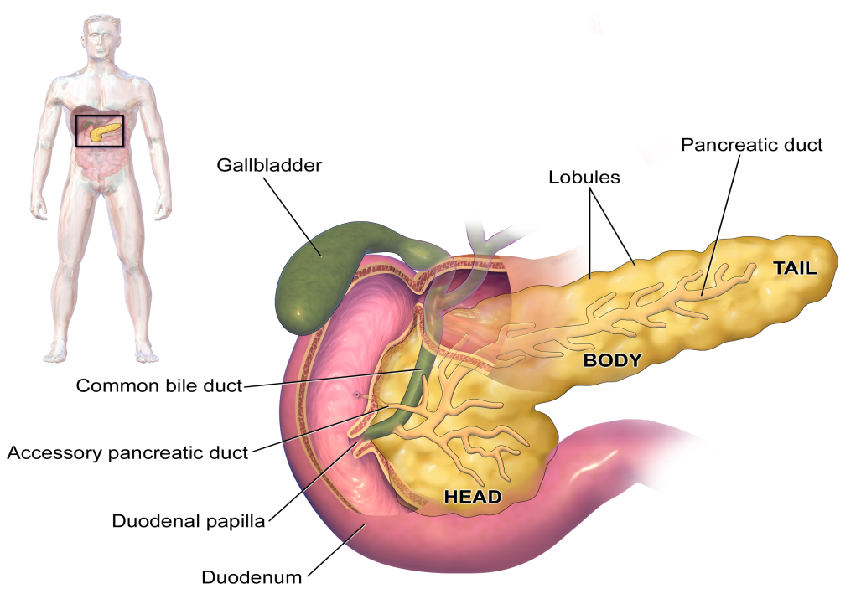
Parts
Head -the widest right part of the organ and lies in the curve of the duodenum
Body- tapered left side extends slightly upward lies behind stomach.
Tail- narrowed end part lies infront of the kidney and just reaches the spleen.

Slide 4
Functions
Endocrine functions
-Islet of langerhens -Alphacells glucagon(20%) –
Beta cells insulin(75%) –
Delta cells somatostatin
Exocrine function
Pancreatic juice
Amylase –
Lipase
Trypsin
Chymotrypsin
Carboxypeptidase

Slide 5
Exocrine cells:
consists of a large number of lobules made up of small acini, which consist of secretory cells.
Each lobule is drained by a tiny duct and these unite eventually to form the pancreatic duct.
pancreatic duct joins the common bile duct to form hepato pancreatic ampulla.
The duodenal opening of the ampulla is controlled by the hepatopancreatic sphincter of the duodenal papilla.

Slide 6
The function of the exocrine pancreas is to produce pancreatic juice containing enzymes, that digest carbohydrates, proteins and fats.
Pancreatic juice consists of: Water, Mineral salts , Enzymes: Amylase Lipase, Inactivated enzyme precursor including Trypsinogen Chymotrypsinogen

Slide 7
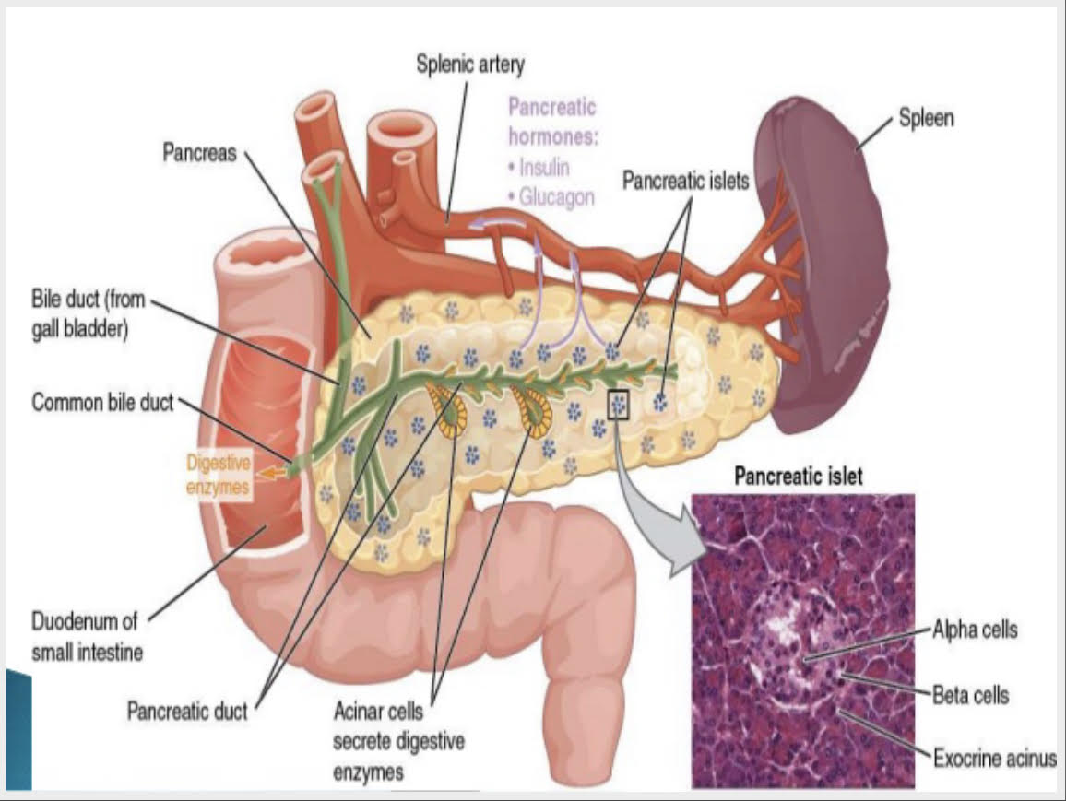

Slide 8
Functions
Digestion of protein: Trypsinogen and chymotrypsinogen are inactive enzyme precursors activated by enterokinase to enzymes trypsin and chymotrypsin which convert polypeptide to tripeptides and dipeptides.
Digestion of carbohydrates Amylase converts polysaccharides(starches) to disaccharides.
Digestion of fats: Lipase converts fats to fatty acids and glycerol ,
bile salts emulsify fats.

Slide 9
Control of secretions
When the partially digested contents of the stomach reach the small intestine, two hormones ,secretin and cholecystokinin are produced by endocrine cells in the walls of the duodenum and these hormones stimulates the secretion of pancreatic juice.

Slide 10
Endocrine functions
Consists of clusters of cells, known as the pancreatic islets scattered throughout the gland.
Alpha cells secrete glucagon
Beta cells secret insulin
Delta cells secrete somatostatin.

Slide 11
Endocrine functions
insulin -Reduces blood glucose levels. Secretion is stimulated by increased blood glucose level,e.g after eating a meal
glucagon-Increases blood glucose level. Secretion is stimulated by low blood glucose levels and exercise, and decreased by somatostatin and insulin.
somatostatins - Inhibits the secretion of insulin and glucagon in addition to inhibiting the secretion of GH from the anterior pituitary.

Slide 12
Definition
Pancreatitis is the inflammation of the pancreas.
1. Acute inflammation: occurs suddenly and lasting for a few days. Usually heals by regeneration without any functional or anatomic changes.
2. Chronic inflammation: occurs gradually with recurrent attacks . Heals by fibrosis that result in endocrine and exocrine insufficiency.

Slide 13
Acute Pancreatitis
It is an acute inflammatory process of the pancreas. The degree of inflammation varies from mild edema to severe hemorrhagic necrosis.
Incidence - most common in middle aged men and women. It affects male and female equally.
Etiological factors(Gallstone,ethanol,trauma etc)
The pathophysiologic involvement ranges from edematous pancreatitis (which is self limiting )to necrotizing pancreatitis.

Slide 14
Causes
I: Idiopathic
G: Gallstones
E: Ethanol (alcohol)
T: Trauma
S: Steroids
M: Mumps (and other infections) / malignancy
A: Autoimmune
S: Scorpion stings/Spider bites
H: Hyperlipidemia/Hypercalcaemia
E: ERCP
D: Drugs

Slide 15
Revised Atlanta Classification - Acute Pancreatitis
A. Mild Pancreatitis
No organ failure
No local or systemic complications
B. Moderately severe acute pancreatitis:
Organ failure that resolves within 48h (transient organ failure) and / or
Local or systemic complications without persistent organ failure
C. Severe acute pancreatitis: Persistent organ failure (>48h)
Single organ failure
Multiple organ failure

Slide 16
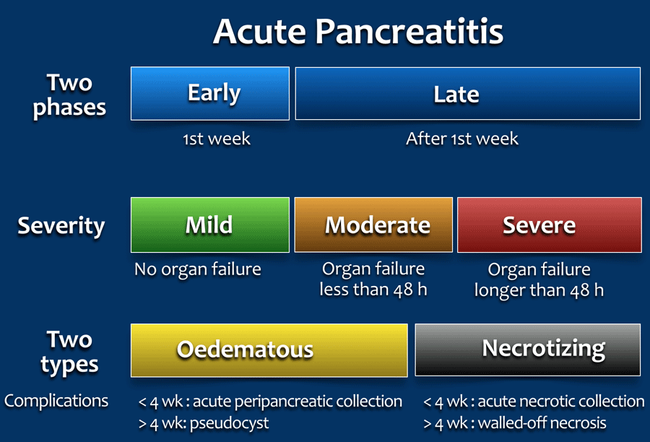

Slide 17
Signs and Symptoms
Severe abdominal pain is predominanat symptoms
Pain located in upper quadrant and midepigastrium Severe, deep piercing and continuous or steady in nature
Hypotension Nausea, vomiting
Crackles present over lungs
Illeus with marked abdominal distensionTachycardia and jaundice
Bowel sound may be decreased or absent

Slide 18
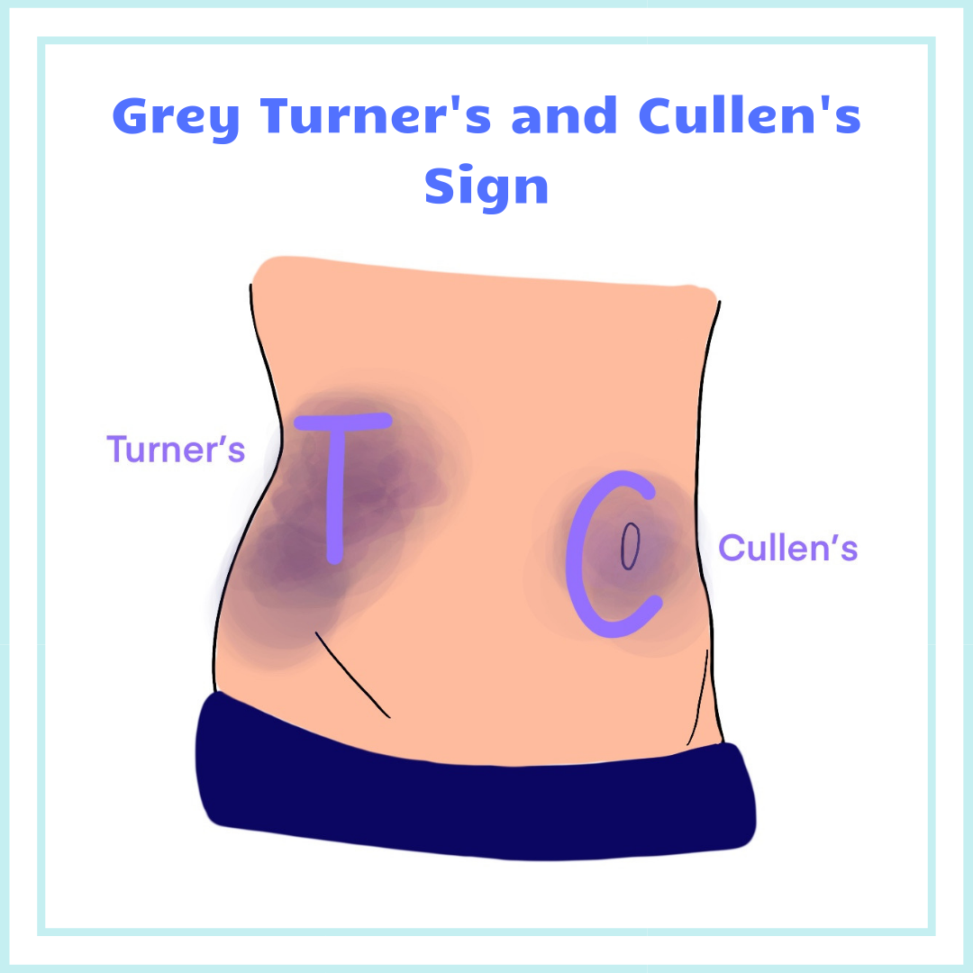
Greys turner spots (bluish flank discolouration)
Cullen’s sign(a bluish periumblical area)

Slide 19
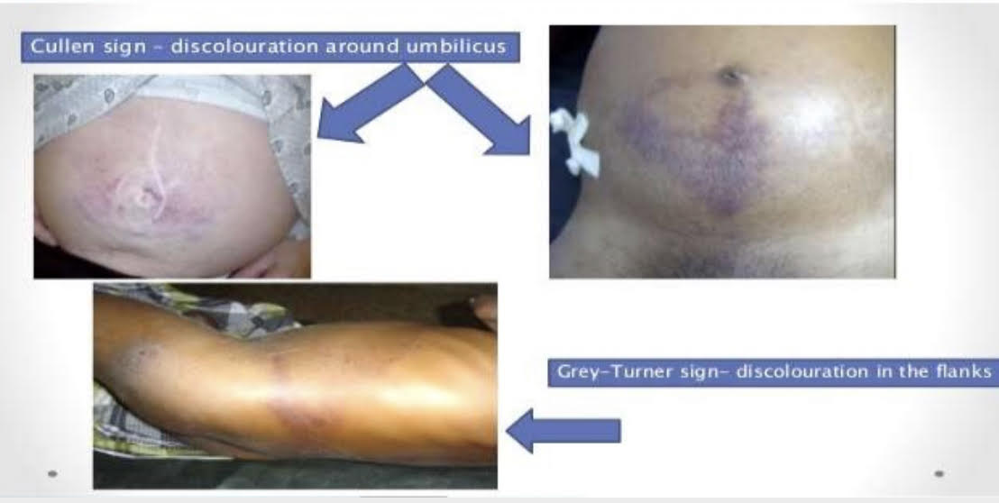
On examination

Slide 20
Shock may be arise due to:
haemorrhage,
toxemia from activated enzymes
hypovolemia as a result of fluid shift.

Slide 21
Chronic pancreatitis
Continuous, prolonged , inflammatory and fibrosing process of the pancreas.
Progressively destroyed as it is replaced with fibrotic tissue.
Strictures and calcification may also occur in pancreas

Slide 22
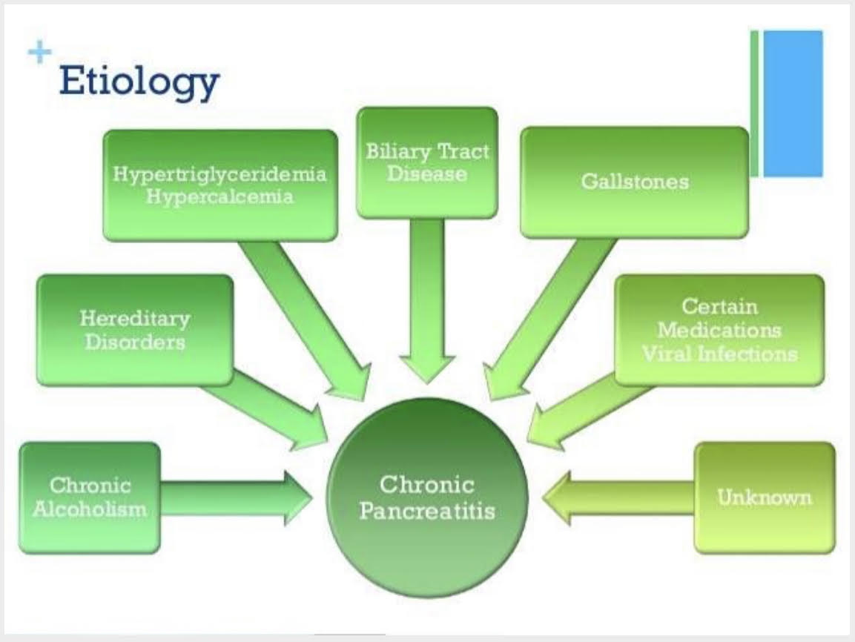
Chronic pancreatitis

Slide 23
Pathophysiology
The 2 major types are chronic obstructive pancreatitits and chronic calcifying pancreatitis.
Toxic effect of alcohol causes obstruction of duct with protein precipitates.
The precipitates block the pancreatic duct and eventually calcify which is followed by fibrosis and glandular atrophy.
Pseudocyst and abscesses commonly develop.

Slide 24
Clinical manifestation
Upper abdominal pain
Losing weight without trying
Oily, smelly stools (steatorrhea)

Slide 25
Complications
Infections: In acute pancreatitis, the pancreas is susceptible to bacteria that can cause infections..
Pseudocyst: Debris and fluid that can collect in pockets of the pancreas. If this cyst-like pocket ruptures, infection and bleeding can result.
Diabetes: Due to damage of the insulin producing cells.

Slide 26
Complications cont’d
Pancreatic abscess(cavity of pus within the pancreas)
Respiratory problems(pleural effusion,atrelactasis,pneumonia)
SIRS(systemic inflammatory response syndrome)-vasodilation,hypotension,capillary leakage,edema)
Malnutrition: Due to lack of absorption.
Pulmonary emboli, disseminated intravascular coagulation.

Slide 27
Lab Investigations
Primary test
Serum amylase Increased (>200 U/L)
Serum lipase Elevated
Urinary amylase Elevated
Secondary tests
Blood glucose Hyperglycemia
Serum calcium Hypocalcemia
Serum triglyceride Hyperlipidemia

Slide 28
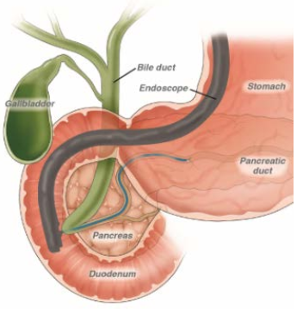
Investigations
Abdominal ultrasonography
Endoscopic ultrasonography (EUS)
Abdominal computed tomography (CT)
Endoscopic retrograde cholangiopancreatogra phy (ERCP)

Slide 29
Management
Objective of collaborative care for acute pancreatitits include:
Relief of pain
Prevention or alleviation of shock
Reduction of pancreatic secretions
Control of fluid and electrolyte imbalances
Prevention or treatment of infections
Removal of the precipitating cause

Slide 30
Conservative therapy- Focused on supportive care
Pain management(Iv morphine,antispasmodic)
Correction of hypovolemia using normal saline and colloids.
Use NG suction to reduce vomiting and gastric distension
Decrease stimulation of pancreas
Avoidance of alcohol.
Keep patient in NPO Oxygen for hypoxic patients those with acute respiratory distress syndrome.

Slide 31
Pharmacological therapy
Morphine –relief of pain.
Nitroglycerine or papaverine-relaxation of smooth muscles and relief of pain.
Antispasmodic(dicyclomine,propantheline bromide)-decreased of vagal stimulation,motility,pancreatic outflow.
Carbonic anhydrase inhibitor (acetazolamide) reduction in volume and bicarbonate concentration of pancreatic secretions.
Antacids – neutralizations of gastric hydrochloride.
Histamine(H2) receptor antagonists ranitidine
proton pump inhibitors (omeprazole) -decrease in HCL and stimulates pancreatic secretion
Calcium :if hypocalcemia tetany occur
Prophylactic broad spectrum antibiotic
Pancreatic enzyme replacement.

Slide 32
Nutritional management
Diet: low in fat and high in protein and carbohydrates
Small frequent feeding
Pancreatic enzyme supplementation with meals
Correct malabsorption of the fat-soluble vitamins (A, D, E, K) and vitamin B12
Medium-chain triglycerides in patients with severe fat malabsorption (they are directly absorbed by the small intestine without the need for digestion).

Slide 33
Surgical therapy
-Done in case of
Abscess
Severe peritonitis 
Acute pseudocyst.

Slide 34
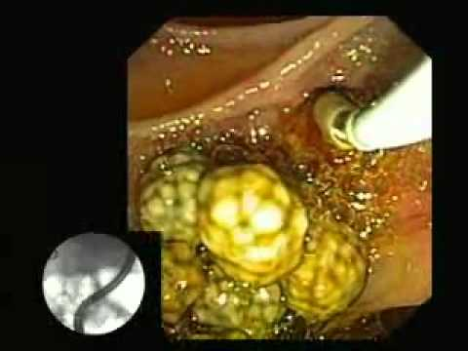
ERCP
ERCP plus endoscopic sphincterotomy- performed to remove duct obstruction - eg, gallstone.

Slide 35
Management
Percutaneous drainage of pseudocyst.
Choledochojejunostomy- Common bilde duct is anastomosed into the jejunum where it diverts bile around the ampulla of vater.
Roux-en Y pancreatojejunostomy.

Slide 36
Thank you

