Slide 1
Course code: CMMB11
Course title: Medical Biochemistry 1
LECTURE 7

Slide 2
CARBOHYDRATES
Definition
Carbohydrates are polyhydroxy aldehydes or polyhdroxy ketones composed of Carbon, Hydrogen and Oxygen.

Slide 3
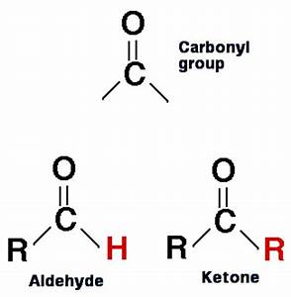

Slide 4
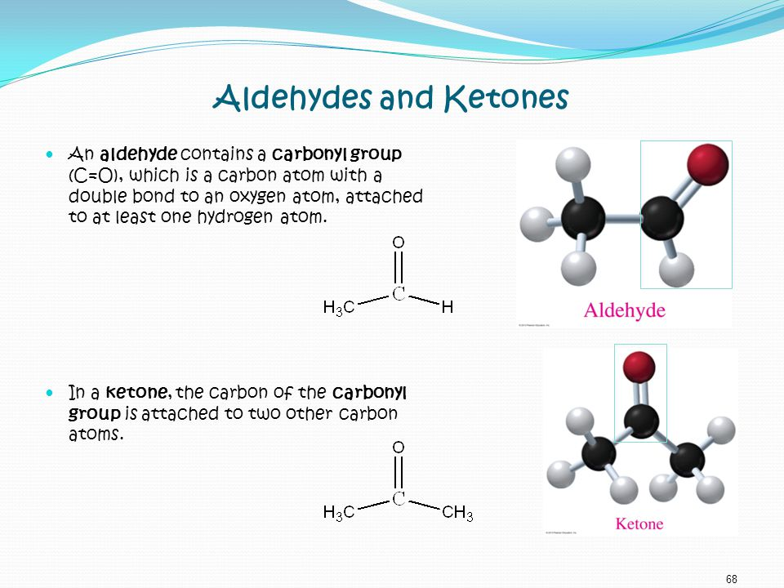

Slide 5
Introduction
Carbohydrates are the most abundant organic molecules in nature and also referred to as “saccharides”.
The carbohydrates which are soluble in water and sweet in taste are known as “sugars”.

Slide 6
The building blocks of all carbohydrates are the simple sugars called monosaccharides.
A monosaccharide can be a polyhydroxy aldehyde (aldose) or a polyhydroxy ketone (ketose).

Slide 7
Structure of Carbohydrates
Carbohydrates consist of carbon, hydrogen, and oxygen.
The general empirical structure for carbohydrates is CnH2nOn or Cn(H2O)n .
n= number of atoms
They are organic compounds organized in the form of aldehydes or ketones with multiple hydroxyl groups coming off the carbon chain.

Slide 8
The carbohydrates can be structurally represented in any of the three forms:
1.Open chain structure – It is the long straight chain form of carbohydrates.
Example; Below is a open chain structure of glucose

Slide 9
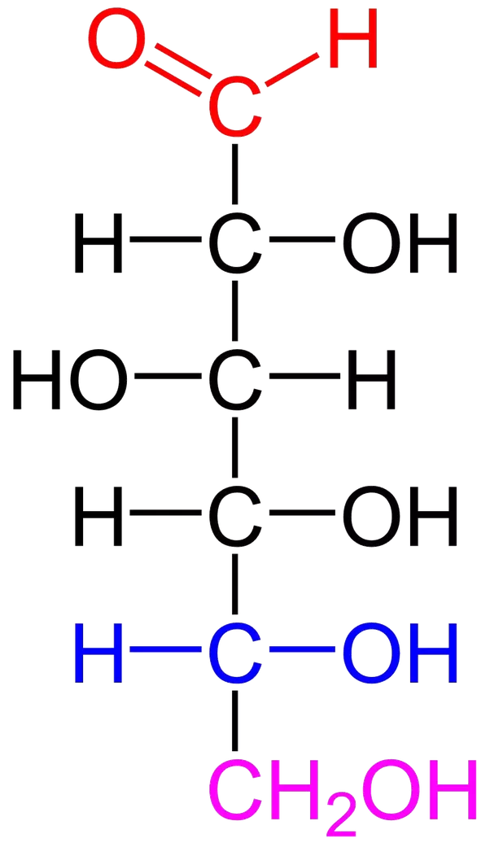

Slide 10
2.Hemi-acetal structure – Here the 1st carbon of the glucose condenses with the -OH group of the 5th carbon to form a ring structure.

Slide 11
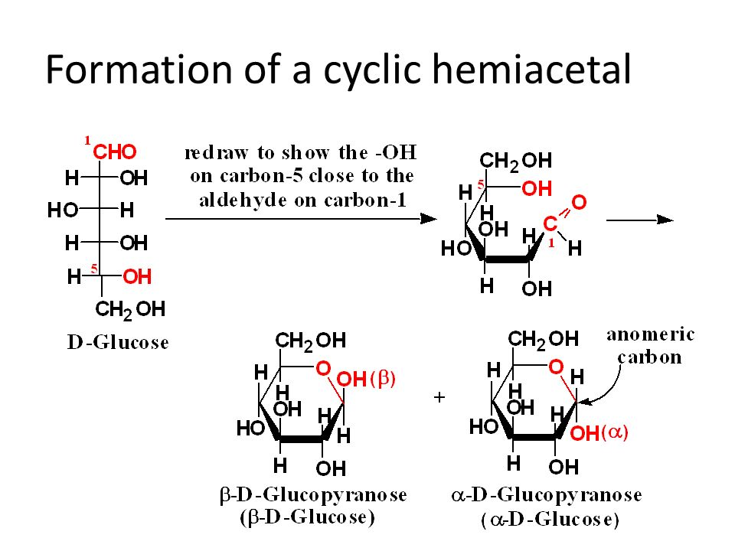

Slide 12
The carbon that determines the D and L designations is the C-5.
It is also the one that determines the α and β configurations.

Slide 13
The α-anomer is the isomer with the OH group on the side opposite to the C-5 substituent (the CH₂OH group), i.e. pointing "down".
The β-anomer has the anomeric OH group on the same side as the CH₂OH group, i.e. pointing "up".

Slide 14
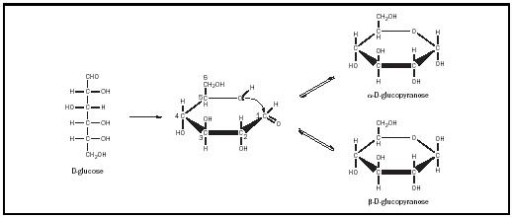

Slide 15
3.Haworth structure – It is the presence of pyranose ring structure.
Definition: Pyranose is a collective term for saccharides that have a chemical structure that includes a six-membered ring atoms consisting of five carbon atoms and one oxygen atom.

Slide 16
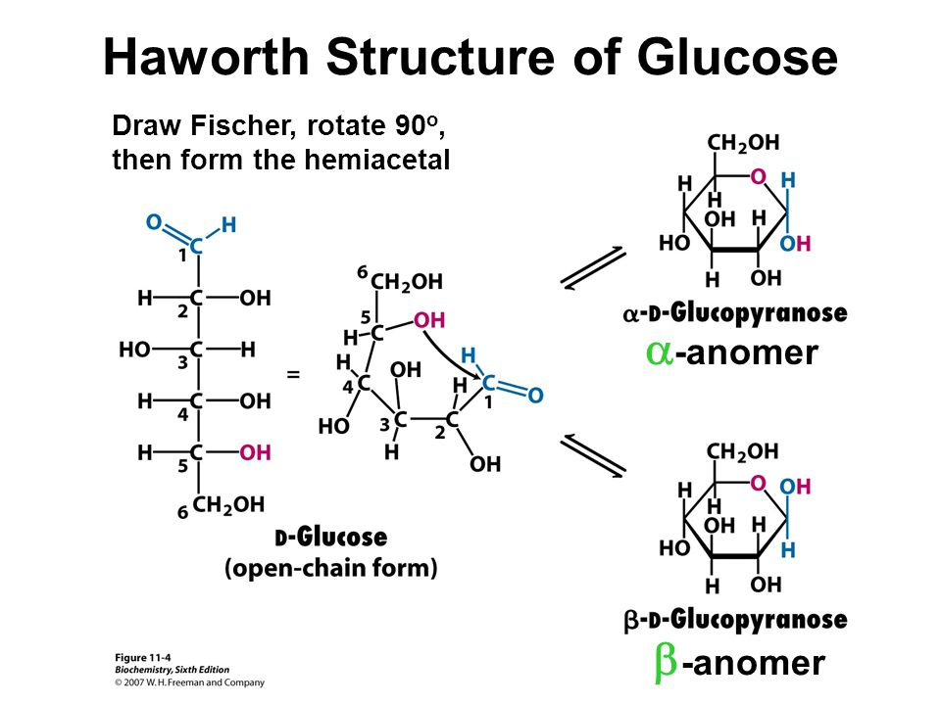

Slide 17
Physical properties
Carbohydrates forms stereoisomers : Sterioisomers are compounds sharing same structural formula but they differ in spatial configuration. Example: Glucose has two isomers which are D-glucose and L- glucose.

Slide 18
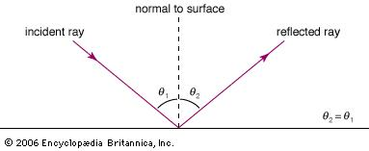
Optical activity: substances which rotate the plane polarised light(light vibrations on the same plane)either towards right or towards left are said to be optically active substances and the property is known as optical activity.

Slide 19
Most of carbohydrates are crystalline and have a sweet taste.
Example;monosaccharides.

Slide 20
Chemical properties
1.Carbohydrates maybe reducing or non reducing sugars depending on reducing property of Carbohydrates because of free aldehyde or Ketone group of anomeric carbon.

Slide 21
Reducing sugars: carbohydrates that is capable of being oxidized(the loss of electrons) and causes the reduction(the gain of electrons) of other substances without having to be hydrolyzed first.Example;maltose
Non reducing sugars: Carbohydrates that can not be oxidized and do not reduce other substances.Example;sucrose

Slide 22
2.Reduction reaction
The aldehyde or carbonyl group of monosaccharides are reduced to their corresponding alcohols by treating them with reducing agents like sodium amalgam - Na(Hg).This is an alloy of mercury and sodium.
3.Oxidation reaction: The terminal aldehyde group may be oxidized in the presence of oxidizing agent.

Slide 23
Classification of carbohydrates
Carbohydrates are classified into four categories.
These include;
Monosaccharides
Disaccharides
Oligosaccharides
Polysaccharides

Slide 24
Monosaccharides
These are also known as simple sugars. They are the basic units of carbohydrates and they can not be hydrolyzed to yield smaller carbohydrate units.

Slide 25
They may be classified as;
trioses(with 3 carbons)
Tetroses (with 4 carbons)
pentoses (with 5 carbons)
hexoses (with 6 carbons)
or heptoses(with 7 carbons)
Above classification is dependent on the number of carbon atoms.
Monosaccharides can also be classified as aldoses or ketoses, depending upon whether they have an aldehyde or ketone group.

Slide 26
Monosaccharides with four or more carbon atoms tend to cyclic structures in nature.
Examples of monosaccharides include; glucose,fructose,galactose

Slide 27
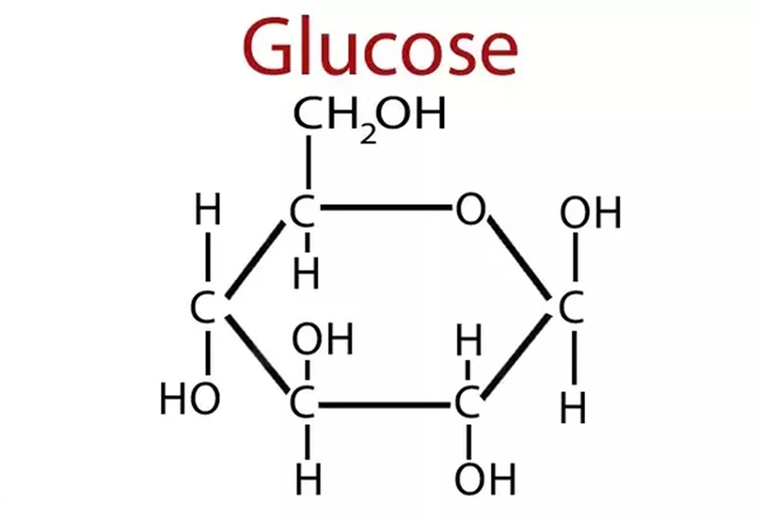

Slide 28
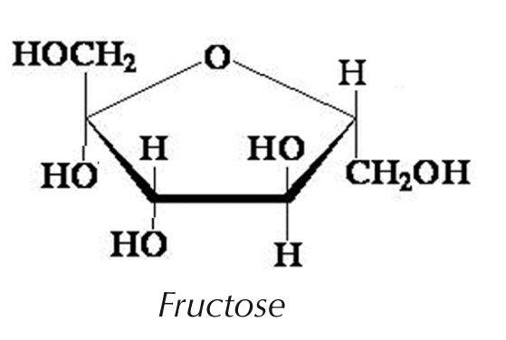

Slide 29
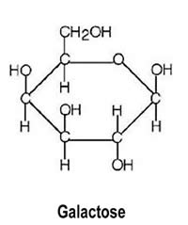

Slide 30
Disaccharides
Disaccharides are condensation products of two monosaccharide units
Examples include;

Slide 31
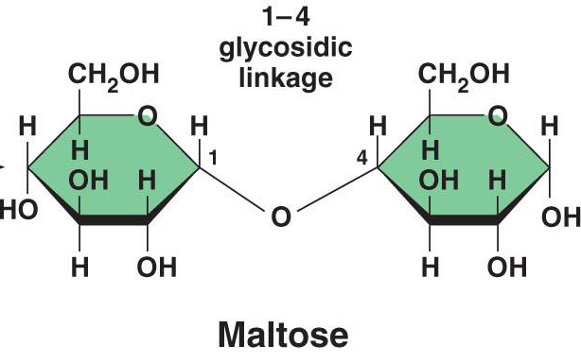
Maltose. This is made up of two monomer units of glucose.

Slide 32
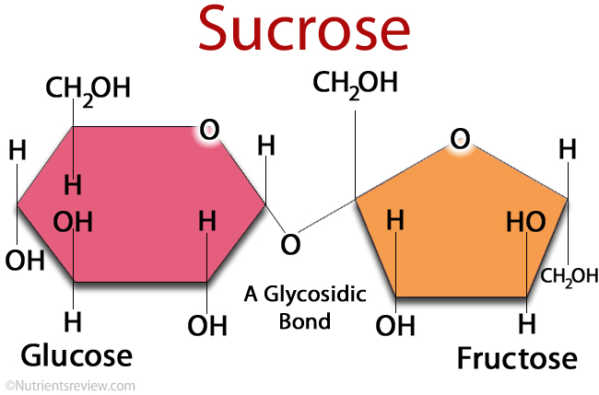
Sucrose. This is made up of one monomer unit of glucose and one monomer unit of fructose.

Slide 33
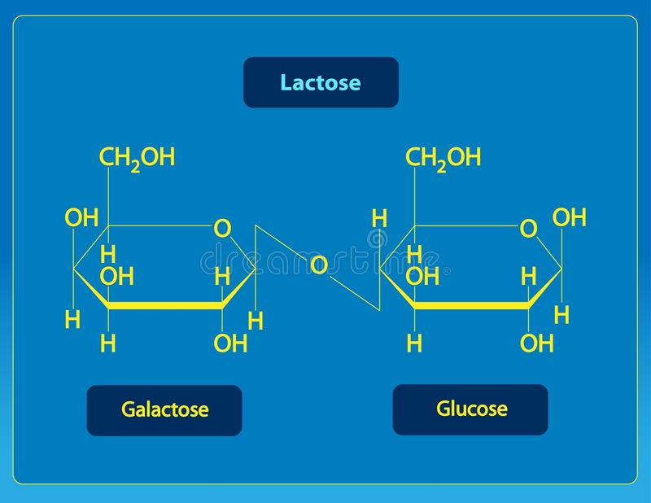
Lactose. This is made up of one monomer unit of glucose and one monomer unit of galactose.

Slide 34
Oligosaccharides
These are sugar polymers consisting of short chains of monosaccharide units joined together by glycosodic bonds.
The monomer units in oligosaccharides usually range from 3 to 10 monosaccharides.
Examples of oligosaccharides include;

Slide 35
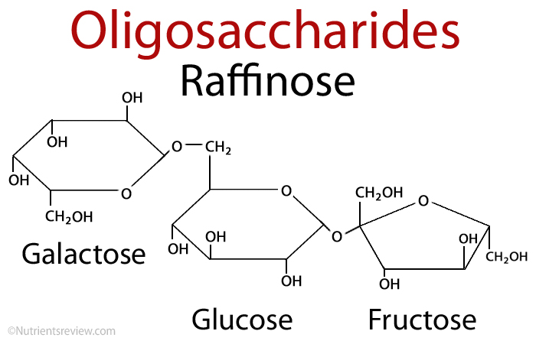
Raffinose: This is a trisaccharide of glucose, fructose and galactose.

Slide 36
Polysaccharides
Polysaccharides are condensation products of more than ten monosaccharide units; examples are the starches, cellulose which may be linear or branched polymers.

Slide 37
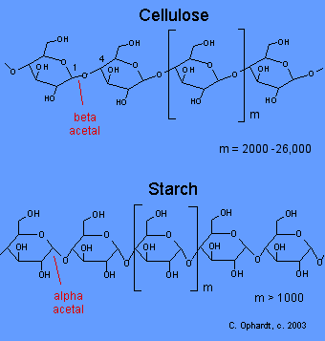

Slide 38
Functions of Carbohydrates
1.Carbohydrates along with being the chief energy source, in many animals, they are instant sources of energy.
Glucose is broken down by glycolysis, kreb’s cycle to yield ATP.

Slide 39
2.They form structural and protective components.
Carbohydrates are Structural elements in the cell walls of bacteria (peptidoglycan or murein), plants (cellulose).
Carbohydrates also are structural components of some animals in form of chitin.

Slide 40
3.Anticoagulants. Heparin , a anticoagulant of blood is a carbohydrate and it prevents blood clotting.
4.Dietary fibers.Cabohydrates are source of dietary fibers, the fiber content prevents constipation

Slide 41
5.Carbohydrates containing lipids( glycolipids ) are one of the important categories of plasma membrane lipids.
6.Carbohydrates act as a source of C,H,O in the cells in the synthesis of other macromolecules.

Slide 42
7.Recognition. Some carbohydrates on the surface of cell membrane have a recognition role.
8.Ribose sugar. A monosaccharide(ribose) is an essential component of genetic material(DNA and RNA)

