Slide 1
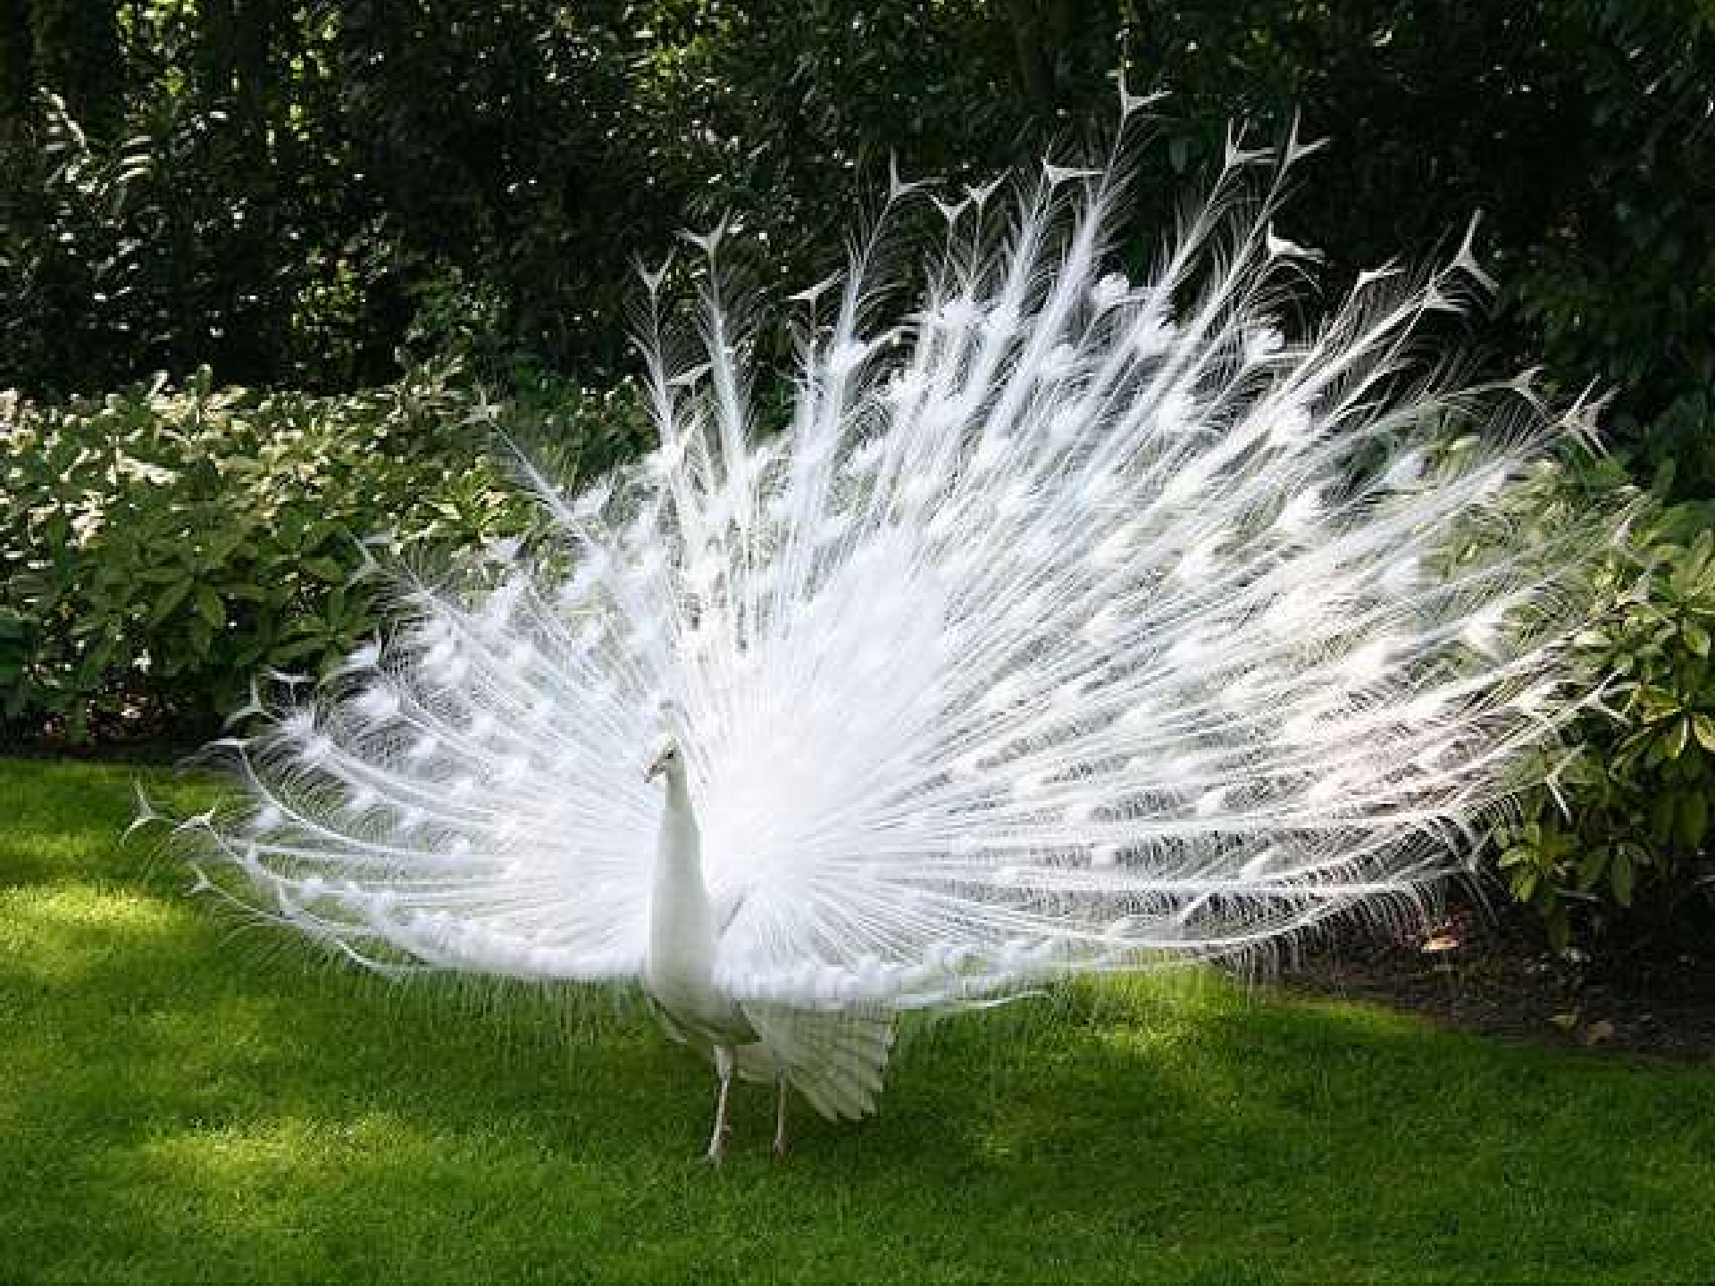

SAMUEL NGIGI K.

Slide 2

CARDIAC CYCLE
It refers to the alternating contraction and relaxation of the myocardium in the walls of the heart chambers coordinated by the conducting system during one heart beat.
The frequency of the cardiac cycle is described by the heart rate

Slide 3
Systole Diastole
The cycle is divided into two major phases
Systole :- contraction
The period
of ventricular
Diastole :- relaxation
The period
of ventricular

Slide 4
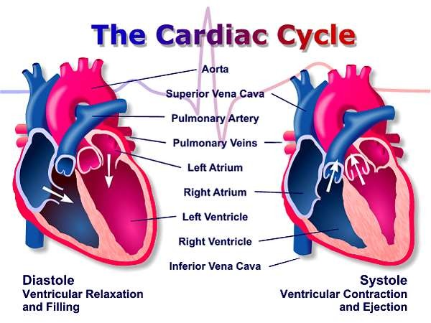

Slide 5
Further subdivided into several discrete phases
The first stages, often considered as the "ventricular filling" stage, involve the movement of blood from atria into ventricles.
The next stages involve the movement of blood from the ventricles to the pulmonary artery (in the case of the right ventricle) and the aorta (in the case of the left ventricle)

Slide 6
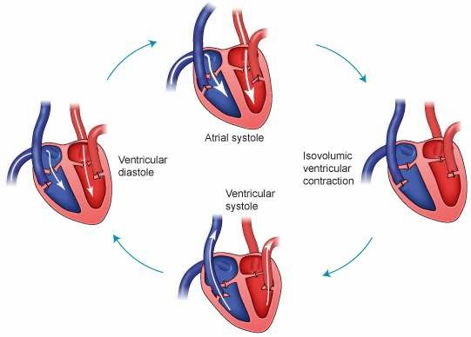

Slide 7
Diastole
the semi lunar valve close
the atrioventricular (AV)valve are open and the whole heart is relaxed
Systole
the atrium contracts and blood flows from the atrium to the ventricle

Slide 8
Isovolumetric ventricular contraction
Ventricle begin to contract
AV and Semi lunar valve close
Ventricular ejection
Ventricles are empty & contracting
Semi lunar valve open
Isovolumetric ventricular relaxation
Pressure decreases
ventricle begins to relax
Semi lunar valves close due to pressure of blood in aorta

Slide 9
The cardiac cycle is coordinated by a
series of electrical produced by
impulses that are
cells and
specialized sinoatrial
heart node
found within
atrioventricular node

Slide 10
 | AV valves* | Semi lunar valves† | Status of ventricles and atria
1. earlydiastole | open | closed | whole heart is relaxed ventricles are expanding and filling
2. atria systole | open | closed | atria contract and pump blood additional 10–40% filling of ventricles^{[2]}
3. isovolumic ventricular contraction | closed | closed | • ventricular myocytes begi n to contract ventricle volume unchanged
4. ventricular ejection | closed | open | ventricles fully contract pump blood to rest of body
5. Isovolumic ventricular relaxation | closed | closed | ventricles relax ventricle volume unchanged atria expand and are filling

Slide 11
1) mitral valve – between the left atrium and the left ventricle
2) tricuspid valve – between the right atrium and the right ventricle
1) aortic valve – between the left ventricle and the aorta
2) pulmonic valve – between the right ventricle and the pulmonary artery

Slide 12
ATRIAL SYSTOLE
It is the contraction of the heart muscle (myocardia) of the left and right atria.
As the atria contract, the blood pressure in each atrium increases, forcing additional blood into the ventricles. The additional flow of blood is called atrial kick.
VENTRICULAR SYSTOLE
It is the contraction of the muscles of the left
and right ventricles.

Slide 13
DETECTION OF VENTRICULAR SYSTOLE
The closing of the mitral and tricuspid valves (known together as the atrioventricular valves) at the beginning of ventricular systole cause the first part of the "lubb-dubb" sound made by the heart as it beats.
Formally, this sound is known as the First Heart Tone, or S₁. This first heart tone is created by the closure of mitral and tricuspid valve
The second part of the "lub-dubb“ is caused by the closure of the aortic and pulmonary valves at the end of ventricular systole

Slide 14
DIASTOLE
Cardiac diastole is the period of time when the heart relaxes after contraction in preparation for refilling with circulating blood.
Ventricular diastole is when the ventricles are relaxing, while atrial diastole is when the atria are relaxing. Together they are known as complete cardiac diastole.
During ventricular diastole, the pressure in the (left and right) ventricles drops from the peak that it reaches in systole. When the pressure in the left ventricle drops to below the pressure in the left atrium, the mitral valve opens, and the left ventricle fills with blood that was accumulating in the left atrium

Slide 15
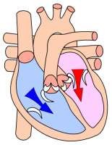
Likewise, pressure in
when the
the right
ventricle drops below that in the right atrium, the tricuspid valve opens, and the right ventricle fills with blood that was accumulating in the right atrium.
During diastole the pressure within the left ventricle is lower than that in aorta, allowing blood to circulate in the heart itself via the coronary arteries.

Slide 16
The heart's rhythmic contractions occur spontaneously, although the rate of contraction can be changed by nervous or hormonal influences, exercise and emotions.
For example, the sympathetic
nerve accelerates heart rate and the vagus nerve decelerates heart rate.

Slide 17




