Slide 1
Non Hodgkin's Lymphoma
NHL clinical presentation and Diagnostic approach

Slide 2
Outline
Epidemiology and classification
Clinical presentation
Diagnostic approach
Ward rounds!

Slide 3
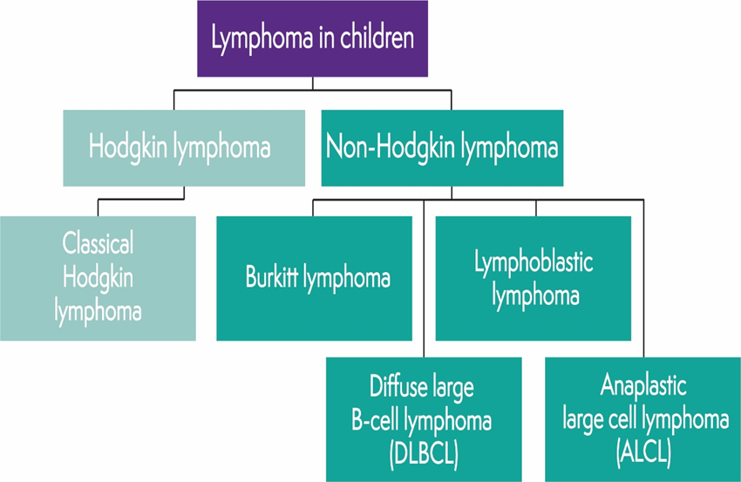
1. Biology of NHL
Malignant neoplasms of lymphoid cells.
    Predominantly affects LN
        In chat box below Can you Name , Lymph Nodes in your local language !!
In addition,
  1º lymphoid tissues
      – Bone marrow and Thymus
  2º Lymphoid tissues
      – spleen, mucosal associated lymphoid tissues.
  Non lymphoid tissues
      – skin, bone , brain, lungs, liver ,salivary gland.
No lymphoma specific signs and symptoms.

Slide 4
Clinical heterogeneity
3 main categories
  Aggressive mature cell NHL
    (BL/leukemia)
    DLBL
  2. Lymphoblastic lymphoma
  3. Anaplastic large cell lymphomas
  4. Others….
Notes:
On basis of clinical features : phenotype (B lineage, T lineage or Nk cell lines)
Cell differentiation( precursors vs Mature B Cell)

Slide 5
2. Epidemiology
Lymphomas Diagnosed in MTRH 2019- 2022
Lymphomas are 3rd most common childhood cancer
NHL
  6% of all childhood cancers
  60% lymphomas
  8-10 % of all malignancies in > 15 – 19 years.
Secondary causes of NHL
Inherited, acquired immune deficiency.
Viruses
  -HIV, EBV,HHV 6
  -post BMT,Post solid tumour organ transplant
  -Ataxia telangiectasia, Bloom syndrome

Slide 6
3. Clinical manifestations
Depend primarily on
  Pathologic subtype
  Primary and secondary sites of involvement
Tumors grow rapidly and can cause symptoms based on size and location.
Approx. 70% of patients with NHL present with advanced disease,
    At stage III or IV ( extranodal disease with GIT, BM, and CNS involvement.)

Slide 7
Clinical Manifestations
NHL TYPE | CLINICAL FEATURES
BL | Abdominal (sporadic type) or Head and neck (endemic type) Jaw or Non Jaw disease with involvement of the bone marrow or CNS.
LL | Intrathoracic or mediastinal supradiaphragmatic mass and has a predilection for spreading to the bone marrow and CNS.
DLBCL | An abdominal or mediastinal (PMB subtype) primary and, rarely, dissemination to the bone marrow or CNS.
ALCL | Primary cutaneous manifestation (10%) or as systemic disease (fever, weight loss) with dissemination to liver, spleen, lung, mediastinum, or skin; spread to the bone marrow or CNS is rare.

Slide 8
Site specific manifestations
Painless, rapid lymphadenopathy
Cough /Dyspnea
    with thoracic involvement
Superior mediastinal syndrome (SMS)-
    Obstructing venous blood flow or respiratory airways
Abdominal (massive and rapidly enlarging) mass,
    intestinal obstruction, intussusception like symptoms, ascites with abdominal involvement
Nasal stuffiness, earache, hearing loss, tonsil enlargement
    waldeyer ring involvement
Localized bone pain (primary/metastatic).
Acute paraplegias - spinal cord or CNS compression
Others
  Tumor lysis syndrome (TLS)
  Pericardial tamponade
  Lymphomatous meningitis and/or CNS mass lesions
  Ureteral obstruction- hydronephrosis
  DVT

Slide 9
Burkitt’s lymphoma
(Small non-cleaved cell lymphoma)
40-50% of NHL
90% intra-abdominal or 75 % jaw in eBL
    Other sites ( CNS, peripheral lymph nodes, skin, BM, bone, testis)
B cell origin
25% contain Epstein Barr virus genomes
Characteristic chromosomal translocations

Slide 10
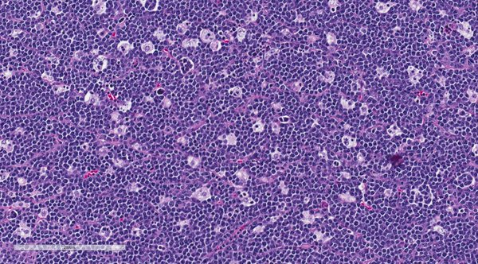
BURKITT’S- Histology
Starry sky appearance
scattered tangible body-laden macrophages (macrophages containing dead apoptotic tumor cells) among tumor cells of uniform size and shape.
Notes:
Tingible body macrophages are large macrophages located in germinal centers that actively phagocytose apoptotic lymphoid cells.

Slide 11
BL clinical presentation
2. Spordaic BL
1 . Endemic BL
Abd tumours with BM involvement.
  Abd - Mass pain and swelling
  Bowel obstruction 2⁰ to ileocecal intussusception, Ascites.
      Abd mass (90% of sBL vs 50% of eBL)
Waldeyers ring ( palatine, lingual tonsils), nasopharyngeal adenoids.
  Dysphagia, dyspnea, wheeze, airway obstruction
  Jaw tumors rare
Jaw swelling 75%, Maxillae >>Mandible.
    Orbital involvement possible
Non jaw tumour – 60% present as abd mass.
  Non tender LN in neck region
Ovarian, skeletal, gonadal, breast involvement documented
Notes:
Symptoms + rapid turnover of cells + involvement of extranodal sites + invasion of adjacent organs

Slide 12
5. Diagnostic Approach
Detailed Hx and PE
Baseline bloods: CBC, UEC, LFT, Uric acid, Calcium, phosphorus, HIV
Inflammatory markers – CRP, ESR, serum ferritin,
  LDH (if > 1000 + Mass ----think lymphoma till proven otherwise).
LP: cytology, cell count, biochemistry
Bone marrow biopsy
CXR, CT chest
Abdominal u/s and/or CT abdomen – if mesenteric/ cecal mass/ causing intussusception ---think again.
Tissue biopsy:
  Morphology,…..starry sky appearance
  Imunophenotyping : flow cytometry and Immunohistochemistry ,
  Cytogenetics :FISH, PCR
Echo
Bone scan (ALCL,DLBCL)
Notes:
Fluorescent in situ hybridization

Slide 13
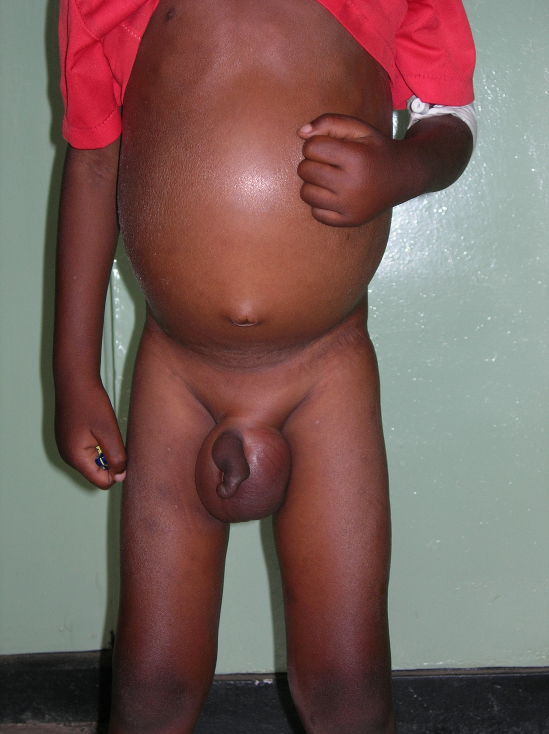
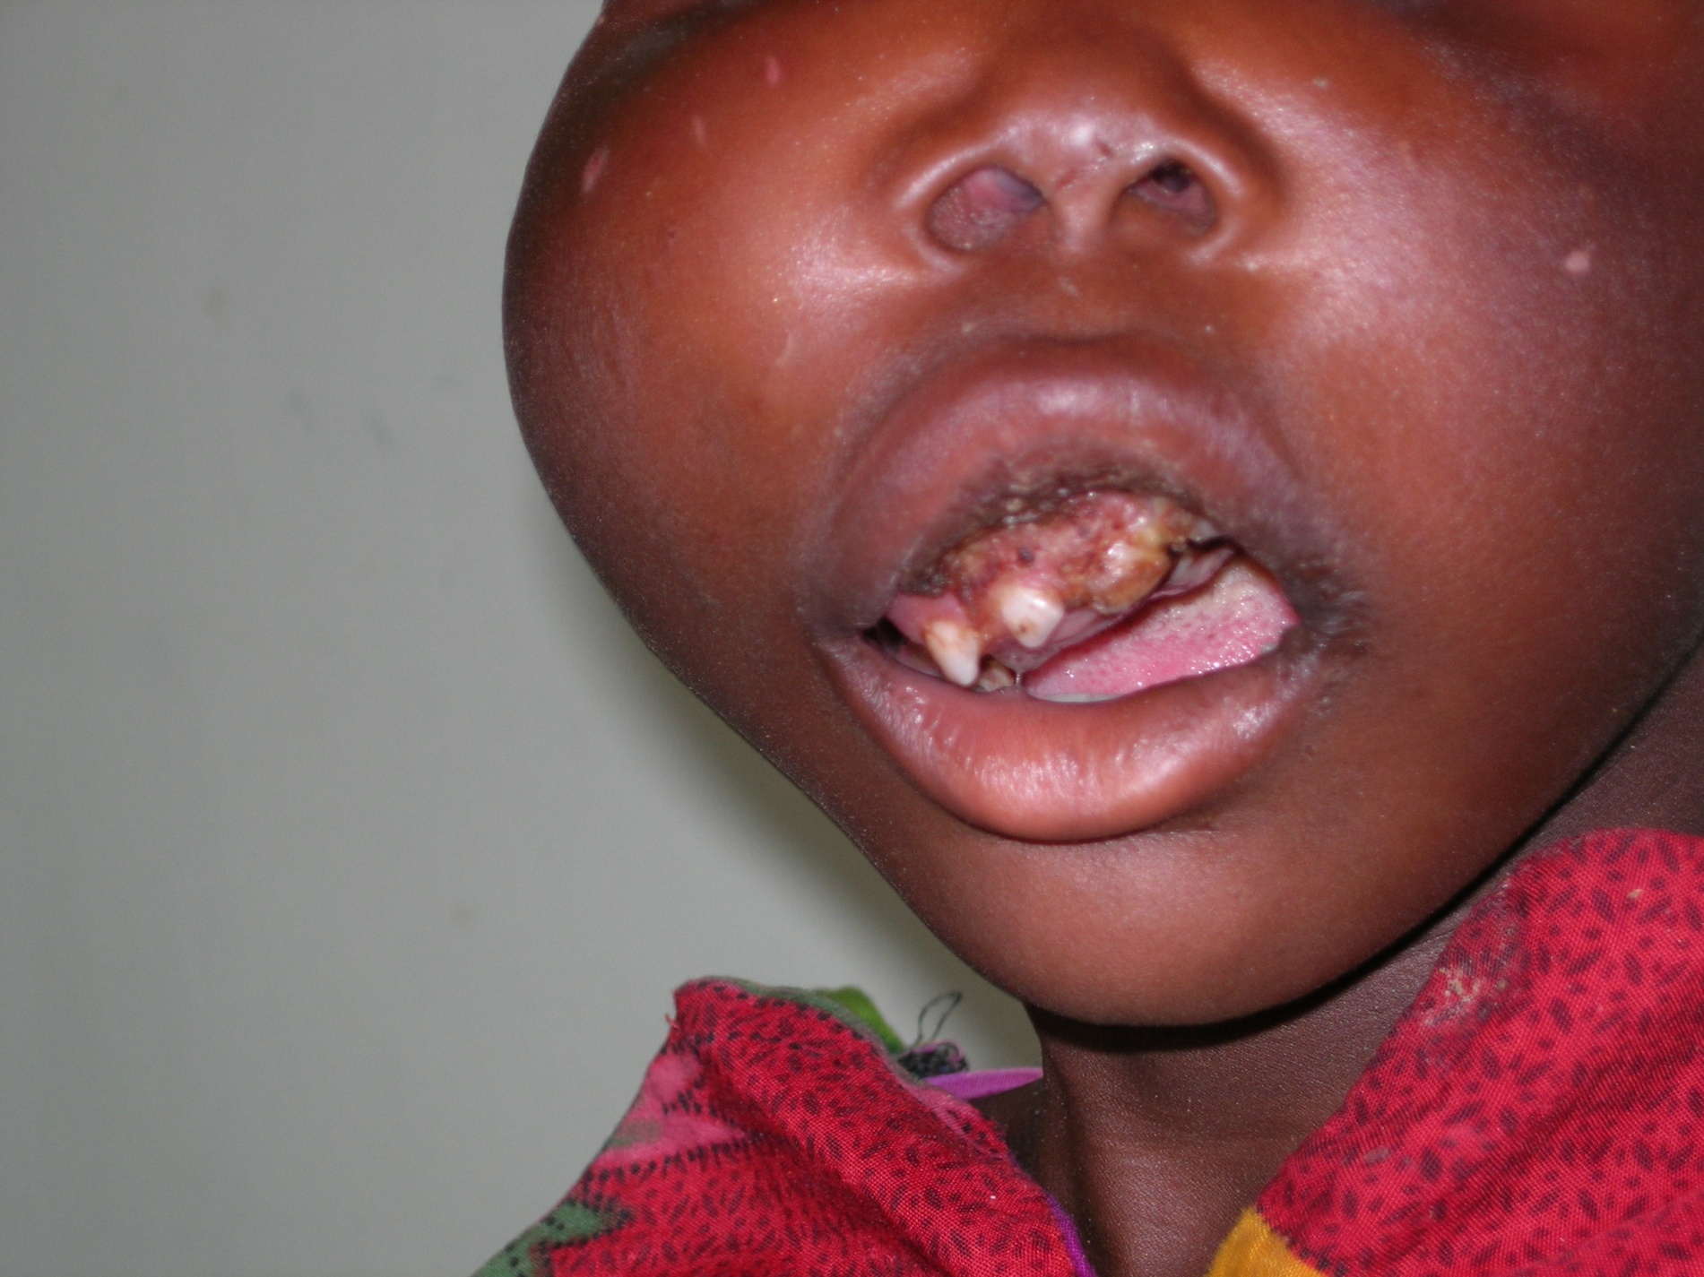
5. Ward Rounds !!!
Case #2
5 yo, sent to dentist ? Tooth issue
Jaw mass, displaced teeth, 2 mo hx
Maxillofacial review
Biopsy, flow cytometry diagnosis and chemo started.
Case #1
8yo, Male, with IDA
Recurrent abd pain, wt loss, loss of appetite.
Diarrheal stools + fever
Diffuse large B cell lymphoma
Remission

Slide 14
Ward rounds…
Case # 3
8 yo, Male , abd pain and vomiting. 1 mo hx,
Early satiety, jaundice
Reduced urine output
Several hosp visits, herbalist, Rx for abd infection…
LP done ----+ve,
  Dx as stage IV Burkitts lymphoma
# 4…
4yr, 10mo, male
Abd pain, loss of appetite
Admitted in surgical ? Appendicites
  Leukocytosis, mildly elevated inflammatory markers, reduced proteins.
    LDH –1846/uL,
Abd u/s, CT scan --- Negative
Ex Lap – abd mass
    DX - - Burkitts Lymphoma (intramural)

Slide 15
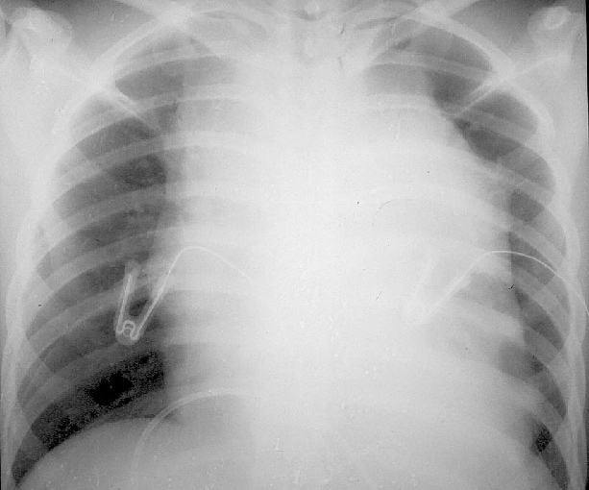
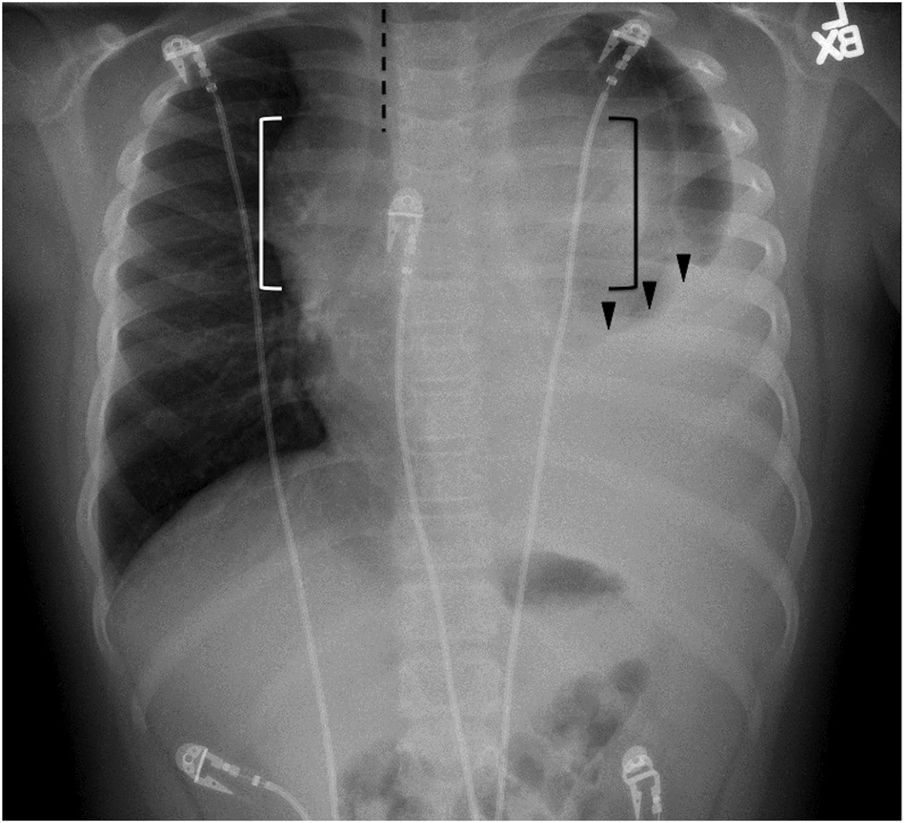
#Last one
B.O, 8yr old, in ED, Exacerbation of recurrent Asthma, DIB, Nebulised + prednisone.

Slide 16
Summary
Presentation.
  Abdominal mass
  Mandibular or Maxillary Mass
  Head and Neck – Non jaw
  CNS involvement and spine!
  Other sites : BM, Gonads check!. Lymphadenopathy rare in children!!
High Index of suspicion
  BL occurs in children
  NHL is an umbrella body (COTU) – several entities
  BL can complicate before you diagnose it.
    TLS, i/o, cord compression : think, prevent and act.
Early diagnosis, referral and treatment makes the difference.

Slide 17


