Slide 1
Upper Respiratory Tract Infections
Samuel Ngigi K.
KMTC

Slide 2
What is a URI?
A URI is an infection that affects the upper air passages, including:
the larynx, which is the muscular organ containing the vocal cords
the nasal cavity, which is the space above and behind the nose
the nasal passages, or the nostrils
the pharynx, which is the cavity behind the nose and mouth

Slide 3
Introduction
Upper respiratory tract infection (URI) represents the most common acute illness evaluated in the outpatient setting.
URIs range from the common cold--typically a mild, self- limited, catarrhal syndrome of the nasopharynx--to life-threatening illnesses such as epiglottitis.
Viruses account for most URIs.
Bacterial primary infection or superinfection may require targeted therapy.
Notes:
Catarrhal: Copious discharge of mucus associated with inflammation of mucous membranes, especially of the nose and throat.

Slide 4
Symptoms
The most common symptoms of a URI include:
coughing
discomfort in the nasal passages
Mild fever, which is more common in children
excess mucus
nasal congestion
pain or pressure behind the face
a runny nose
a scratchy or sore throat
sneezing
Less common symptoms can include:
bad breath
body aches
headache
hyposmia, or the loss of sense of smell
itchy eyes
Notes:
Hyposmia, or microsmia, is a reduced ability to smell and to detect odors. A related condition is anosmia, in which no odors can be detected. Some of the causes of olfaction problems are allergies, nasal polyps, viral infections and head trauma.

Slide 5
Causes
The causes of URIs are almost always viral. Droplets of infected saliva and mucus spray out into the air when a person sneezes or coughs. Other people may breathe them in, or they can land on surfaces that others touch.
If another person then puts their hand near their mouth, they may get an infection.
There are more than 200 common cold viruses that cause URIs.
Other risk factors include:
damage to the airways or nasal cavity
not washing the hands frequently
contact with groups of children
crowded places, such as airplanes and buses
having an autoimmune disorder
removal of adenoids or tonsils, which are part of the immune system
smoking and secondhand smoke
spending time in the hospital or in a care center

Slide 6
Treatment
Antihistamines
brompheniramine (Bromfed)
chlorpheniramine (Chlor-Trimeton)
diphenhydramine (Benadryl)
Pain-relievers
acetaminophen (Tylenol)
ibuprofen (Advil)
Decongestants
oxymetazoline (Afrin)
phenylephrine (Sudafed PE)
pseudoephedrine (Sudafed)

Slide 7
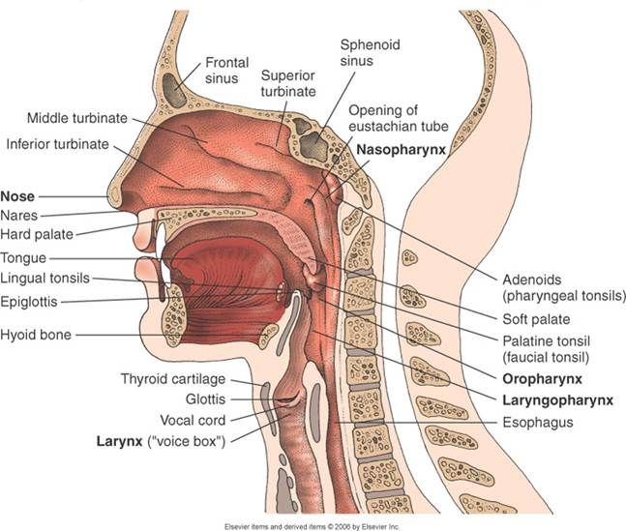
Upper Respiratory Tract

Slide 8
SINUSITIS
DEFINITION:
"Sinusitis" simply means your sinuses are inflamed―red and swollen―because of an infection or another problem

Slide 9
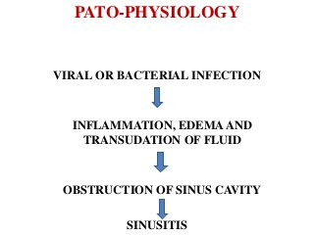

Slide 10
TYPES OF SINUSITIS
ACUTE SINUSITIS
CHRONIC SINUSITIS

Slide 11
ACUTE SINUSITIS
Acute sinusitis (acute rhinosinusitis) causes the cavities around your nasal passages (sinuses) to become inflamed and swollen.
CAUSES:
Viral infection (Rhinovirus, influenza, and parainfluenza)
Bacterial infection (Streptococcus pneumoniae, Haemophilus influenzae, Moraxella catarrhalis, Group A beta-hemolytic streptococci, andStaphylococcus aureus)
Fungal infection (Saprophytic fungi of the order Mucorales, including Rhizopus,Rhizomucor,Absidia,Mucor,Cunninghamella,Mortierella,Saksenaea, and Apophysomyces species)
Allergies such as hay fever/allergic rhinitis
Nasal polyps or tumours
Deviated nasal septum
Tooth infection
Enlarged or infected adenoids in children

Slide 12
RISK FACTORS
Hay fever/allergic rhinitis or another allergic condition
A nasal passage abnormality
A medical condition such as cystic fibrosis, gastroesophageal reflux disease (GERD), or an immune system disorder
Regular exposure to pollutants
Notes:
Allergic rhinitis, also known as hay fever, is a type of inflammation in the nose which occurs when the immune system overreacts to allergens in the air. Signs and symptoms include a runny or stuffy nose, sneezing, red, itchy, and watery eyes, and swelling around the eyes.

Slide 13
SIGN AND SYMPTOMS
Drainage of a thick, yellow or greenish discharge from the nose or down the back of the throat
Nasal obstruction or congestion, causing difficulty breathing through your nose
Pain, tenderness, swelling and pressure around your eyes, cheeks, nose or forehead
Aching in your upper jaw and teeth
Reduced sense of smell and taste
Cough, which may be worse at night
Other signs and symptoms can include:
Ear pain
Headache
Sore throat

Slide 14
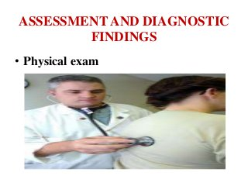

Slide 15
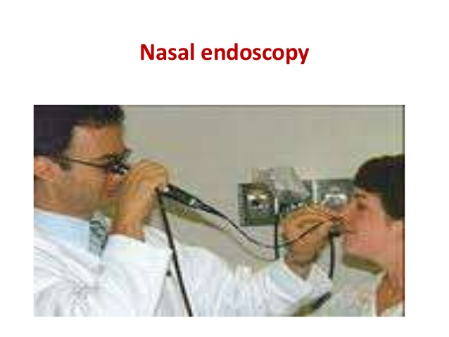

Slide 16
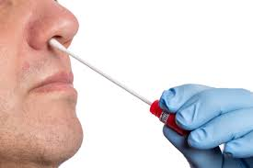
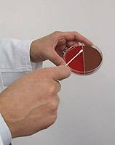
Nasal and sinus cultures

Slide 17
COMPLICATIONS
Asthma
Chronic sinusitis
Meningitis
Vision problems
Ear infection

Slide 18
MEDICAL MANAGEMENT

Slide 19

Saline nasal spray

Slide 20
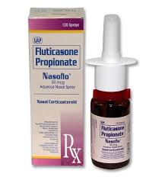
Nasal corticosteroids

Slide 21
Over-the-counter pain relievers
aspirin, acetaminophen or ibuprofen.
Aspirin has been linked with Reye's syndrome, so use caution when giving aspirin to children or teenagers.
Though aspirin is approved for use in children older than age 2, children and teenagers recovering from chickenpox or flu- like symptoms should never take aspirin.
Reye's syndrome usually occurs in children who have had a recent viral infection, such as chickenpox or the flu. Taking aspirin to treat such an infection greatly increases the risk of Reye's. Both chickenpox and the flu can cause headaches. That is why it is important to not use aspirin to treat a child's headache.
Notes:
Reye's syndrome is a rare disorder that causes brain and liver damage. Although it can happen at any age, it is most often seen in children. Reye's syndrome usually occurs in children who have had a recent viral infection, such as chickenpox or the flu.

Slide 22
Decongestants
oral decongestants include Sudafed, Actifed and Drixoral.
Nasal sprays include phenylephrine and oxymetazoline.
These medications are generally taken for only a few days at most.

Slide 23
Antibiotics
Antibiotics used to treat acute sinusitis caused by a bacterial infection include amoxicillin, doxycycline or the combination drug trimethoprim- sulfamethoxazole.

Slide 24
Antifungal medications
acute sinusitis is caused by a fungal infection, which can be treated with antifungal medication (ketoconazole or itraconazole).

Slide 25
Immunotherapy
If allergies are contributing to your sinusitis, allergy shots (immunotherapy) that help reduce the body's reaction to specific allergens may help treat your symptoms.

Slide 26
LIFE STYLE AND HOME REMEDIES
Get plenty of rest
Drink plenty of fluids
Steam your sinus cavities
Apply warm compresses to your face
Rinse out your nasal passages
Sleep with your head elevated

Slide 27

Steam your sinus cavities

Slide 28
CHRONIC SINUSITIS
Chronic sinusitis is a common condition in which the cavities around nasal passages (sinuses) become inflamed and swollen.
Chronic sinusitis lasts 12 weeks or longer despite treatment attempts.

Slide 29
CAUSES
Nasal polyps or tumours
Allergic reactions
Deviated nasal septum
Trauma to the face
Respiratory tract infections
Allergies such as hay fever

Slide 30
RISK FACTORS
A nasal passage abnormality, such as a deviated nasal septum or nasal polyps
Aspirin sensitivity that causes respiratory symptoms
A medical condition, such as cystic fibrosis or chronic obstructive pulmonary disease (COPD)
An immune system disorder, such as HIV/AIDS or cystic fibrosis
Hay fever or another allergic condition that affects your sinuses
Asthma — about 1 in 5 people with chronic sinusitis have asthma
Regular exposure to pollutants such as cigarette smoke

Slide 31
SIGN AND SYMPTOMS
Drainage of a thick, yellow or greenish discharge from the nose or down the back of the throat
Nasal obstruction or congestion, causing difficulty breathing through your nose
Pain, tenderness and swelling around your eyes, cheeks, nose or forehead
Reduced sense of smell and taste
Ear pain
Aching in your upper jaw and teeth
Cough, which may be worse at night
Sore throat
Bad breath (halitosis)
Fatigue or irritability
Nausea

Slide 32
ASSESSMENT AND DIAGNOSIS
Nasal endoscopy
Imaging studies
Nasal and sinus cultures
An allergy test

Slide 33
COMPLICATIONS
Asthma flare-ups
Meningitis
Vision problems
Aneurysms or blood clots
Notes:
An aneurysm refers to a weakening of an artery wall that creates a bulge, or distention, of the artery. Most aneurysms do not show symptoms and are not dangerous. However, at their most severe stage, some can rupture, leading to life-threatening internal bleeding.

Slide 34
MEDICAL MANAGEMENT
The goal of treating chronic sinusitis is to:
Reduce sinus inflammation
Keep your nasal passages draining
Eliminate the underlying cause
Reduce the number of sinusitis

Slide 35
Treatments to relieve symptoms
Saline nasal spray, which you spray into your nose several times a day to rinse your nasal passages.
Nasal corticosteroids:
These nasal sprays help prevent and treat inflammation.
Examples include fluticasone, budesonide, triamcinolone, mometasone and beclomethasone.
Oral or injected corticosteroids:
These medications are used to relieve inflammation from severe sinusitis, especially if you also have nasal polyps.
Examples include prednisone and methylprednisolone.

Slide 36
Decongestants
These medications are available in over-the- counter (OTC) and prescription liquids, tablets and nasal sprays An example of an OTC nasal spray is oxymetazoline.

Slide 37
Antibiotics
Antibiotics used to treat chronic sinusitis caused by a bacterial infection include amoxicillin, doxycycline or the combination drug trimethoprim- sulfamethoxazole.

Slide 38
Immunotherapy
If allergies are contributing to your sinusitis, allergy shots (immunotherapy) that help reduce the body's reaction to specific allergens may help treat the condition.

Slide 39
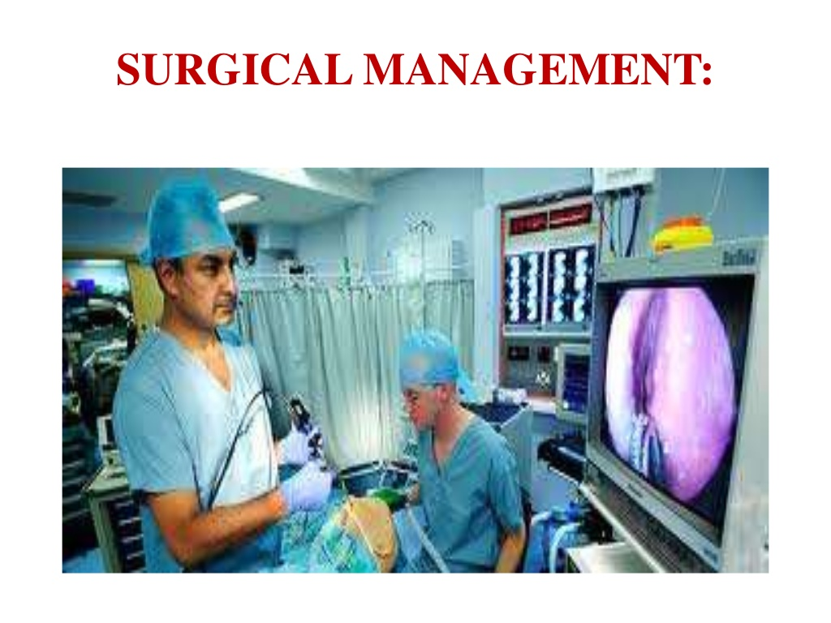
SURGICAL MANAGEMENT

Slide 40
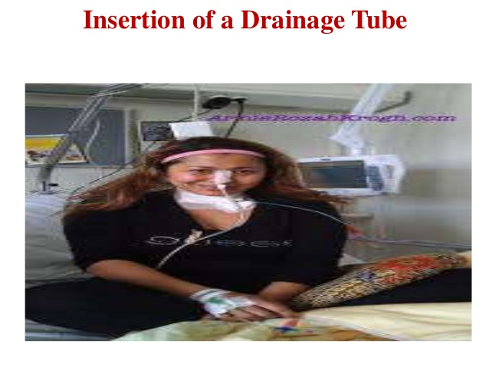

Slide 41
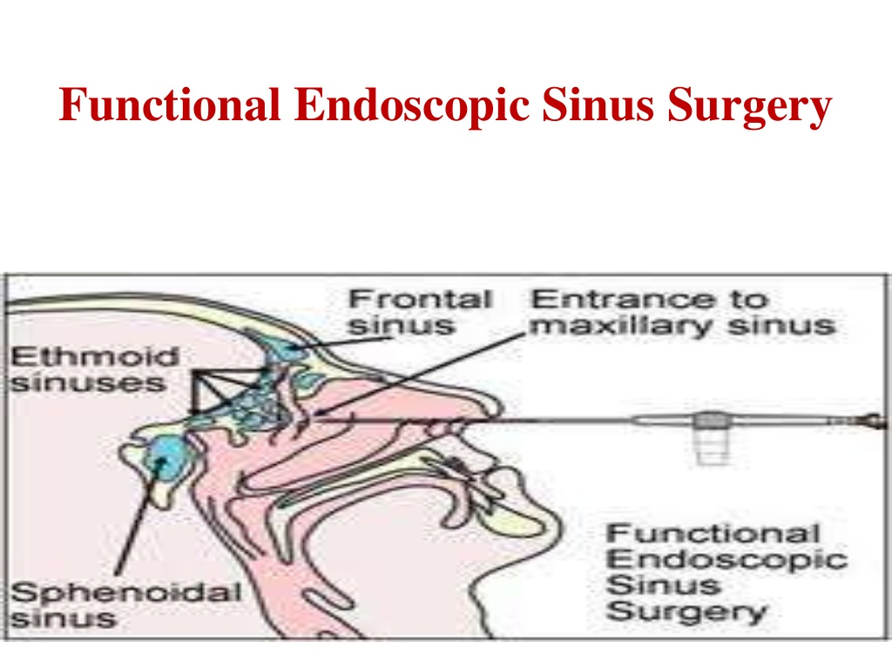

Slide 42
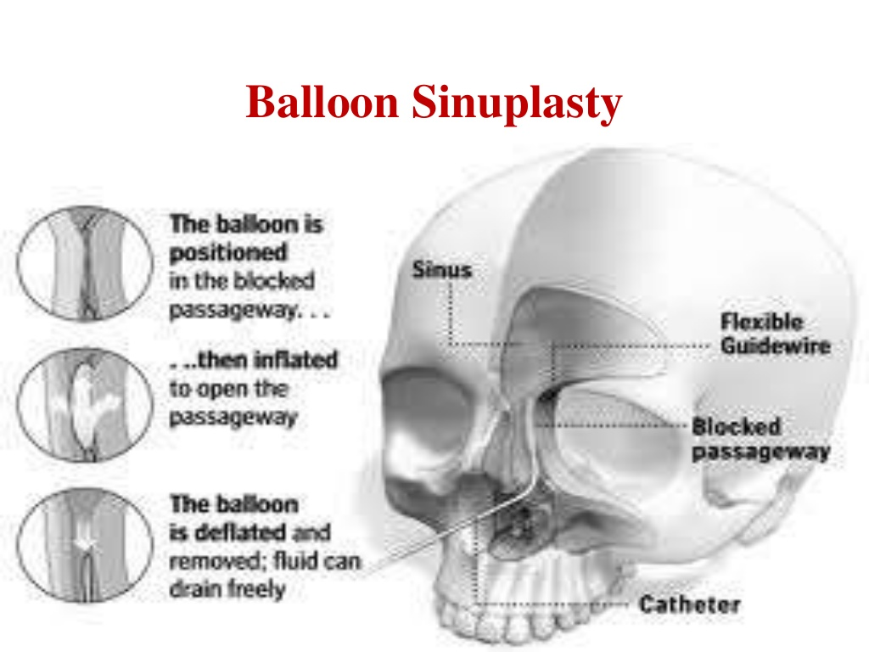

Slide 43
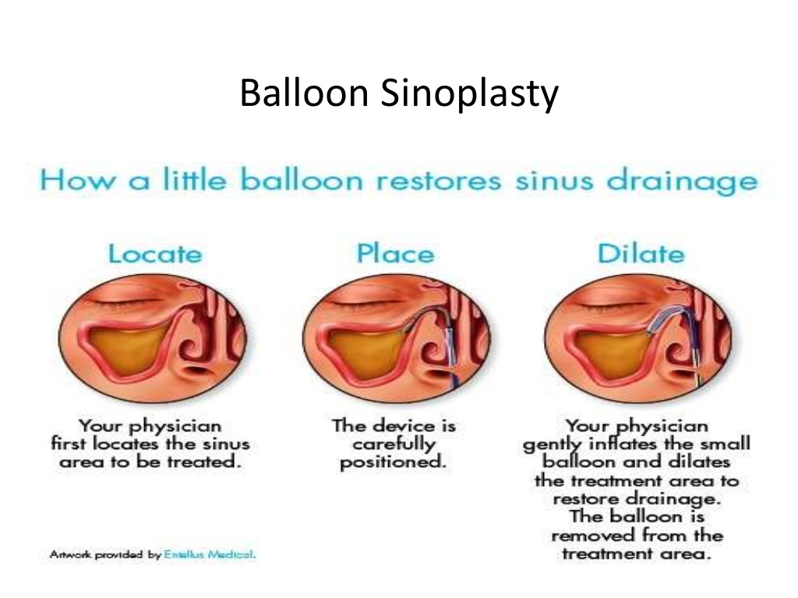

Slide 44
Non-pharmacological treatment
Humidifier to relieve the drying of mucous membranes associated with mouth breathing
Increase oral fluid intake
Saline irrigation of the nostrils
Moist heat over affected sinus

Slide 45
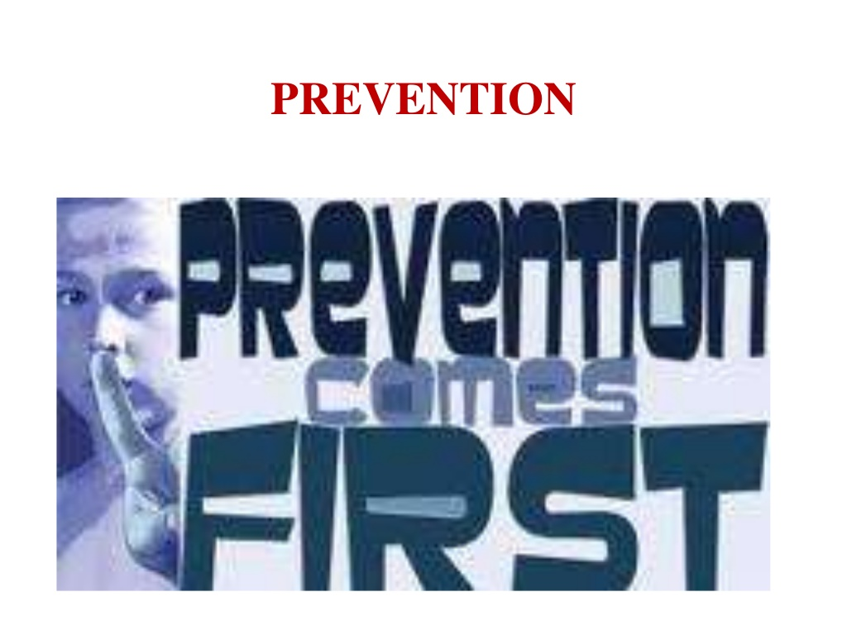

Slide 46
To Be Continued…
Thank You

