Slide 1
Interferons and their antiviral activity
Wallace Bulimo PhD

Slide 2
Introduction
Among the most powerful immunomodulatory substances available for therapeutic use.
Highly pleiotropic properties :
    immunomodulatory
    direct cytostatic
    direct cytotoxic.
    antiproliferative activity and apoptotic effects
Notes:
Desired and the adverse effects of interferons vary dramatically with dose, schedule, and route of administration, as well as pharmacologic manipulations of the interferon molecule.

Slide 3
Discovery of Interferons
1957
Isaacs and Lindenmann
Did an experiment using chicken cell cultures
Found a substance that interfered with viral replication and was therefore named interferon (“Interference factors”)
Nagano and Kojima also independently discovered this soluble antiviral protein

Slide 4
What are Interferons?
  Naturally occurring proteins and glycoproteins
  Secreted by eukaryotic cells in response to viral infections, tumors, and other biological inducers
  Strucurally, they are part of the helical cytokine family which are characterized by an amino acid chain that is 145-166 amino acids long

Slide 5
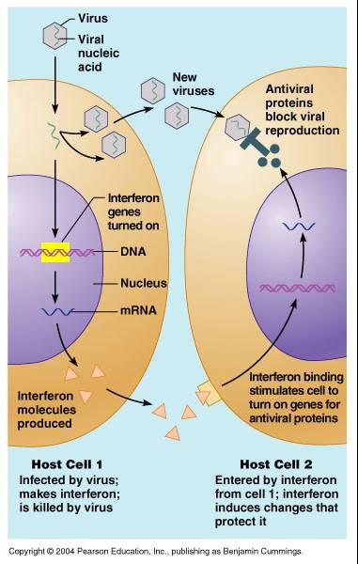
when a tissue cell is infected by a virus, it releases interferon. interferon will diffuse to the surrounding cells. when it binds to receptors on the surface of those adjacent cells, they begin the production of a protein that prevents the synthesis of viral proteins. this prevents the spread of the virus throughout the body.
General Action of
Interferons

Slide 6
Induce a state in which viral replication is impaired by the synthesis of a number of enzymes that interfere with cellular and viral processes
Anti-viral activity induces antiproliferative as well as immunomodulatory activities.
It is these additional functions induced by interferons that resulted in their evaluation as anticancer agents

Slide 7
Humans -2 classes
Type I family - α, β, δ, ε, κ, τ and ω subtypes.
Type II interferon family - γ interferon subtype.
Subtypes further subdivided for pharmaceutical preparations (e.g., interferon alfa-2a, interferon gamma-1b).

Slide 8
  Type I interferons
  - chromosome 9p
  - all bind to the same receptor
  - induced primarily in response to a viral infection of a cell.
  - Interferon α, ω - produced predominantly from leukocytes,
  - Interferon β - can be produced by most cell types, esp. fibroblasts.

Slide 9
INTERFERON β induction by fibroblasts during viral
infection
@
v@
NFκ B
Iκ B)
NFκ B
@
(TRANSCRIPTION)
INTERFERON -β
protein kinase R (PKR),
Viral ds RNA
@

Slide 10
Viral induction of interferon- α in leukocytes is less well understood
Induction stimuli
- Classical -Viral infection
- proteins or DNA constructs of microbial derivation, (bacterial endotoxins, CpG dinucleotide repeats,) also stimulates production of type I interferons.

Slide 11
Type II interferons (Interferon γ )
- composed of a single subtype.
- binds to its own unique receptor
- produced by T lymphocytes and
natural killer (NK) cells
- in response to immune and inflammatory stimuli.

Slide 12
NK cells-part of the innate immune response
-activation not dependent on antigen recognition.
T cells- part of the adaptive immune response
- activated by stimulation of antigen- specific T-cell receptor

Slide 13
NK cells are stimulated to produce interferon- γ when exposed to inflammatory cytokines (Tumor necrosis factor-α and interleukin-12 (IL-12)) from macrophages.
In a positive amplification loop, the interferon- γ then stimulates the secretion of TNF- α and IL-12 from macrophages.
TNF –α
IL-12
+
M
NK
+
Interferon- γ

Slide 14
The distinct receptors and the downstream signaling that is initiated by ligand-receptor interactions are responsible for the biologic effects of the individual type I and type II interferons.

Slide 15
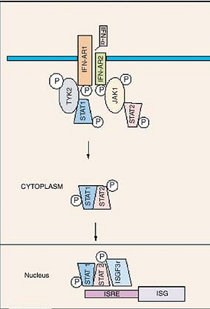
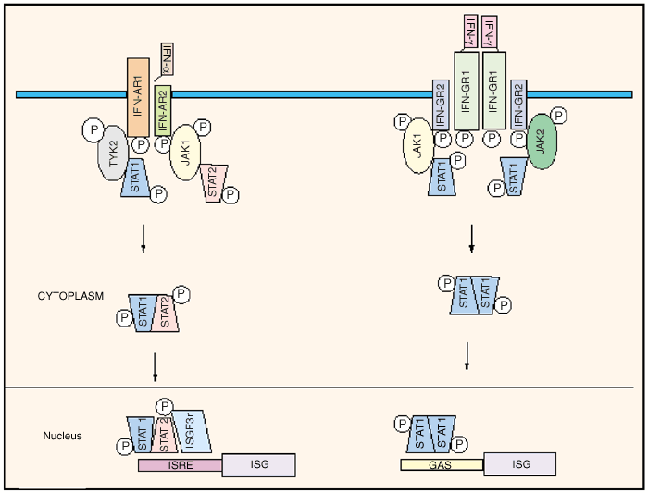
Biologic Effects of Interferons
Interferons ά and β bind to the same receptor, which is composed of two subunits
The binding of either interferon- ά or interferon- β to this receptor results in the activation of Janus tyrosine kinases Jak1 and Tyk2, which results in the phosphorylation of signal transducers and activators of transcription 1 and 2 (STAT1 and STAT2).

Slide 16
STAT1 and STAT2 phosphorylation results in their heterodimerization, dissociation from the interferon receptor, and translocation to the nucleus.
In nucleus, the STAT complex associates with DNA-binding protein p48 (interferon-stimulated gene factor 3) (ISGF3),which binds to the interferon-stimulated response element of ά- and β-responsive genes.
induction of interferon target genes, responsible for the biologic effects of interferons ά and β .

Slide 17
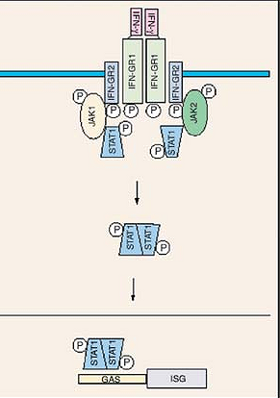
Interferon- γ
Interferon-γ binds as a homodimer to the specific interferon-γ receptor
Dimerization of the receptor activates the Janus tyrosine kinases Jak1 and Jak2, which ultimately results in the phosphorylation of STAT proteins.

Slide 18
Interferon- γ
Instead of activating STAT1 and STAT2( as with type I interferon receptor) interferon-γ activates two separate STAT1 molecules.
form a homodimer known as the - γ activated factor (GAF)
translocates to the nucleus and binds to γ -activating sequences (GAS), elements of interferon- γ inducible genes

Slide 19
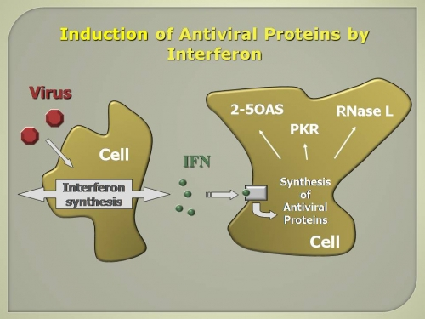
The antiviral activity of interferons is mediated by three pathways.
- 2'-5' oligoadenylate synthetases
-dsRNA-dependent PKR
-Mx pathways.

Slide 20
2'-5' oligoadenylate synthetases
ATP
Adenosine oligomers (2'-5’A)
@
RIBONUCLEASE- L
(RNase L)
cleaves single-stranded RNA
inhibition of protein synthesis and hence cellular proliferation
Notes:
It is an antiviral enzyme that counteracts viral attack by degrading viral RNA. The enzyme uses ATP

Slide 21
dsRNA-dependent Protein kinase, RNA-activated or protein kinase R (PKR)
PKR is activated by binding to dsRNA.
Once activated, PKR phosphorylates the translation initiation factor eIF2, which inhibits messenger RNA translation.
PKR also can activate NFκ B, which can lead to increased cytokine and chemokine levels.
Increased PKR activity can also induce apoptosis by a Bcl2- and caspase-dependent mechanism.
Notes:
Protein kinase RNA-activated also known as protein kinase R (PKR), interferon-induced, double-stranded RNA-activated protein kinase, or eukaryotic translation initiation factor 2-alpha kinase 2 (EIF2AK2) is an enzyme that in humans is encoded by the EIF2AK2 gene.[

Slide 22
dsRNA-dependent PKR
2.NFκ B
CHEMOKINES
@
+
dsRNA
CYTOKINES
PKR
P
1.eIF2
_
mRNA
translation
Eif2-Translation initiation factor

Slide 23
Another group of proteins induced by interferon that exhibits antiviral properties is the Myxovirus Resistance Gene A (MxA) family of glutamyl transpeptidases.
MxA is produced during viral infections and inhibits viral replication at the level of transcription by binding to susceptible viral nucleocapsids in the cytoplasm and preventing their movement into the nucleus.

Slide 24
Thank you

