Slide 1
EPIDEMIOLOGY
(SESSION 1)

Slide 2
Course Objectives
Upon completion of the course, the student shall be able to:-
Define the different concepts of epidemiology.
Apply epidemiological concepts in determining the health status of populations.
Identify determinants (causes) of diseases and other health-related problems in populations.
4. Differentiate different study designs, including, their advantages and disadvantages.
5. Calculate and interpret measures for disease occurrence and association.
6. Apply epidemiological skills in public health-related areas (e.g. Community Diagnosis).

Slide 3
Course content
I. Basic Principles
  Definitions, uses and applications of epidemiology.
  Sources of data.
  The dynamics of disease transmission.
  Measuring morbidity, mortality and other health-related conditions.
  Natural history of disease in relation to disease prevention.
II. Epidemiological Studies and related topics.
Study Types
  Descriptive, case-control, cohort studies.
  Experimental studies.
Measuring associations between exposure to risk factors and disease.
Screening for diseases.
II. Epidemiological Studies and related topics.
Study Types
  Descriptive, case-control, cohort studies.
  Experimental studies.
Measuring associations between exposure to risk factors and disease.
Screening for diseases.

Slide 4
REFERENCES
Barker & Hall. Practical Epidemiology. Churchill Livingstone, 1991
Coggon D, Barker D., & Rose D. Epidemiology for the Uninitiated. BMJ Books, 4th Edition, 2003
Bonita R, Beaglehole R., Kjellstrom T. Basic Epidemiology. WHO, 1993.
Mausner & Bahn. Epidemiology: An Introductory Text.
Others: (Textbooks on Epi. & Biostatistics.)

Slide 5
Epidemiology
EPI DEMO LOGOS
Upon,on,befall People,population,man the Study of
The study of anything that happens to people

Slide 6
Epidemiology is a basic science of public health.
Public Health is concerned with: Management, Prevention and Control
  of diseases and other health-related events in
  Populations.
Epidemiology studies ……….
how disease and other health-related problems are distributed in populations.
factors that influence the distribution of diseases and other health-related problems in populations.
GOAL of Epidemiology is to: Improve the health status of the population.
      Decrease in:
            Morbidity (illness).
              Mortality (deaths).
                Injuries, etc.

Slide 7
Epidemiology defined
Epidemiology is the study of the distribution and determinants of diseases and
other health-related states or events in specified populations and the application
of epidemiological methods to control the health-related problems.
(Leon Gordis, 2008, Last, 1983)
Health-related states and events
Epidemiology is concerned with occurrence of diseases and other health-related events.
Examples:
    Diseases,
    Injuries,
    Accidents,
    Drug use, etc.
  NOTE: Epidemiology is not restricted to diseases alone.

Slide 8
2. Population
Groups of individuals (in defined geographical areas).
Epidemiology is concerned with the health status of populations or groups of
individuals (in defined geographical areas).
Distribution
Concerned with the frequency and patterns diseases and other health-related
events in populations.
Frequency
Epidemiology is quantitative in nature.
  Numbers are central in epidemiology.
  What is the burden or amount of disease or health-related event in the population?
    Malaria.
    Diabetes.
    STIs, etc.

Slide 9
Diseases or and other health-related problems in the populations
are quantified in terms of …………
    Counts.
    Rates,
    Proportions,
    Ratios.

Slide 10
Questions asked are:
  WHAT? Event of interest.
  WHO? Persons affected – their characteristics.
  WHERE? Place of occurrence
  WHEN does the problem occur? - Time of occurrence.
      Person – Time – Place (PTP) model

Slide 11
Characterization of health-related events is an aspect of epidemiology referred to as “Descriptive epidemiology”.
Descriptive epidemiology provides the What, Who, Where and When of health-related events.
Hypotheses are usually generated.

Slide 12
4. Determinants
Are factors that influence health - i.e. occurrence of diseases or health-related
events in populations.
Epidemiology is used to search for causes and other factors that influence occurrence of health-related events.
This area of epidemiology is referred to as “Analytic epidemiology”.
Analytic epidemiology attempts to provide the Why and How of such health-related events.
  Examples of determinants:
    Poor sanitation,
    Noisy environment,
    Risky behaviour,
    High risky Occupation,
    Cigarette smoking,
    Drug abuse, etc.

Slide 13
Assignment 1(a)
List the determinants of :
    Malaria.
    Malnutrition.

Slide 14
Classifications of Determinants

Slide 15
Classifications of Determinants
Host
  Environmental
    3, Agent
The interplay among the three types of determinants (host, environmental and agent) can be presented using an ‘Epidemiologic triad’.
The Host – Environmental - Agent model

Slide 16
Epidemiologic triad
Host
Agent
Environment

Slide 17
Epidemiologic triad
Demographic characteristics
Biological characteristics
Socioeconomic characteristics
Host
Agent
Environment
Biological agents
Physical agents
Chemical agents
Nutrient agents
Mechanical agents
Social agents
Physical environment
Biological environment
Social environment

Slide 18
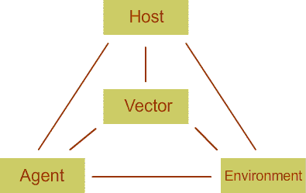
Epidemiologic Triad (cont.)

Slide 19
Assignment 1(b)
Arrange the determinants of ‘malaria’ in form
an ‘Epidemiologic triad’.
2. List and arrange the determinants of malnutrition in a form of an “Epidemiologic triad”.

Slide 20
5. Study
This is the process through which epidemiology undergoes in order to determine magnitude or determinants of health-related events in populations.
  Then take some action for improvement of the health status of the populations.
  Control / prevent health-related events from occurring.

Slide 21
Kinds of Epidemiologic Studies
Descriptive
Analytic
Experimental
Study of the occurrence and distribution of disease
Further studies to determine the associations between factors and occurrence of diseases.
Deliberate manipulation of the cause is predictably followed by an alteration in the effect not due to chance

Slide 22
Kinds of Study methods
Observational studies:
    Descriptive
    Cohort
    Case-control.
Experimental (Intervention) studies

Slide 23
6. Application
Analysis, conclusion, distribution, and timely Use of epidemiologic information to protect the health of the population.
Control / Prevention
Measures are taken in order to prevent diseases/events from
occurring in future or control disease from progressing.
Examples:
Educating mothers on provision of healthy
foods to their children.
(2) Taking sick people to health facilities for treatment.
e.g. T.B cases
(3) Taking children to health facilities for immunizations.
(4) Wearing of Personal Protective Equipment (PPE)
at workplace.

Slide 24
LEVELS OF DISEASE PREVENTION
Primary Prevention
Is targeted at the period before the disease infects the individual.
Examples of Interventions:
  Health education, Safety measures, Immunizations, Healthy behavior,
  smoking cessation, preserving good nutritional status, etc.
Secondary prevention
  is concerned with detecting a disease in its earliest stages, before symptoms appear, and intervening to slow or stop its progression.
    Use of screening tests or other suitable procedures to detect serious disease as early as possible so that its progress can be arrested and, if possible, the disease eradicated

Slide 25
Tertiary Prevention
Takes place during the advanced stages of the disease progression to minimize the complications or reverse the effects.
Main interventions are rehabilitative in nature .
  physical therapy, occupational therapy, etc.
Examples: Leprosy cases, diabetics, etc.

Slide 26
Two approaches are…….
1. Descriptive Epidemiology.
2. Analytic Epidemiology.
Descriptive Epidemiology
Studies the pattern of health events and their frequency in populations in terms of:
‒ Person
‒ Place
‒ Time
Person – Place – Time model
Questions asked are: WHAT? WHO? WHERE? WHEN?
Purpose:
‒ To identify problems for further study.
‒ To plan, provide, and evaluate health
services

Slide 27
Analytic Epidemiology
Studies the association between risk factors and disease
Determinant/ Disease
Risk factor
        WHY? and HOW?
Purpose:
‒ To determine why disease rates are high (or low) in one group and not
in the other.
      Test Hypotheses

Slide 28
Principle of Epidemiology
EPIDEMIOLOGY
Distribution Determinants
Methods Control &
Prevention
Evaluation

Slide 29
APPLICATION
BEHAVIORAL Epidemiology
Clinical Epidemiology.
Occupational Epidemiology.
Nutritional Epidemiology.
Infectious diseases epidemiology
BEHAVIORAL SCIENCES
Clinical Medicine
Occupational Health
Nutrition
Infectious Diseases

Slide 30
Sources of Epidemiologic Data
Disease notifications
Census data.
Surveillance data
Surveys (morbidity, mortality etc.).
Reports (morbidity, mortality, etc.
Records.
Laboratory Investigations.

Slide 31
USES OF EPIDEMIOLOGY
Determining the disease burden in the population.
2. Community diagnosis
The presence, nature and distribution of health and disease among the
population.
Searching for causes of diseases and other health-related conditions.
Learning about the natural history of diseases (NHD) and of their pathogenesis.
NHD - Is the progression of the disease from inception to termination.
Healthy state Termination
Uninterrupted
Why knowledge of the NHD?
Prognosis.
Prevention.
.

Slide 32
Stages in the NHD
Susceptibility stage.
  Subclinical (or Pre-symptomatic ) stage.
    Clinical (or symptomatic ) stage.
      Disability (or death) stage.

Slide 33
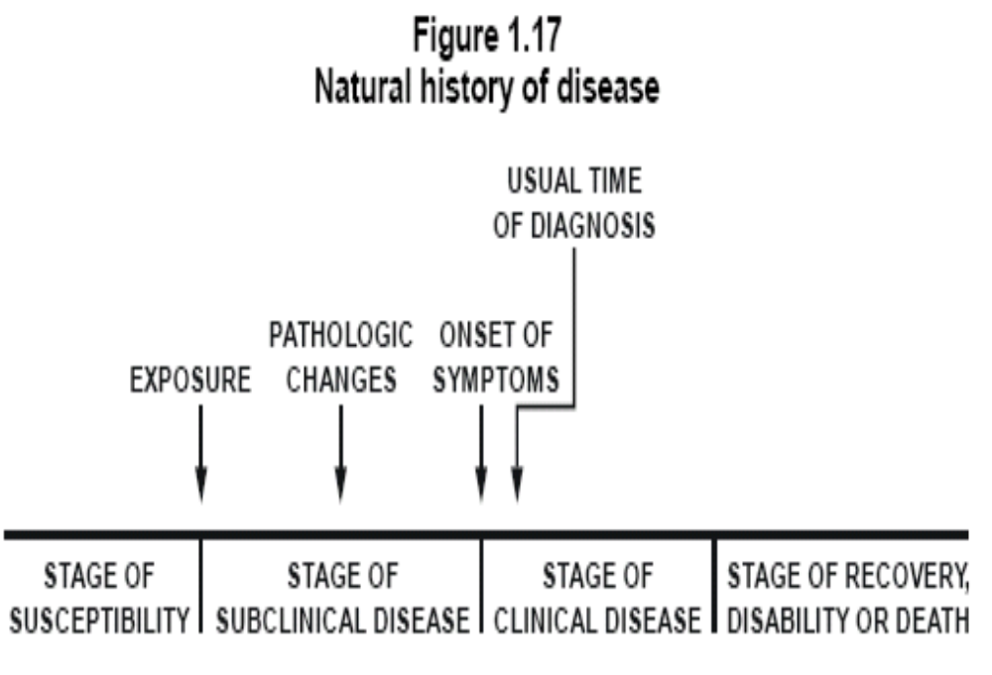

Slide 34
Natural history of disease
Onset of symptoms
Usual time of diagnosis
Exposure
Pathologic
changes
Stage of subclinical disease
Stage of recovery, disability or death
Stage of
susceptibility
Stage of clinical disease
PRIMARY PREVENTION
SECONDARY PREVENTION
TERTIARY PREVENTION

Slide 35
NATURAL HISTORY
Vs.
PREVENTION
Stage/State of Disease | Level of Prevention
Healthy State | Primary
Pre-symptomatic or Symptomatic Stage | Secondary
Disability Stage | Tertiary

Slide 36
Uses of Epi. (cont.)
5. Screening for diseases and risk factors.
  6. Planning, implementing, monitoring and evaluating of health programmes.
  7. Surveillance for specific health conditions in the population.
  8. Identification and investigation of outbreaks or epidemics.

Slide 37
Endemic, Epidemic and Pandemic
Endemic - The habitual presence (or usual occurrence) of a disease within a given geographic area
Epidemic - The occurrence of an infectious disease clearly in excess of normal expectancy, and generated
from a common or propagated source
Pandemic - A worldwide epidemic affecting an exceptionally high proportion of the global population
Number of Cases
of Disease
Time

Slide 38
APPROACHES IN MEDICINE VS. EPIDEMIOLOGY
APPROACH/ CONSIDERATION | CLINICAL MEDICINE | EPIDEMIOLOGY
Focus | Individuals | Population
Main Goal | Diagnosis and treatment | Prevention and Control
Questions | What is wrong with this patient? | What are the leading causes of death or disability in this population? Risk factors?
Treatment | What treatment is appropriate for this patient? | What can be done to reduce or prevent disease or risk factors?
Follow-up | Follow-up | Follow-up.
Evaluation | Evaluation | Evaluation

