Slide 2
Overview on ‘Measures in Epidemiology’

Slide 3
Measures of disease occurrence.
  Incidence.
    Cumulative incidence.
    Incidence density.
  Prevalence.
    Point prevalence.
    Period prevalence.

Slide 4
Measures of association.
  Strength.
    Relative risk.
    Odds ratio.
  Impact/effect.
    Attributable risk.
    Attributable fraction.
    Population attributable risk.

Slide 5
Study design

Slide 6
Objectives:
On completion of sessions on Study Designs, you
should be able to:
Identify the different study designs.
Differentiate the different study designs.
List the strengths and limitations of each of the study designs.
Select appropriate designs for research problems.
Design an epidemiological study on a problem of your choice.

Slide 7
What is a study design?
Is a specific plan or protocol for conducting a study.
  to address specific research question(s).

Slide 8
Choice of study design depends on many factors:

Slide 9
Choice of study design depends on many factors:
Prior knowledge of the problem being investigated.

Slide 10
Choice of study design depends on many factors:
Prior knowledge of the problem being investigated.
Research question/study objective.

Slide 11
Choice of study design depends on many factors:
Prior knowledge of the problem being investigated.
Research question/study objective.
Availability of resources – human, financial, etc.

Slide 12
Choice of study design depends on many factors:
Prior knowledge of the problem being investigated.
Research question/study objective.
Availability of resources – human, financial, etc.
Available time for the study.

Slide 13
Choice of study design depends on many factors:
Prior knowledge of the problem being investigated.
Research question/study objective.
Availability of resources – human, financial, etc.
Available time for the study.
Acquired research skills.

Slide 14
Choice of study design depends on many factors:
Prior knowledge of the problem being investigated.
Research question/study objective.
Availability of resources – human, financial, etc.
Available time for the study.
Acquired research skills.
Frequency of disease/outcome and exposure.

Slide 15
Choice of study design depends on many factors:
Prior knowledge of the problem being investigated.
Research question/study objective.
Availability of resources – human, financial, etc.
Available time for the study.
Acquired skills.
Type of disease/outcome and exposure.
Availability of study subjects.

Slide 16
Choice of study design depends on many factors:
Prior knowledge of the problem being investigated.
Research question/study objective.
Availability of resources – human, financial, etc.
Available time for the study.
Acquired skills.
Type of disease/outcome and exposure.
Availability of study subjects.
Ethical issues, etc.

Slide 17
Note on terminology
“Outcomes”
  Health outcome of interest in the study
  Disease, death, side effect, complication, etc.
    (Biostats: “dependent variables”)
“Exposures”
  Measures that may be associated with the outcome
  Possible “risk factors”, “causes”, “determinants”
    (Biostats: “independent variables”)

Slide 18
I. Framework for thinking about study designs

Slide 19
Why are study designs important?

Slide 20
Why are study designs important?
Provide general guidelines for thinking about specific aspects of study conduct:
  sampling populations
  systematically collecting measurements
  analysing data

Slide 21
Different types of study questions lead to different types of study designs

Slide 22
Different types of study questions lead to different types of study designs
What is the prevalence of condition Z in Community X?

Slide 23
Different types of study questions lead to different types of study designs
What is the prevalence of condition Z in Community X?
What are the factors associated with condition Z?

Slide 24
Different types of study questions lead to different types of study designs
What is the prevalence of condition Z in Community X?
What are the factors associated with condition Z?
Is exposure to unhealthy foods associated with developing cancer?

Slide 25
Different types of study questions lead to different types of study designs
What is the prevalence of condition Z in Community X?
What are the factors associated to condition Z?
Is exposure to unhealthy foods associated with developing cancer?
Is the newly developed drug X more effective in treatment of diabetes?

Slide 26
Different types of study questions lead to different types of study designs
What is the prevalence of condition Z in Community X?
What are the factors associated to condition Z?
Is exposure to unhealthy foods associated with developing cancer?
Is the newly developed drug X more effective in treatment of diabetes?
What are the characteristics of breast cancer cases?

Slide 27
Different types of study questions lead to different types of study designs
What is the prevalence of condition Z in Community X?
What are the factors associated to condition Z?
Is exposure to unhealthy foods associated with developing cancer?
Is the newly developed drug X more effective in treatment of diabetes?
What are the characteristics of breast cancer cases?
How has been the trend of non-communicable diseases in the past ten years in Kenya?

Slide 28
Selecting the right study design option
Relevant
  Design allows you to answer your research question

Slide 29
Selecting the right study design option
Relevant
  Design allows you to answer your research question
Novel
  Design allows meaningful contribution to existing knowledge ~ new insights

Slide 30
Selecting the right study design option
Relevant
  Design allows you to answer your research question
Novel
  Design allows meaningful contribution to existing knowledge ~ new insights
Feasible
  Design allows study to be done within available time and funds.

Slide 31
Selecting the right study design option
Relevant
  Design allows you to answer your research question
Novel
  Design allows meaningful contribution to existing knowledge ~ new insights
Feasible
  Design allows study to be done within available time and funds
Simple
  ALWAYS avoid ALL unnecessary complexities

Slide 32
Choice of study design
Inform how you will sample a specific study population

Slide 33
Choice of study design
Inform how you will sample a specific study population
Inform the most appropriate measurements to collect on participants in a standardised manner (create data).

Slide 34
Choice of study design
Inform how you will sample a specific study population .
Inform the most appropriate measurements to collect on participants (create data).
3. Study designs will point to the most appropriate analysis of data to answer study question.

Slide 35
Broad categories of study designs

Slide 36
Broad categories of study designs
Cross-sectional
Case report / case series
Case-control
Cohort
Randomised Controlled Trial (RCT)

Slide 37
Broad categories of study designs
Cross-sectional
Case series
Case-control
Cohort
Randomised Controlled Trial
Descriptive
Analytic

Slide 38
  Descriptive
    Calculate the proportion of the study population with condition Z (incident or prevalent).
  Analytic
    Compare the frequency of condition Z among groups of the population

Slide 39
Broad categories of options in study design
Cross-sectional
Case report/series
Case-control
Cohort
RCT
Observational designs:
investigator is only observing distribution of variables (risk factors, diseases, etc) ‘in nature’
Experimental designs:
investigator assigns study conditions ~ usually testing an intervention
(many variations here)

Slide 40
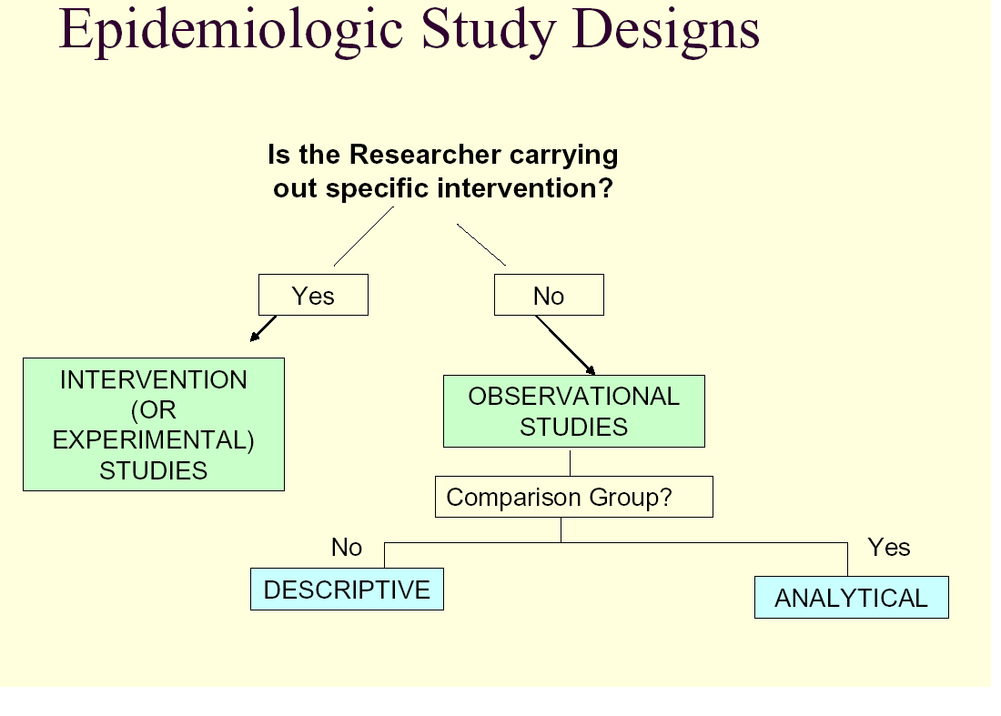

Slide 41
Sequence for studying a topic:
Notes:
When choosing a study design, many factors must be take into account.
Different types of studies are subject to different types of bias.
For example describing distributions of disease and health-related characteristics in the population
Experiments usually occur later in the sequence of research studies, and answer more narrowly focused questions that arise from the findings of observational studies.
No study is ever perfect

Slide 42
Sequence for studying a topic:
Descriptive studies
  What is the burden of condition Z in the population?
Notes:
When choosing a study design, many factors must be take into account.
Different types of studies are subject to different types of bias.
For example describing distributions of disease and health-related characteristics in the population
Experiments usually occur later in the sequence of research studies, and answer more narrowly focused questions that arise from the findings of observational studies.
No study is ever perfect

Slide 43
DESCRIPTIVE STUDY ANALYTIC STUDY
(start with) (then conduct this)

Slide 44
Sequence for studying a topic:
  Descriptive studies
    What is the burden of condition Z in the population?
  Analytic studies to evaluate associations and discover cause-and-effect relationships
    Which factors are associated with condition Z?
Notes:
When choosing a study design, many factors must be take into account.
Different types of studies are subject to different types of bias.
For example describing distributions of disease and health-related characteristics in the population
Experiments usually occur later in the sequence of research studies, and answer more narrowly focused questions that arise from the findings of observational studies.
No study is ever perfect

Slide 45
Sequence for studying a topic:
  Descriptive studies
    What is the burden of condition Z in the population?
  Analytic studies to evaluate associations and discover cause-and-effect relationships
    Which factors are associated with condition Z?
  Clinical trial to establish the effects of an intervention
    Is treatment Y effective in treating patients with condition Z?
Notes:
When choosing a study design, many factors must be take into account.
Different types of studies are subject to different types of bias.
For example describing distributions of disease and health-related characteristics in the population
Experiments usually occur later in the sequence of research studies, and answer more narrowly focused questions that arise from the findings of observational studies.
No study is ever perfect

Slide 46
Key differences between study designs
How participants are sampled
  Are participants sampled according to exposure status, disease status, neither, both?

Slide 47
Key differences between study designs
How participants are sampled
  Are participants sampled according to exposure status, disease status, neither, both?
When measurements are taken
  Are some variables measured before others, or are measurements taken all at once?

Slide 48
Key differences between study designs
How participants are sampled
  Are participants sampled according to exposure status, disease status, neither, both?
When measurements are taken
  Are some variables measured before others, or are measurements taken all at once?
How outcome variables are measured
  Incident or prevalent outcomes (morbidity/mortality)?

Slide 49
Key differences between study designs
How participants are sampled
  Are participants sampled according to exposure status, disease status, neither, both?
When measurements are taken
  Are some variables measured before others, or are measurements taken all at once?
How outcome variables are measured
  Incident or prevalent outcomes (morb/mort)?
Are there comparison groups involved?

Slide 50
Key differences between study designs
How participants are sampled
  Are participants sampled according to exposure status, disease status, neither, both?
When measurements are taken
  Are some variables measured before others, or are measurements taken all at once?
How outcome variables are measured
  Incident or prevalent outcomes (morb/mort)?
Are there comparison groups involved?
Is design observational or experimental?

Slide 51
II. Details on categories of study designs

Slide 52
II. Details on categories of study designs
Case report & case series
Cross-sectional
case-control
Cohort
RCT & other experimental designs

Slide 53
Observational Studies

Slide 54
Types of Observational study designs
Cross-sectional
Case series
Case-control
Cohort
Descriptive
Analytic

Slide 55
Broad categories of descriptive study designs
Cross-sectional
Case series
Case-control
Cohort
Descriptive

Slide 56
Descriptive Studies: Features
Usually conducted when much is not known about the problem.
No comparison group.
  Select a study sample – through random sampling procedure.
Generate hypotheses.

Slide 57
Descriptive studies may be carried out to:
Determine the magnitude of the problem in the population (i.e. prevalence).

Slide 58
Descriptive studies may be carried out to:
Determine the magnitude of the problem in the population.
Determine the characteristics of people with a disease or exposure of interest.

Slide 59
Descriptive studies may be carried out to:
Determine the magnitude of the problem in the population.
Determine the characteristics of people with a disease or exposure of interest.
Determine the changes in disease frequency over time.

Slide 60
Descriptive studies may be carried out to:
Determine the magnitude of the problem in the population.
Determine the characteristics of people with a disease or exposure of interest.
Determine the changes in disease frequency over time.
Determine the relationships between exposures and outcomes (i.e. analytic cross-sectional).

Slide 61
Sub-types of descriptive studies.
  Case studies.
  Case-series studies.
  Cohort (or longitudinal studies).
  Cross-sectional studies.
  Ecological studies.

Slide 62
Case-report & case-series
Cases
  people with health outcome
  depends on what is of interest
Case report / series
  Describes
    characteristics of disease / condition
    characteristics of individual that may be associated with the condition

Slide 63
Issues in case-only designs
Useful for descriptive purposes only
Implicit comparisons to what is ‘expected’ or ‘normal’
  Why might this be problematic?

Slide 64

Issues in case-only designs
Useful for descriptive purposes only
Implicit comparisions to what is ‘expected’ or ‘normal’
Why might this be problematic?
vs

Slide 65
Descriptive: Cohort

Slide 66
Descriptive: Cohort
Also referred as ‘longitudinal’ study.

Slide 67
Descriptive: Cohort
Also referred as ‘longitudinal’ study.
A single group or cohort is identified and followed to future outcome.

Slide 68
Descriptive: Cohort
Also referred as ‘longitudinal’ study.
A single group or cohort is identified and followed to future outcome.
TWO or MORE sets of observations are collected for every unit in the study.

Slide 69
Descriptive: Cohort
Also referred as ‘longitudinal’ study.
A single group or cohort is identified and followed to future outcome.
TWO or MORE sets of observations are collected for every unit in the study.
Such populations are AT RISK (disease-free) at the start of the study.

Slide 70
e.g: What is the rate of recovery among patients
treated for diabetes at KNH?
At risk participants
(without outcome)
Develop outcome of interest
Do not develop outcome of interest
Time

Slide 71
CROSS-SECTIONAL STUDIES

Slide 72
Cross-sectional studies
Most common form of research ~ “surveys”

Slide 73
Cross-sectional studies
Most common form of research ~ “surveys”
Measure all variables on participants at same point in time (approximately)

Slide 74
Cross-sectional studies
Surveys exposures and disease status at a single point in time (a cross-section of the population)
time
Study only exists at this point in time
Notes:
Cross section al studies are some of the first studies completed because of ease and low cost

Slide 75
Cross-sectional studies
Most common form of research ~ “surveys”
Measure all variables on participants at same point in time (approximately)
Measure prevalent disease (not incidence)

Slide 76
Cross-sectional studies
Most common form of research ~ “surveys”
Measure all variables on participants at same point in time (approximately)
Measure prevalent disease (not incidence)
X Disease
X Exposure
Time

Slide 77
Defined population

Slide 78
Defined population
Sampling

Slide 79
Defined population
Sampling
Collect data on outcome (disease) and exposure (risk factors)

Slide 80
Defined population
Sampling
Collect data on outcome (disease) and exposure (risk factors)
Exposed
Diseased
Not exposed
Diseased
Exposed
Not diseased
Not exposed
Not Diseased

Slide 81
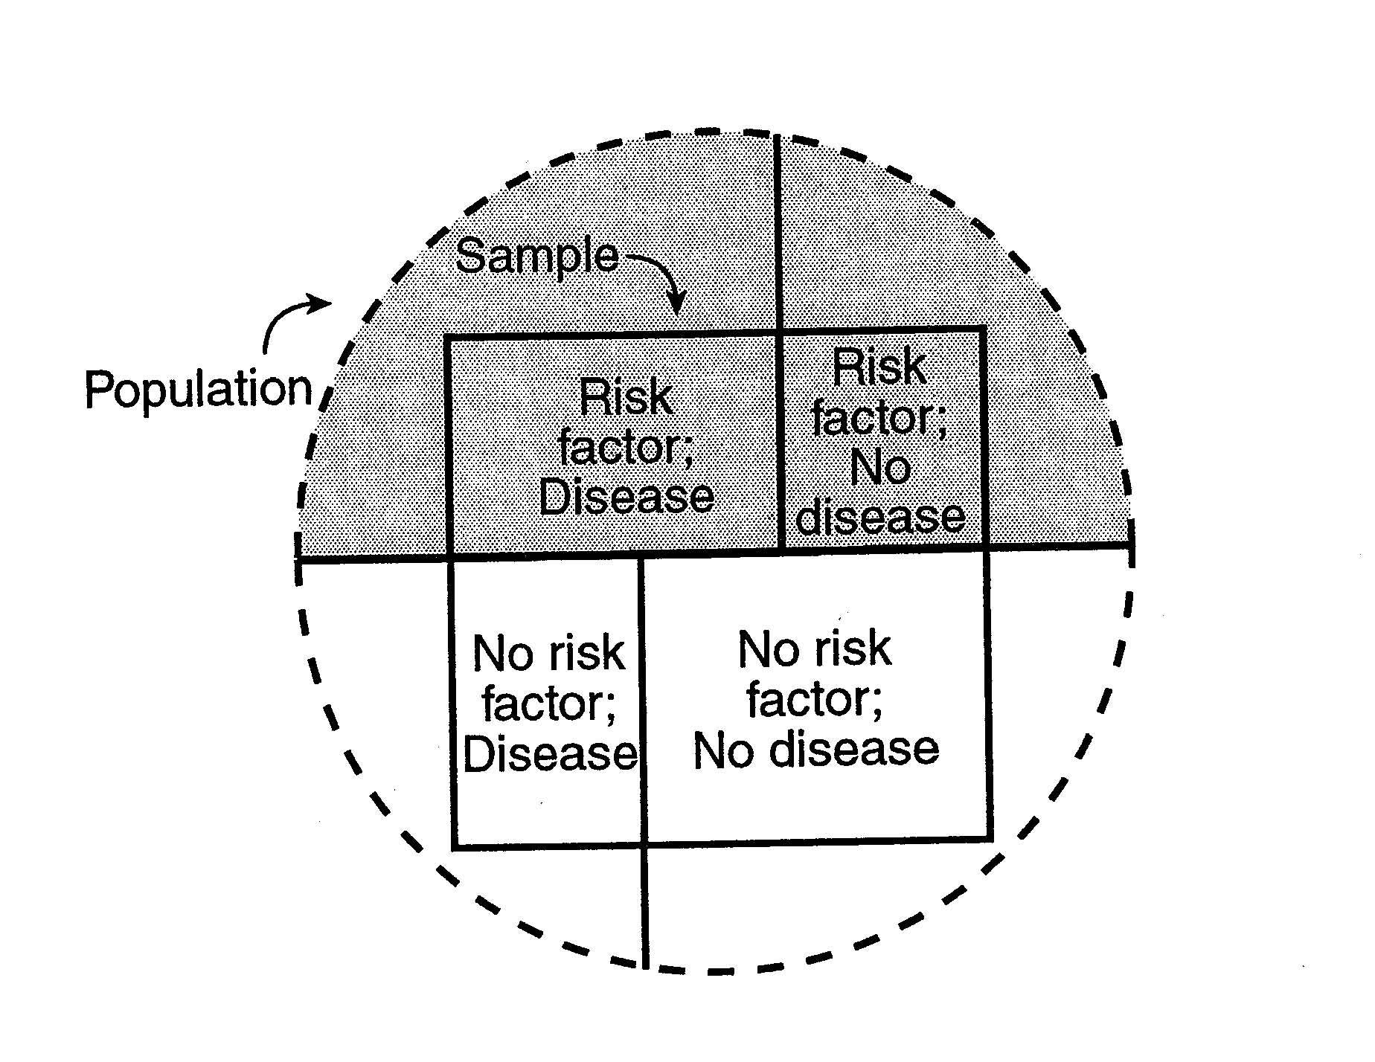
Cross-Sectional Study Example

Slide 82
Analysis – Descriptive CS study
Objective:
  To describe the disease in time, place and person
  To generate hypothesis
Analysis
  Means & SD
  Median & percentile
  Proportions – Prevalence
  Ratios
  Age, sex or other group specific analysis

Slide 83
Analysis – Analytical CS study
Objective:
  Is there any association?
  If “YES”, then what is the strength of association?
Analysis:
  Is there any association?
    Chi-square, student-t test, etc
  What is the strength of association?
    Correlations
    Odds ratio, etc.

Slide 84
Odd ratio
OR is the ratio of one odds to another
Odds of disease among exposed
Disease OR = -------------------------------------
Odds of disease among not exposed
Odds of exposure among diseased
Exposure OR = -------------------------------------
Odds of exposure among not diseased

Slide 85
Example: Is there any relationship between exposure to fumes and experiencing headache?
Study population: Patients attending a certain health facility during one month period.
Measures: headache (outcome); demographics, fumes (exposures)
Analysis: Prevalence of headache and exposure to fumes among patients; association between headache and different exposures

Slide 86
Measures of association- Odds ratio
Example:
Exposure to fumes | Headache present | Headache absent | Total
Factor present | 10 | 90 | 100
Factor absent | 50 | 850 | 900
Total | 60 | 940 | 1000

Slide 87
Rate ratio
Exposure to fumes | Headache present | Headache absent | Total
Factor present | 10 | 90 | 100
Factor absent | 50 | 850 | 900
Total | 60 | 940 | 1000
Prevalence ratio = {a/(a+b)}/{c/(c+d)} = 1.8
Exposure ratio = {a/(a+c)}/{b/(b+d)} = 1.74

Slide 88
Rate difference
Exposure to fumes | Headache present | Headache absent | Total
Factor present | a=10 | b=90 | a+b= 100
Factor absent | c=50 | d=850 | c+d= 900
Total | a+c=60 | b+d=940 | n=1000
Prevalence difference = {a/(a+b)} - {c/(c+d)} = 0.0444
Exposure difference = {a/(a+c)} - {b/(b+d)} = 0.07

Slide 89
Benefits of cross-sectional study

Slide 90
Benefits of cross-sectional study
Feasibility → easy to do
  Low cost, rapid
    Not waiting for incident outcomes to develop

Slide 91
Benefits of cross-sectional study
Feasibility → easy to do
  Low cost, rapid
    Not waiting for incident outcomes to develop
Can calculate prevalence
  Often most relevant measure for burden of disease, informing health care strategies

Slide 92
Issues in cross-sectional studies

Slide 93
Issues in cross-sectional studies
Measuring prevalent disease only
  Prevalence incorporates incidence of disease AND duration of disease
  Risk factors for prevalent disease often different from risk factors for incident disease

Slide 94
Issues in cross-sectional studies
Measuring prevalent disease only
  Prevalence incorporates incidence of disease AND duration of disease
  Risk factors for prevalent disease often different from risk factors for incident disease
Issues of timing (temporality) are a problem
  Exactly when did disease develop?
  Did exposures come before or after onset of disease?

Slide 95
Issues in cross-sectional studies
Measuring prevalent disease only
  Prevalence incorporates incidence of disease AND duration of disease
  Risk factors for prevalent disease often different from risk factors for incident disease
Issues of timing (temporality) are a problem
  Exactly when did disease develop?
  Did exposures come before or after onset of disease?
Unsuitable for acute events.

Slide 96
CASE-CONTROL STUDIES

Slide 97
Purpose: To relate exposure and occurrence of an outcome
Exposure (E) Outcome (O)
(e.g. Cigarette smoking verses Coronary heart Disease)

Slide 98
Case-Control Studies (CCS)
Question:
  How do diseased cases differ from non-diseased (controls) with respect to prior exposure history?

Slide 99
Cases
Controls

Slide 100
Case-control studies
Set of cases (usually from health service)
  Define cases – case definition.

Slide 101
Case-control studies
Set of cases (usually from health service)
Comparable set of controls (various sources)
      Health facilities.
      General population.
        Neighbours.
        Relatives.
        Associates.
        siblings

Slide 102
Case-control studies
Set of cases (usually from health service)
Comparable set of controls (various sources)
Both groups evaluated on characteristics / ‘exposures’ of interest.
    Records.
    Interviews.

Slide 103
Exposed
Cases
Unexposed
Exposed
Controls
Unexposed
Time

Slide 104
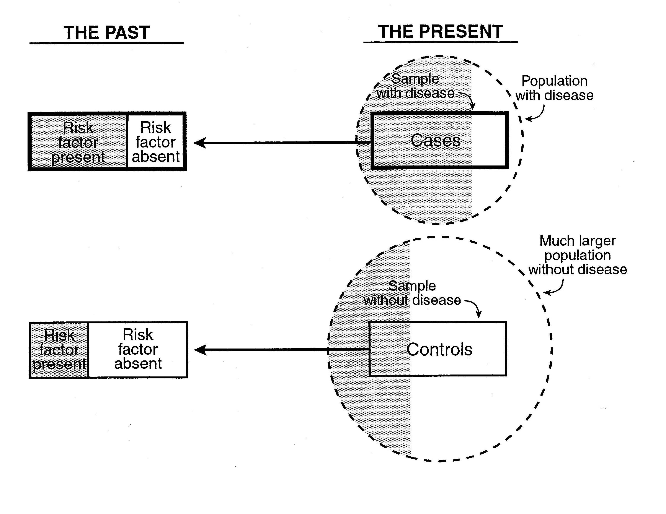
Case-Control Example

Slide 105
Case-control Study – Design
Select subjects on the basis of disease/outcome status

Slide 106
Case-control studies
Set of cases (usually from health service)
Comparable set of controls (various sources)
Both groups evaluated on characteristics / ‘exposures’ of interest
Compare frequency of exposure among cases and controls.

Slide 107
Example: Does children’s inhalation of hairspray
facilitate development of asthma?

Slide 108
Example: Does children’s inhalation of hairspray
facilitate development of asthma?
50 new cases of severe asthma identified at a health facility in 12-month period, all <5 yrs of age.
90 children <5 years attending at a health facility who do not have asthma.
Cases and controls are compared on maternal hairspray use since child’s birth

Slide 109
Hairspray
Children
with asthma
No hairspray
Hairspray
Children
without asthma
No hairspray

Slide 110
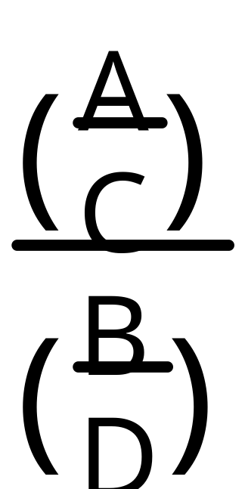
Odds ratio in 2x2 table
Odds ratio = (A/C) / (B/D)
Cases
Controls
E+
A
B
E-
C
D

Slide 111
Example CCS - Smoking and Myocardial Infarction

Slide 112
Example CCS - Smoking and Myocardial Infarction
Study: Population = 2,000 people, prevalence of smoking = 50% , identify all MI cases that occurred over last year (N=40), obtain a random sample of N=40 controls (no MI).
What is the association between smoking and MI?

Slide 113
Example CCS - Smoking and Myocardial Infarction
Study: Population = 2,000 people, prevalence of smoking = 50% , identify all MI cases that occurred over last year (N=40), obtain a random sample of N=40 controls (no MI). What is the association between smoking and MI?
40
40
OR = a . d = 30 . 20 = 3.0
c . b 10 . 20

Slide 114
Strengths & limitations of case-control studies

Slide 115
Strengths in case-control studies
  Relatively quick.

Slide 116
Strengths in case-control studies
  Relatively quick.
  Ideal to study rare diseases (vs cohort)

Slide 117
Strengths in case-control studies
  Relatively quick.
  Ideal to study rare diseases (vs cohort)
  Cases & potential controls are accessible in health care setting

Slide 118
Strengths in case-control studies
  Relatively quick
  Ideal to study rare diseases (vs cohort)
  Cases & potential controls are accessible in health care setting
  Can study multiple exposures for a given disease.

Slide 119
Strengths in case-control studies
  Relatively quick.
  Ideal to study rare diseases (vs cohort)
  Cases & potential controls are accessible in health care setting
  Can study multiple exposures for a given disease.
  Less costly as compared to cohort studies.

Slide 120
Weaknesses of case-control studies
Cannot calculate Incidence rates.

Slide 121
Weaknesses of case-control studies
Cannot calculate Incidence rates.
Choice of the wrong control group ~ selection bias

Slide 122
Weaknesses of case-control studies
Cannot calculate Incidence rates.
Choice of the wrong control group ~ selection bias
Cases may over-report past exposures ~ information bias.

Slide 123
Weaknesses of case-control studies
Cannot calculate Incidence rates.
Choice of the wrong control group ~ selection bias
Cases may over-report past exposures ~ information bias.
Recall bias.

Slide 124
Weaknesses of case-control studies
Cannot calculate Incidence rates.
Choice of the wrong control group ~ selection bias
Cases may over-report past exposures ~ information bias.
Recall bias.
Unsuitable for rare exposures.

Slide 125
Weaknesses of case-control studies
Cannot calculate Incidence rates.
Choice of the wrong control group ~ selection bias
Cases may over-report past exposures ~ information bias.
Recall bias.
Unsuitable for rare exposures.
Temporal sequence of events cannot be determined.
    Effect cause.

Slide 126
Strengths + problems in case-control studies
Strengths
  Relatively quick.
  Ideal to study rare diseases (vs cohort)
  Cases & potential controls are accessible in health care setting
  Can study multiple exposures for a given disease.
  Less costly as compared to cohort studies.
Weaknesses
  Cannot Incidence rates.
  Choice of the wrong control group ~ selection bias
  Cases may over-report past exposures ~ information bias.
  Recall bias.
  Unsuitable for rare exposures.
  Temporal sequence of events cannot be determines.

Slide 127
  END OF SESSION

