Slide 1
  COHORT STUDIES

Slide 2
Purpose: To relate exposure and occurrence of an outcome
Exposure (E) Outcome (O)
(e.g. Cigarette smoking verses Coronary heart Disease)
Exposure not randomly assigned, but assessed

Slide 3
Cohort studies
Start with group of individuals without the outcome of interest: “at risk”.
Identify those exposed and those not exposed to the factor of interest .
  Measure exposures at the beginning of the study.

Slide 4
Cohort studies
Start with group of individuals without the outcome of interest: “at risk”.
Identify those exposed and those not exposed to the factor of interest.
Follow in time (i.e. from time of identification) to observe incidence of disease(s) or outcomes .

Slide 5
Analytic cohort study
Develop the outcome of interest
Exposure
Study population without the outcome of interest
Do not develop the outcome of interest
Develop the outcome of interest
No exposure
Do not develop outcome of interest
Time

Slide 6
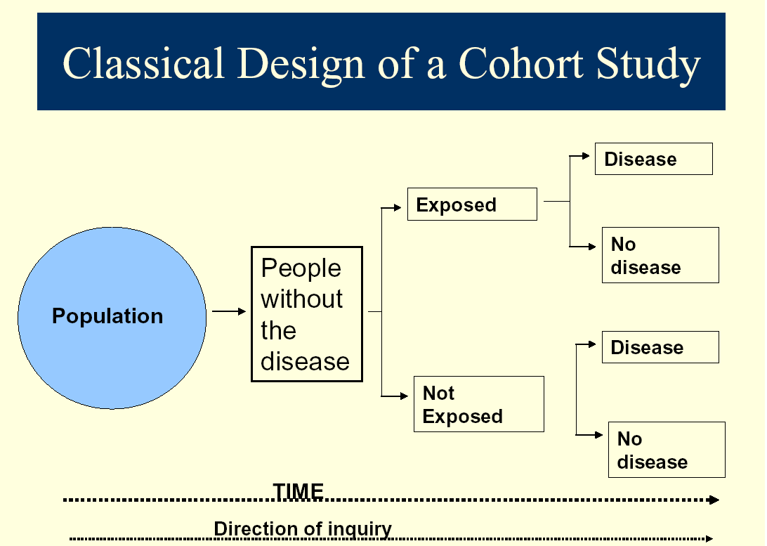

Slide 7
Frame work of Cohort studies
Disease Status
Total
Yes
No
Yes
a+b
Study cohort
Exposure
Status
No
c+d
Comparison cohort

Slide 8
Frame work of Cohort studies
Disease Status
Total
Yes
No
Yes
a+b
a
b
Study cohort
Exposure
Status
No
c+d
c
d
Comparison cohort

Slide 9
Multi-Sample Cohort Study Design
TIME
Diseased
Study Cohort
Exposed
Not Diseased
Diseased
Control Cohort
Not Exposed
Not Diseased

Slide 10
Cohort studies
Start with group of individuals without the outcome of interest: “at risk”.
Identify those exposed and those not exposed to the factor of interest.
Follow forward in time to observe incidence of disease or outcome.
Compare the incidence rates in the exposed and unexposed groups.

Slide 11
Frame work of Cohort studies
Disease Status
Total
Yes
No
Yes
a+b
a
b
Study cohort
Exposure
Status
No
c+d
c
d
Comparison cohort

Slide 12
Types of cohort studies
Prospective.
Retrospective (or Historical Cohort).

Slide 13
Types of cohort studies: Prospective
  Following cohort forward through time from present.
  Outcomes are future events

Slide 14
Prospective cohort study
Disease
occurrence
Exposure
Study starts
time
Disease
occurrence
Study starts
Exposure
time

Slide 15
Types of cohort studies: Retrospective
  Group of subjects or cohort is identified in the past
    is then to the present (Outcomes have already occurred).
    Follow-up is in the past (can extend into present)
  Advantage that most data already collected and events have occurred
  Cheaper to perform as do not have to wait long period before analysis

Slide 16
Retrospective cohort studies
Disease
occurrence
Exposure
Study starts
time

Slide 17
Analysis – Cohort Studies
Presentations: tables, diagrams, graphs
Summarization:
  Measures of central tendency.
  Measures of dispersion.
  Proportions – Prevalence
  Ratios.
Measures of association.
  Strength .
  Impact/effect.

Slide 18
Analysis – Cohort Studies
Measures of association.
  Strength .
    Relative risk.
    Odds ratio.
  Impact/effect.
      Attributable risk (i.e. rate difference).
      Attributable fraction (i.e. attributable rate percent)
      Population attributable risk.

Slide 19
Measure of association in a cohort study: relative risk ( risk ratio, rate ratio)
New cases of outcome
Participants who do not develop outcome
A
B
Exposed
Total number of exposed = A + B
C
D
Unexposed
Total number of unexposed = C + D
Total number of participants = A + B +C + D
RR = [A/(A+B)] / [C/(C+D)]

Slide 20
Measure of association in a cohort study: Odds ratio
New cases of outcome
Participants who do not develop outcome
A
B
Exposed
Total number of exposed = A + B
C
D
Unexposed
Total number of unexposed = C + D
Total number of participants = A + B +C + D
OR = [A/B] / [C/D] = [A.D] / [B.C]

Slide 21
Example: Designing a Cohort Study
Disease Status
CHD cases
(Cases)
No CHD
(Controls)
TOTAL
Exposure Status
Smoker
?
?
288
Non-smoker
?
?
312

Slide 22
Example: Calculating the Relative Risk
Disease Status
TOTAL
CHD cases
No CHD
Exposure Status
Smoker
112
176
288
Non-smoker
88
224
312

Slide 23
Example: Calculating the Relative Risk
Disease Status
TOTAL
CHD cases
No CHD
Exposure Status
Smoker
112
176
288
Non-smoker
88
224
312
A/(A+B)
112 / 288
Relative Risk
=
=
=
1.38
B/(C+D)
88 / 312

Slide 24
Example: Interpreting the Relative Risk
Relative Risk
=
1.38
The risk of developing CHD is 1.38 times higher for a smoker than for a nonsmoker.
or
The risk of developing CHD is 38% higher for a smoker than for a nonsmoker.

Slide 25
Example: Calculating the Odds Ratio
Disease Status
TOTAL
CHD cases
No CHD
Exposure Status
Smoker
112
176
288
Non-smoker
88
224
312
A.D
112 x 224
Odds Ratio
=
=
=
1.62
B.C
176x88

Slide 26
Example: Other Measures
Attributable risk
=
?
Attributable fraction = ?

Slide 27
Example: Other Measures
Attributable risk
=
(38.9 – 28.2)% = 10.7 per 100
Attributable Fraction (AF) or AR% = 27.5%
NOTE
In Case-control studies: AF = [OR - 1] / [OR]

Slide 28
Strengths + Weaknesses of cohort studies
Strengths
  Can calculate incidence rates and relative risks.
  Timing of exposure before disease assured
  Good for studying health effects of rare exposures (can select an exposed cohort)
  Can study multiple outcomes for given exposure.
Weaknesses
  Take time, resources (if prospective)
  Many subjects needed for rare outcomes.
  Attrition – loss to follow-up.
  Unsuitable for rare outcomes.
  Change in the exposure status during the follow-up period.

Slide 29
Observational study designs include:
Descriptive study designs.
  Case series study.
  Longitudinal study.
  Cross-sectional (or prevalence) study.
  Ecological study.
  Case study.
Cohort study design.
  Prospective
  Retrospective or historical.
Case-control study design
  Retrospective.
  Prospective (nested case-control)

Slide 30
Schematic diagram showing temporal direction of three study designs
(1) Exposure Outcome
(2) Exposure Outcome
Exposure
(3)
Outcome

Slide 31
EXPERIMENTAL STUDIES

Slide 32
Experimental Studies
Provide the strongest evidence for testing any hypothesis regarding the cause of disease.
As in a cohort study, individuals start off with exposure status (i.e. Intervention status).
  However, the distinguishing characteristic is that investigators themselves allocate or manipulate the exposure.
Both the exposure (i.e. intervention) and the
outcome must be defined at the time of
planning for the study. And how they will be measured.

Slide 33
Experimental studies
Experimental (or Intervention) studies can generally be
considered either as:
  Therapeutic or
  Preventive.

Slide 34
Experimental studies: Therapeutic trials
Are conducted among patients with a particular disease to determine the ability of an agent or procedure to:
  diminish symptoms,
  prevent recurrence, or
  decrease risk of death from that disease.

Slide 35
Experimental studies: Preventive trials
Involve the evaluation of whether an agent or procedure reduces the risk of developing disease among those free from that condition.
Can be conducted among health individuals at usual risk or those already recognized to be at high risk of developing a disease (e.g. Community trials)
  e.g. Health education, vaccination programs.

Slide 36
Experimental Studies: Randomization
Randomization is the allocation of study participants to study groups/arms at random.
The subjects are usually randomized to the study groups (or arms).
  The purpose of randomization is to ensure comparability of the groups with respect to baseline characteristics.
    Controlling for ‘confounding’.

Slide 37
Have outcome of interest
Exposure
Study population without the outcome of interest
Do not develop outcome of interest
Randomisation
Have outcome of interest
No exposure
Do not develop outcome of interest
Time

Slide 38
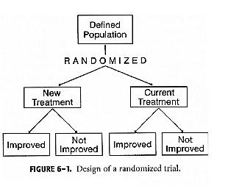
Design of a
Randomized Clinical Trial

Slide 39
Randomized Clinical Trials
In simplest implementation:
    Subject enrolls in study
    Randomly assigned to one of ≥ 2 treatments
    Followed up until end of study or outcome measure is obtained
Outcome comparisons are made among treatment groups
Treatment groups should be comparable on measured and unmeasured covariates due to randomization
    Strongest design to establish causal relationships
May be beneficial to blind subjects/investigators to treatment groups

Slide 40
Experimental Studies: Quasi-Experimental Designs
Groups or subjects not randomly assigned
  e.g., sample of convenience
May not have a comparison group
Typical of clinical research
  e.g., within subjects repeated measures
Less “subject-intensive”
Note:
Other Types of Experimental Studies are also
designed.

Slide 41
Masking (Blinding)
Attempt to eliminate biases & preconceptions
Single-blind
  Subject masking
Double-blind
  Subject masking and researcher masking
    Data collectors and data analysts
Triple-blind
  Subject masking, researcher masking and study sponsor masking/data handler/drug administrator.

Slide 42
Experimental studies: Ethical issues
Although scientifically a randomized controlled trial
is the best way to demonstrate the benefit of a
treatment regime, its use raises important ethical
issues.
Is it justifiable to withhold a treatment from the control group that might be beneficial to them?
Is randomization justified, or should participants be able to choose which group they are in?
Is informed consent necessary?

Slide 43
Experimental studies: Compliance
An intervention study requires the active participation and cooperation of the study subjects.
  After consenting to participate, subjects in a trial may deviate from the protocol for a variety of reasons, including:
    developing side effects,
    forgetting to take their medication, or
    simply withdrawing their consent after randomization.
Non-compliance can affect the validity of a trial.

Slide 44
Experimental studies: Compliance
An intervention study requires the active participation and cooperation of the study subjects.
  After consenting to participate, subjects in a trial may deviate from the protocol for a variety of reasons, including:
    developing side effects,
    forgetting to take their medication, or
    simply withdrawing their consent after randomization.

Slide 45
Data Analysis
Different methods may be applied depending on the:
  Research questions.
  Kind of data collected.
As for analytic cohort studies.

Slide 46
Experimental studies: Disadvantages
Expensive and take a long time to complete.
Attrition or losses to follow-up of study subjects.
Non-compliance of the study participants.
Ethical issues when dealing with human subjects.
Sometimes blinding may not be possible e.g. Surgical procedures.

Slide 47
Choice of study design depends on:
Research question/ objective.

Slide 48
Choice of study design depends on:
Time available for study

Slide 49
Choice of study design depends on:
Resources available for the study

Slide 50
Choice of study design depends on:
Type of outcome of interest (common or infrequent).

Slide 51
Choice of study design depends on:
Quality of data from various sources.

Slide 52
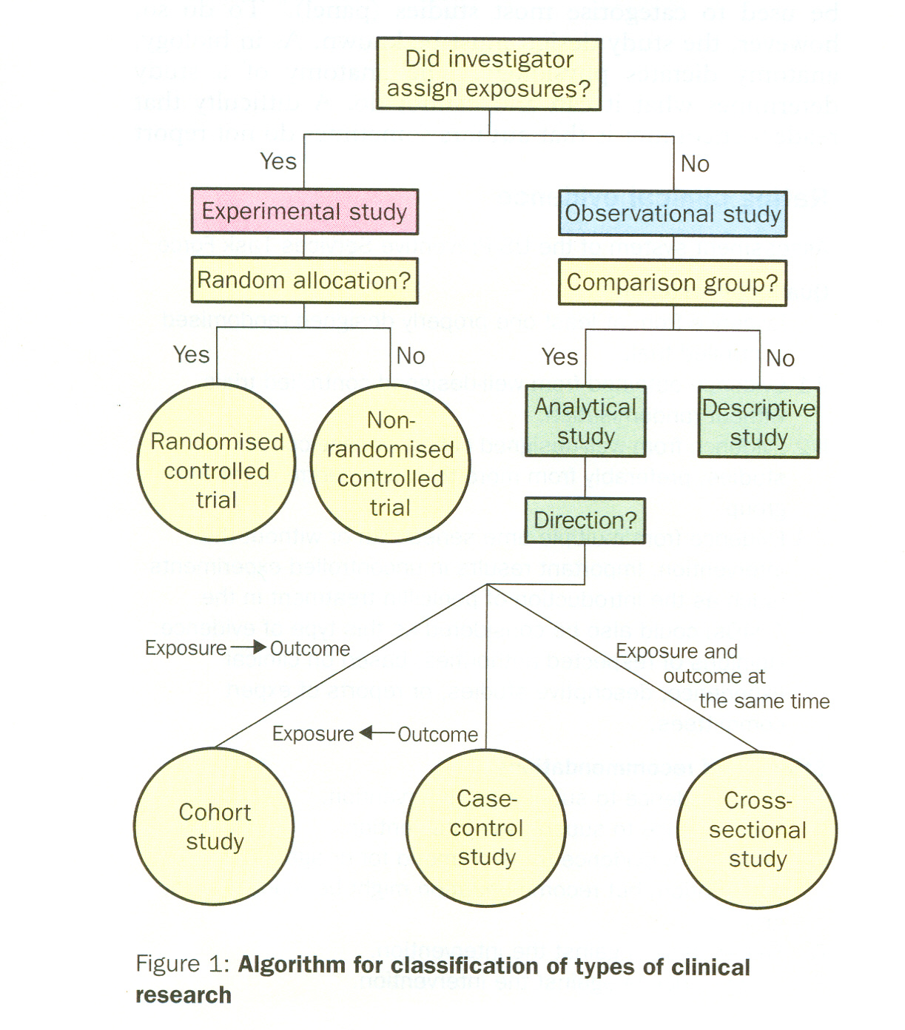
Grimes DA and Schulz KF 2002. An overview of clinical research. Lancet 359:57-61.

Slide 53
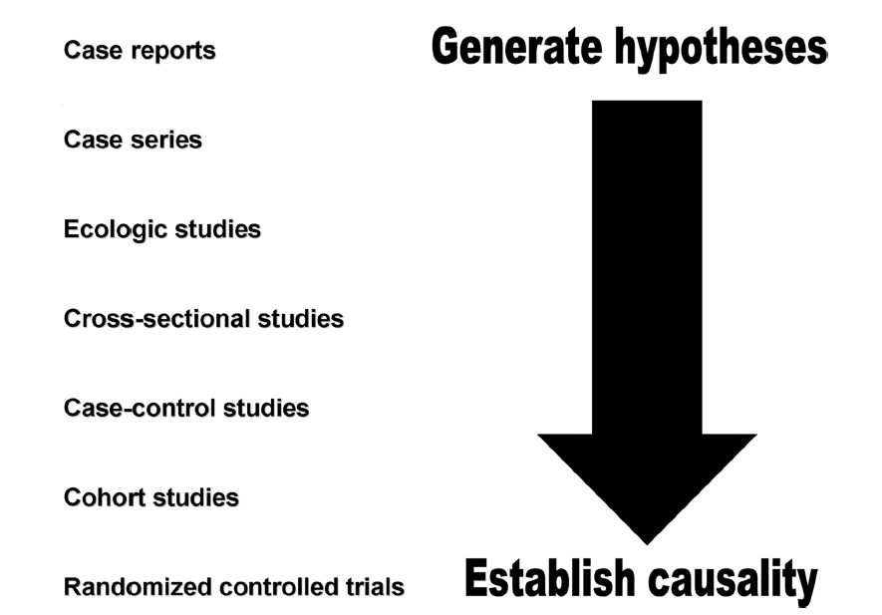
Hierarchy of Epidemiologic Study Design
Tower & Spector, 2007 (www)

Slide 54
Problem:
In 1975, there were 1,000 women who worked in a factory painting radium dials on watches. The incidence of bone cancer in these women up to 2005 was compared to that of 1,000 women who worked as telephone operators in 1975. Forty (40) of the radium dial painters and eight (8) of the telephone operators developed bone cancer between 1975 and 2005.
What study design is this?
What are the:
a) Strengths of this study design?
b) Limitations of this study design?
3. How much of bone cancer could be prevented if women were not exposed to radium dials?

