Slide 1
TRICHINELLA SPIRALIS
KIMAIGA H.O
MBChB (University of Nairobi)

Slide 2
Causal Agents:
Trichinellosis (trichinosis) is caused by nematodes (roundworms) of the genus Trichinella.
Several other species of Trichinella include
  T. spiralis- Worldwide in many carnivorous and omnivorous animals
  T. pseudospiralis - Mammals and birds worldwide
  T. nelsoni- Africa (predators & carnivores)
  T. nativa- Artic (bears)
  T. britovi- Europe and western Asia (carnivores).

Slide 3
Geographic Distribution:
Worldwide.
Most common in parts of Europe and the United States.
More in areas where pork is eaten

Slide 4
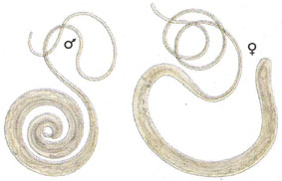
MORPHOLOGY
Adults; males (1.5mm); female (4mm)
Larvae; encapsulated in human muscle
Adult Trichinella spp. reside in the intestinal tract of the mammalian host

Slide 5
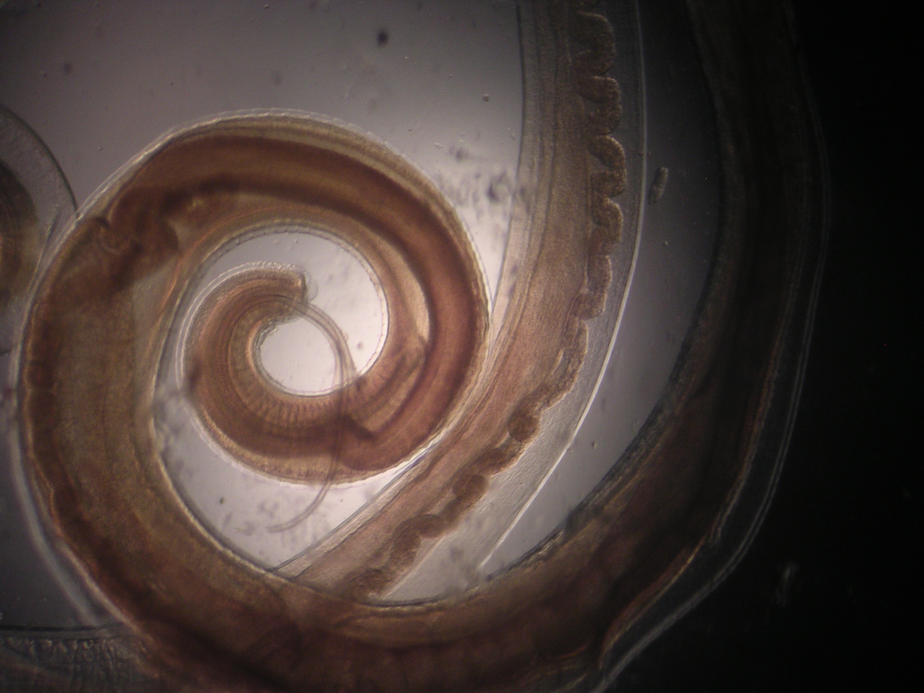
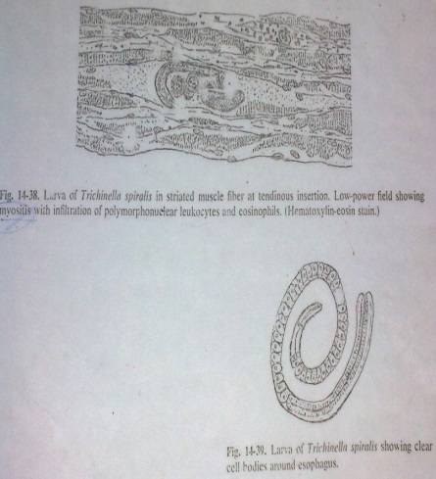

Slide 6
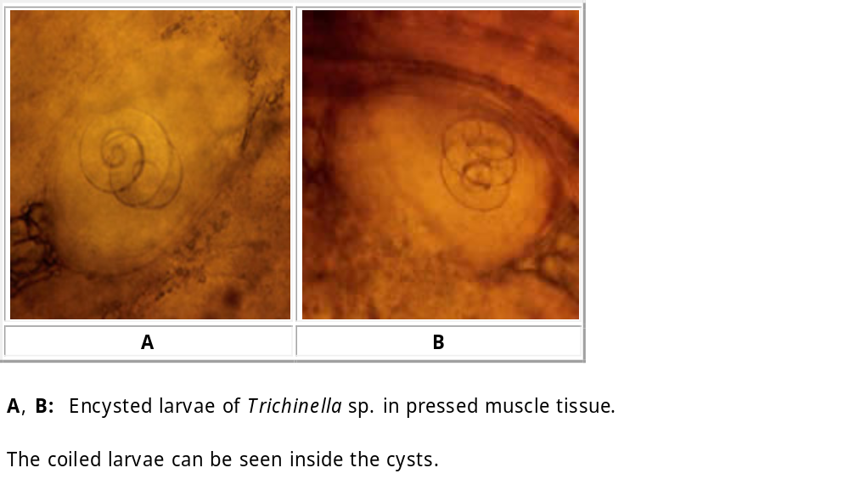
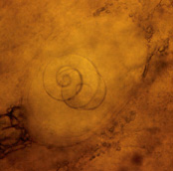

Slide 7
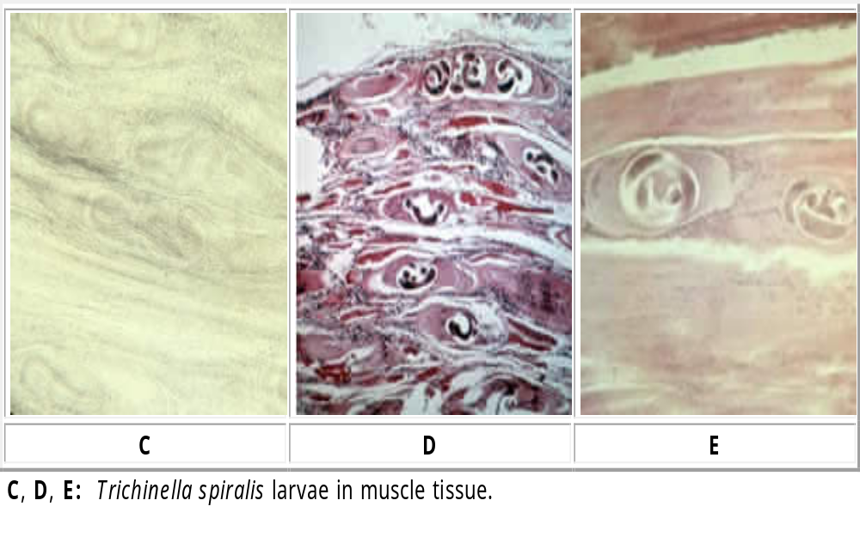

Slide 8
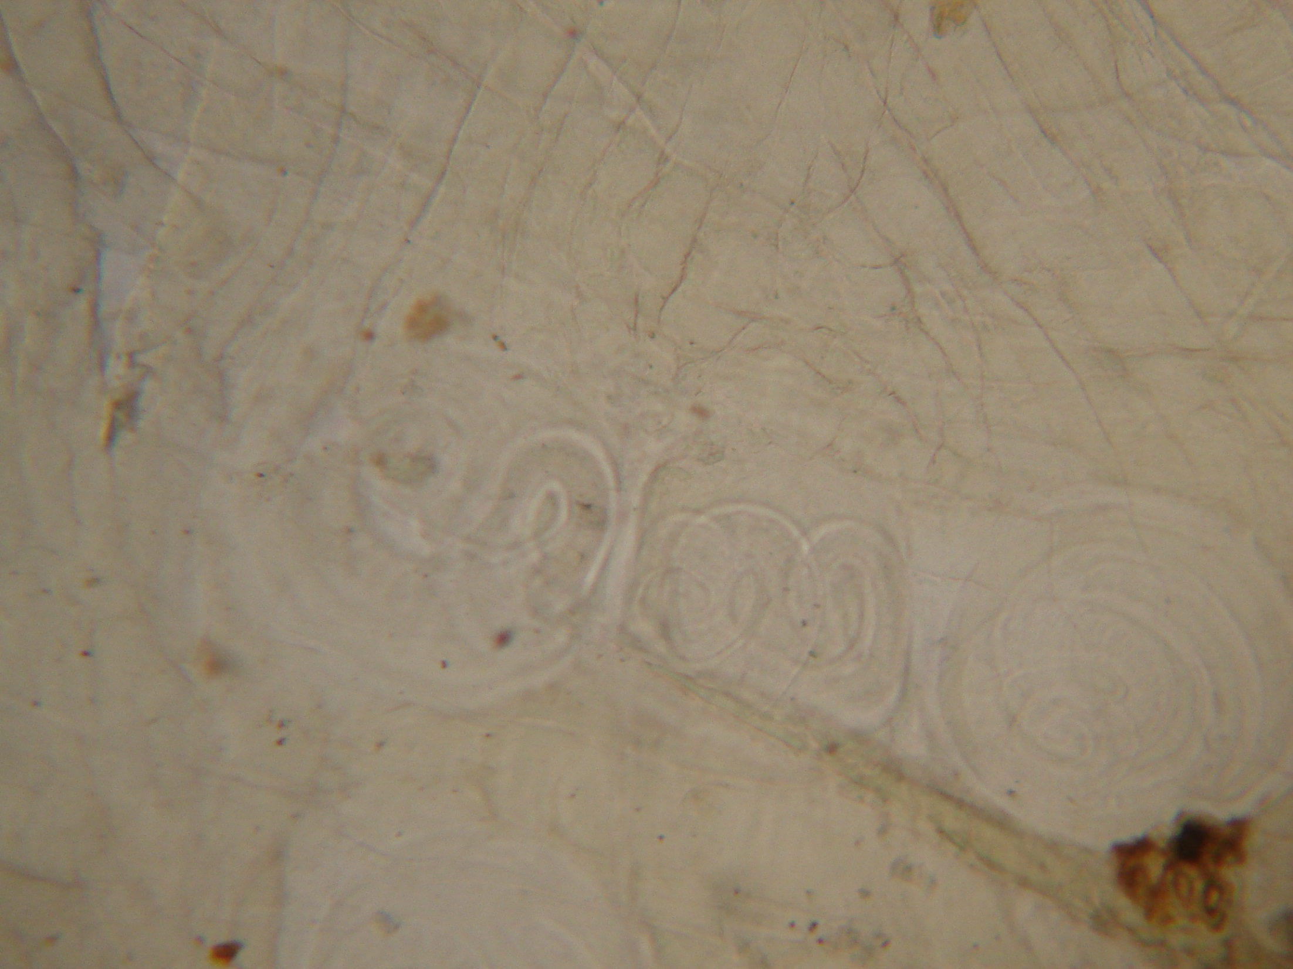

Slide 9
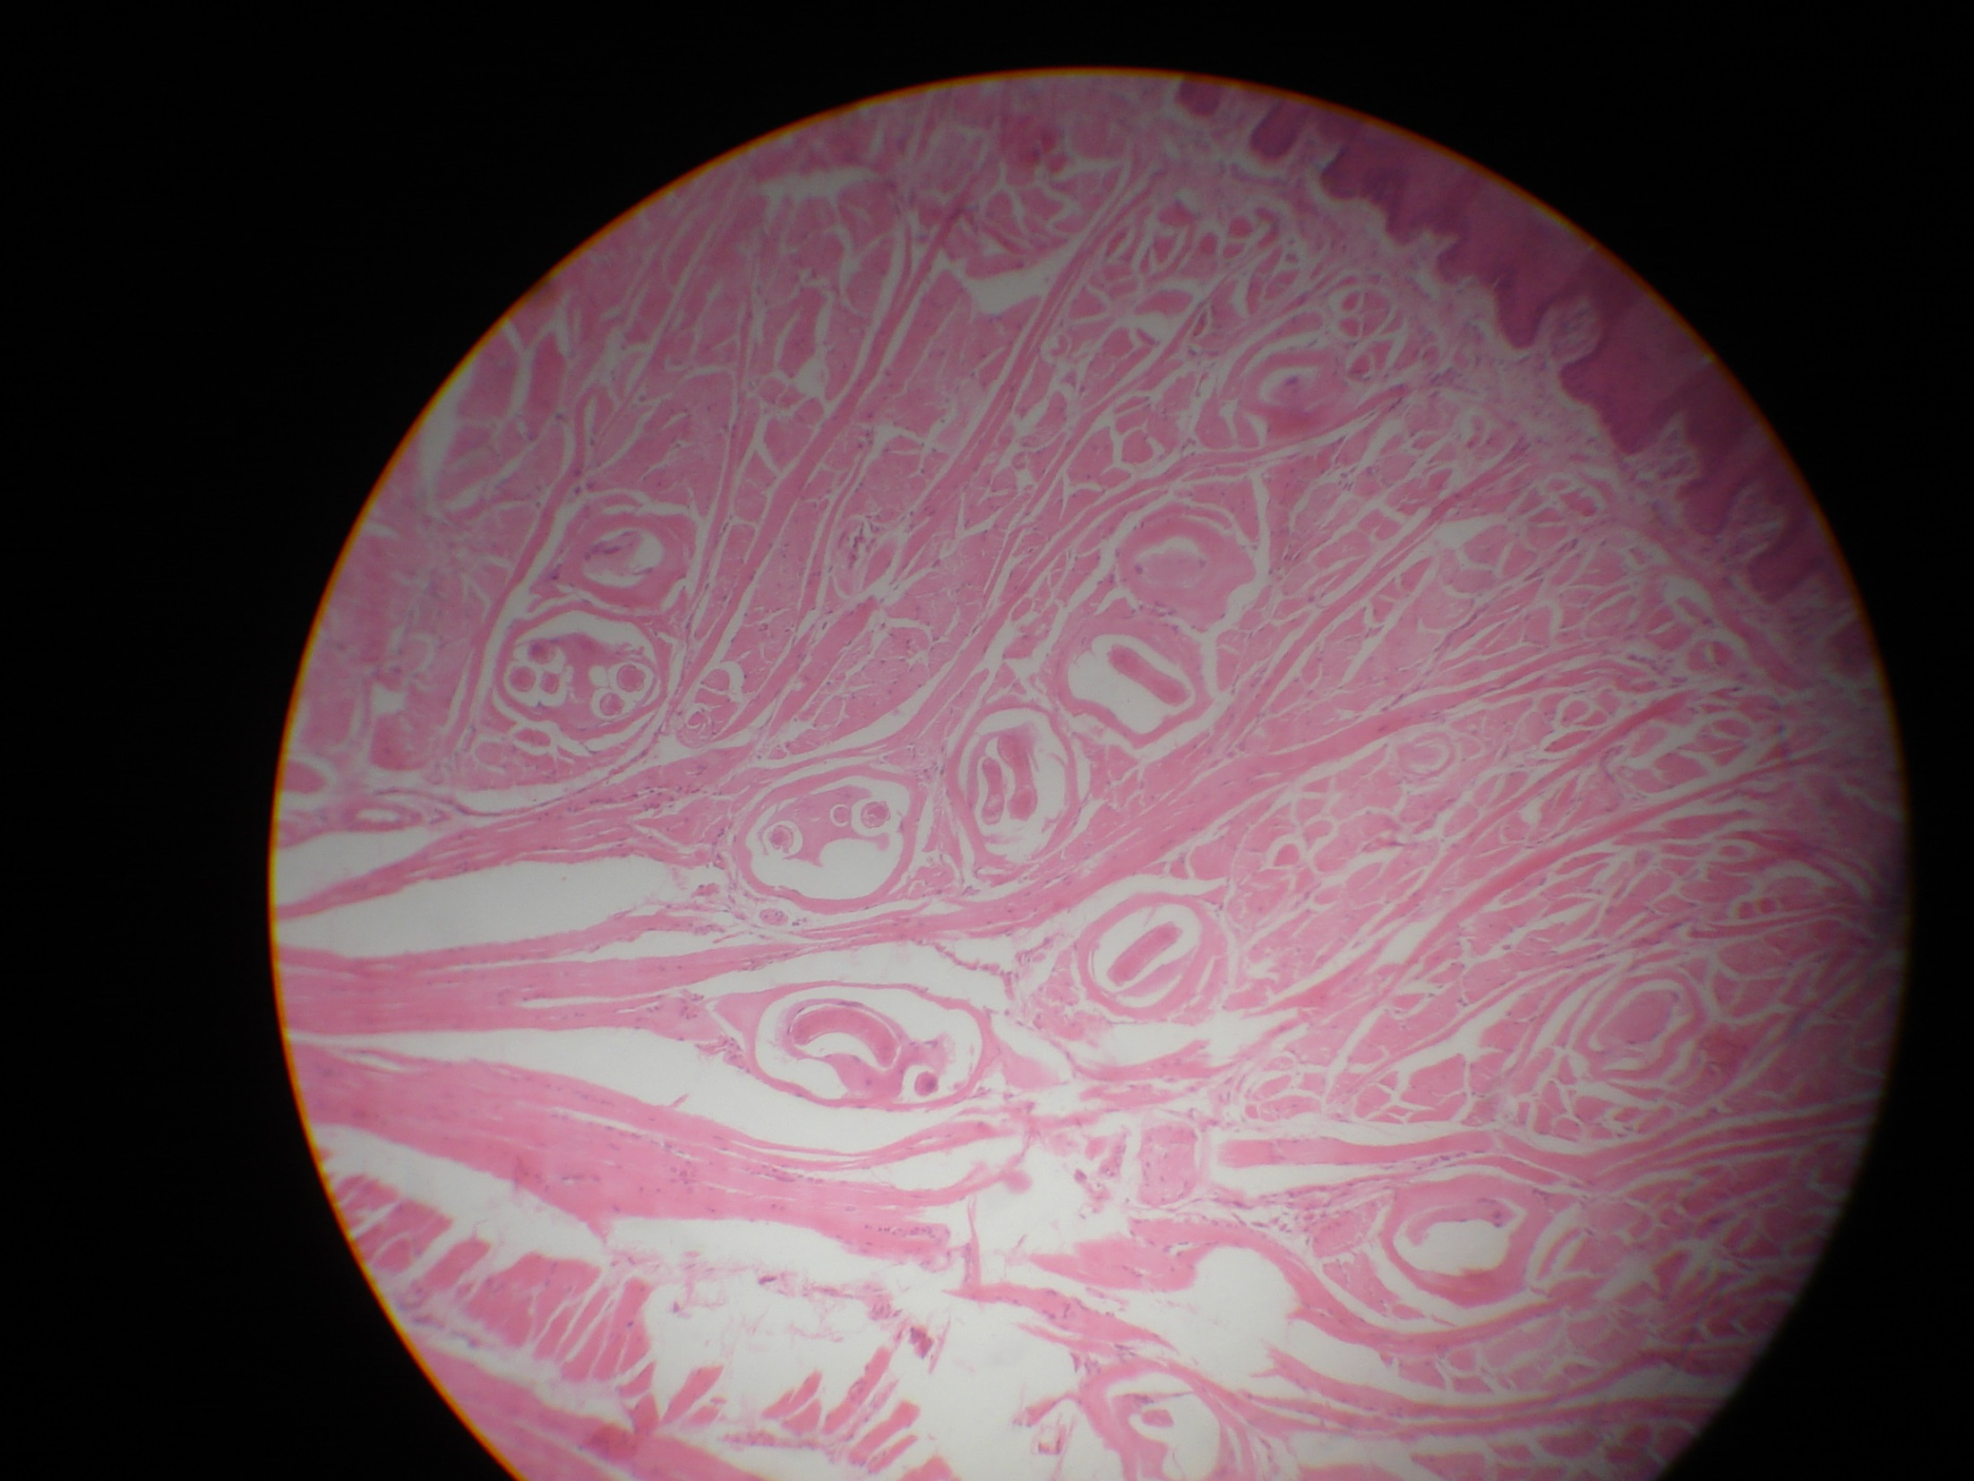
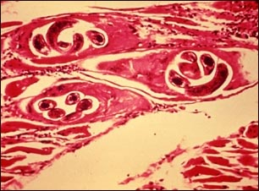
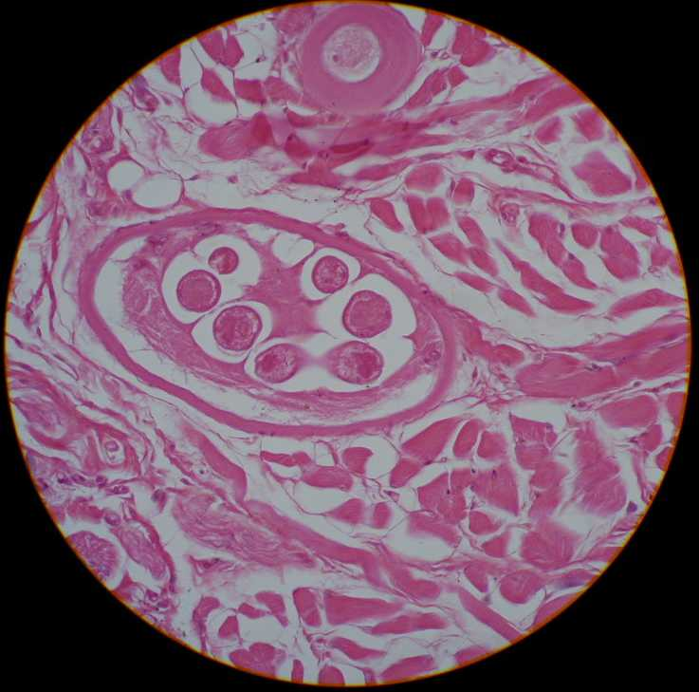

Slide 10
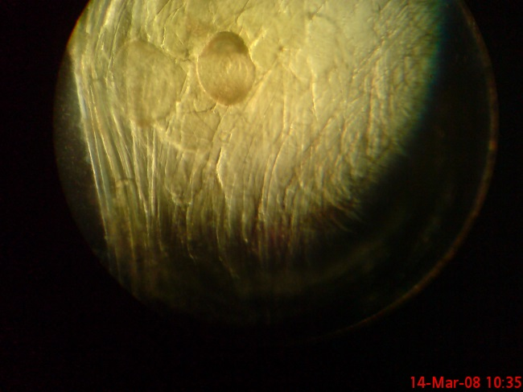
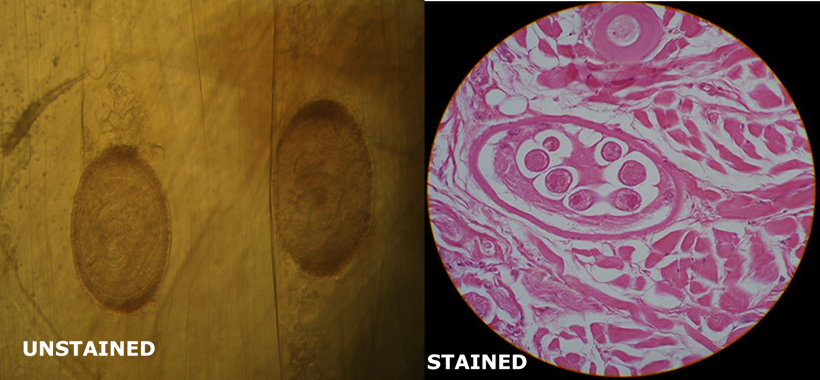
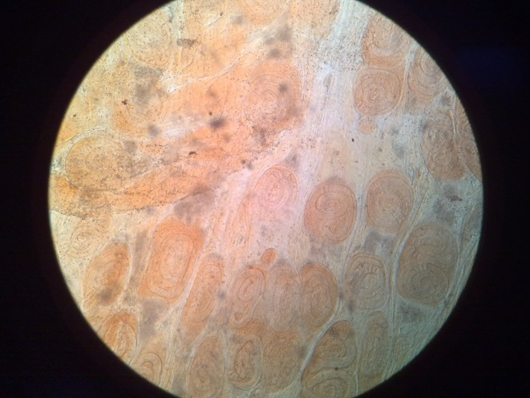
Trichinella spiralis in muscle

Slide 11
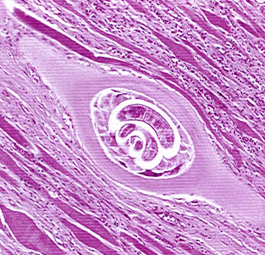
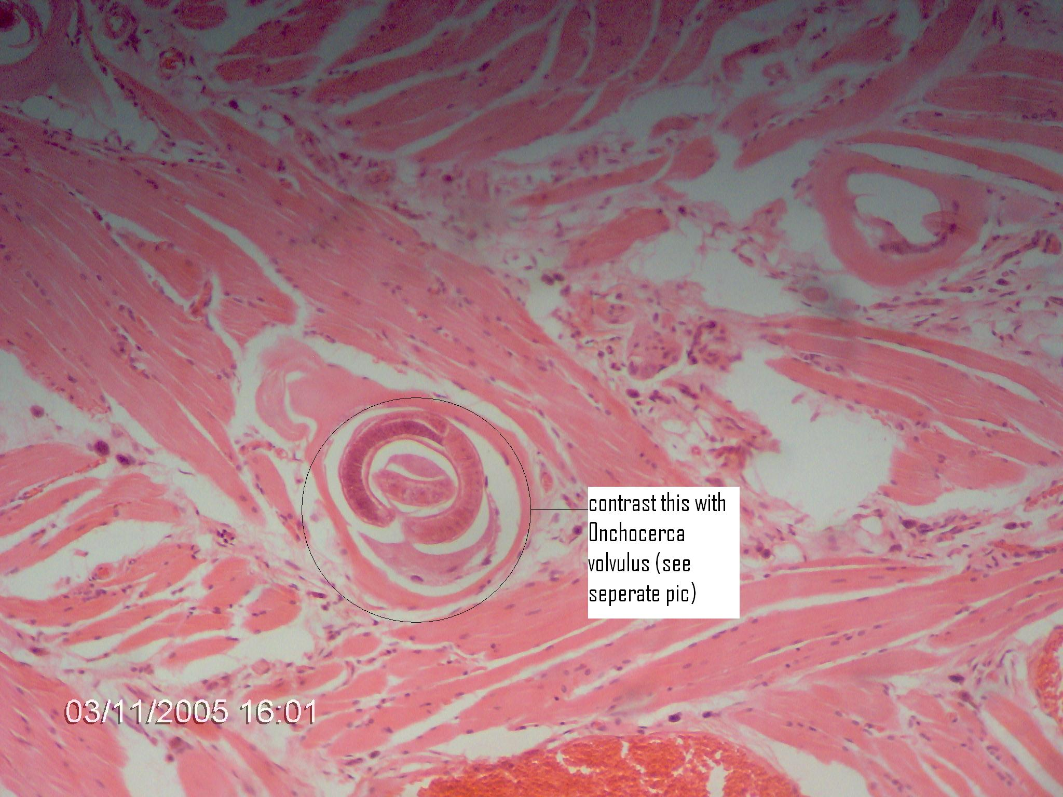

Slide 12
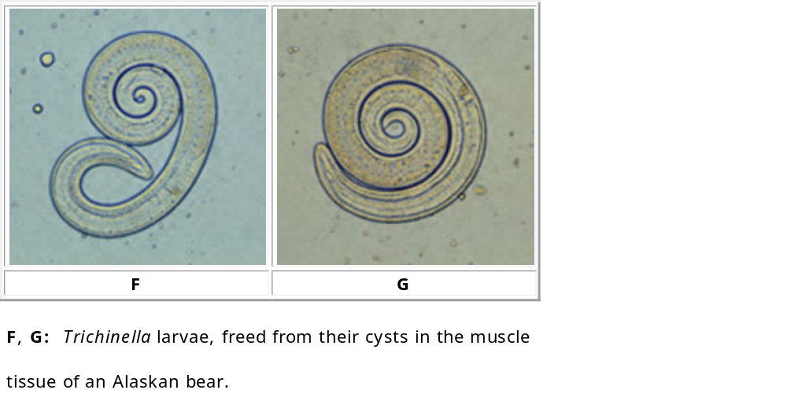
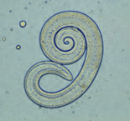

Slide 13
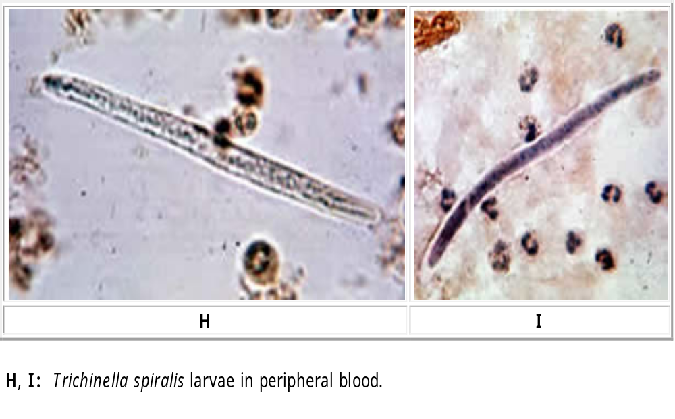

Slide 14
LIFE CYCLE
Trichinellosis is acquired by ingesting meat containing cysts (encysted larvae) of Trichinella.
After exposure to digestive enzymes, gastric acid and pepsin, the larvae are released from the cysts
They invade the small intestine (upper two thirds) mucosa and develop into adult worms. Life span in the small bowel: 4 weeks.
After 1 week, the females release larvae
Larvae migrates to striated muscles where they encyst. Trichinella pseudospiralis, however, doesn’t encyst. Encystment is completed in 4 to 5 weeks and encysted larvae remain viable for several years. Ingestion of the encysted larvae perpetuates the cycle.

Slide 15
Rats and rodents are primarily responsible for maintaining the endemicity of this infection.
  Carnivorous/omnivorous animals, such as pigs or bears, feed on infected rats or meat from other animals or by nipping of each other tails or ears
Humans are infected when eating undercooked infected pork
Reservoirs – Rats, pigs, and wild animals such as wolf, seals, bears and polar bears in the Arctic, and warthogs, hyenas, jackals, lions, and leopards in the Tropics

Slide 16
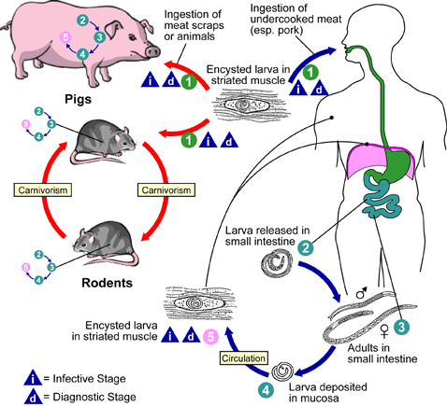

Slide 17
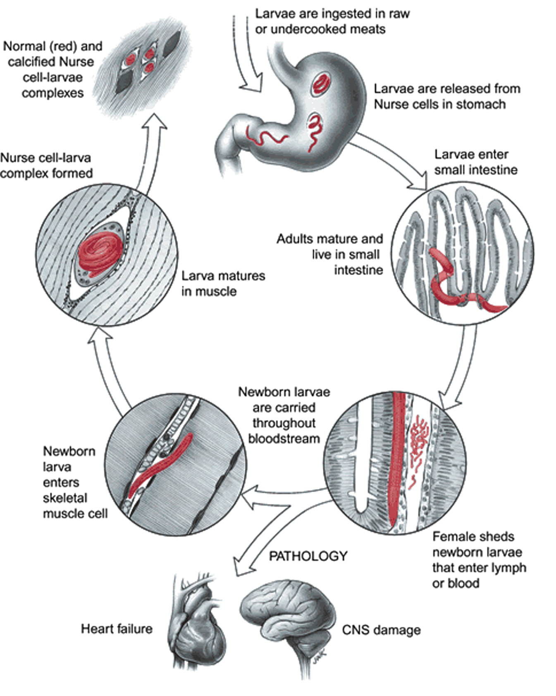

Slide 18
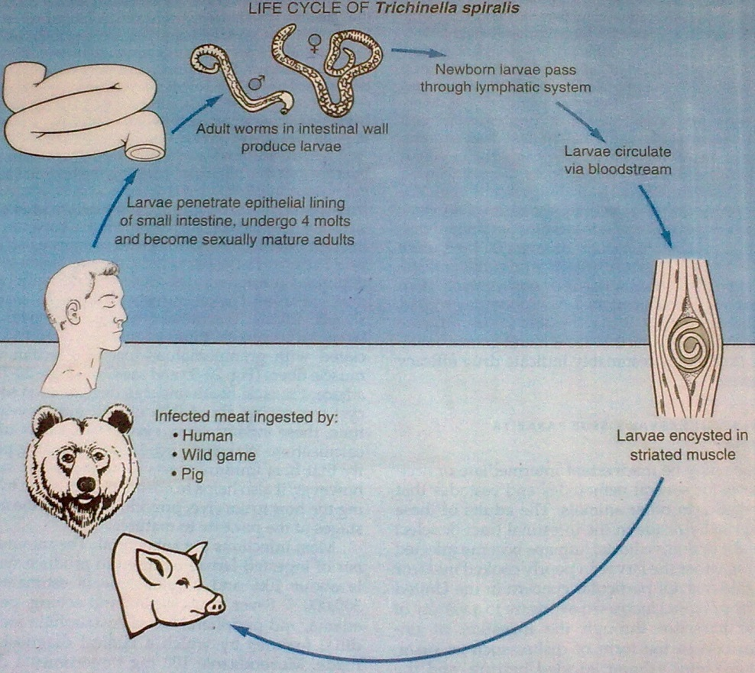

Slide 19
Pathology
The immature parasites penetrate the columnar epithelium at the base of the villus. They live within a row of these cells, and are considered intra-multi-cellular organisms
Eventually, acquired, protective responses interfere with the overall process of embryogenesis and creates physiological conditions in the local area of infection which forces the adult parasites to egress and relocate further down the intestinal tract.
Expulsion of worms from the host is the final expression of immunity, and may take several weeks.

Slide 20
The newborn larva is the only stage of the parasite that possesses a sword-like stylet, located in its oral cavity.
It uses it to create an entry hole in potential host cells. Larvae enter the lamina propria in this fashion, and penetrate into either the mesenteric lymphatics or into the bloodstream.
Most newborn larvae enter the general circulation, and become distributed throughout the body.
Migrating newborns leave capillaries and enter cells.
There appears to be no tropism for any particular cell type. Once inside, they can either remain or leave, depending upon environmental cues received by the parasite.
Most cell types die as the result of invasion.
Skeletal muscle cells are the only exception.

Slide 21
Not only do the parasites remain inside them after invasion, they induce a remarkable series of changes, causing the fully differentiated muscle cell to transform into one that supports the growth and development of the larva.
This process is termed Nurse cell formation. Parasite and host cell develop in a coordinated fashion. T. spiralis is infective by the 14th day of infection, but the worm continues to grow in size through day 20.
The significance of this precocious behavior has yet to be appreciated.
Parasites inside cells other than striated muscle cells fail to induce Nurse cells, and either reenter the general circulation or die.
Nurse cell formation results in an intimate and permanent association between the worm and its intracellular niche.

Slide 22
At the cellular level, myofilaments and other related muscle cell components become replaced over a 14-16 day period by whorls of smooth membranes and clusters of dysfunctional mitochondria.
The net result is that th
e host cell switches from an aerobic to an anaerobic metabolism. Host cell nuclei enlarge and divide, amplifying the host’s genome within the Nurse cell cytoplasm.
The Nurse cell-parasite complex can live for as long as the host remains alive.
Most do not, and are calcified within several months after forming.
In order for the life cycle to continue, an infected host must die and be eaten by another mammal.
Scavenging is a common behavior among most wild mammals, and this helps to ensure the maintenance of T. spiralis and its relatives in their respective host species.

Slide 23
Clinical Features:
Incubation period is 10-14 days
Light infections may be asymptomatic.
Intestinal invasion can be accompanied by gastrointestinal symptoms (diarrhea, abdominal pain, vomiting).
Larval migration into muscle tissues (one week after infection) can cause oedema of the upper eye lid, subconjuctival hemorrhage, photophobia, diarrhea, muscle pain, generalized weakness and fever, myalgias, splinter hemorrhages, rashes, and blood eosinophilia.
Complication; cardiac failure when heart muscle affected, resp. failure when diaphragm affected, meningitis when meninges affected, meningoencephalitis, fits and coma in very heavy infections. (Larvae go the brain and cause these complications), very severe infections and pneumonitis.

Slide 24
Laboratory Diagnosis:
Muscle biopsy / autopsy - one will see encapsulated larvae
Serology; ELISA (Enzyme Linked Immuno Solvent Assay), CFT (Compliment Fixation Test), IHA (Indirect Hemaglutination Assay)
Ab assays (Enzyme immunoassay)(EIA)
Microscopy (histology) for larvae
Blood eisinophilia test and antibody detection
X-Ray; one can see some calcified lesions in the muscle

Slide 25
Definitive diagnosis depends upon finding the Nurse cell-parasite complex in muscle biopsy by microscopic examination
Detection of Trichinella–specific DNA by PCR.33 PCR is very sensitive and specific for detecting small numbers of larvae in muscle tissue, but due to the infrequency of request and the costs associated with maintaining such a capability, PCR is usually prohibitive for most hospital laboratories. This will undoubtedly change in the near future, as more and more parasitic infections become diagnosed routinely by PCR-based methods.
Muscle biopsy can be negative, even in the heaviest of infections, due to sampling errors. In addition, the larvae may be at an early stage of their development, making them inconspicuous, even to experienced pathologists.
Muscle enzymes, such as creatine phosphokinase (CPK) and lactic dehydrogenase (LDH), are released into the circulation causing an increase in their serum levels. Serological tests begin to show positive results within two weeks. ELISA can detect antibodies in some patients as early as 12 days after infection.37

Slide 26
Prevention and control
To minimize the chances of infection, meat must be cooked at 77°C throughout to kill all larvae that may be present. Microwave ovens do not uniformly cook meat and as a result may not kill the parasite.
Freezing of meat less than 6 inches thick if to be eaten raw (-25ºC for 7 days) though NOT a reliable way of killing Trichinella roundworms.

Slide 27
Treatment of trichinellosis should begin as soon as possible
Swine Mx:
  Strict garbage feeding regulation
  Stringent rat control
  Avoidance of exposure of pigs to carcasses (other dead pigs)
  Proper disposal of pig & carcasses (burial/incineration)
  Effective barrier between pig & wildlife
  Proper inspection of pork products
  Surveillance & Dx of trichinosis infected pigs
  Education of farmers/hunters/meat processors

Slide 28
Cook meat, especially pork, bear, walrus, and wild pig thoroughly (to an internal temperature of 170°F).
Cook all meat fed to pigs and other animals and do not allow pigs to eat carcasses of infected rats.
Clean all tools used to prepare meat.
You CANNOT rely on salting, drying, smoking or microwaving to kill the encysted worms

Slide 29
Treatment:
Treatment of trichinellosis should begin as soon as possible and the decision to treat is based upon symptoms, exposure to raw or undercooked meat, and laboratory test results.
Albendazole, mebendazole, thiabendazole; useful in early stages of infection
Steroids are used for infections with severe symptoms to reduce pain and inflammation, coz they later stages of the larvae will just die off (calcification).

