Slide 1
Sleep and Sleep Disorders by RaeAnnon Fairlie
[Sleep is] the golden chain that ties health and our bodies together.
  Thomas Dekker
  English dramatist (1572 - 1632)

Slide 2
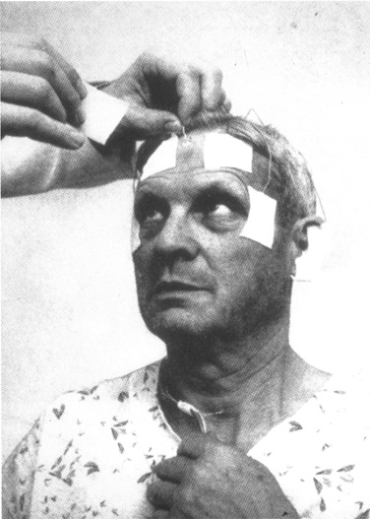
A Brief History of Sleep Research
1913, Henri Pieron wrote “Le probleme physiologique du sommeil”
Nathaniel Kleitman regarded as the father of American sleep research
His crucial work included studies of sleep characteristics in different populations and the effects of sleep deprivation
In 1953, along with one of his students, Eugene Aserinsky, discovered REM during sleep

Slide 3
A Brief History of Sleep Research
William C. Dement, another of Kleitman’s students, described the cyclical nature of sleep in 1955
Published a paper in 1958 that created an explosion of fundamental research that led Michel Jouvet to identify REM sleep as an independent state of alertness

Slide 4
Physiology of the Sleep Cycles
Waking Stage
When the body prepares to rest
Stage I
50% reduction in activity
May last for 5-10 minutes
Stage II
Polysomnographic readings show positive and negative waves where there are spontaneous periods of muscle tone mixed with periods of muscle relaxation

Slide 5
Physiology of the Sleep Cycles
Stage III and IV
These stages are known as the deep sleep stages
Slow-wave or delta waves appear, signaling deep sleep
The period of stages I-IV is known as non-REM or NREM sleep
These stages last from 90-120 minutes with each stage lasting from 5-15 minutes

Slide 6
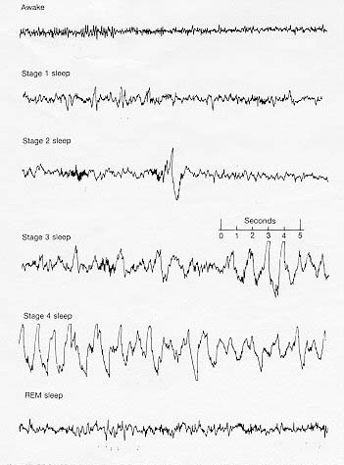

Slide 7
Physiology of Sleep Cycles
Stage V
When REM sleep occurs there is an increase in heart rate and respiration
Face, fingers, and legs may twitch
Due to high cerebral activity, intense dreaming occurs in this stage
REM sleep is also called paradoxical sleep because the brain is in excitation mode while the muscles are immobilized
The first cycle is completed after the first REM stage
Each cycle becomes longer as the REM stage extends so a person may go through as many as 5 cycles a night

Slide 8
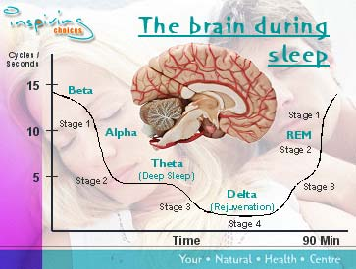

Slide 9
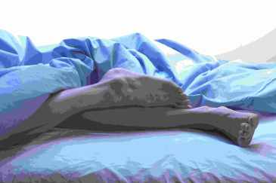
Restless Legs Syndrome

Slide 10
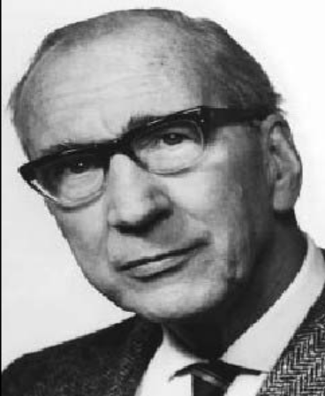
Brief History
The term was first introduced in 1945 by Karl-Axel Ekbom
A common movment disorder with sensorimotor symptoms that are felt during quiet wakefulness and getting to sleep
Earliest description of this disease was in 1672 by Thomas Willis, an English physician

Slide 11
Prevalence
Before 1995, Ekbom estimated that 5% of the general population was affected by this disorder
Since then, studies have improved and suggested that the prevalence is from 5-15% in the white population

Slide 12
Possible Causes
Iron deficiency anaemia
43% of patients with iron deficiency may have RLS
Studies have shown reduced CSF ferritin and raised transferrin levels in idiopathic RLS, suggesting a low brain iron content (Earley et al. 2000)
Using MRIs in five RLS patients, it was reported that iron concentration was significantly lower in the putamen and substantia nigra
There is some evidence to suggest that serum iron levels have a drop up to 50% at night when symptoms are most obvious (Garcia-Borreguero et al. 2002)

Slide 13
Possible Causes
During pregnancy, RLS has been reported in 11-27% of women, usually during the third trimester (Goodman et al. 1988)
However, RLS often resolves following delivery
20-57% of renal dialysis patients have RLS
May also be associated with hypothyroidism and diabetes mellitus.
RLS has also been reported in up to 25% of patients with rheumatoid arthritis and Sjogren’s syndrome

Slide 14
Pathophysiology
The underlying cause of RLS during sleep is not known, although the most likely would be central dopaminergic or opioid dysfunction
The dysfunction of the dopaminergic and/or dopamine linked premotor circuits and the hypothalamic A11 dopamine cells which converge and descend on the spinal flexor reflexes, disinhibit as a result
The final common pathway is influenced by other supraspinal influences such as the reticulospinal, opioid, and monoamine pathways.

Slide 15
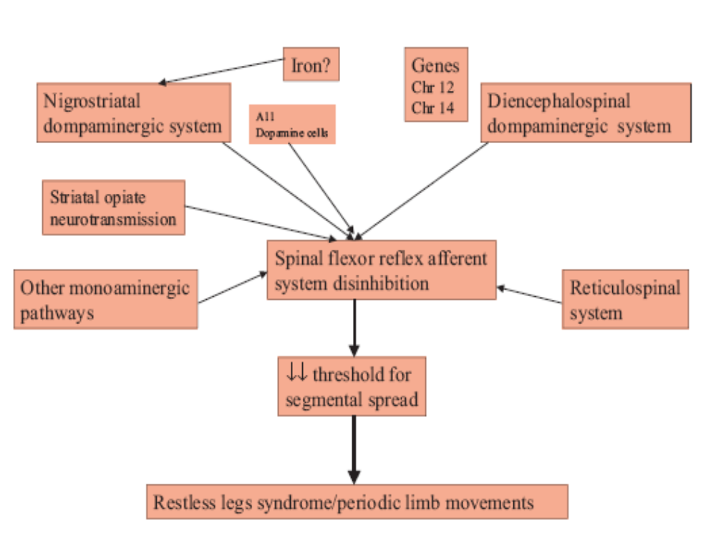

Slide 16
Criteria for Diagnosis of RLS
Urge to move the limbs
Usually associated with para/dysaesthesia
Symptoms worse or exclusively present at rest
Partial/temporary relief with activity
Symptoms become worse in the evening or at night
Dopaminergic drug responsiveness
Periodic limb movements during sleep
Positive family history

Slide 17
Symptoms Described by Patients
Like an electric current
Crazy legs
Like Coca-Cola bubbling through my veins
Aching in my bones
Pulling
Tearing
Throbbing
Creepy crawly
Pain/Growing Pains
Itching Bones

Slide 18
Treatment for RLS
In many patients simply giving advice on sleep hygiene and avoidance of stimulants or aggravating drugs at night is enough
In iron deficient patients, iron supplements should be tried first
Activities such as: walking and stretching, hot or cold bath, relaxation exercises, engaging in discussion or activities during sitting, or massaging the limbs may help during an attack

Slide 19
Treatment for RLS
Levodopa has been suggested to reduce the effects consistently, but there are adverse side effects
Opiates such as oxycodone and propoxyphene have been shown to diminish effects
Iron supplements, adrenergic drugs, anti-epileptic drugs, etc.

Slide 20
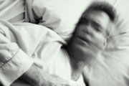
Insomnia

Slide 21
Prevalence
Is a very common sleep disorder that affects approximately 10% of the adult population on a chronic basis
More common among women and older adults
Insomnia can also be associated with chronic pain and psychological disorders such as anxiety or depression
If left untreated, insomnia could lead to major depression
Less than 15% of individuals affected by this disorder receive any treatment

Slide 22
Possible Causes
Most common cause is stress, and insomnia can hit at the most inopportune times in one’s life
The environment one is sleeping in
Excessive napping during the day
Too much caffeine, nicotine, or alcohol before bed
Excessive neural activity and chemical imbalances could also be a factor such as high levels of cortisol and other stress hormones
Psychological disorders such as anxiety, depression, and bipolar disorder can cause insomnia

Slide 23
Symptoms
Individual may fall into a deep sleep for the first few hours and then wake up after about 2 or 3 hours
Person will toss and turn, think and worry about unimportant details, or listens to every sound
Problems falling back asleep even though one is very tired
Feeling sleepy during the day
Having poor and slow judgement
Inability to remember things
Easily irritated

Slide 24
Other Forms and Types of Insomnia
Difficulty falling asleep
Waking up too early
Not feeling refreshed after waking up
Transient
Short-term
Chronic

Slide 25
Treatment for Insomnia
Tips for getting a better night’s sleep:
Avoid or limit use of caffeine, alcohol, tobacco, and/or cold medicines before bed
Exercise more often, but not within a few hours of going to bed
Learn to reduce or manage stress in life
Try eating a light snack before going to bed
Don’t nap during the day if it makes symptoms worse
About 15% of chronic insomniacs need medical treatment

Slide 26
Treatment for Insomnia
Prescription drugs include:
Nefazodone (Serzone)
Chloral hydrate
Barbiturates (Seconal, Nembutal)
However, this treatment can be very dangerous if an overdose occurs and addiction and abuse are common with this drug

Slide 27
Thank You!!

Slide 28
References
Sleep Stages. (1998). Retrieved December 5, 2005, from http://www.sleepdisorderchannel.net/stages/
A Brief History of Sleep Research. (1999, February 3). Retrieved December 5, 2005, from http://www.stanford.edu/~dement/history.html
Sleep 4 Health. (2003). Retrieved December 3, 2005, from http://www.sleep4health.com.au/sleep.asp
Chaudhuri, K. Ray. (2003). The Restless Legs Syndrome: Time to Recognize a Very Common Movement Disorder. Practical Neurology, 4, 204-213. Retrieved December 5, 2005, from EBSCOhost.
Insomnia-The Effects, Symptoms, and Treatment. Retrieved December 5, 2005, from http://miscarriage.homestead.com/insomnia.html
Information of Insomnia-Symptoms, Causes, Treatments. (2002). Retrieved December 4, 2005, from http://scsc.essortment.com/insomniasymptom_roqy.htm
What Are Drug Treatments for Insomnia? (2002, June 30). Retrieved December 5, 2005, from http://www.umm.edu/patiented/articles/what_drug_treatments_insomnia_000 027_8.htm

