Slide 1
HIV and The Lung
Dr. Loice Achieng

Slide 2

Outline
Stages of Untreated HIV Infection
Opportunistic Infections- General
  Definition
  Risk based on CD4
Pulmonary problems in HIV
  Infections
  Malignancies
  Others
2

Slide 3
Stages of Untreated HIV Infection Review
HIV Transmission
    2-3 wks
Acute Retroviral Syndrome
    2-3 wks
    Recovery and Seroconversion
    2-4 wks
Asymptomatic HIV Infection
    Avg 8 yrs to >30 years (EC), <2 years (RP)
Symptomatic HIV/ AIDS
    1.3 yrs
    Death
3
Notes:
Rapid progressor, LTNP, EC, VC
CD4<350- diagnosis in U.S and Canada

Slide 4
In patients with AIDS, what is death usually from?
Notes:
What is an opportunistic infection

Slide 5
Opportunistic Infections
Definition:
  An infection caused by a pathogen which does not usually cause disease in healthy hosts.The pathogen takes advantage of the opportunity to infect the host with a compromised immune system
  Can also be atypical presentation or more severe clinical manifestations of a disease which can also infect healthy hosts
Notes:
Death is usually from OIs

Slide 6
How does HIV predispose to OIs?
HIV infects the CD4 cells and uses them to replicate into more viruses
CD4 cells are destroyed and replenished at a rate of 2 X 10⁹ cells/day, eventually capacity is lost and depletion occurs
  Increased destruction
  Direct infection
  Apoptosis
  Lymphocyte turnover
  Decreased production
  Redistribution
Without sufficient numbers of functioning CD4s, cellular immunity decreases, as well as interactions with humoral and cytotoxic immunity

Slide 7
What is the relationship between CD4 and OIs?

Slide 8
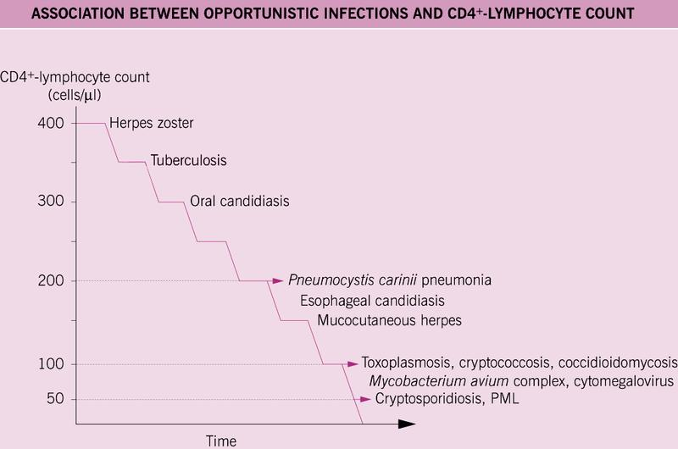
Continuum of risk of OIs in relation to CD4
OIs can occur above their CD4 threshold rarely
Although CD4 is the most important predictor of OI risk, increasing VL is also a risk (esp when CD4>300)
Notes:
Used to think only cd4 was correlated to Ois, but now know that uncontrolled Viral replication also increases the risk for Ois
Several recent trials have shown increased risk of OIs in patients with intermittent treatment interruption of HAART.
These trials confirm that there is a continuum of risk of OIs in relation to CD4 count.
OIs can occur above their CD4 thresholds, but rarely.
Although CD4 cell count is the most important predictor of OI risk, increasing viral load is also a risk, especially when CD4 count is relatively high (300 cells/uL range).

Slide 9
How do we classify OIs?
Microbiology
Clinical presentation
Level of immune deficiency

Slide 10
Classification of OIs: Microbiology
  Bacterial : tuberculosis, MAC, bacterial pneumonia and septicemia
  Fungal : candidiasis, pneumocystis jiroveci pneumonia (PCP), cryptococcosis, aspergillosis
  Viral : cytomegalovirus, herpes simplex virus, varicella-zoster virus, JC virus
  Parasitic : toxoplasmosis, cryptosporidium, microsporidium, leishmania

Slide 11
Classification: Clinical
  Brain: Cryptococcus, Toxoplasmosis, Lymphoma, Progressive multifocal leukoencephalopathy(PML), Cytomegalovirus (CMV), HIV-associated dementia
  Eye: CMV, Varicella zoster virus (VZV)
  Mouth: Herpes simplex virus (HSV), Candida
  Lungs: Pneumocystis jirovecii (PCP), Tuberculosis, bacterial pneumonia, fungal pneumonia
  Gut: Mycobacterium avium complex (MAC), CMV, Salmonella Cryptosporidium, Microsporidia
  Bone marrow: TB, MAC, histoplasmosis, leishmania
  Skin: HSV, VZV, mucocutaneous manifestations, pyogenic infections
  Genitals: HSV, Human papilloma virus, Candida

Slide 12
Classification: Immunosuppression
CD4 >500
Candida vaginitis, pulmonary TB, Streptococcus pneumoniae
CD4: 200-500
Pneumococcal disease, herpes simplex virus, varicella zoster virus, pulmonary TB, Kaposi’s sarcoma, thrush
CD4 <200
Pneumocystis jirovecii, miliary and extra-pulmonary TB, non-Hodgkin’s lymphoma, disseminated histoplasmosis, recurrent bacterial disease
CD4<100
Toxoplasmosis, Cryptococcosis, chronic cryptosporidiosis, microsporidiosis, candidal eosophagitis
CD4<50
Cytomegalovirus (CMV), Mycobacterium avium complex (MAC), CNS lymphoma, Progressive multifocal leukoencephalopathy (PML).

Slide 14
Pulmonary OIs
Common Pulmonary OIs in Developing world
Bacterial pneumonia – Lobar pneumoina
Pneumocystis jirovecii pneumonia
Tuberculosis
Kaposi Sarcoma
Uncommon Pulmonary OIs
Histoplasmosis
Penicillium
Coccidiomycosis
Mycobacterium Avium

Slide 15
Pneumocystis jiroveci pneumonia (PCP)
Causative organism
  Fungus (NOT a protozoa)
  Caused by P jiroveci (formerly P carinii- rodents)
  Ubiquitous in the environment
  Initial infection usually occurs in early childhood
  PCP may result from reactivation or new exposure
  In immunosuppressed patients, possible airborne spread
Prior to ART
  Occurred in 70-80% of patients with AIDS
  Treated cases with mortality of 20-40% with AIDS
  90% of cases among patients with CD4<200
Notes:
PCP is a common opportunistic disease that occurs almost exclusively in persons who have profound immunodeficiency.(1) In immunocompetent hosts, infection probably occurs but the individual is asymptomatic, presumably because of the organism's low virulence. Serologic studies have shown that 65-100% of children have antibodies to P jiroveci by the time they are 2-4 years of age
Although the causative agent of pneumocystosis was long considered a protozoan, studies of ribosomal RNA from the organism have shown greater homology with fungi.(34-36) In 2001, P carinii was officially reclassified as a fungus and was renamed P jiroveci.(17,37) Despite the name change, the disease is still referred to as PCP (Pneumocystis pneumonia). Such a reclassification has no immediate clinical importance, but it may suggest new therapeutic approaches.
P jiroveci has both intracystic and extracystic forms.(38) The cysts are oval or round, approximately 5-8 µm in diameter, and contain 4 to 8 intracystic organisms (sporozoites). The sporozoites are nucleated and measure approximately 1-2 µm in diameter. The extracystic form (trophozoite) measures 2-5 µm in diameter. It is pleomorphic and often has an eccentric nucleus.

Slide 16
PCP Risk Factors
Risk factors:
CD4 count <200 cells/µL
CD4% <14%
Prior PCP
Oral thrush
Recurrent bacterial pneumonia
Unintentional weight loss
High HIV RNA
16

Slide 17
Clinical Manifestations
Progressive exertional dyspnea, fever (can be predominant symptom), nonproductive cough, chest discomfort
Subacute onset, worsens over days-weeks (fulminant pneumonia is uncommon)
Oxygen desaturation with exercise
Chest exam may be normal (early disease), or diffuse dry rales, tachypnea, tachycardia (especially with exertion), hypoxia, fever
Extrapulmonary disease seen rarely; occurs in any organ, associated with aerosolized pentamidine prophylaxis
Notes:
Because of the diverse presentations of PCP and the lack of pathognomonic physical findings for this disease, patients often do not appear with a "classic" presentation. Typically, however, patients present with fever, dry cough, and shortness of breath or dyspnea on exertion, often of gradual onset and progression over several weeks. Chest findings may include diffuse dry rales, but often are minimal even in advanced pneumonitis. Bullous disease or pneumothorax may lead to decreased or absent breath sounds over the affected lung fields. Cough is either nonproductive or produces thin, clear mucus (although concurrent sinusitis may occasionally lead to purulent sputum in the setting of PCP). Rarely, hemoptysis occurs as a presenting symptom of PCP.(44)
In HIV-infected patients, the clinical presentation is often insidious, with slow but steady progression of fatigue, fever, chills, sweats, and exertional dyspnea.(45-48) In severe cases, tachypnea may be pronounced, and patients may be so dyspneic that they are unable to speak without stopping to rest. Circumoral, acral, and mucous membrane cyanosis may be evident.

Slide 18
Diagnosis
Clinical presentation, blood tests, radiographs suggestive but not diagnostic
  Organism cannot be cultured
Hypoxemia: characteristic, may be mild or severe (PO₂ <70 mmHg or A-a gradient >35 mmHg)
LDH >500 mg/dL is common but nonspecific
Sputum:
  Induced sputum (sensitivity <50% to >90%)
    Spontaneously expectorated sputum: low sensitivity
  Bronchoscopy with bronchoalveolar lavage (sensitivity 90-99%)
  Transbronchial biopsy (sensitivity 95-100%)
  Open-lung biopsy (sensitivity 95-100%)
Cant be done in resource limited settings so diagnosis is made clinically
Notes:
A diffuse interstitial infiltrate is typical on chest x-ray, but this finding is neither sensitive nor specific for PCP. A case series of 279 patients with respiratory symptoms and risk factors for HIV infection identified PCP in only 31 (11%). Four independent predictors of PCP were identified: presence of diffuse or perihilar infiltrates, presence of thrush or hairy leukoplakia, a lactate dehydrogenase (LDH) level higher than 220 IU, and an erythrocyte sedimentation rate (ESR) >=50 mm/hour.(49) Patients with diffuse perihilar infiltrates had an 84% probability of having PCP, but those with other chest radiographic findings and 2 of the 3 other markers still had an appreciable probability (47%) of having PCP.
although serum LDH concentration is a nonspecific indicator of lung parenchymal damage and thus is of limited diagnostic use, it may serve as a prognostic indicator in PCP.

Slide 19
PCP
CXR: various presentations
  May be normal in early disease
  Typical: diffuse bilateral, symmetrical interstitial perihilar infiltrates (butterfly appearance)
  May see atypical presentations, including nodules, asymmetric disease, blebs, cysts, pneumothorax
  Cavitation, intrathoracic adenopathy, and pleural effusion are uncommon (unless caused by a second concurrent process)

Slide 20
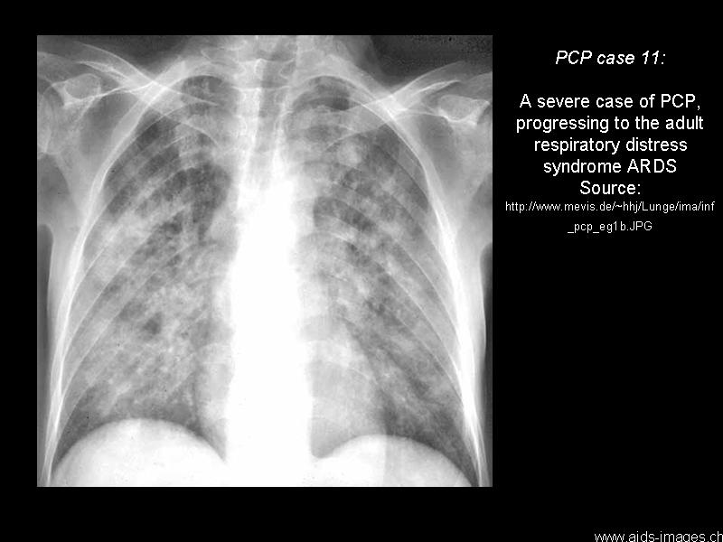
Notes:
Caption/Legend:
PCP, case 11A severe case of PCP, progressing to the adult respiratory distress syndrome (ARDS).

Slide 21
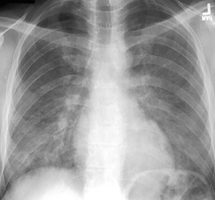
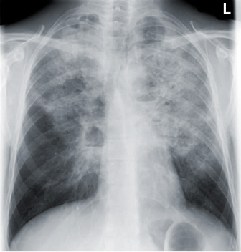
PCP: Diagnosis (Imaging)
Chest X ray: PCP with bilateral, diffuse granular opacities
Credit: L. Huang, MD, HIV InSite
Chest X ray: PCP with bilateral perihilar opacities, interstitial prominence, hyperlucent cystic lesions
Credit: HIV Web Study, www.hivwebstudy. org, © 2006 University of Washington
21
Notes:
Typical chest X-ray:
Bilateral interstitial perihilar infiltrates (butterfly)
Sometimes chest X-ray is normal
Chest CT, thin-section
Patchy ground-glass attenuation
May be normal
Mortality is very high if not treated

Slide 22
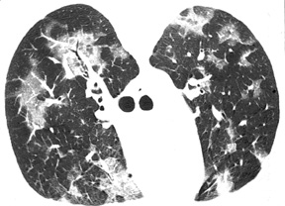
PCP: Diagnosis
High-resolution computed tomograph (HRCT) scan of the chest showing PCP. Bilateral patchy areas of ground glass opacity are suggestive of PCP.
Credit: L. Huang, MD, HIV InSite
22

Slide 23
First-line Treatment of PCP
Treatment:
  Treat for 21 days
  Treat with TMP-SMX 15 mg/kg/day divide in 3 doses
    oral dose is 2 DS tabs TID
  If severe disease with hypoxemia (PO2<70, A-a gradient >35, or patient very hypoxic, or with large drop in pulse ox)
    Add prednisone 40 mg po BID x 5 days, 40 mg po QD x 5 days, then 20 mg po QD x 11 days
  Clinical response noted in 5-7 days
Notes:
Mortality is very high if not treated

Slide 24
Bacterial Pneumonia
Organisms:
S pneumoniae
  Drug-resistant strains are increasingly common in the developed world
H influenzae
P aeruginosa
S aureus
Atypicals (less common)
No identified organism in up to 33%

Slide 25
Bacterial Pneumonia: Clinical Manifestations
Presentation similar to that of HIV uninfected, with acute symptoms
  Subacute illness suggests alternative diagnosis (PCP, TB, chronic fungal disease, etc)
Physical exam: evidence of focal consolidation or pleural effusion
WBC usually elevated

Slide 26
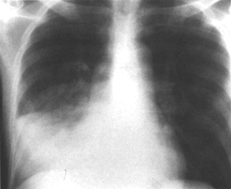
Bacterial Pneumonia: Diagnosis
Chest X ray:
  Commonly shows focal, segmental, or lobar consolidation, but may show atypical presentations (multilobar, nodular, reticulonodular)
Chest X ray: pneumococcal pneumonia showing right middle lobe consolidation
Credit: C. Daley, MD, HIV InSite

Slide 27
Bacterial Pneumonia: Diagnosis
Routine testing to identify specific pathogen is controversial
  Gram stain and culture of expectorated sputum specimen; 2 blood cultures
  Blood and sputum cultures: low sensitivity but very specific; may influence treatment
  If specific pathogens are suspected, obtain cultures or perform other diagnostic testing
Consider the possibility of TB: if compatible clinical and X ray presentation, manage as potential TB
Evaluate for PCP, if clinically indicated (PCP may coexist with bacterial pneumonia)
Consider diagnostic thoracentesis if pleural effusion

Slide 28
Bacterial Respiratory Infections:
Treatment
Target most common pathogens, particularly S pneumoniae and H influenzae
Treatment principles as for HIV-uninfected patients, and consider disease severity
Treatment should be started empirically while awaiting culture results
If specific pathogen identified, direct antibiotics at pathogen
HIV-infected patients should not receive empiric macrolide monotherapy (risk of macrolide-resistant S pneumoniae)
Fluoroquinolones (FQ) should be used cautiously if TB
is suspected but is not being treated (risk of TB monotherapy)

Slide 29
TB in HIV negative patient
Typical presentation
Cough >3/52
Weight loss and night sweats
CXR showing upper lobe cavitary disease
Smear positive

Slide 30
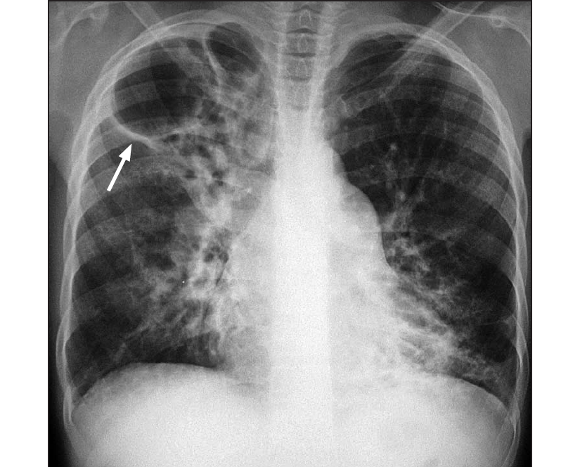

Slide 31
TB in era of HIV
Atypical symptoms (no cough, acute or very long symptoms)
Smears often negative
Disease can occur anywhere in the lung
Cavities are rare with CD4 count below 200
CXR may be negative in as many as 1 in 3 patients
Extrapulmonary TB commom
    Fielder JF. TB in the era of HIV

Slide 32
TB in era of HIV
SA clinic relying on cough missed ½ cases of TB
Of all patients entering the ART clinic who were not already on TB RX, 19% were found to have TB
22% of patients with TB had no symptoms at all
Only 9% of proven TB cases were sputum AFB positive
        Basset I et al. Intensive TB screening for HIV infected patients ready to start ART in Durban, SA: limitations of WHO guidelines. 16th CROI, abstract 779. Montreal 2009

Slide 33
TB in HIV
In HIV negative, 85 % of TB is pulmonary, in HIV positive patients, >50% have extrapulmonary disease
        Rana FS, Hawken MP, Mwachari C, et al. Autopsy study of HIV-1-positive and HIV-1-negative adult medical patients in Nairobi, Kenya. J Acquir ImmuneDefic Syndr 2000;24(1):23-9.
        Sharma SK, Mohan A. Extrapulmonary tuberculosis. Indian J Med Res 2004;120(4):316-53.

Slide 34
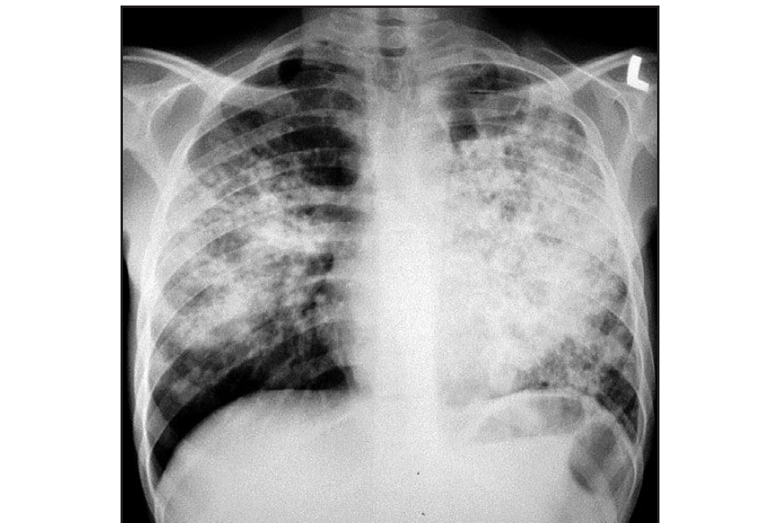

Slide 35
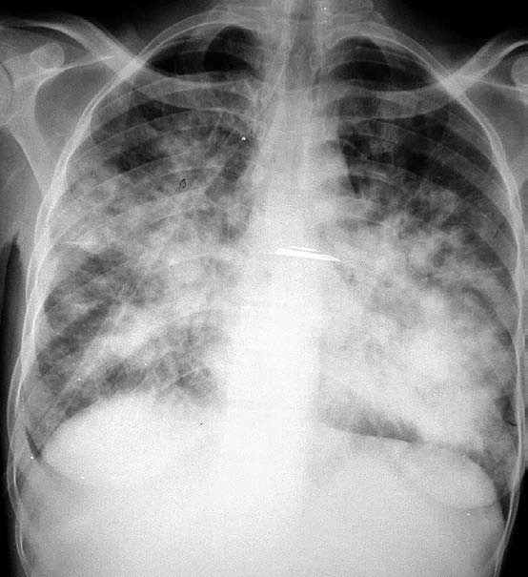

Slide 36
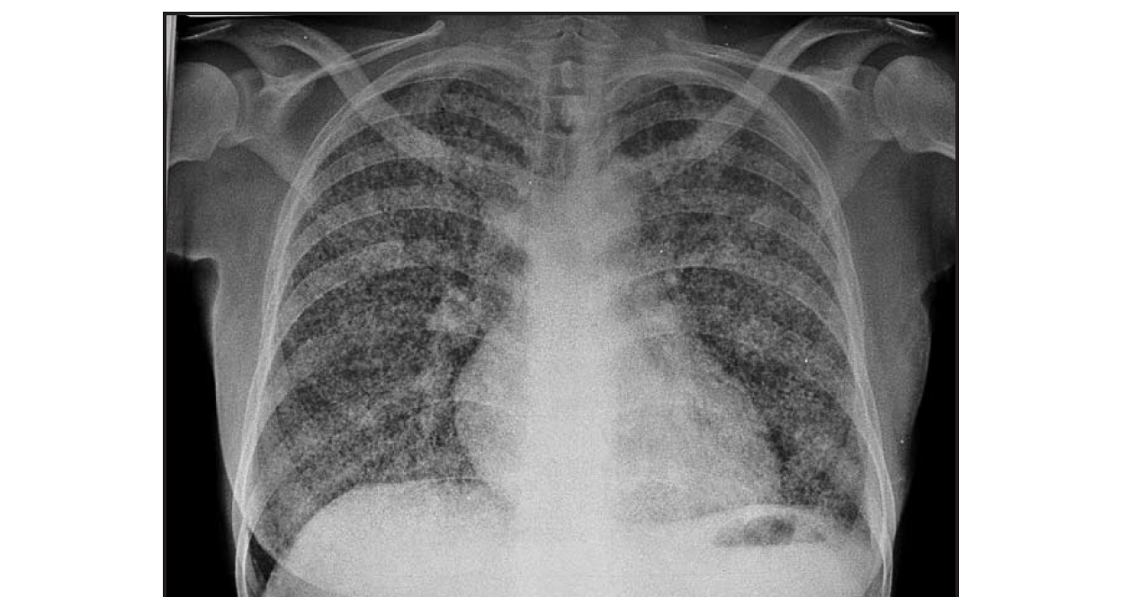

Slide 37
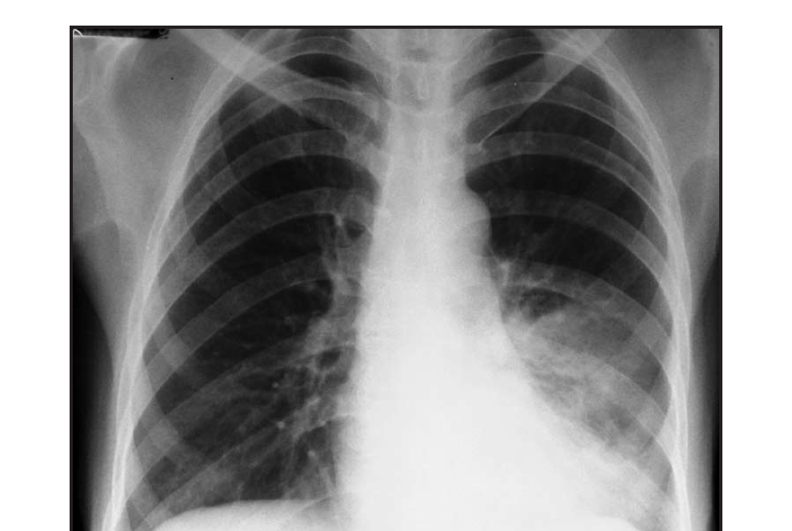

Slide 38
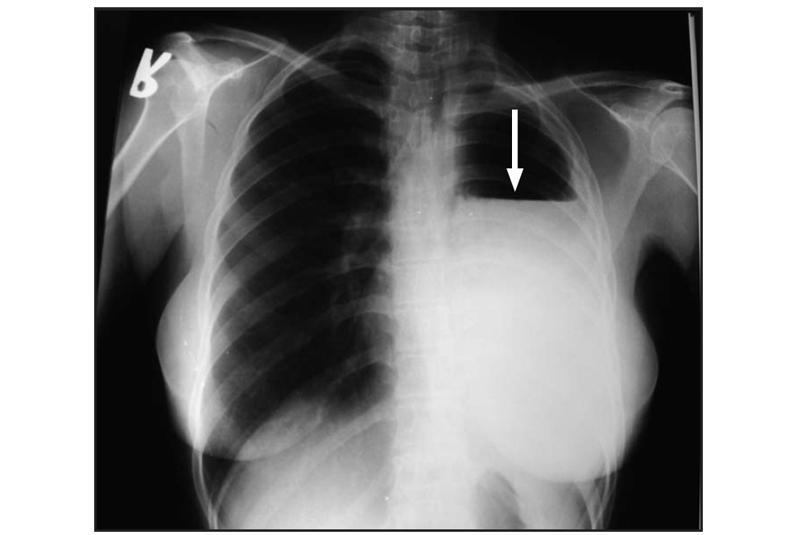

Slide 39
Treatment
Treated as in HIV negative patients
Prophylaxis – Isoniazid prophylaxis has a role in patients in whom TB has been ruled out

Slide 40
Histoplasmosis
Caused by Histoplasma capsulatum
Endemic in midwest United States, Puerto Rico, some parts of Central America, Amazon basin, subSaharan Africa, Asia
Occurs in up to 5% of AIDS patients in endemic areas who are not on ART
In nonendemic areas, usually seen in those who previously lived in endemic area

Slide 41
Histoplasmosis
Acquired by inhalation
Reactivation of latent infection may occur
Disseminated disease usually seen in patients with CD4 count <150 cells/µL
Pulmonary histoplasmosis may occur with CD4 count >300 cells/µL
Incidence has declined with use of potent ART

Slide 42
Histoplasmosis
Disseminated multiorgan disease: fever, fatigue, weight loss, hepatosplenomegaly, lymphadenopathy
  Cough, chest pain, dyspnea in 50%
  Most common in patients with low CD4 count
Isolated pulmonary disease: usually occurs in patients with higher CD4 count
CNS, GI, and skin manifestations possible
  CNS: fever, headache, seizures, focal neurological deficits, altered mental status
  GI: fever, diarrhea, abdominal pain, weight loss

Slide 43
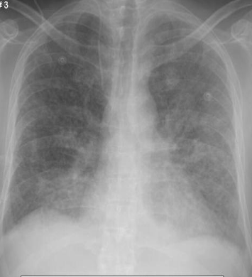
Histoplasmosis: Clinical Manifestations
Acute disseminated histoplasmosis, chest X ray
Credit: Images courtesy AIDS Images Library www.aidsimages.ch

Slide 44
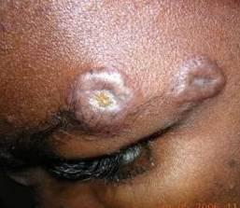
Histoplasmosis: Clinical Manifestations
Skin lesions of histoplasmosis
Credit: Image courtesy AIDS Images Library www.aidsimages.ch

Slide 45
Histoplasmosis Clinical Manifestations
Fever, hepatosplenomegaly, pallor,
also adenopathy, abdominal tenderness
General labs include anemia, leucopenia, LDH>AST>ALT, ferritin often >1,000
Blood smear may reveal intracellular organisms

Slide 46
Histoplasmosis Diagnosis
Detection of Histoplasma antigen in serum or urine
  Sensitive for disseminated histoplasmosis (>85% for serum, >95% for urine Ag test)
  Insensitive for pulmonary infection
Biopsy with histopathologic examination shows characteristic budding yeast
Culture from blood, bone marrow, respiratory secretions, lesions
(>85% sensitive, but may take 2-4 weeks)
Serologic tests usually not useful in immunosuppressed patients

Slide 47
Histoplasmosis Treatment
Disseminated histoplasmosis
Moderate-severe disease
  Induction (2 weeks or until clinically improved):
    Preferred: liposomal amphotericin B 3 mg/kg IV QD
    Alternative:
      Amphotericin B 0.7 mg/kg IV QD
      Amphotericin B lipid complex 5 mg/kg IV QD
  Maintenance: itraconazole 200 mg PO TID for 3 days, then BID (liquid formulation preferred)
Less-severe disease
  Itraconazole 200 mg PO TID for 3 days, then BID (liquid formulation preferred)
Duration of therapy: ≥12 months

Slide 48
Histoplasmosis Prophylaxis
Primary Prophylaxis: Consider if Cd4<150 and residence in endemic region (itraconazole)
Secondary Prophylaxis: 1 year, can be stopped under certain conditions (Tx>12mon, ART >6mon, CD4>150, urine/serum antigen<4.1)

Slide 49
Viral pneumonitis
Cytomegalovirus
Herpes simplex virus
Varicella zoster virus

Slide 50
Malignancies
Kaposis sarcoma
Lymphomas
Primary effusion lymphoma

Slide 51
Others
Lymphocytic interstitial pneumonitis
Non specific interstitial pneumonitis
Pulmonary hypertension

Slide 52
HIV and host lung defenses
Progressive HIV infection decreases numbers of lung CD4 T cells
Causes intense infiltration of CD8+ T cells in the interstitium and alveolar spaces – lymphocytic alveolitis
Pronounced in patients with early to middle stage disease
Caused by compartmentalization of HIV specific cytotoxic T cells

Slide 53
Summary
Pulmonary manifestations common in HIV infection
Presentation is often atypical
Prompt diagnosis is important
Early HIV diagnosis, initiation of ART and primary prophylaxis of OIs where indicated

