Slide 1

Anxiety and somatoform disorders

Slide 2
WHAT IS ANXIETY?
 SUBJECTIVE EXPERIENCE OF DISCOMFORT IN RESPONSE TO AN ACTUAL OR PERCEIVED THREAT OR LOSS (“STRESSOR”)
 THREAT MAY BE EXTERNAL OR INTERNAL
 ANXIETY MAY PERSIST EVEN AFTER THREAT IS GONE

Slide 3
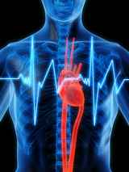
WHAT IS ANXIETY, cont’d
 PERCEPTION OF THREAT DEPENDS ON THE INDIVIDUAL
 SOMATIC COMPONENT: AUTONOMIC (SYMPATHETIC) NERVOUS SYSTEM ACTIVATION

Slide 4
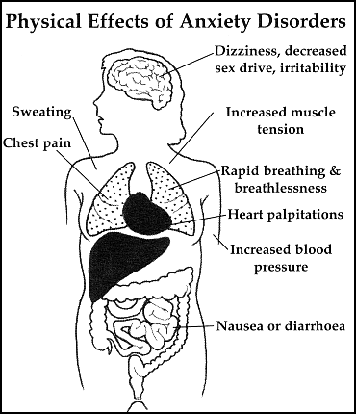

Slide 5
Levels of Anxiety
Mild
Moderate
Severe
Panic

Slide 6

Mild Anxiety
Increased alertness
Broad field of perception
Enhances learning and performance

Slide 7

Moderate Anxiety
Perceptual field narrows
Tunes out stimuli
Focused on one task
Decreased attention span
↓ Problem solving ability

Slide 8

Severe Anxiety
Narrow or distorted perception and cognition
Flight of ideas
Physical symptoms problematic
Behavior directed toward relief of discomfort

Slide 9


Panic
Disorganized and irrational
Overwhelmed, out of control
May become violent, hysterical, or immobilized
“Fight, Flight or Freeze”

Slide 10
Some Guidelines for treatment
Assess level of anxiety via objective, subjective data
Assess client’s coping methods and effectiveness
Planning: can source of client’s stress/anxiety be managed or not?
Client teaching:
  will not be effective if anxiety is severe or panic level
  OK for moderate anxiety if it is simple and step-by-step

Slide 11
ANXIETY DISORDERS
 WHEN ANXIETY INTERFERES WITH FUNCTIONING AND SELF-CARE
MOST ARE CHRONIC, BUT MAY BE IN RESPONSE TO ACUTE SITUATION
CHALLENGING TO TREAT/MANAGE

Slide 12
ANXIETY DISORDERS
⬥ More common than mood disorders 
FIRST EPISODE BY AGE 21.5
CO-OCCURRENCE WITH DEPRESSION AND SUBSTANCE ABUSE
COMMON TO HAVE MORE THAN ONE ANXIETY D/O

Slide 13


UNDERSTANDING ANXIETY: Primary Gain
Internal “advantages” gained from efforts to relieve anxiety
  Physical symptoms
  Obsessions
  Compulsions
  Fears, e.g. cannot drive
  Worry
  Isolation

Slide 14


UNDERSTANDING ANXIETY: Secondary Gain
Attention or benefit obtained from others by having an anxiety-related disorder
Can become more important
than relieving the anxiety
  Decreases motivation to get well
  Others take care of individual
Complicates treatment

Slide 15
Anxiety Disorders
Generalized Anxiety Disorder (GAD)
Panic Disorder
with Agoraphobia
  without Agoraphobia
Phobias

Slide 16
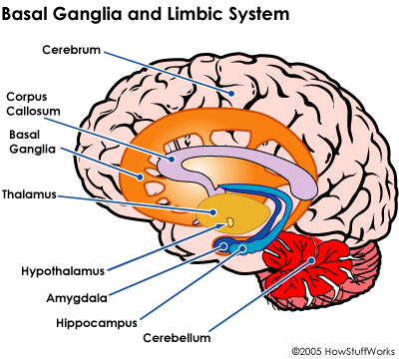
Etiology/Theories of Anxiety Disorders
Biological Theories
  Defects in Brain Chemistry; Person over-responds to stimuli
    Neurotransmitter dysregulation
    Altered # of benzodiazepine receptors

Slide 17
Genetic Theory
  Some disorders clearly run in families: e.g. panic
  Inherited trait for shyness has been discovered

Slide 18
Psychoanalytic/Psychodynamic
Result of conflict between instincts and values
Defense mechanisms are used to manage discomfort that results from anxiety
(see p. 37, Keltner)
  Repression
  Displacement
  Conversion

Slide 19

Interpersonal Theory
Anxiety caused by threat to
self-esteem, security or self-control

Slide 20
Generalized Anxiety Disorder (GAD)
Most common type
Cognitive and physical symptoms
Chronic and excessive worry ( > 6 months)
Worry is habitual, cannot be controlled
Causes impairment

Slide 21

Interventions for GAD
Goal: to assist the client to develop adaptive coping responses
Assess for level of anxiety: moderate to severe
Reduce level of anxiety
Identify and describe feelings
Assist to identify causes of feelings

Slide 22
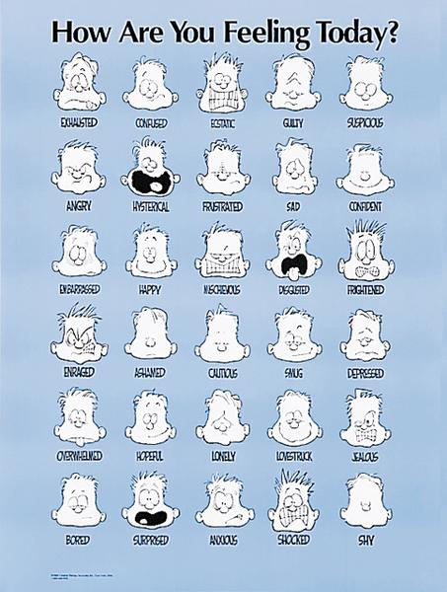

Slide 23
Milieu Management for GAD
Calm environment
Cognitive Behavioral Therapy
  Corrects faulty assumptions
  If you change others will change
Recreational activities
  Relaxation
Groups: assertiveness, expressive arts, etc.

Slide 24
Panic Disorder
  □ Recurring, sudden, intense feelings of
    Apprehension
    Terror
    Impending doom
    Losing control
    Going crazy
Somatic Symptoms
  Heart Attack
  Dying
Recurrent
May or may not be situational
  If situational, will avoid places or situations
Peaks within 10 minutes

Slide 25
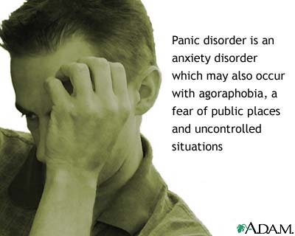

Slide 26
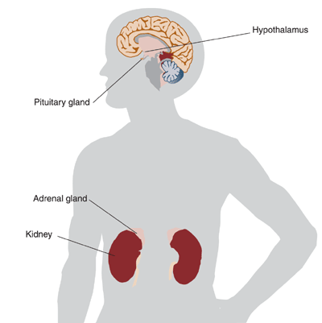

Etiology of Panic Disorder
Psychological
  Life stresses
    Separation, disruption of attachment in childhood
Biological
  Heredity –seen in families
  Interaction of Cognitive with Sympathetic Nervous System & Endocrine responses


Slide 27
Acute Phase of Panic Disorder
Communication: Similar to panic level anxiety, stay with them, reassure that they are safe
Calm environment, ↓ stimulation
Assess for suicidal ideation: 1 in 5 are suicidal
Use touch carefully
PRN Medications: Xanax, Ativan

Slide 28
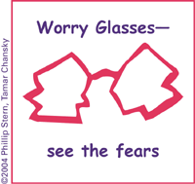
Basic treamant guidelines
Client teaching: improvement often follows
You are not crazy
Recognize and address triggers
Recognize symptoms
Meds. can help

Slide 29
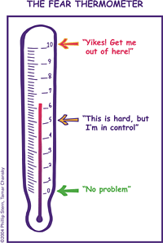
Milieu Outpatient Tx
Relaxation Exercises
  Stretching
  Yoga
  Soft music
Gross motor activities
  Walking
  Jogging
  Basketball
□ Cognitive Restructuring

Slide 30

Critical Thinking!
  A 42 year old married secretary has been coming to the health
  clinic for years, with frequent minor physical complaints, and
  tells the nurse she worries about her family and home so
  much that she cannot sleep at night. She can not specifically
  name anything that is a significant problem with family or
  home, denies marital problems except, “my husband says I
  worry too much.” Increasingly, she fears losing her job due to
  problems concentrating and from constantly calling family on
  her cell phone.
  Can you name some nursing diagnosis labels which are appropriate for her?

Slide 31
Phobias/DSM 5
Marked and specific fear that is excessive and unreasonable cued by the presence or anticipation of object.
Person recognizes fear as unreasonable
Situation or object is avoided

Slide 32

Phobias-Continued
Agoraphobia without Panic Disorder: a fear of being in public places
Social Phobia: fear of being humiliated in public, fear of stumbling while dancing, choking while eating
Specific phobia: fear of a specific object or situation; animals, heights, flying

Slide 33
Treatment for Phobias
Outpatient is most common
Behavior therapy: systematic desensitization; like Fear of Flying groups
Nurse-client relationship and Milieu
  Interventions are very similar to GAD

Slide 34
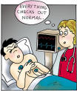
Somatoform Disorders
Anxiety is relieved by developing physical symptoms for which no known organic cause or physiologic mechanism can be determined.
Somatization Disorder
Conversion Disorder
Pain Disorder
Hypochondriasis

Slide 35
Somatoform Disorders: Characteristics
Client expresses psychological conflict through symptoms
Client is not in control of symptoms and complaints
See general practitioners, not mental health professionals
Repression of feelings, conflicts, and unacceptable impulses
Denial of psychological problems
Individuals are dependent and needy
Primary and Secondary gain

Slide 36

Somatization Disorder
Recurrent frequent somatic complaints for years
Complaints change over time
Onset prior to 30 years old
See many physicians
May have unnecessary surgical procedures
Impairment in interpersonal relationships
Etiology
  Chronic emotional abuse
  Unable to verbalize anger

Slide 37

Pain Disorder
Severe Pain in one or more areas
  Significant distress and impairment
  Location or complaint does not change
  Doctor Shoppers
  Pain may allow secondary gain
    Avoidance
      Does not have to go to work
    Pain medication
  When there is a physiologic disorder: amount of pain is out of proportion

Slide 38

Hypochondriasis
Worry they have a serious illness despite no medical evidence
Misinterpretation of bodily symptoms
Check for reassurance from doctors and friends

Slide 39


Conversion Disorder
Suggests a Neurological Condition
  Deficit or alteration in voluntary motor or sensory function
Conflicts, stressors precede symptoms
Symptoms
  Paralysis, blindness, or seizures
May show little concern or anxiety

Slide 40
Clinician-Client Relationship and Management of Somatoform Disorders
Always rule out the physical
Show acceptance and empathy; do not challenge or force insight
Encourage identification, appropriate expression of emotions
Teach adaptive coping e.g. assertiveness skills

Slide 41
Critical Thinking!
A 20 year old army private was brought to the medical unit with
persistent, severe chest pain and weakness. He was scheduled to
deploy to Afghanistan. After days of dx. testing, no physical
cause has yet been found. The treating cardiologist and
neurologist suspect a Somatization Disorder. The client has
developed a trusting relationship with a nurse.
Which statement by the nurse is helpful to this client?
Why or Why Not?
“I notice you were scheduled to go overseas before your illness.
Do you think there is any connection between that and your
symptoms?”

Slide 42
Critical Thinking, cont’d
“ The doctors seem to think there is nothing physically wrong with you. How do you feel about that?”
“Tell me what your strong points are that will help you to
get through this.”

Slide 43

MEDICATIONS FOR ANXIETY

Slide 44
BENZODIAZEPINES (BZDs)
CNS Depressants
Compete for GABA receptors; decrease response of excitatory neurons
Tolerance, dependence are problems
Cause dizziness, somnolence, confusion
Best for short-term use
Stopping abruptly may cause seizures
Shorter acting BZDs PRN for episodes of anxiety or panic: clonazepam (Klonopin)
lorazepam (Ativan)

Slide 45
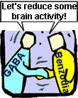
Mechanism of action: Benzodiazepines
CNS depressant
Enhance the effect of GABA.
GABA is a neurotransmitter that inhibits neuronal activity i.e. reduces the firing rate of neurones.

Slide 46
Agonist = Facilitate
Benzodiazepines bind to a site near the GABA binding site thus facilitating the action of GABA

Slide 47
Adverse Effects
Physical dependence occurs in about 1 in 3 patients.
History substance abuse > risk dependence
Increased accident risk.
Tolerance & rebound insomnia.
Alcohol & CNS depressants potentiate adverse effects.

Slide 48
60y+ > vulnerability to confusion, memory impairment, over sedation (most common S/E) & falls.
Adverse mood effects: depression, emotional anaesthesia, aggression, increased suicide risk in elderly

Slide 49
Withdrawal from Benzodiazepines
Abrupt cessation: > seizures
Withdrawal symptoms may occur between doses during continuous use (inter-dose withdrawal). Patients may think these symptoms are due to the original problem.
Withdrawal symptoms: increased anxiety, sleep disorder, aching limbs, nervousness & nausea.
Short half life benzodiazepines are associated with more acute & intense withdrawal symptoms.
Long half life benzodiazepines - milder, more delayed withdrawal

Slide 50
Withdrawal from benzodiazepines
Benzodiazepines should not be ceased abruptly.
Dose reduced by 10-20% per week.
Patient allowed to stabilise between each reduction.
Admission for high dose users, history of seizures or psychosis, or for more rapid withdrawal.
Implement relaxation/cognitive techniques.
If necessary referral:
Drug & Alcohol Services
Self Help group TRANX www.tranx.org.au
Psychologist (for CBT)

Slide 51
Overdose Benzodiazepines
Generally safe in overdose unless mixed with alcohol/CNS depressants.
Symptoms overdose: hypotension, respiratory depression & coma.
Treatment: Supportive
Flumazenil rarely indicated

Slide 52
NON-BENZODIAZEPINES
First line agent: buspirone (BuSpar)
Binds to serotonin and dopamine receptors
No CNS depression
No abuse potential documented
May have paradoxical effects (increased anxiety, depression, insomnia, etc.)
May not be fully effective for 3-6 weeks
May cause EPS

Slide 53
NON-BENZODIAZEPINES: ANTIHISTAMINES
Very sedating
No addiction potential
May be used long-term
Examples: diphenhydramine (Benadryl)
hydroxyzine (Vistaril)

Slide 54
ANTIDEPRESSANTS-treatment of anxiety
Useful in long-term treatment of panic (with or without agoraphobia), obsessional thinking
Low abuse potential
SSRI’s: first line drugs due to low sedation

Slide 55
ANTIDEPRESSANTS, CONT’D
SSRI’s and SNRI’s:
  fluoxetine (Prozac)
sertraline (Zoloft)
citalopram (Celexa)
escitalopram (Lexapro)
fluvoxamine (Luvox): best for OCD
paroxetine (Paxil): useful for OCD
Tricyclics:
clomipramine (Anafranil): for OCD

Slide 56
MISCELLANEOUS
Propranolol (Inderal)--Beta adrenergic blocker
Clonidine (Catapres)--Alpha 2 agonist
  Both decrease autonomic symptoms in panic : e.g. tachycardia, muscle tremors
Gabapentin (Neurontin)
  For OCD and social phobias

Slide 57
GENERAL GUIDELINES FOR USE OF ANTIANXIETY AGENTS
Sedation potentiates falls, accidents
Cautious use in elderly, renal, liver problems
Do not combine with other CNS depressants or alcohol
Paradoxical effects common: esp. with BZDs, buspirone, some antidepressants
Don’t stop benzodiazepine therapy abruptly

