Slide 1
INTELLECTUAL DISABILITY
Year 4 MBChB

Slide 2
LEARNING OBJECTIVES
The aim is to provide a framework for assessment of children with ID for features of ID, strengths, possible causes of ID and for comorbid disorders, highlighting issues to be considered in the assessment. At the end of the section you should be able to:
Outline List the risk factors for psychiatric disorders in this population
Recognize specific issues in the assessment of children with ID
Appreciate the need for a multidisciplinary approach.
Appreciate the need for a multidisciplinary approach.

Slide 3
OUTLINE
Introduction
Definitions of key terms
  WHAT IS INTELLIGENCE?
  WHAT IS INTELLIGENT QUOTIENT [IQ]?
  WHAT IS ADAPTIVE BEHAVIOR?
  WHAT IS INTELLECTUAL DISABILITY [ID]?
Causes of ID
Presentation/characteristics of ID
Psychiatric and Medical Co-morbidity
Differential Diagnosis
Investigations
Management

Slide 4
You need to know about Intellectual disability because:
Intellectual disability (ID):
  very common - general population prevalence of ~ 1%
  preventable
  pose a huge burden
  lead to stigmatization
ID poses risks to those with ID:
  harmful forms of traditional healing
  neglect or harsh treatment
High caregiver stress

Slide 5
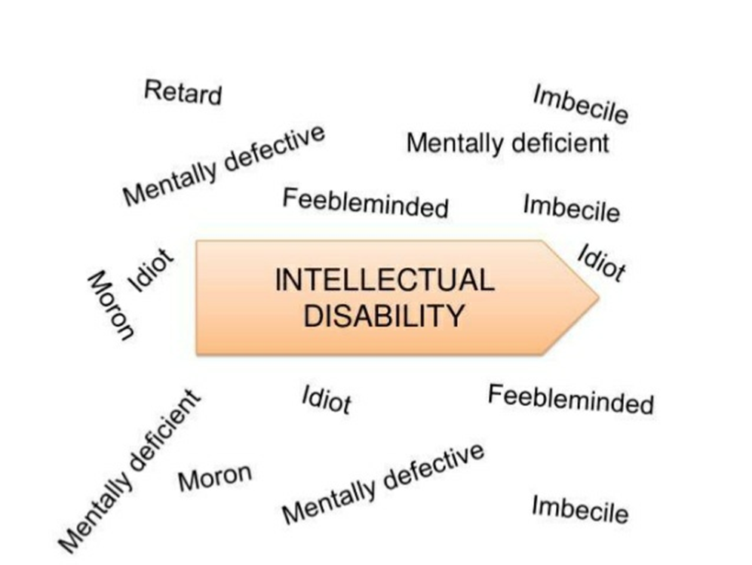
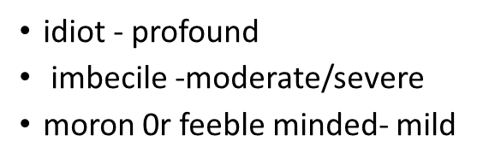
INTRODUCTION:
Intellectual disability [ID], is general learning disability resulting in substantial limitations in present functioning. Those with ID, develop at a below average rate and experience difficulty in learning and social adjustment. OLD TERMINOLOGY
ID is inability to cope with an intellectually demanding world.
As Esquirol noted, ID is not a disease in and of itself; it is a statement about how a person is functioning cognitively within a social context.

Slide 6
DEFINITIONS
WHAT IS INTELLIGENCE?
WHAT IS INTELLIGENT QUOTIENT [IQ]?
WHAT IS ADAPTIVE BEHAVIOR?
WHAT IS INTELLECTUAL DISABILITY [ID]?

Slide 7
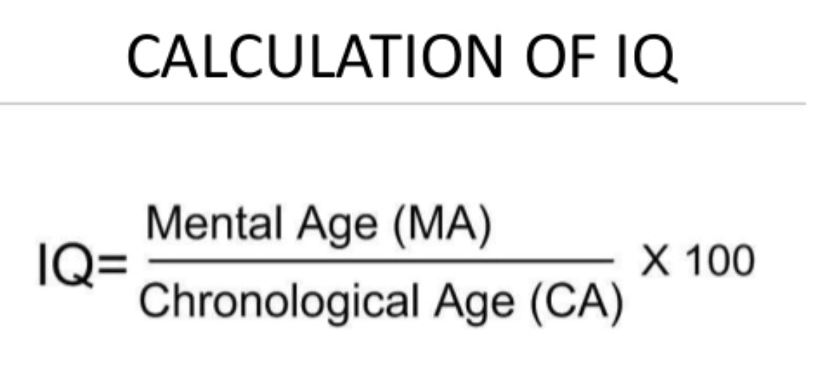
WHAT IS INTELLIGENCE?
Intelligence refers to general mental ability such as learning efficiently, learning from experience, thinking abstractly, understanding complex ideas and concepts, ability to reason, plan, solve problems and so on.
People with intellectual disability [ID] find it difficult to do some of these things; may do them more slowly; or may not be able to do them at all (Bigby & Frawley, 2010).
WHAT IS INTELLIGENT QUOTIENT [IQ]?
Intellectual functioning is represented by IQ scores that are obtained from standardized tests. IQ is defined as mental age [MA] divided by chronologic age [CA] and multiplied by 100.
If MA equals CA, then ratio equals one and IQ is"100".
ID, present if an individual scores 70 or below score on IQ tests.

Slide 8
WHAT IS ADAPTIVE BEHAVIOR?
Adaptive functioning is one’s ability to cope with day-to-day tasks. Adaptive behavior is collection of conceptual, social and practical skills learned by people that are necessary for day to day life i.e. effective communication, interacting with others and self care.
DSM-5’S THREE DIMENSIONS OF ADAPTIVE FUNCTIONING:
Conceptual skills – language and literacy, time and number concepts, self-direction.
Social skills – Interpersonal skills, social responsibility, self esteem, gullibility, social problem solving and ability to follow rules and to avoid being victimized.
Practical skills – personal care/activities of daily living, health care, occupational skills, travel, schedules, safety, use of money, use of the telephone.

Slide 9
WHAT IS INTELLECTUAL DISABILITY [ID]?
ID is limited mental abilities or arrested/incomplete development of mental abilities, during developmental period, resulting in impairing subnormal intelligence [as measured by IQ] and adaptive functioning deficits in conceptual, social, and practical domains which commence in early life and persist with development.
ID CORE SYMPTOMS: [1] low intellectual functioning [IQ <70] and [2] impaired adaptive behavior with onset during developmental period.
Is universal definition of ID that applies in all situations and in all cultures reasonable?
Current ID definition was developed western countries to identify and label people who are failing to cope due to a low intellectual ability, so that they may be given the assistance they need to have a reasonable quality of life.

Slide 10
Whether somebody is coping or not will depend on two distinct factors:
The environmental demands on them.
  Environmental demands people have to cope with vary as per age and where they live. Children have to cope with formal education, adults with demands of caring for themselves.
  The intellectual demands of the environment will also vary between countries and may well be considerably fewer in many developing countries, where there is less need to use modern technology, and skills, once learned, can continue to be used over a lifetime.
  If an individual is able to cope with one environment at one time does not mean that he/she will be able to cope with another environment at another time.
Society’s judgment as to what is an acceptable quality of life.
  The other factor in determining if somebody is coping is what a society can tolerate, which in turn will depend on its political outlook, resources, priorities and desire to help people who it considers not to be coping. This changes over time and place.

Slide 11
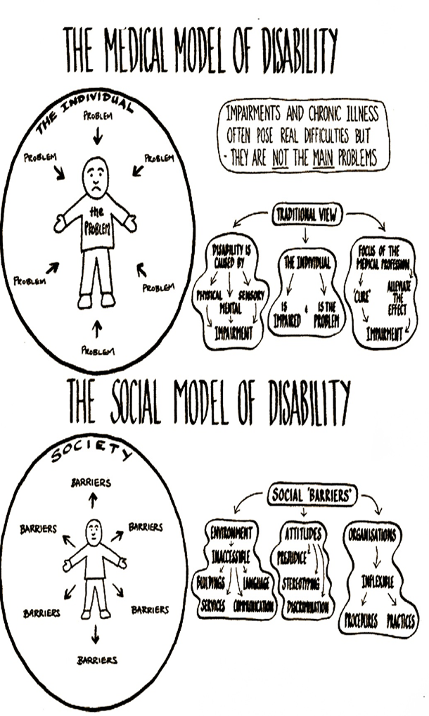
An assessment as to whether an individual is coping would made on the basis of judgment as to how well an individual is dealing with his/her environmental demands, what is considered an acceptable quality of life and consideration as to what resources are available to help individuals who are deemed not to be coping.
Adaptive functioning deficits severity may be increased or decreased by external environmental factors and the support given to person with ID.

Slide 12
SOCIOLOGICAL DEFINITION OF INTELLECTUAL DISABILITY
Constructive and pragmatic, as ID defined in terms of the support needs of an individual and the effect of ID seen as something that will vary and can be increased or decreased by external factors.
This definition does not rely on the capacity of the person being set in stone, but also on the environment and the support that they receive.
So, adjusting the environment and the support to meet the person’s needs can increase the person’s capacity and reduce the effect of ID!
Unlike medically based 'cures', which focuses on the individual & their impairment, social model sees 'cure' to the problem of disability is in restructuring of society. This is an achievable goal and to the benefit of all.

Slide 13



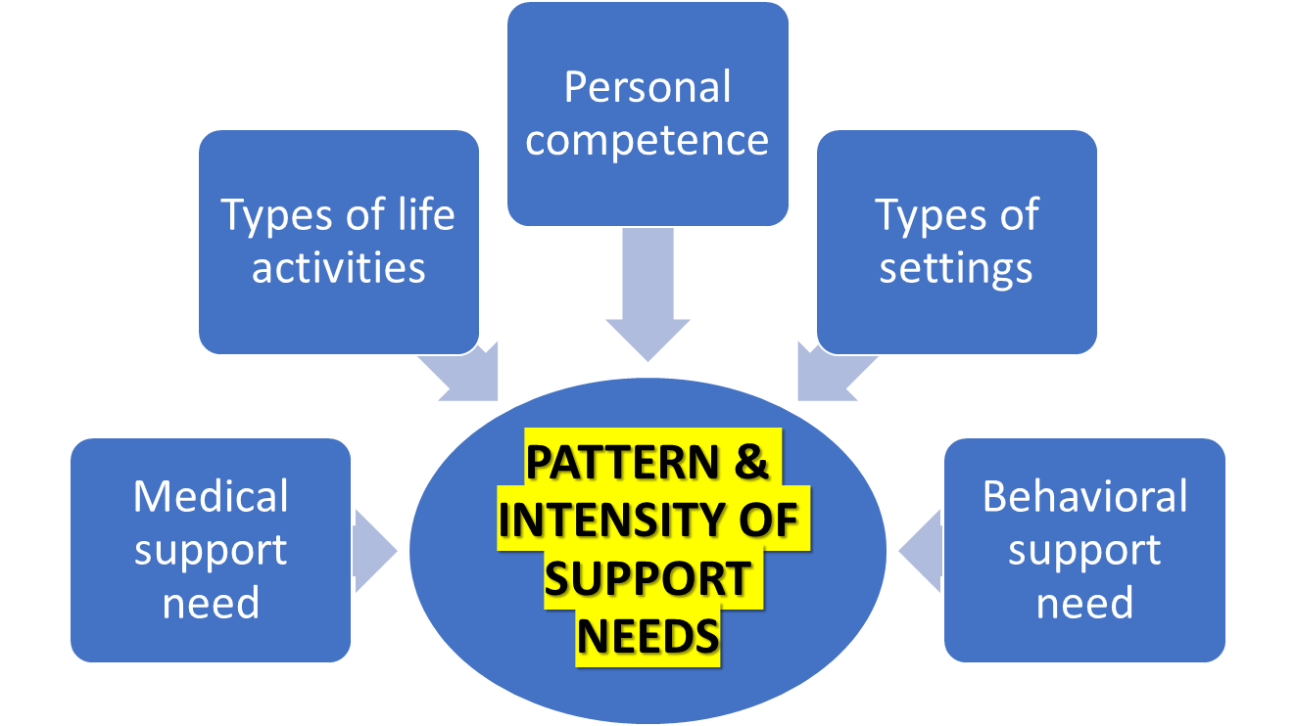
CLASSIFICATIONS OF INTELLECTUAL DISABILITY SEVERITY
Wide range of intellectual functional impairments and difficulties with daily life skills in ID. Levels of severity of intellectual impairment & need for support vary from profound to mild.
Severity Category | % of ID | DSM-IV just IQ | DSM-5 - based on daily skills | American Association Intellectual and Developmental Disabilities (AAIDD) -intensity of support needed
Mild | 85% | IQ range 50–69 | Can live independently with minimum levels of support. | Intermittent support needduring transitions or periods of uncertainty.
Moderate | 10% | IQ range 36–49 | Independent living may be achieved with moderate levels of support, such as those available in group homes. | Limited support needed in daily situations.
Severe | 3.5% | IQ range 20–35 | Requires daily assistance with self-care activities and safety supervision. | Extensive support needed for daily activities.
Profound | 1.5% | IQ <20 | Requires 24-hour care. | Pervasive support needed for every aspect of daily routines.

Slide 14
CAUSES
PRENATAL CAUSES
  Genetic conditions
  Problems during pregnancy
Problems at birth:
POST NATAL CAUSES
  Socio-cultural factors
  Postnatal infections/ Trauma or physical agents
  Post natal brain disease
  Unknown influences

Slide 15
INTELLECTUAL DISABILITY [ID]: CAUSES
ID final common pathway of several perinatal disorders or childhood problems:
1. PRENATAL CAUSES:
Genetic conditions
Fragile X syndrome: most common cause; characteristics - large ears, large testes, plantar crease, double jointed thumbs, simian crease, increased hand width & length, hyper-extensible joints, hypotonia, broad forehead, elongated face, high arched palate.
Chromosomal abnormalities defects e.g. the most widely recognized chromosomal abnormality is Down syndrome.
Cranial Malformations - Microcephaly, Hydrocephaly
Problems during pregnancy
Maternal infection, such as congenital rubella, HIV, and toxoplasmosis which damages cerebral resulting in ID.
Damage may also be caused by: excessive maternal alcohol/tobacco use, exposure to certain environmental hazards (e.g. x-rays) during pregnancy or incompatible blood types between fetus and mother.

Slide 16
[ID]: CAUSES: CONTINUED
Problems at birth:
Maternal substance abuse associated with premature birth and low birth weight.
Birth Anoxia: breech presentation, knotted umbilical cord.
For most people with moderate, severe, profound ID, problems are evident at birth.
2. POST NATAL CAUSES
Socio-cultural factors
  Living in adverse economic conditions.
  Receiving poor nutritional and medical care.
  Living in an environment that offers few opportunities for learning
Postnatal infections eg, encephalitis, measles, mumps); toxic excesses (lead or carbon monoxide poisoning, drugs); extreme malnutrition
Post natal brain disease. Several disorders are associated with gross postnatal brain disease, such as neurofibromatosis and tuberous sclerosis.
Trauma or physical agents may occur either prior to birth, during delivery, or after the baby is born.
Unknown influences - 75% of causes unknown

Slide 17
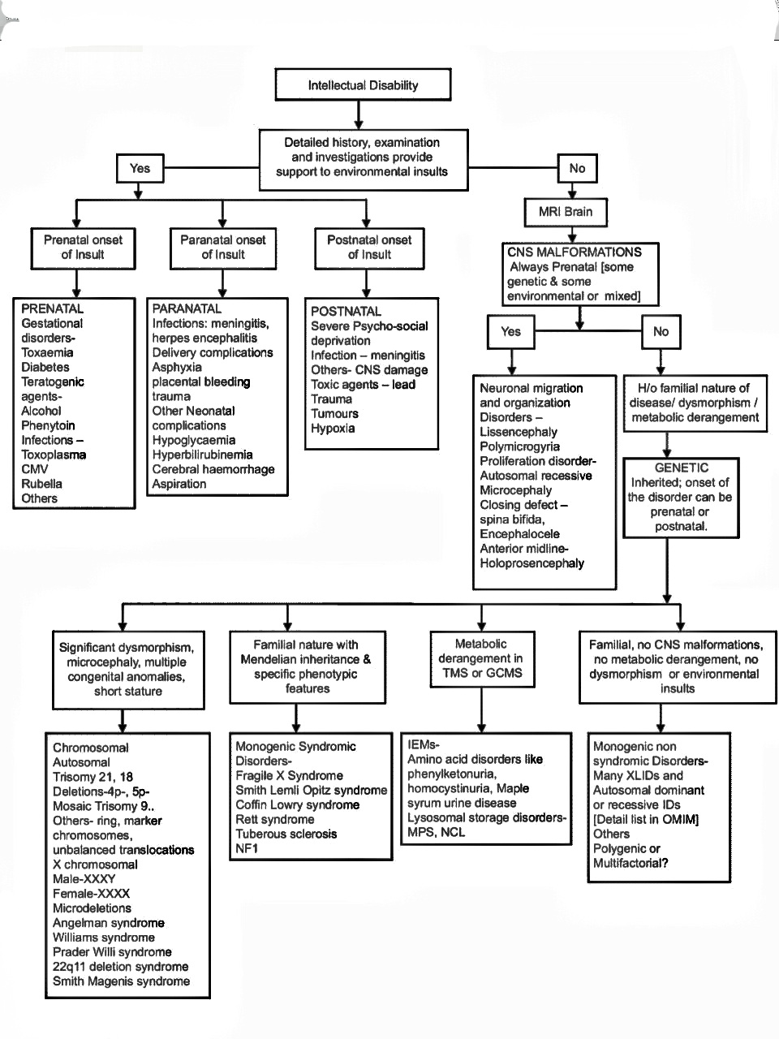

Slide 18
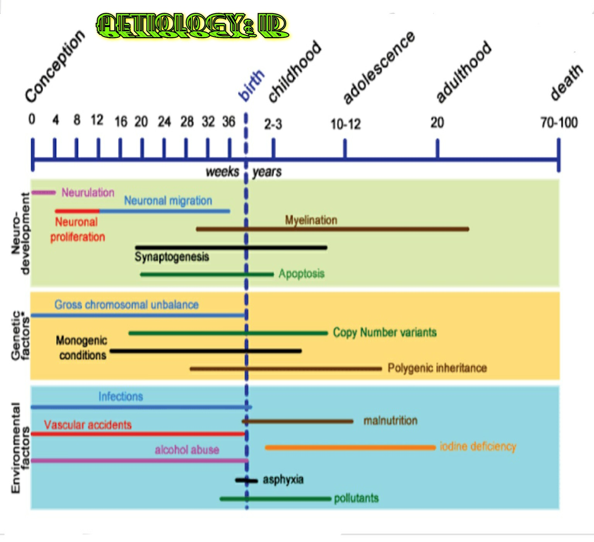
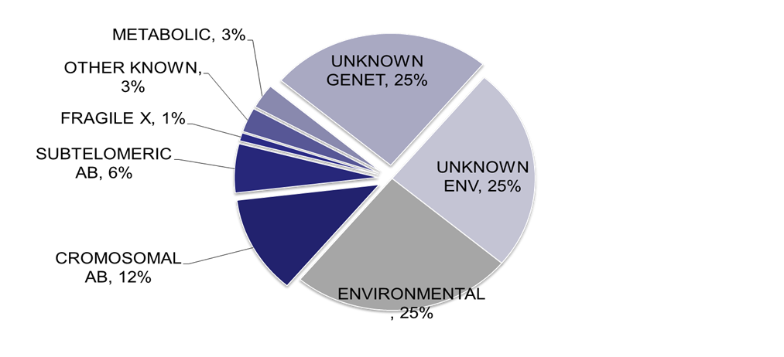

Slide 19
Intellectual Disability Clinical Presentation

Slide 20
CLINICAL MANIFESTATIONS
The manifestations of ID are mainly developmental delay in intellectual functioning and deficits in social adaptive functioning arising before age 18.
Children with ID progress with normal milestones in similar pattern to normal but the rate of developmental progress is slower and there is a ceiling on ultimate achievement.
Abilities of children with ID significantly lower than children of same age and their adaptability in daily life is adversely affected.
Developmental aspects affected by ID:
⬥ Learning ability, ⬥ Attention, ⬥ Memory, ⬥ Language ability, ⬥ Motor coordination, ⬥ Problem-solving abilities, ⬥ Social/self care abilities and⬥ Emotion/behavior control
SIGNS OF ID :
⬥ Failure to achieve developmental milestones,⬥ Cognitive functioning deficiency,⬥ Failure to achieve intellectual developmental markers, ⬥ Reduced ability to learn or meet academic demands,⬥ Expressive or receptive language problems, ⬥ Psychomotor skill deficits

Slide 21
ID presenting symptoms/signs typically include delays in cognitive, language and adaptive skills. The developmental delays vary depending on level of ID and etiology, eg, in mild non-syndromic ID, delays may not be notable until preschool years, whereas with severe/profound ID associated with syndromes or extreme prematurity, significant delays in milestones may be noted from birth.
Language delay: One first sign of ID may be language delays, including expressive language (speech) and receptive language (understanding). Red flags include no mama/dada/babbling by 12 months, no 2-word phrases by age 2, and parents reporting they are concerned that the child may be deaf.
Fine motor/adaptive delay: Significant delays in self-feeding, toileting, dressing typically reported in children with ID. Also prolonged, messy finger feeding & drooling oral-motor incoordination.
Cognitive delay: difficulties with memory, problem-solving and logical reasoning. Early preacademic difficulties or difficulty following directions (particularly multipart directions).

Slide 22
Social delays: Children with ID may display lack of interest in age-appropriate toys and delays in imaginative play and reciprocal play with age-matched peers. Rather than their chronological age, play reflects their developmental levels.
Gross motor: Delays in gross motor development infrequently accompany the cognitive, language, and fine motor/adaptive delays associated with ID unless the underlying condition results in both ID and cerebral palsy. Subtle delays in gross motor acquisition, or clumsiness, may be identified in the developmental assessment.
Behavioral disturbances: Even before an age at which psychopathology can be identified, infants and toddlers who go on to have ID may be more likely to have difficult temperaments, hyperactivity, disordered sleep, and colic. Associated behaviors may include aggression, self-injury, defiance, inattention, hyperactivity, sleep disturbances, and stereotypic behaviors.
Neurologic and physical abnormalities: Prevalence of ID is increased among children with seizure disorders, microcephaly, macrocephaly, history of intrauterine or postnatal growth retardation, prematurity, and congenital anomalies. In the process of addressing somatic problems, assessment of a child's cognitive abilities is often overlooked.

Slide 23
ID presents differently in the various developmental periods:
Infancy: Mild and moderate ID may go undetected in infancy, otherwise, for severe ID, most children with ID have physical malformations that identify them at birth as being at high risk for ID and these infants may show significantly low intellectual functioning, characterized by significant limitations in emotional expressiveness, language, purposeful behavior, gross and fine motor skills and apparent cognitive abilities.
Early Childhood: Young children with ID may be identified by parents or pediatricians after failure to meet developmental milestones in a number of functional areas such as significant delays in walking, speech, social skills or self-care skills capacity-self feeding, toilet learning; or on scoring <70 on standardized IQ tests.
Middle Childhood/Adolescence: Developmental delays usually clear by this age. Intellectual function also clearly significantly below average. Evaluation further identify strengths and weaknesses in cognitive and adaptive abilities.
ID SEVERITY LEVELS As per severity of deficits in adaptive function, IQ and support need - ⬥ mild;⬥moderate;⬥ severe and ⬥profound ID severity levels.

Slide 24
CLASSIFICATION BASED ON SEVERITY AND EDUCABILITY EXPECTATIONS:
Mild - Educable [IQ55-70]: 2nd to 5th class achievement in academics. Social adjustment will permit some degree of independence in the community. Occupational sufficiency with permit partial or total self support.
Moderate - Trainable [IQ40-55]: learning primarily of self-help skills; some achievement in academics. Social adjustment often limited to the home. Employment opportunities include supported work in a community job.
Severe - Custodial [IQ40-20]: may be unable to achieve sufficient skills to care for basic needs. Many children labeled as custodial a few years ago are now receiving educational experiences that are increasing their adaptive skills in family and community setting
Profound - [IQ below 20].

Slide 25
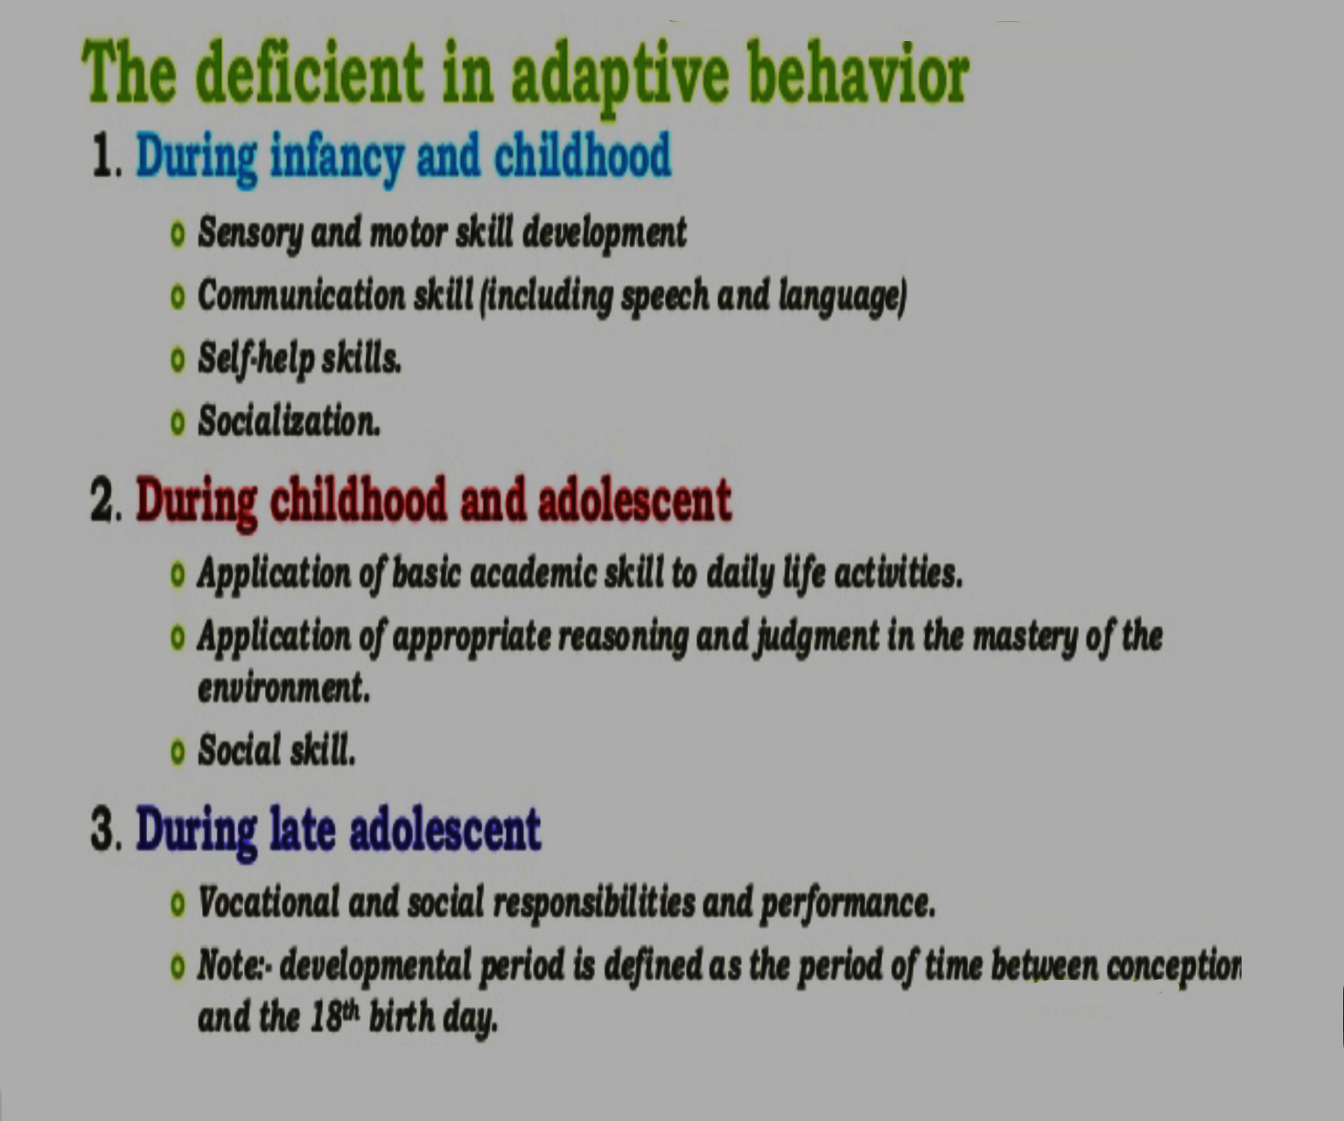
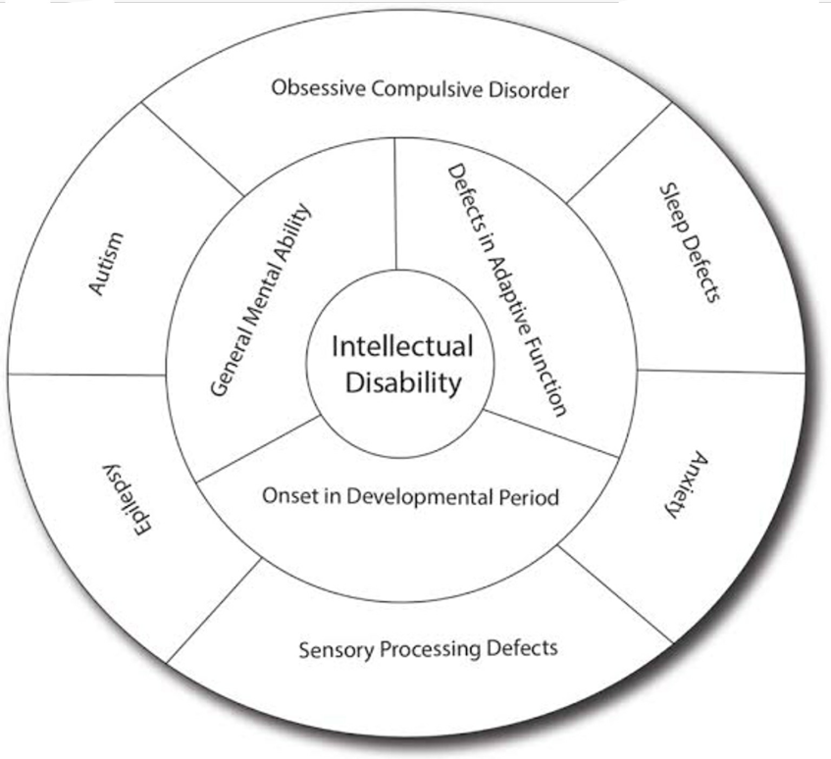

Slide 26
LEGAL RIGHTS
28-yr-old, male identified as having MA of an 8-yr-old, accused of possessing pornography, if convicted – mandatory minimum 1-year imprisonment. Defense attorney, argue that since persons are not criminally responsible when they are chronologically less than 12 yrs, the same ought to be extended to those with MA of less than 12 yrs;
Individuals with ID generally represent a minority of the delinquent population. Most live without committing crimes, socially adjusted and there is no evidence to increased prevalence of delinquency among those with ID.
However, due to the fact that they are more easily influenced and manipulated by other people; they are more likely to become scape goats in criminal situations, so there is significantly more ID in the prison than in the general population.
The importance of comorbidity with ID emphasized in subjects with ID who commit crimes – Lund found that 91.7% had psychoses, bipolar or depressive disorders mental illlness. Substance use in individuals that commit crime reported less common in those with ID than in those without.
it may affect the person’s ability to adapt to new or unfamiliar situations • it can involve the person presenting well ‟ “cloak of competence”

Slide 27
DSM 5 DIAGNOSIS CRITERIA

Slide 28
DSM 5 DIAGNOSIS CRITERIA
ID classified under neurodevelopmental disorders which must meet the below criterion:
A. Deficits in intellectual functions, such as reasoning, problem solving, planning, abstract thinking, judgment, academic learning, and learning from experience, confirmed by both clinical assessment and individualized, standardized intelligence testing.
B. Deficits in adaptive functioning that result in failure to meet developmental and sociocultural standards for personal independence and social responsibility.
  Conceptual skills (communication, language, time, money, academic)
  Social skills (interpersonal skills, social responsibility, recreation, friendships)
  Practical skills (daily living skills, work, travel)
C. Onset of intellectual and adaptive deficits during the developmental period.

Slide 29
ID: Psychiatric and Medical Co-morbidity
Compared with normal children, children with ID higher risk of other health problems. Co-occuring mental, neurodevelopmental, medical| physical conditions frequent.
Medical co-morbidity [eg, epilepsy, cerebral palsy, sensory issues], common-3 to 4 times higher than general population; often undetected & undertreated: epilepsy (22%), cerebral palsy (20%), anxiety disorders (17%), ODD (12%) and autistic disorder (10%).
Visual and hearing problems present in ~ 5%-10% of persons with ID.
Challenging behavior: Difficulties accepting criticism, aggression or self-injury common.
Diagnosing psychiatric disorders in ID difficult, yet, ~ 40-70% have psychiatric disorders eg, ADHD, ODD, depression, bipolar disorders, anxiety disorders, impulse-control & conduct problems, autism, stereotypic movement disorder [with or without self- injurious behavior] and major neurocognitive disorder. .

Slide 30
Psychiatric illnesses, recognition can be difficult in youth with moderate and severe ID, as tend to display more disorganized, unpredictable and difficult to understand symptoms, compounded by inability to describe their experiences: ⬥ Aggression without clear precipitants, associated with bizarre behaviors suggest hallucinations or suspiciousness suggesting schizophrenia. Family history of mood disorders, schizophrenia may be clues. ⬥ Depression may present as withdrawn behavior, irritability, aggression. ⬥ Mania may present as distinct periods in which youth with ID absconds, becomes boisterous, irritable or disinhibited. Timely identification and treatment of comorbid conditions reduce disability, family burden and improve quality of life.
Questionnaires such as Developmental Behaviour Checklist and Aberrant Behavior Checklist, help in the assessment of comorbid psychiatric problems

Slide 31
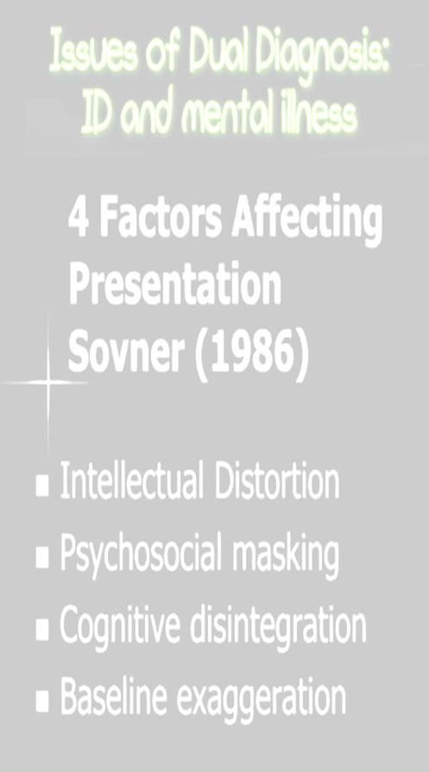
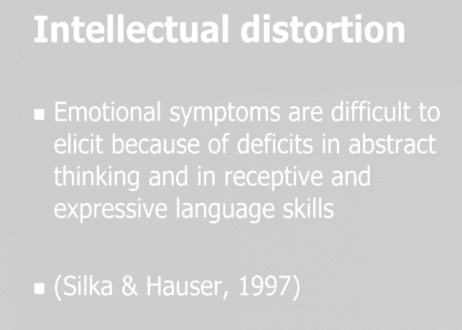
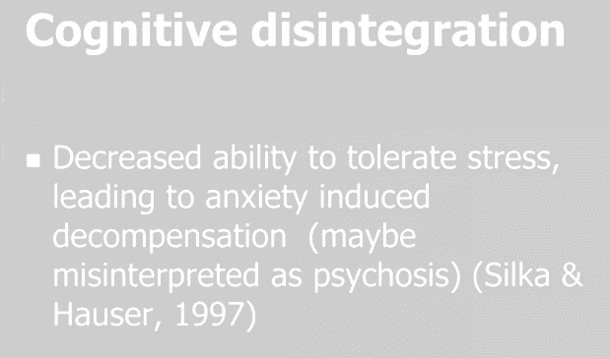
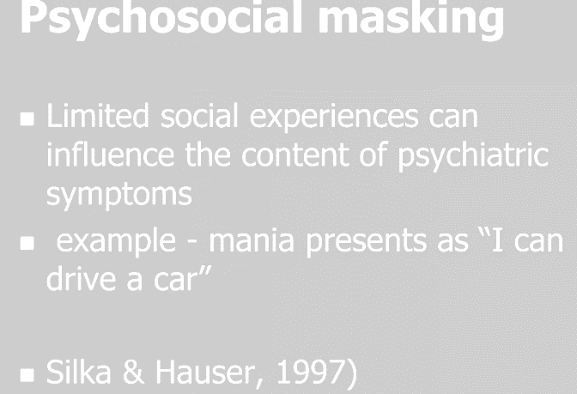
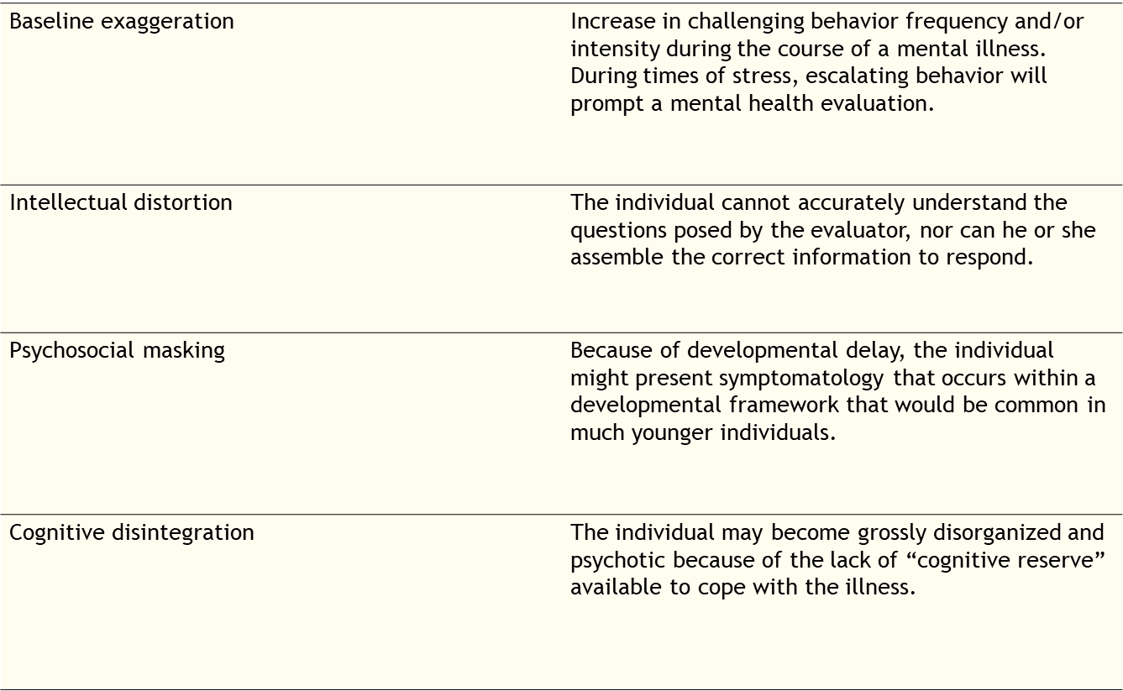

Slide 32
DIFFERRENTIAL DIAGNOSIS
Borderline intellectual functioning
Posttraumatic Stress Disorder
Cognitive Deficits
Learning Disorders
Pediatric Depression
Autism Spectrum Disorder
Severe communication/language disorders

Slide 33
CLINICAL ASSESSMENT

Slide 34
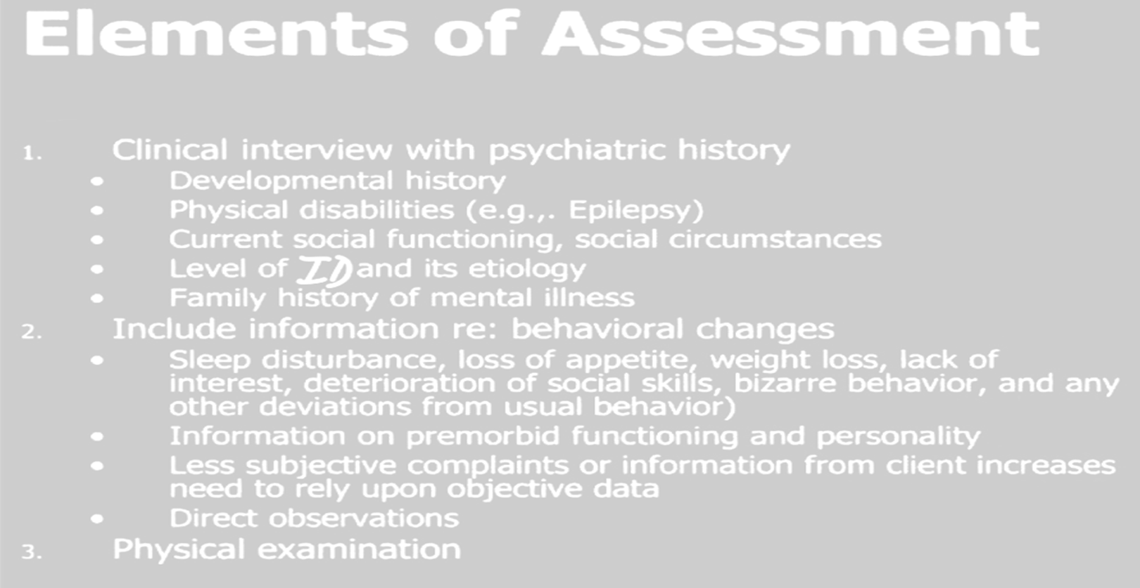
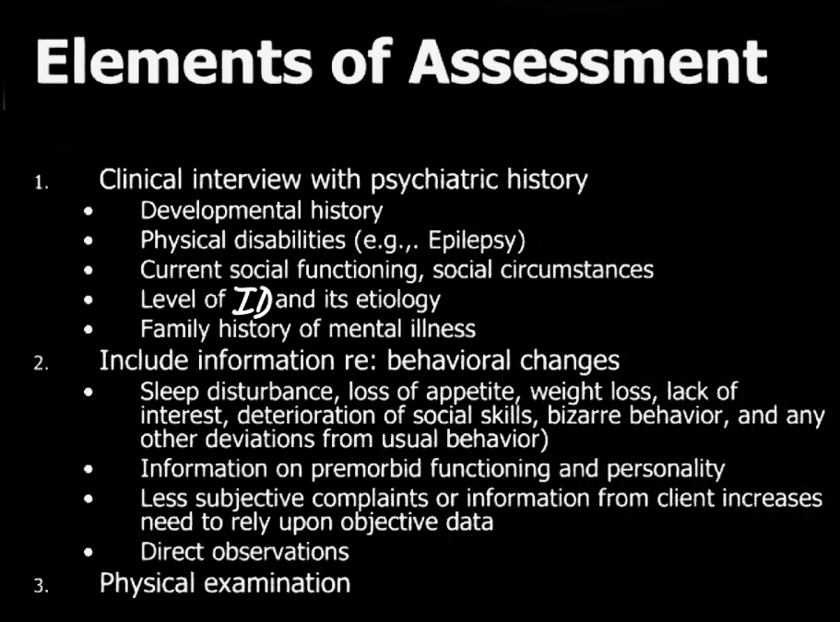
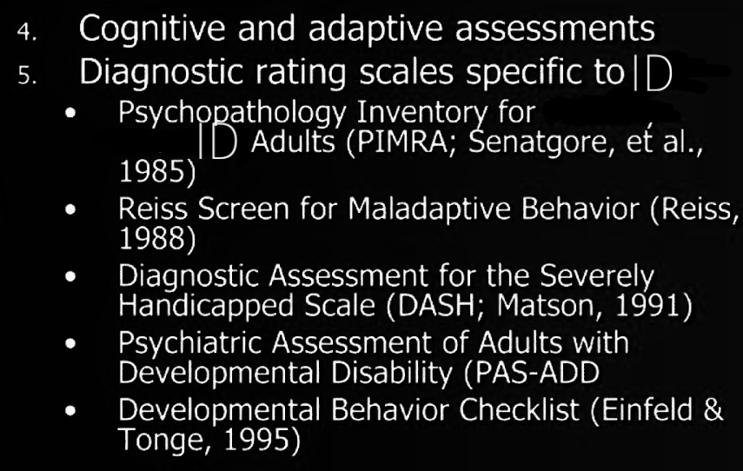

Slide 35
COMPLETE AND DETAILED HISTORY:
⬥Pregnancy history: maternal age, parity, infections
⬥Birth: type, weight, APGAR score, complications
⬥Postnatal: incubator, ventilator, disease
⬥ Medical:
  complete systemic review
  surgical history: trauma, accidents
  medical illnesses: hospitalization, general heath
  drugs: mother/child
⬥Social /Developmental Hx: milestones, school, IQ tests, adaptive skills
⬥Family history: Evaluation of a child with ID includes an extensive family history, with particular attention to family members with ID, developmental delays, consanguinity, psychiatric illness, congenital malformations, miscarriages, stillbirths, early childhood deaths.

Slide 36
PHYSICAL EXAMINATION:
Head circumference: Microcephaly correlates highly with cognitive deficits. Macrocephaly may indicate hydrocephalus and is associated with some inborn errors of metabolism
Height: Short stature may suggest a genetic disorder, fetal alcohol syndrome or hypothyroidism. Tall stature may suggest Fragile syndrome or other associated with ID.
Sensory: visual impairment and hearing deficits
Neurologic: assessments of head growth (for micro/macrocephaly), muscle tone (for hypotonia or spasticity), strength and coordination, deep tendon reflexes, persistent primitive reflexes, ataxia, and other abnormal movements such as dystonia or athetosis.
Skin exam: hyperpigmented/hypopigmented macules café-au-lait macules, as well as ash-leaf spots (associated with tuberous sclerosis), fibromas,
Extremities: major malformations accounts for only 5-10% of all cases, most have 3-4 minor anomalies, especially involving the face and digits.
Dysmorphic features assessment is important. An effective dysmorphological assessment is by the use of photography. With appropriate parental consent a full face view, right and left lateral views, a full body view and close up views of any specific dysmorphic features are a vital part of the medical record. Also of skull, face, neck, hands, feet, chest, mouth.

Slide 37
INVESTIGATIONS
1. BIOLOGICAL INVESTIGATIONS
There is no specific investigation for ID but good hx and physical examination guide us toward appropriate ones
Chromosomal abnormalities (eg. trisomy 21) ~50% among severe to profound ID.
Sex chromosome aneuploidy in ~ 5% of children with mild ID. Metabolic labs: not ordered unless clinically indicated.
Lead testing if risk factors. Audiology/Vision assessment
Brain MRI preferred over CT scan for greater resolution & enhanced detection of abnormalities in the progression and timing of myelination, demyelination & heterotopic gray matter. Skeletal films assist with phenotypic description, syndrome characterization and assessment of growth.
Head CT scan - the preferred imaging study for calcifications that may be identified with TORCH infections, if tuberous sclerosis is suspected, or if craniosynostosis is a concern.

Slide 38
LABORATORY INVESTIGATION.
Finding a cause for ID is important for prognosis, genetic counseling, and, in some cases, for therapy, though cause will remain unknown in many cases and that a combination of multiple factors may be more frequent than single causes thus making decision difficult, especially in mild cases.
Screening for specific diseases is a highly effective diagnostic method. Whenever a reliable and simple test is available, an effective treatment is possible and the frequency of the target disorders is sufficient. Its major interest lies in the possibility of preventing intellectual and developmental disability.
The routine urinary amino acids and organic acids chromatographies for diagnosis of metabolic causes of ID not entirely reliable as excretion of abnormal metabolites may be intermittent or require specific techniques. It may be more cost effective to study in detail those cases in which a clinical suspicion is present.
Magnetic resonance imaging is definitely indicated when epilepsy or neurological signs are present and the frequency of cortical malformations in such cases is well documented. Chromosomal analysis is indicated for cases with clear cut dysmorphism. However, many chromosomal aberrations are not associated with major dysmorphism, and a karyotype is indicated whenever minor peripheral malformations are found. A routine karyotype is often enough, and more specific techniques of deoxyribonucleic acid analysis are essential for confirmation (Aicardi 1998).

Slide 39
2. PSYCHOLOGICAL TESTS
Developmental assessment Tests: Child Development Inventories (CDI), Ages/Stages Questionnaires (ASQ), Parents' Evaluation of Developmental Status (PEDS),
Intelligence Tests: Wechsler/Stanford-Binet Intelligence Scales but these tests developed in the western parts of the world, suffer limitation of widespread use because of the influence of socio-cultural variations across the world, that impact on child rearing practices and cultural expectations of a child in a particular society.
A viable option of IQ score assessment among sub-Saharan African children with intellectual disability, is using a ratio of culture-specific estimated mental age and chronological age of the child in the absence of standardized alternatives, borne out of great diversity in socio-cultural context of sub-Saharan Africa.
3. SOCIAL INVESTIGATIONS
Family background. Family interactions. History of similar disorder in family etc.

Slide 40
MANAGEMENT
Currently, there is no "cure" for ID, but with appropriate support and teaching, most can learn to do many things. Mainstay of treatment of ID is developing a comprehensive management plan for the condition &requires input from multiple disciplines, including special educators, language therapists, behavioral therapists, occupational therapists.
Management of ID begins with breaking the news to parents sensitively, compassionately and culturally appropriately.
Parent Counseling is done as given below:
Provide information regarding child’s ID, management of associated medical problem and other disabilities must be made available to the parents.
Development of correct attitudes towards their child by giving correct information on nature, causes & treatment ID . In order to deal with false guilt, parents should be explained that it ID is generally due to causes over which they have no direct control.
Educate parents about their role in training child.

Slide 41
Aims of Treatment
Identify and treat reversible causes of ID
Alleviate suffering for child and family
Promote healthy development towards greatest possible independence
Evidence-Based Treatments:
Etiological treatment if cause is known and treatable (e.g., PKU, hypothyroidism)
Parent skills training
Behaviour intervention for challenging behaviour
Psychoeducation
Physio/speech/occupational therapy (when available)
Education plan
Community based rehabilitation

Slide 42
EVIDENCE-BASED TREATMENTS:
Etiological treatment if cause is known and treatable (e.g., PKU, hypothyroidism)
Parent skills training
Behavior intervention for challenging behavior
Family psychoeducation-explain problem to carers, give parents skills to support child development, promote participation in family, school and community life address psychosocial needs of carers. Also Advice for teachers
Physio/speech/occupational therapy (when available)
Education plan
Community based rehabilitation
Manage risk/contributing factors hearing and vision problems and nutrition, co occurring epilepsy, depression, maternal depression, lack of stimulation

Slide 43
GENERAL RULES OF MANAGEMENT
Identify cause then initiate a comprehensive plan
Multidisciplinary team -special educator, language, behavior, OT and physical therapists. ⬥ Early intervention is critical.
Provide an individualized education plan (IEP) and teach skills, physical therapy, OT, speech/language therapy, special school programs, community services as needed
During infancy and early childhood: ⬥ Development of sensory/motor communication/self help skills and socialization.
(b) During childhood and adolescence: ⬥ basic academic skills,⬥ activities of daily life skills ⬥ application of reasoning and judgment in the mastery of environment.⬥ use of social skills
(c) During late adolescence and adulthood:⬥ vocational performances and social responsibilities

Slide 44
PREVENTION
Primary (preventing occurrence of ID):
  Prenatal: (toxins, infections incl. HIV)
  Peri-natal: (delivery, neo-natal screening)
  Post-natal: (immunization, treatment for infections, safe and enriching environment)
Secondary (halting disease progression):
  Discover ID early, provide stimulation for optimal development
Tertiary (maximizing functioning)
  Support for families
  Stimulation, training, vocational opportunities

Slide 45
PROGNOSIS
Early identification of children with develop’ delays necessary to begin receiving early intervention services.
Infant/Toddler ID Rx focuses on obtaining a diagnosis & developing relevant/realistic goals for family and child.
Pre-School services often include an Individualized Education Plan (IEP), developed in collaboration with child's school teachers and counselor to improve the child's skills, may include psychological counseling, speech/occupational therapy and parent education, training and counseling.
Many with ID, particularly mild or moderate ID, are often ultimately able to live independently within the community.
Even those with more severe cases of ID who are not able to live independently can be challenged to learn, grow, and develop to the best of their ability.

Slide 46
SPECIFIC LEARNING DISORDERS

Slide 47
What is learning disability?
Learning disability (LD) is a disorder in one or more of the basic psychological processes involved in understanding or in using language, spoken or written, that may manifest itself in an imperfect ability to listen, think, speak, read, write, spell, or to do mathematical calculations, including conditions such as perceptual disabilities, brain injury, minimal brain dysfunction, dyslexia, and developmental aphasia.
Basically have trouble:
  Processing information
  Organizing information
  Applying information

Slide 48
Types of learning disabilities
Specific Learning Disorders in domain of…
      Reading (Dyslexia)
      Writing (Dysgraphia)
      Maths (Dyscalculia)
      Others

Slide 49
1. Reading Disorders (dyslexia)
A specific learning disability - affects reading and related language-based processing skills.
  Difficulty reading single words (decoding)
  Phonological difficulties – hearing, blending and manipulating the sounds in words
  Poor “sight” vocabulary
  Can have poor auditory working memory
  Can have visual tracking/scanning/discrimination or other visual perception issues

Slide 50
2. Writing Disorder (dysgraphia)
A specific learning disability-affects a person’s handwriting ability and fine motor skills.
  Poor spelling
  Handwriting that is often messy or illegible
  Cramping in hands or poor pencil grip
  Difficulty with technical aspects of writing (punctuation, capitals, grammar)
  Inconsistencies in letter formation (upper/lowercase) and spacing between words
  Large gap between oral expression and ability to express oneself in written format

Slide 51
3. Mathematics Disorder (dyscalculia)
  Poor quantitative thinking
  Difficulty memorising arithmetic facts
  Poor accuracy in calculation
  Reduced speed in calculations
  Difficulty understanding time and space
  May count on fingers
  May switch procedures when completing maths problems

Slide 52
AETIOLOGY OF LEARNING DISABILITIES
BIOLOGY:
Influences the neural, chemical, and functional aspects of the body.
  Accounts for traits and conditions which are hereditary.
  Are transmitted to the child from the mother and the father.
  Examples of hereditary: schizophrenia, depression, and temperament.
Birth: Prenatal: maternal drug/alcohol use, disease, maternal poor nutrition. Perinatal: brain damage from anoxia. Postnatal: brain damage from accident or shaken severely, lead poisoning and encephalitis
Genetics: 75% likelihood of having LD if both parents have LD. 51% likelihood if 1 parent has LD. More than 1/2 of reading impairments of identical twins is heredity
Medical: Complication during birth – lack of oxygen. Chromosomal abnormalities. Sensory impairments
ENVIRONMENTAL
  Neglect and lack of maternal stimulation
  Alcohol and drug use
  Poor nutrition and exposure to lead in water or in paint

Slide 53
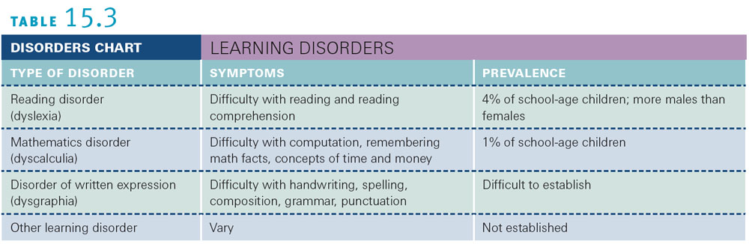

Slide 54
Treatment of learning disability - types of interventions or treatments
Behavioral Treatment
  Supplement medical treatment
  Used as primary therapy tools
  Learning strategy interventions should be packaged to appeal to children
Instructional Interventions
precise use of specific stimuli and consequences
Identification and modification of behaviours
Teaching skills that capitalize on abilities and strengths
Students are provided with “generally effective” instruction
Progress is monitored, Students not responding get something more, if students still not responding either qualify for special education or get evaluated for special education

Slide 55
Prognosis for children with learning disabilities
The prognosis for those with learning disabilities as adults is brighter than ever before
research literature on adults with learning disabilities is increasing
the literature on learning disabilities has historically focused more on childhood than on adolescence and adulthood.
Now research on learning disabilities is increasingly investigating long-term outcomes in adulthood (postsecondary schooling)

Slide 56
REFERENCES
IACAPAP Textbook of Child and Adolescent Mental Health, 2015
Child Psychology and Psychiatry: Frameworks for Practice. Edited by David Skuse, Helen Bruce, Linda Dowdney and David Mrazek: © 2011 John Wiley & Sons, Ltd. Published 2011 by John Wiley & Sons, Ltd. ISBN: 978-0-470-97382-0
Kang’ethe R, et al. Child and Adolescent Psychiatry. In: Njenga FG, editor. Essentials of Clinical Psychiatry in sub-Saharan Africa. Milan: Masson; 2005.
The African textbook of psychiatry and mental health by Ndetei et al 2006

