Slide 1
ABORTION: THERAPEUTIC AND CRIMINAL, DEATHS RELATED TO PREGNANCY
DR M.P.OKEMWA

Slide 2
PREGNANCY/DELIVERY
Pregnancy is physiological condition of having a developing embryo or fetus in the body
It occurs from the time of fertilization of an ovum by a sperm until birth of a child
Delivery is complete evacuation of a fetus that has attained viability with other products of conception from within uterus and genital passage to external environment

Slide 3
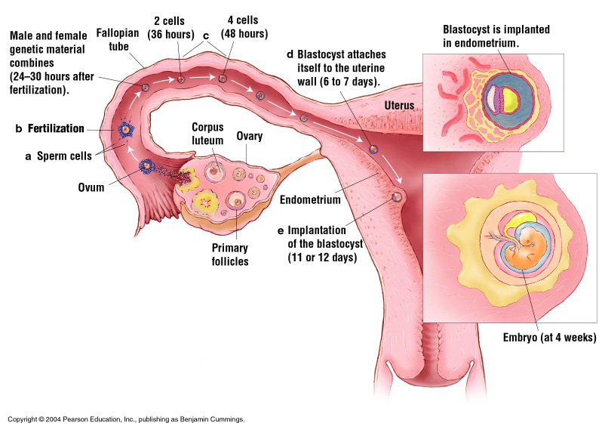
Fertilization
Figure 7.11

Slide 4
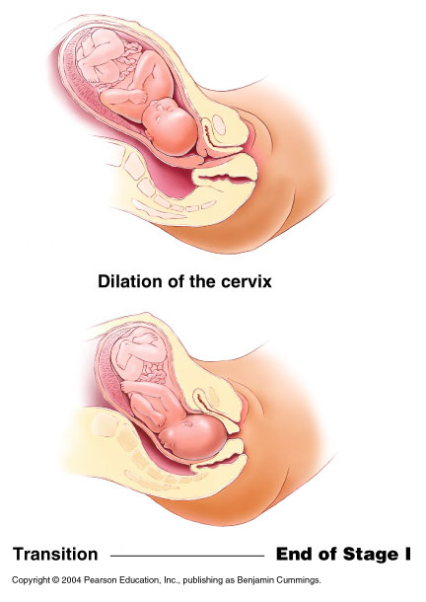
The Birth Process
Figure 7.13a

Slide 5
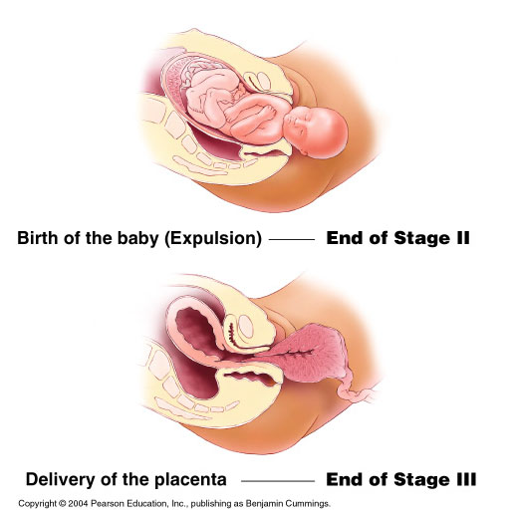
The Birth Process (continued)
Figure 7.13b

Slide 6
Complications
Preeclampsia and eclampsia
Miscarriage
Rhesus incompatibility
Ectopic pregnancy
Stillbirth
Sudden Infant Death Syndrome (SIDS)
Cesarean section (C-section)

Slide 7
PREECLAMPSIA/ECLAMPSIA
Also known as hypertension in pregnancy
3% of pregnancies: thought to be due to defective trophoblastic invasion hence hyoperfused placenta.
Carries significant morbidity and mortality.
Early recognition of syndrome, adherence to agreed protocols and well timed delivery is key.
Delivery is the only CURE.

Slide 8
ECTOPIC PREGNANCY
Implantation outside the uterine cavity
Fallopian tube is commonest site. Other sites include omentum, liver and occasionally brain.
May rupture and lead to hypovolemic shock.
High index of suspicion from presentation and swift management is key
High mortality rate if not managed. May occur post BTL

Slide 9
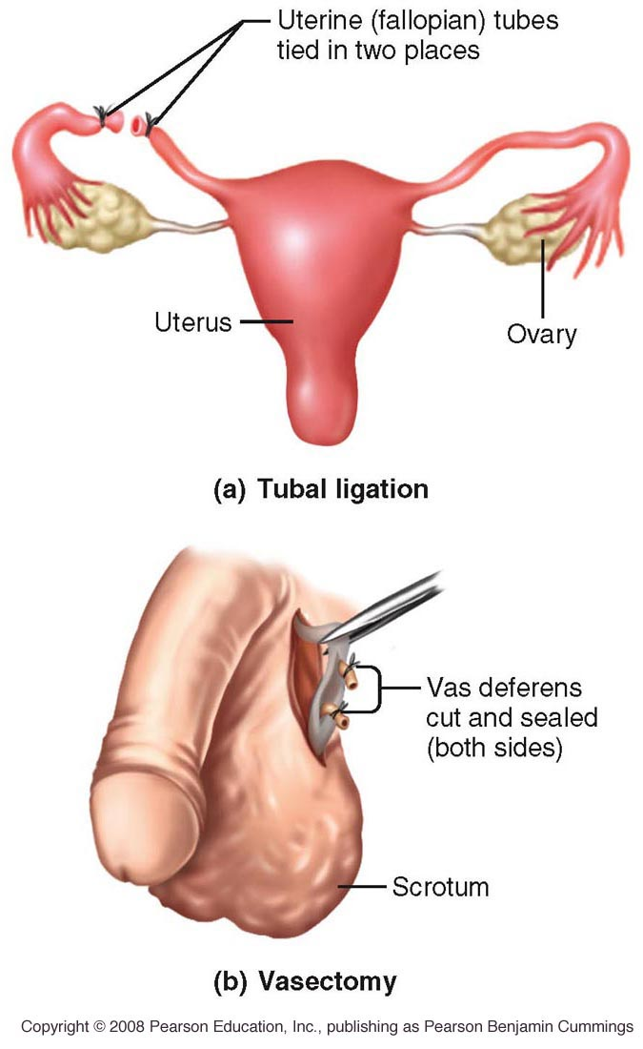
Sterilization
Figure 7.7

Slide 10
RHESUS DISEASE
Also known as hemolytic disease of newborn.
Occurs when Rh- mothers conceive a Rh+ child. During birth, the mother may get exposed to the infants blood causing isoimmunization. This may affect subsequent pregnancies causing hemolysis/still birth.
May also occur if Rh- mother is transfused Rh+ blood.
Rh- women to be given a medical alert card.

Slide 11
STILL BIRTHS
Death of a fetus in utero that is not induced.
Delivery of a fetus showing no signs of life - fresh or macerated.
Identifiable causes:
-maternal causes - diabetes, infections, HTN
-fetal causes - multiple gestation, genetic etc
-placental causes - abruptio, cord round neck, placental insufficiency etc

Slide 12
Childbirth Considerations
Choosing where to have your baby
Labor and delivery
  First stage – amniotic sac breaks
  Second stage – expulsion
  Third stage – delivery of placenta
Managing labor
  Medical
  Non-medical
Birth alternatives
Postpartum period

Slide 13
C SECTION
Surgical delivery thought to be have been used on Julius Caesar.
Delivery of a viable fetus through an incision in the abdomen and uterus.
Increased rates now being seen some due to Caesarean on demand.
Death may occur due surgery or anesthesia and all are subject to board investigation.

Slide 14
PREGNANCY RELATED DEATHS
Maternal death from any cause related to or aggravated by pregnancy, delivery and post partum period. Its also includes death within 42 days of TOP.
MDG 5; Reduce by ¾ maternal mortality ratio which ratio of maternal deaths in a period to live births x 100000.
Kenya; 717 in 1996 fell to 510 in 2015 which is a sign of improved healthcare. Counties like Mandera with 3795 per 100000 births means 10 die daily of birth related complications.

Slide 15
ABORTION
Termination of pregnancy before 20 weeks gestation calculated from LMP.
Early- before 12 weeks
Late- between 12-20 weeks
It is also delivery of a fetus of a weight less than 500g

Slide 16
Definitions of Medical Abortion
Induced- Intentional termination of pregnancy using medical or surgical means
Elective- woman desires
Therapeutic- for mothers health
Criminal- Against the law
Notes:
The term “medical abortion” refers to early pregnancy termination, usually before 9 weeks’ gestation, resulting from abortifacient medications and without primary surgical intervention.

Slide 17
TYPES
TYPES OF ABORTIONS
  Induced
  Threatened
  Inevitable
  Incomplete
  Complete
  Septic
  Missed
  Recurrent

Slide 18
WHO ESTIMATES 200 million illegal abortions worldwide.
There is associated 50% deaths associated with these abortions.
Sepsis, severe hemorrhage, obstruction, infertility, severe emotional guilt leading to suicide amongst others cause mortality.
In Kenya abortion is illegal unless mothers health is endangered.

Slide 19
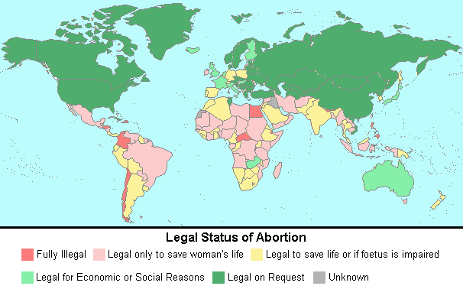

Slide 20
LEGALITY OF ABORTION
Pro-life and pro-choice debate with moral considerations
Slippery slope argument
Being human
Being like human
Right based arguments for abortion
Middle ground
Virtual based approach

Slide 21
Potentiality Arguments IN Abortion
“The fact that the fetus will develop into an adult human being that was once that fetus (if the fetus develops normally) establishes the fetus’s right to life”
If we value the fetus because of its potentiality, we will also have to value sperm and eggs because of their potentiality.
  Sperm and eggs are not potential people, because neither of them can be the same entity as the person they produce.
Things considered potential Xs don’t have the same rights as Xs.
  Potential presidents
  Potential Life Partner
  Potential doctors

Slide 22


The Church View……
According to Catholicism, every life is sacred from the moment of conception because at that moment, our souls, personalities and everything about us that makes us unique is given to us.
Pope John Paul II said recently "All human beings, from their mother’s womb, belong to God who searches them and knows them, who forms them and knits them together with his own hands, who gazes on them when they are tiny shapeless embryos and already sees in them the adults of tomorrow..."
The Church believes that every life is sacred, no matter how old, how developed or any other circumstances. The taking of a life, goes against the moral ethics of the Church. As humans we are created in God’s image, and destroying the miracle that he created is wrong.

Slide 23
Pregnancy Periods
First trimester- first 3 months
Second trimester- middle three months
Third trimester- last three months

Slide 24
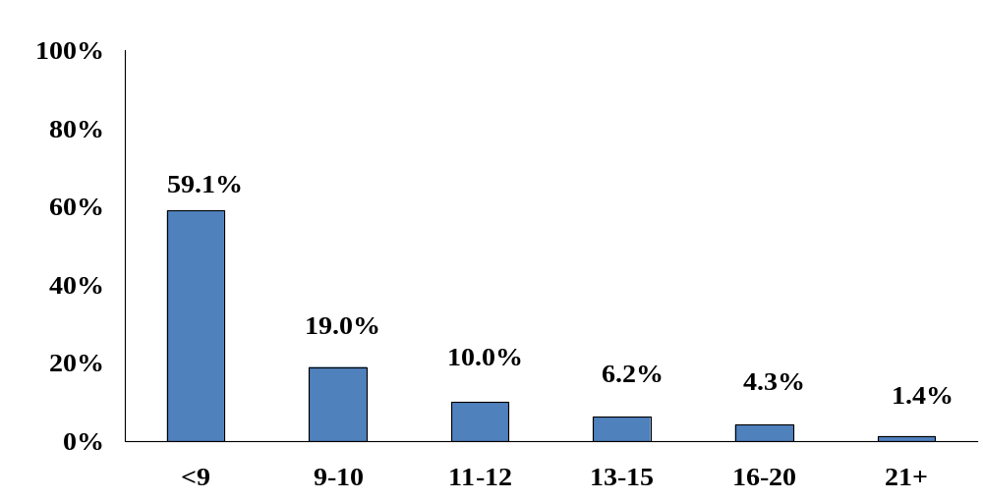
Abortions by Gestational Age
(Weeks Since Last Menstrual Period)
% of Abortions
Weeks
Source: Strauss et al., 2004 (2001 data)
Notes:
Weeks of Gestation at Time of Abortion:
Almost 90% of abortions are performed in the first trimester of pregnancy (in the first 12 weeks after the first day of the last menstrual period).
More than half of abortions are performed before 9 weeks after the last menstrual period, or within 5 weeks of the first missed period.
The proportion of abortions performed very early in pregnancy (at 6 weeks or before) increased from 14% in 1992 to 25% in 2001.
Fewer than 2% of abortions are performed after 20 weeks.
An estimated 0.08% of abortions are performed after 24 weeks, when the fetus may be viable (AGI, 1997).

Slide 25
METHODS OF ABORTION

Slide 26
Study: Women using crude abortion methods Standard, 16 Jun 2014
Harrowing accounts have it that women are using sharp pieces of wire, thorny tree branches and poisonous roots to poke into the uterus and force out the unborn
Health workers are said to charge between Sh. 2,000 and Sh. 10,000 but herbalists offer service for as low as Sh. 100.
Women are so terrified of unplanned pregnancies that they would tinker with death than give birth, a new survey in Bungoma and Trans Nzoia counties has revealed.

Slide 27
Modern Abortion Methods
Early-safer more effective
SURGICAL
CHEMICAL
Vacuum aspiration-up to 12 weeks
D+C-dilation and curettage-less used-1st trimester
D+E-Dilation+evacuation-2nd trimester
12-16 weeks-surgical crushing/stronger vacuum
Instillation-2nd trimester (not used much anymore)
Hysterotomy-3rd trimester-C-section
Prostaglandins
Mifepristone (RU486)+ prostaglandins- 8-10 weeks -
RU486 with stronger prostaglandin-till week 19
Methotrexate+prosta-glandins-through week 9

Slide 28
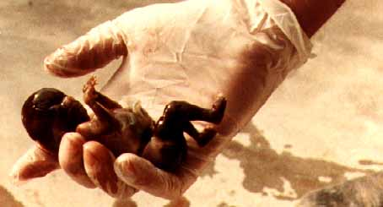
RU 486
Is a pill that uses two powerful synthetic hormones, mifepristone and misoprostol to chemically induce abortions in women 5-to-9 weeks pregnant.
RU 486 blocks the action of progesterone, the natural hormone vital to maintaining the rich nutrient lining of the uterus. The developing baby starves as the nutrient lining disintegrates.
At a second visit 36 to 48 hours later, the woman is given a dose of artificial prostaglandins, usually misoprostol, which initiates contractions and usually causes the baby to be born.
A third visit about 2 weeks later determines whether the abortion has occurred or a surgical abortion is necessary to complete the procedure.

Slide 29
Methods Of Abortion
Surgical abortions
  Vacuum aspiration
  Dilation and evacuations (D&E)
  Dilation and curettage (D&C)
Induction abortions
Hysterotomy
Intact dilation and extraction (D&X)

Slide 30
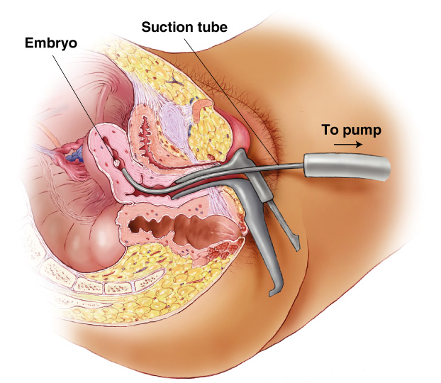
Vacuum Aspiration Abortion
Figure 7.10

Slide 31

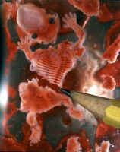
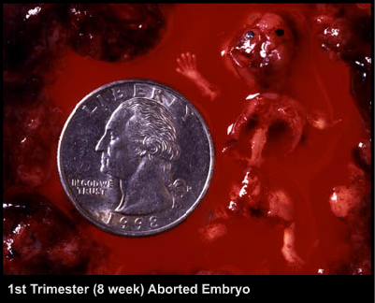
Suction aspiration
Also known as “vacuum curettage," a powerful suction tube with a sharp cutting edge is inserted into the womb through the dilated cervix. The suction dismembers the body of the developing baby and tears the placenta from the wall of the uterus, sucking blood, amniotic fluid, placental tissue and fetal parts into a collection bottle.

Slide 32
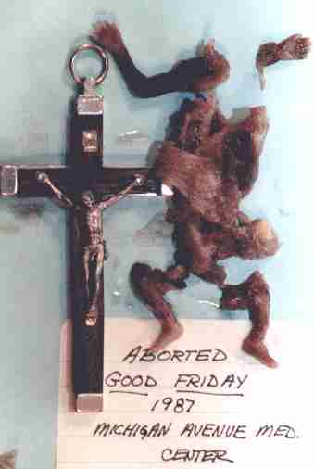

Dilatation and Curettage (D&C)
When the baby is to big to be sucked out by the suction method a D&C is performed. In this technique, the cervix is dilated or stretched to permit the insertion of a loop shaped steel knife. The body of the baby is cut into pieces and removed and the placenta is scraped off the uterine wall. This method should not be confused with routine D&C’s done for reasons other than undesired pregnancy (to treat abnormal uterine bleeding, dysmenorrhea, etc.).

Slide 33
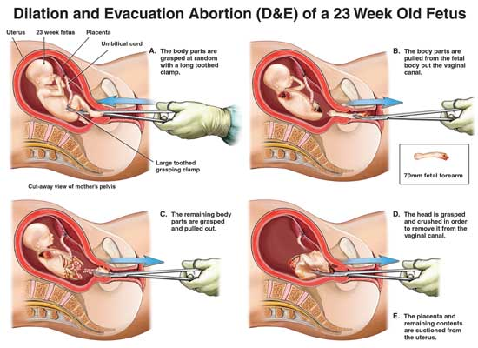

Slide 34
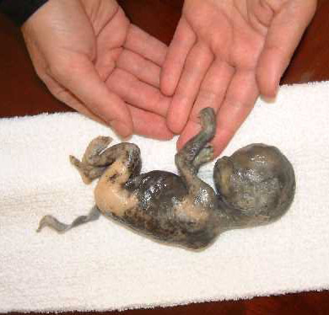
Salt Poisoning
Is used after 16 weeks of pregnancy, when enough fluid has accumulated in the amniotic fluid sac surrounding the baby. A needle is inserted through the mother’s abdomen and 50-250 ml of amniotic fluid is withdrawn and replaced with a solution of concentrated salt. The chemical solution also causes painful burning and deterioration of the baby’s skin. The baby breathes in, swallowing the salt and is poisoned. Usually, after about an hour, the child dies. The mother goes into labor about 33 to 35 hours after and delivers a burned and shriveled baby left to die.

Slide 35
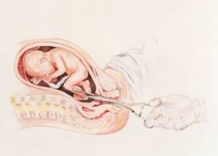
Partial-Birth Abortion
This procedure is used to abort babies who are 20 to 32 weeks gestation -- or even later into pregnancy. * Guided by ultrasound, the abortionist reaches into the uterus, grabs the unborn baby’s leg with forceps.

Slide 36
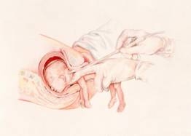
After removing the scissors, a suction catheter is inserted into the skull and the baby’s brains are sucked out. The collapsed head is then removed from the uterus.

Slide 37
Vacuum Aspiration and D&E
The risks associated with vacuum aspiration and D&E increase the longer you are pregnant and if sedation or general anesthesia is used. Possible risks include:
* Incomplete abortion — the embryo or fetus and other products of conception are not entirely removed from the uterus
* Allergic reaction
* Infection
* Very heavy bleeding
* Undetected ectopic pregnancy, which can be fatal if left untreated
* Blood clots in the uterus
* Injury to the cervix
* Organ injury
* In extremely rare cases death is possible from very serious complications. In general, the risk of death from abortion increases the longer a woman has been pregnant. Overall, the risk of death from childbirth is 11 times greater than the risk of death from abortion up to 20 weeks of pregnancy. After 20 weeks, the risk of death from abortion is about the same as the risk of death from childbirth.

Slide 38
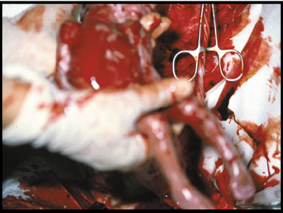
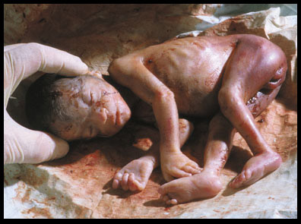
Hysterotomy 2nd & 3rd Trimesters
Similar to the Caesarean Section, this is used if chemical methods such as salt poisoning or prostaglandins fail. Incisions are made in the abdomen and uterus and the baby, placenta and amniotic sac are removed. Babies are sometimes born alive during this procedure, raising questions as to how and when these infants are killed and by whom.
The umbilical cord is usually cut while the baby is still in the womb, thus cutting off his oxygen supply and causing him to suffocate. Sometimes the baby is removed alive and simply left in a corner to die of neglect or exposure.

Slide 39
INDUCED ABORTIONS - COMPLICATIONS
Because most induced abortions are done by less skilled persons they are usually associated with fatal complications including:
1. Perforation of uterus, intestines, etc
2. Severe haemorrhage,
3. Sepsis and its associated complications,
4. Asherman’s syndrome, etc

Slide 40
INDUCED ABORTION – MEDICO-LEGAL ASPECTS IN KENYA
Only allowed for medical indications:
  If continuation of pregnancy is risk to life of the woman
At least two medical doctors should reach the decision and sign
Elective abortions – are unlawfull

Slide 41
LEGAL ASPECTS
Abortion trials or infanticide, question of delivery is important
Abortion occurred. Indications, who performed, how, where and when
Civil case- compensation
Criminal case- criminal intent with a jail conviction

Slide 42
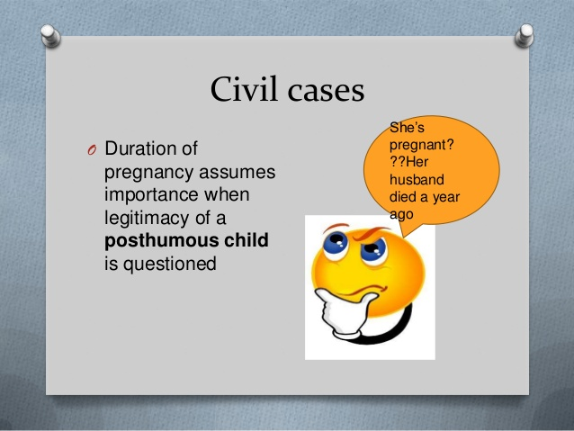

Slide 43
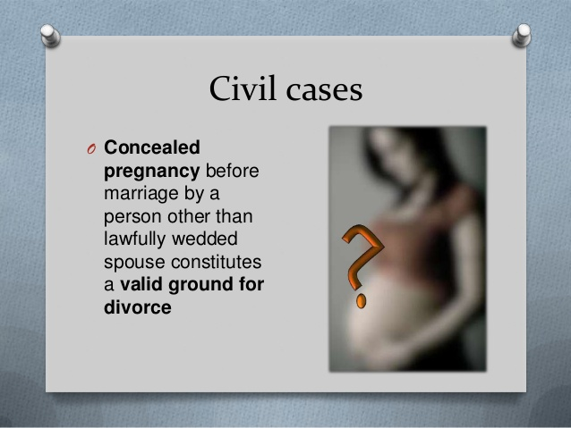

Slide 44
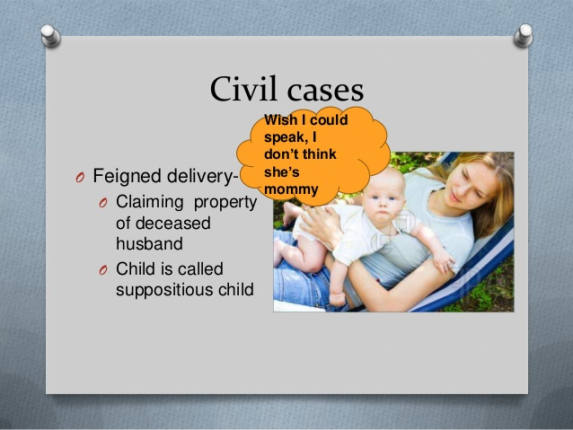

Slide 45


Slide 46
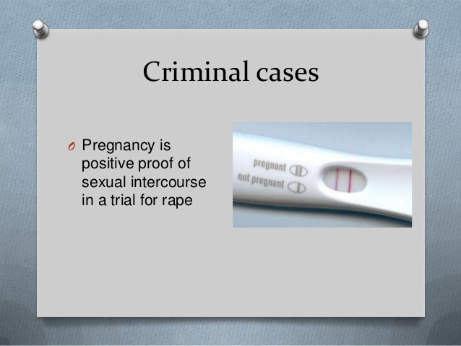

Slide 47
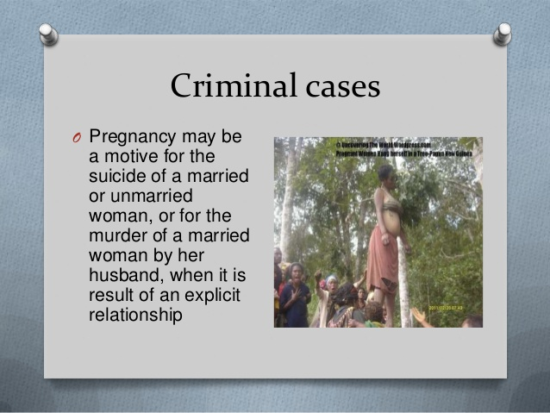

Slide 48
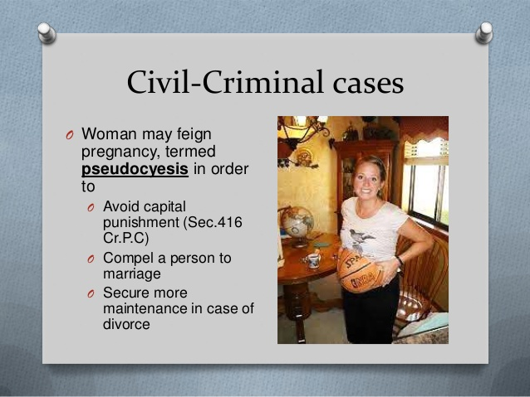

Slide 49
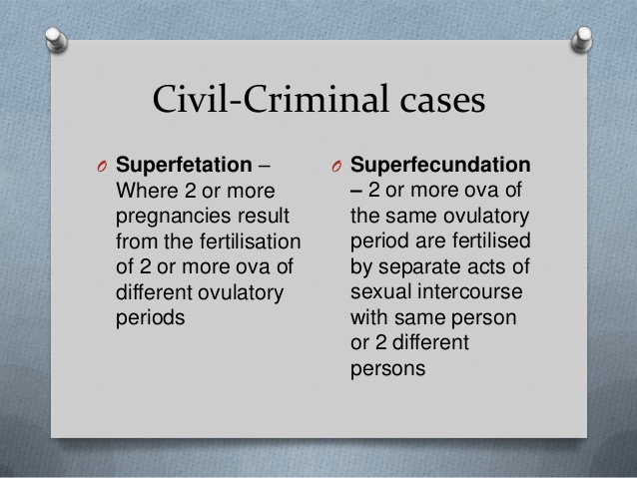

Slide 50
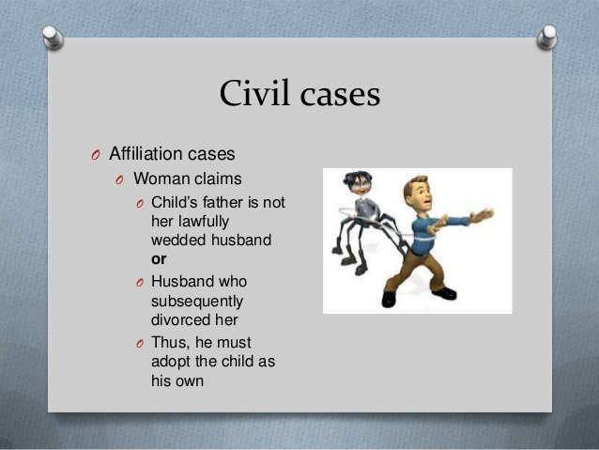

Slide 51
All of the following drugs have been used for medical abortion, except ?
A) Mifepristone
B) Misoprostol
C) Methotrexate
D) Atociban
E) PGE2

