Slide 1
Approach To A Patient With Chest Pain

Slide 2
Introduction
Chest pain most common EDs complaints globally
Spectrum of signs and symptoms reflect potential etiologies
  Who has CP?
  What is the nature of CP?
Important to recognize the most life threatening causes of chest pain.

Slide 3
Differential Diagnosis
Life Threatening Causes
Acute Coronary Syndrome
Acute Aortic Dissection
Pulmonary Embolism
Tension Pneumothorax
Pericardial Tamponade - Pericarditis
Mediastinitis

Slide 4
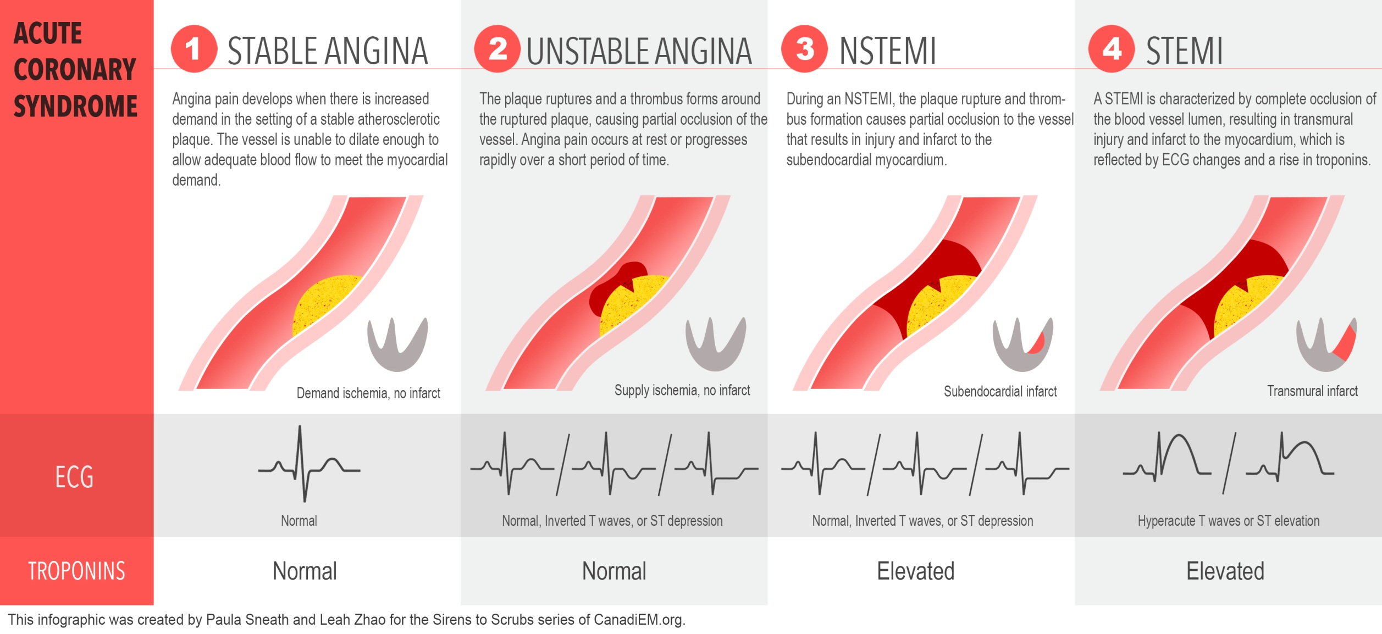
Acute Coronary Syndromes

Slide 5
Acute Aortic Dissection
Estimated at 3 per 100,000 patients per year.
Most commonly affects patients with HTN in 7th decade.
May affect younger individuals with known AV or CT abnormalities
Dissection begins with a tear between the intima and media.
Pulsatile blood flow causes propagation of the dissection with subsequent obstruction branch arteries.

Slide 6
Pulmonary Embolism
Over 1 in 1000 patients.
Mortality varies depending on comorbidities & size embolus.
Thromboembolism; clot lodged PA branch point or distally.
Consequences:
  PHT
  RV strain/dysfunction
  poor gas-exchange and
  pulmonary infarction

Slide 7
Pneumothorax
Pneumothorax can occur following trauma or pulmonary procedures.
Spontaneously in patients with underlying lung disease (secondary pneumothorax) or those without (primary pneumothorax).
Regardless of etiology, can lead to tension pneumothorax with compression of the mediastinum causing rapid clinical deterioration and death if unrecognized.

Slide 8
Mediastinitis
Common causes include odontogenic infections, esophageal perforation and iatrogenic complications of cardiac or upper G.I. surgery.
High mortality (14-42%) even when treated with operative debridement and antibiotics.

Slide 9
Pericardial Tamponade
Accumulation of fluid in the pericardial space under pressure leading to impaired cardiac filling.
May occur with aortic dissection, thoracic trauma or as a consequence of acute pericarditis (infectious, malignant, uremia).

Slide 10
Other Common Causes of Chest Pain
Cardiac: ADHF. Stable Angina; Aortic stenosis. Pericarditis, Myocarditis ; MV prolapse
Pulmonary/Pleural: Pneumonia, Bronchitis, Asthma exacerbations; Malignancy pleura involved; Cor Pulmonale.
GIT: GERD, esophageal spasm/rupture; sliding hiatus hernia.
Musculoskeletal: Rib contusions & #; Costochondritis; Intercostal muscle strains.
Psychiatric: Panic attack.
Other: Herpes zoster; Referred pain; CP associated with inflammatory disorders such as SLE, scleroderma.

Slide 11
History
Thoracic organs share afferent nervous system pathways.
Significant overlap in symptoms-difficult to distinguish organ system involved.
“Atypical” presentations more often than initially thought.
Obtain a detailed history of chest pain:
  Prior diagnostic studies, procedures.
  Whether similar to prior illness.
  Associated symptoms.
  Preceding symptoms.
  Risk factors and co morbidities.

Slide 12
SOCRATES
Site: Left chest, substernal, epigastric pain, right sided
Onset: When did it start? Constant/ Intermittent? Gradual or sudden?
Character: Pressure, heaviness, tightness of squeezing
Radiation: Arm, neck, jaw, back, shoulders.
Associated symptoms: Diaphoresis, SOB, nausea & vomiting.
Time course: duration? 1-5 minutes – stable angina, > 20 minutes – Unstable angina, MI?; Hrs non-anginal
Exacerbating/Relieving factors: Exertion, relieved by rest; Occurs at rest; Heavy meal; Emotion; Relieved by NTG?
Severity: Sharp, dull

Slide 13
Risk Factors for ACS/ATS
Diabetes mellitus
Hypercholesterolemia
Hypertension
Tobacco use
Prior CAD
Cocaine or Amphetamine use
Male sex
Age >55
Family history of CAD

Slide 14
Physical Examination
Most often unhelpful in distinguishing ACS & other non-cardiac causes
Patient may be anxious, distressed, diaphoretic and dyspneic.
Discrepancies in pulses or BP are notable findings in Aortic dissection.
Evidence of atherosclerosis (ATS): carotid bruits, diminished lower extremity pulses; xanthelasmas and xanthomas.

Slide 15
Physical Examination-2
Jugular venous distension, tender hepatomegaly; peripheral edema suggest RHF, possibly due to ACS or PE.
New apical systolic murmur MR signify papillary muscle dysfunction.
Pericardial friction rub may suggest pericarditis.
Basal rales +/- S3 gallop associated LVF.

Slide 16
Physical Examination-3
Asymmetric leg swelling raises concern for PE.
Unilateral decreased breath sounds may be seen in pneumothorax.
Chest wall tenderness, localization pains to point - single fingertip-, MI improbable
Epigastric tenderness suggests GI source

Slide 17
Investigations
ECG
CXR
Cardiac biomarkers
Imaging

Slide 18
Electrocardiogram
A standard 12-lead ECG in all patients presenting with CP of ACS probable; ACC/AHA recommend an ECG within 10 minutes
ECG is best immediately available test for ACS, sensitivity low for AMI
Single ECG at initial presentations detects <50 percent of AMIs
ECG repeated as frequently as every 10 minutes if not diagnostic & patient remains symptomatic-assess dynamic changes

Slide 19
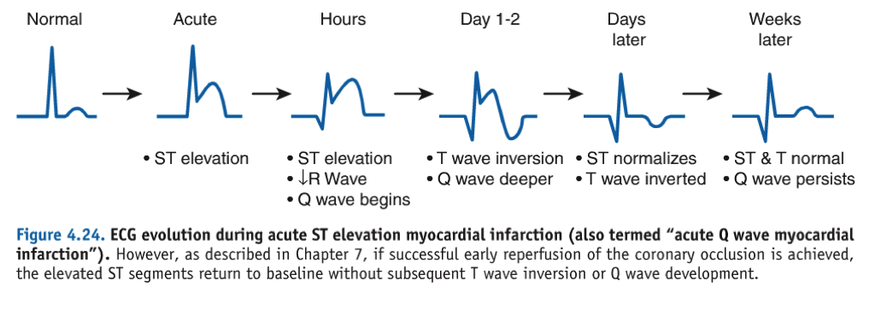
ECG Evolution in STEMI

Slide 20
Electrocardiogram-2
Pulmonary Embolism
  Limited value in PTE.
  Most common finding Sinus Tachy; S1Q3T3 reflects RV strain; low Sen & Spec.
  If clinical scenario suggests PE, evidence of RAD, RBBB or RAE increases suspicion.
Pericardial tamponade and pericarditis
  ECG suggestive of tamponade: low voltage & electrical alternans.
  ECG in pericarditis may mimic AMI. Findings include PR depression and ST segment elevation and T wave inversions.; typically more diffuse than AMI.

Slide 21
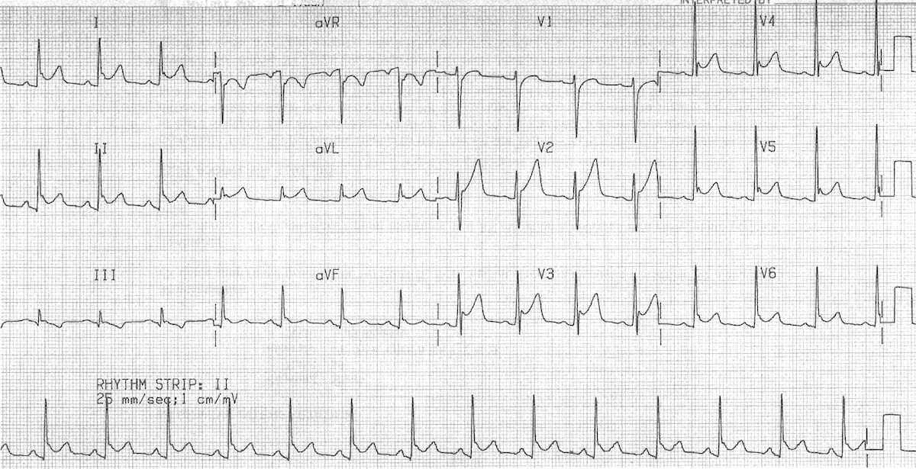
ECG-Pericarditis

Slide 22
Electrocardiogram-3
Acute aortic dissection: can range from completely normal to ST segment elevation if the dissection involves the origin of CA.

Slide 23
Chest Radiograph
A CXR is obtained in all CP with hemodynamic instability or a potentially life-threatening diagnosis:
  Usually non diagnostic and non-specific CXR in ACS and PE.
  Rare findings such as pleural based wedge-shaped defect (Hampton’s hump) or paucity of vascular markings distal to the site of embolus (Westermar’s sign) may occur.
  90% of patients with acute Ao dissection will have some CXR abnormality; classic findings a widened mediastinum and aortic knob.
  Will help detection of a pneumonia or pneumothorax.
  Cardiomegaly and pulmonary edema suggest AHF.
  Hiatal hernia, pleural effusion or mass may also be seen.

Slide 24
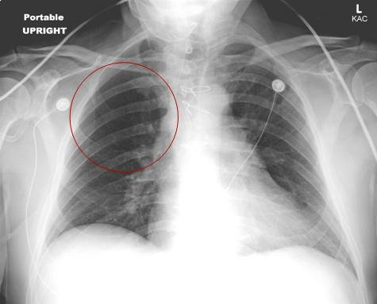
CXR - PE

Slide 25
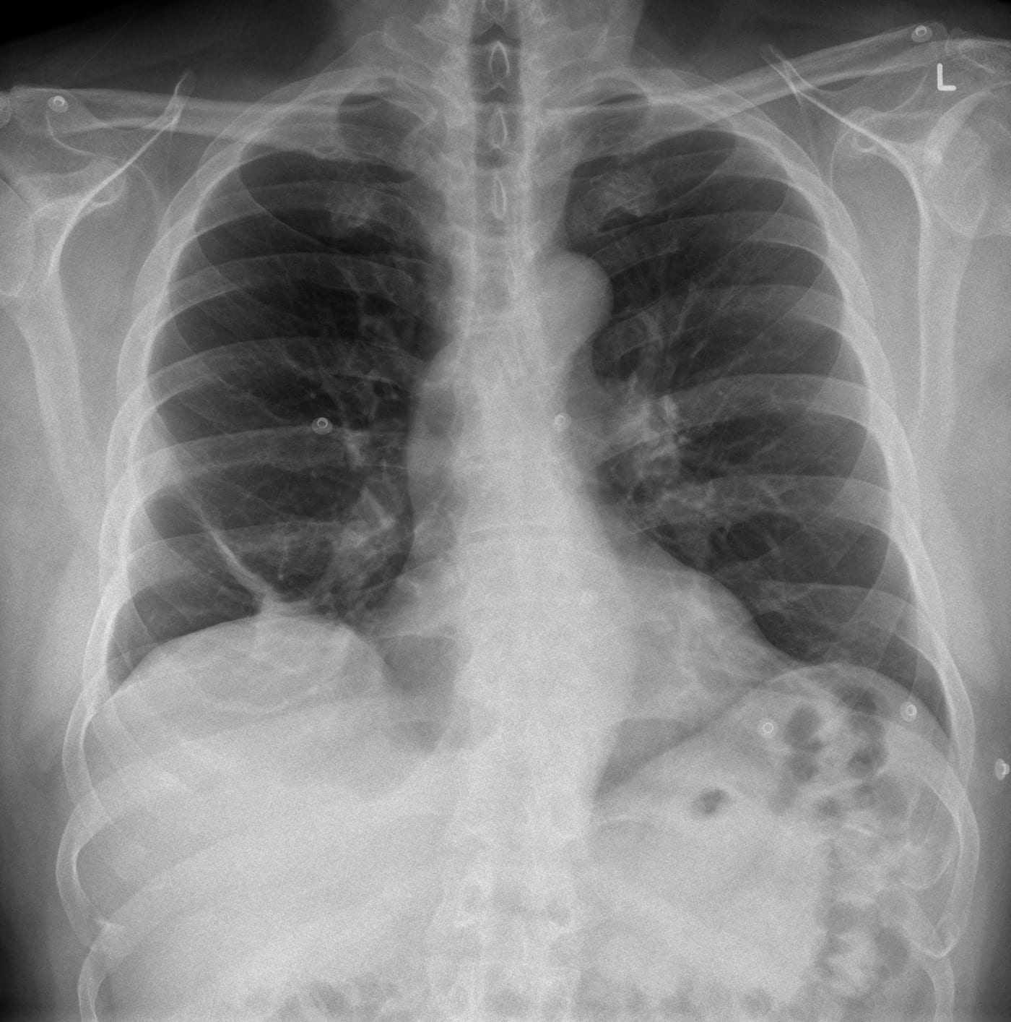
CXR - PE

Slide 26
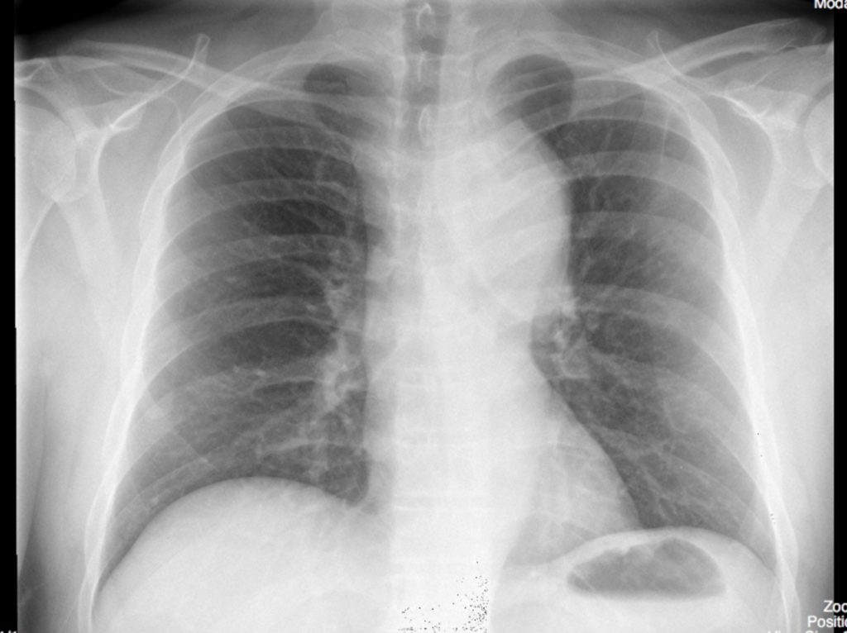
CXR - Aortic Dissection

Slide 27
Investigations
Cardiac Biomarkers
  Troponin I and T detect elevations within 3 hours and peak at 12 hours remaining elevated for 7 to 10 days.
  HS troponin assays become elevated even more rapidly.
  CK MB isoform levels rise to twice the normal at 6 hours and peak within approximately 24 hours.
  A single set of negative cardiac biomarkers is NOT sufficient to rule out MI; however using HS troponin assay, a level of <6ng/L in patient with CP > 2hrs can safely rule out AMI.
  Interval testing is important to assess for serial elevation.

Slide 28
Investigations Other
D-Dimer
  Among patients with suspected PE, this test can rule out a diagnosis if negative and can avoid further testing.
  elevated at baseline in elderly and malignancies, sepsis, recent major surgery or trauma, or pregnancy
WBC: Elevated in inflammatory or infectious etiologies of CP
NT-proBNP:
  Above 100pg/ml are highly suggestive of HF; levels below 50 high NPV
Compression Venous-Doppler US
Echocardiography TT/TEE: RWMA in ACS; Pericardial eff & Tamponade

Slide 29
Imaging for Aortic Dissection and Pulmonary Embolism
Acute Aortic Dissection: CT and MRI sensitivity of 98%. TEE (94%) at the bedside. CT angiography is the most common initial study.
Pulmonary Embolism:
  CT-PA is the gold standard; contraindicated in contrast allergy and renal insufficiency. Risk of AKI vs benefit of immediate diagnosis weighed with clinical index of suspicion.
  V/Q scan done when a CT-PA is unavailable or contraindicated.

Slide 30
Investigations
POCUS – Bedside ultrasound is being used with increasing frequency and often helps to exclude or support a diagnosis.
  It can be used to assess blunt trauma as part of the extended FAST to identify traumatic pneumothorax.
  Can identify pericardial effusions and tamponade, wall motion abnormalities, right ventricular strain and pleural effusions.

Slide 31
Approach To Diagnosis
Often definitive diagnosis cannot be made initially and additional testing is performed; in parallel with management.
History, co morbidities and description of symptoms help to narrow the scope of potential diagnoses & to stratify risk for life threatening condition.
The physical examination focuses on vital sign abnormalities; cardiac & pulmonary findings and may support a diagnosis.
An ECG and CXR are essential tools in diagnosis.

Slide 32
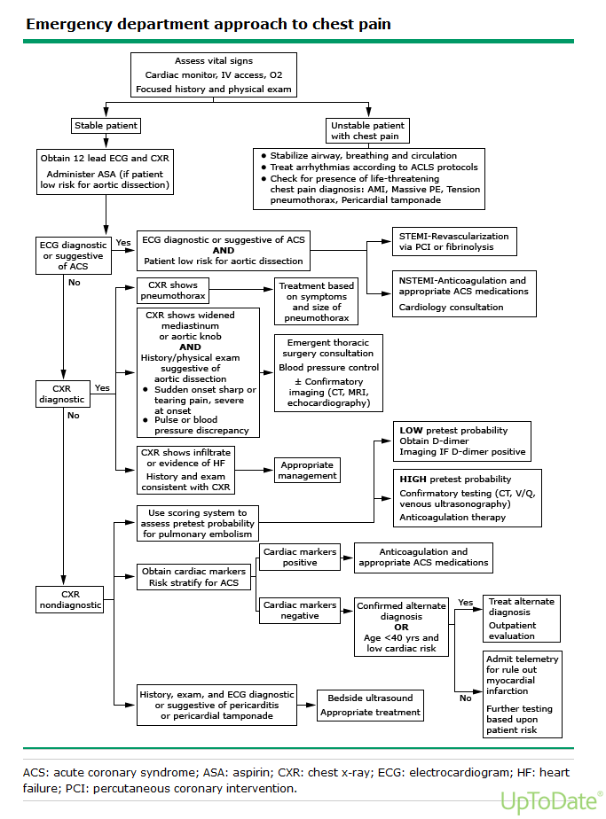

Slide 33
ECG &CXR

Slide 34
ECG: No ACS
CXR: Dxtic

Slide 35
CXR Non-Dxtic

