Slide 1
PNEUMONIAS
MBChB VI
18th February 2021
Dr Marybeth C. Maritim
MBChB, MMed, DTMH, FCP (ECSA)

Slide 2
Lecture Objectives
Define pneumonia
Classify and define types of pneumonia
Describe the etiologic organisms, risk factors for, clinical features, investigations, treatment, complications and preventive measures of the various types of pneumonias

Slide 3
Case 1
JK, 70 yrs, male, admitted with 3 day Hx of cough, chest pain, fever and confusion
Has been living at an Old People’s home for the past 10 yrs. Hx of smoking, 5-pack years but stopped several years ago
O/E sicklooking, tachypnoeic, RR-40b/min, BP -100/50mmHg, features of consolidation RT middle lobe
With reasons, what is your diagnosis?
What investigations would you do and why?

Slide 4
Case 2
SM, 48yr old female, admitted 4 days ago with a 1-day Hx of inability to move the LT side of her body
She has difficulty keeping food in the mouth and had NG Tube inserted for feeding on admission
Today on the MWR, she is found to have new onset cough, fever and breathlessness
With reasons, what is your diagnosis?
What investigations would you do?

Slide 5
Organisms
Case 1 – What are the likely aetiological organisms in case 1? Why?What treatment would you give?
Case 2 – What are the likely organisms in case 2? Why? What treatment woul you give?

Slide 6
Pneumonia
Definition
Acute respiratory illness associated with recently developed radiological pulmonary shadowing which is either segmental or lobar
Pneumonia may be bacterial, viral, mycobacterial or fungal

Slide 7
Classification
1) Community-acquired pneumonia
2) Hospital-acquired pneumonia
3) Aspiration pneumonia (including suppurative pneumonia)
4) Pneumonia in the immunocompromised host

Slide 8
Community-Acquired Pneumonia (CAP)
Definition
Pneumonia acquired in the patient’s home or in the non-hospital environment such as a nursing home
Mainly spread by inhalational

Slide 9
CAP - Definitions
Lobar pneumonia - radiological and pathological term
  Refers to homogeneous opacification (red hepatisation) of one or more lung lobes often associated with pleural inflammation
Bronchopneumonia - patchy alveolar consolidation associated with bronchial and bronchiolar inflammation affecting both lower lobes

Slide 10
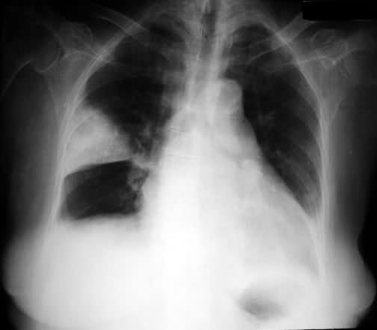
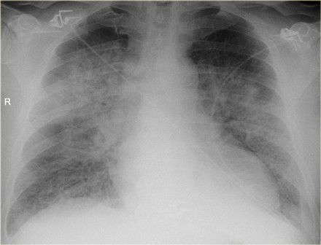
Lobar Pneumonia vs Bronchopneumonia

Slide 11
CAP – Organisms I
Etiologic Organisms
Streptococcus pneumoniae 30%
Chlamydia pneumoniae 10%
Mycoplasma pneumoniae 9%
Legionella pneumophila 5%
Hemophilus influenza 3%

Slide 12
CAP – Organisms II
Etiologic Organisms
Others – Staphylococcus aureus, Chlamydia psittaci, Coxiella burnetti, Klebsiella pneumoniae, Actinomyces israeli all <1%.
Viruses – Influenza virus 7-8% of CAP
- Parainfluenza
- Measles
- Respiratory syncytial virus (RSV) in infancy
- Varicella (chicken pox)

Slide 13
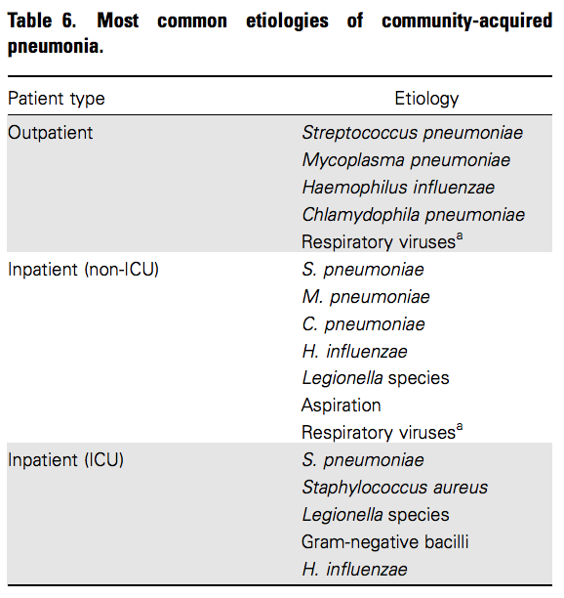
Aetiological Organisms of CAP

Slide 14
Risk Factors
Cigarette smoking
Alcohol intake
Corticosteroid therapy
Old age
Recent influenza infection
Preexisting lung disease
Contact with sick birds (Chlamydia psittaci)
Farm environments (Coxiella burnetti)

Slide 15
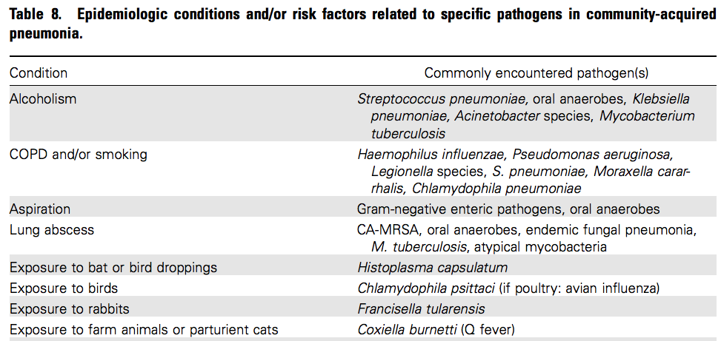
Risk Factors and Specific Pathogens I

Slide 16
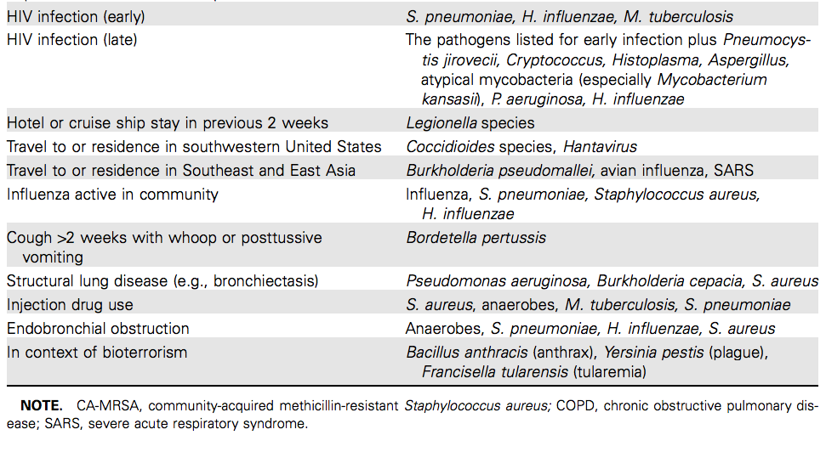
Risk Factors and Specific Pathogens II

Slide 17
Clinical Features - Symptoms
Cough – productive of rust coloured sputum
Fever
Malaise
Pleuritic chest pain
Headache
Confusion

Slide 18
Clinical Features - Signs
Fever
Tachycardia
Tachypnoea
Hypoxemia
Hypotension
Confusion
Pleural rub
Signs of consolidation – dull percussion note and bronchial breath sounds
Crepitations
Signs of a pleural effusion – stony dullness and absent or reduced breath sounds.

Slide 19
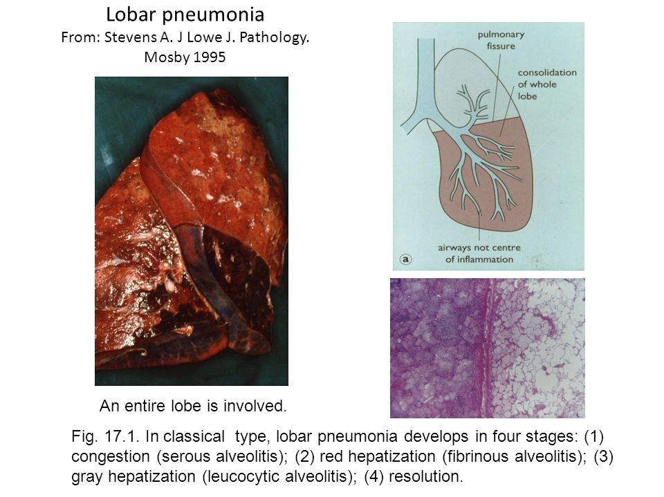
Pathological Basis for the Signs in Lobar Pneumonia

Slide 20
Assessment of Disease Severity I
Clinical parameters
- Age of 60yrs or older
- Respiratory rate >30/min
- Diastolic blood pressure 60mmHg or less
- Confusion
- More than 1 lobe involved in CXR
- Presence of underlying disease

Slide 21
Assessment of Disease Severity II
Laboratory parameters
- Hypoxemia (PaO2 <8kPa)
- Leucopenia (<4,000x10⁹/L)
- Leucocytosis (>20,000x10⁹/L)
- Raised serum urea ≥7mmol/L
- Positive blood culture
- Hypoalbuminemia

Slide 22
Assessment of Disease Severity III
The 4 cardinal markers of severity are:-
- RR ≥30/ min
- Diastolic BP ≤60mmHg
- Serum BUN of ≥7mmol/L
- Presence of confusion
Patients with 2 or more of the 4 cardinal markers of severity have a 36-fold higher risk of dying compared with patients without these signs

Slide 23
CURB – 65 Score
Based upon 5 easily measurable factors
  Confusion (based upon a specific mental test or new disorientation to person, place, or time) = 1 point
  Urea (BUN) >7 mmol/L = 1 point
  RR >30 breaths/minute = 1 point
  BP (systolic <90 mmHg or diastolic <60 mmHg) = 1 point
  Age >65 years = 1 point

Slide 24
CURB -65 and Mortality Risk
Score | Mortality % | Risk Level | Site of Care
0 | 0.6 % | Low | Outpatient
1 | 2.7 % | Low | Outpatient
2 | 6.8 % | Moderate | Short inpatient/Supervised inpatient
3 | 14 % | Moderate to High | Inpatient
4 or 5 | 27.8 % | High | Inpatient/ICU

Slide 25
Investigations I
Chest radiograph
Homogenous opacity localised to the affected lobe or segment
Useful in identifying pleural effusion, intrapulmonary abscess formation or when empyema is suspected
Hilar lymphadenopathy is seen in Mycoplasma pneumonia

Slide 26
Investigations II
2)Microbiological investigations
- sputum microscopy, culture and sensitivity
- aspiration of tracheal/ bronchial secretions during bronchoscopy for M/C/S
- Blood cultures and sensitivity patterns
3) Arterial blood gas measurement for assessment of disease severity

Slide 27
Investigations III
4) Complete blood count
- Neutrophil leucocytosis suggests bacterial pneumonia
- Leucopenia suggests viral etiology

Slide 28
Treatment
Supportive and specific treatment
Good response to antibiotic therapy
When there is delayed recovery suspect:-
- complications
- wrong diagnosis
- proximal bronchial obstruction
- recurrent aspirate

Slide 29
Supportive Treatment
Oxygen- for all hypoxemic patients. Use concentrations ≥35% in those without advanced COPD or hypercapnia
IV fluids
Physiotherapy
Pain relief with paracetamol or if severe then with pethidine or morphine

Slide 30
Empiric Treatment
Pretreatment specimen samples (blood cultures and expectorated sputum) should be obtained for microbiological evaluation before starting empirical therapy
Combination empirical treatment is recommended

Slide 31
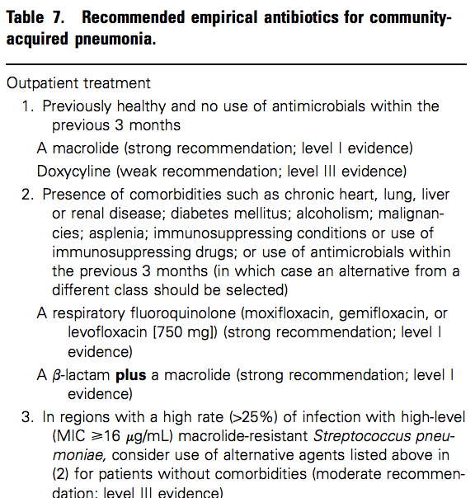
Empiric Antibiotic Use for CAP I

Slide 32
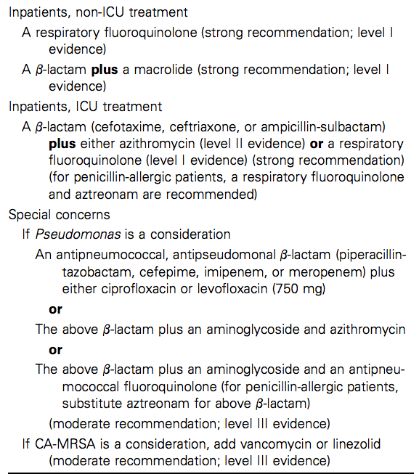
Empiric Antibiotic Use for CAP II

Slide 33
2018 KNH Guidelines
Outpatient:
Amoxicillin or Amoxicillin /Clavulanic or Cefuroxime acetyl
Inpatient
Amoxicillin /Clavulanic or Cefuroxime or Ceftriaxone
PLUS
Macrolide

Slide 34
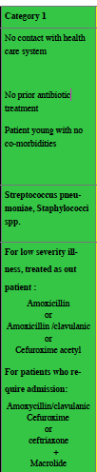

Slide 35
Pathogen Specific Treatment
Antibiotic therapy – given after specimens have been obtained for microbiological evaluation
  S. pneumoniae - B-lactam antibiotic eg ceftriaxone
  C. pneumoniae/ C.psitacci - macrolide or tetracycline (doxycycline)
  M. pneumoniae – Macrolide or tetracycline

Slide 36
Pathogen Specific Treatment II
  L. pneumophila – Fluoroquinolone or macrolide
  H. influenza – B-lactam antibiotic, ciprofloxacin
  Klebsiella pneumoniae - gentamicin and ceftazidime
  Actinomycosis – benzyl penicillin
  Varicella pneumonia – acyclovir

Slide 37
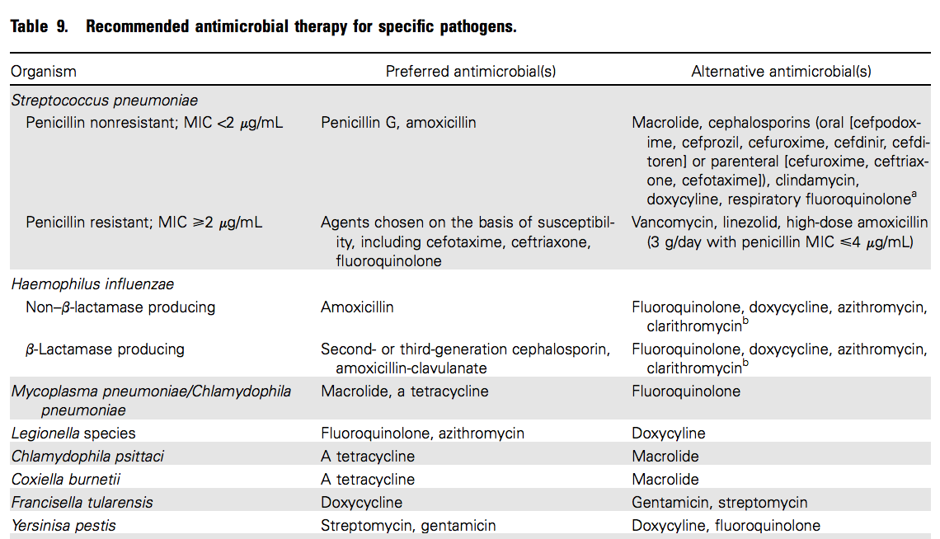
Pathogen Specific Therapy III

Slide 38
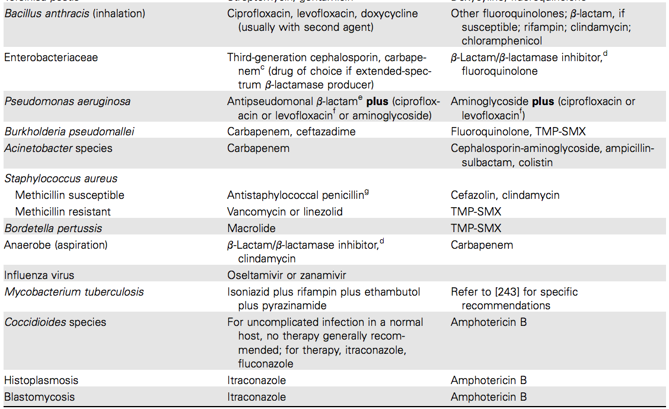
Pathogen Specific Therapy IV

Slide 39
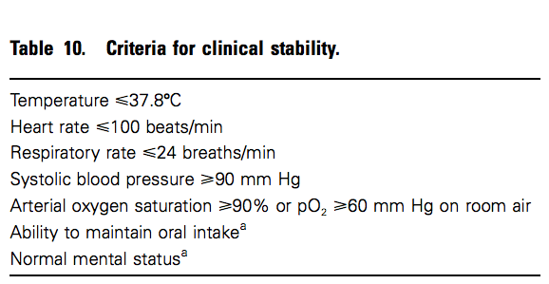
Indicators of Improvement

Slide 40
Complications
Parapneumonic effusions
Empyema
Sputum retention
Pneumothorax

Slide 41
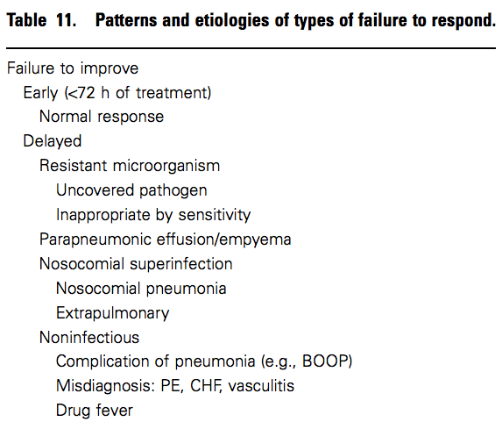
Patterns of Delayed Response and Causes I

Slide 42
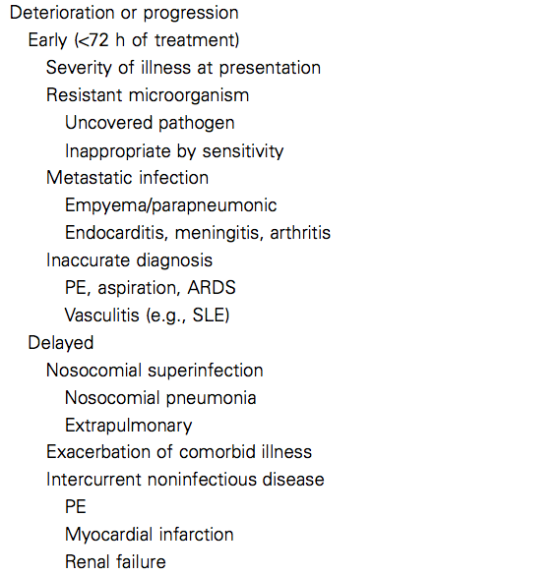
Patterns of Delayed Response and Causes II

Slide 43
Prevention of CAP
Immunization with annual influenza vaccine for all people >50yrs
Immunization with 23 polyvalent pneumococcal and H. influenza type B vaccines for all susceptible people e.g.
  elderly>65yrs
  Co-morbidities like diabetes, immunocompromised, sickle cell disease or asplenia
Pneumococcal conjugate vaccine (PCV 13) is recommended as booster 1 year after PPV23
Treatment of water sources to prevent Legionella pneumophila

Slide 44
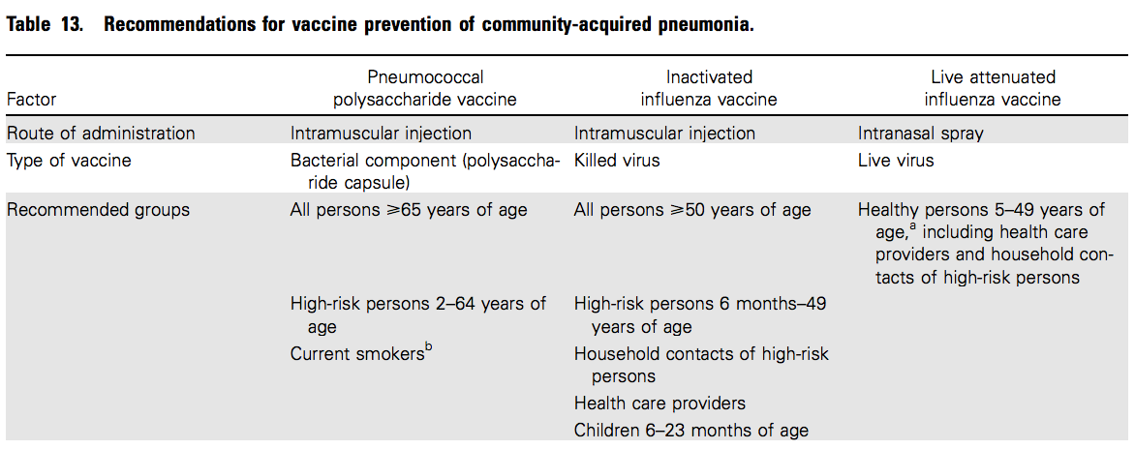
Vaccine Recommendations I

Slide 45
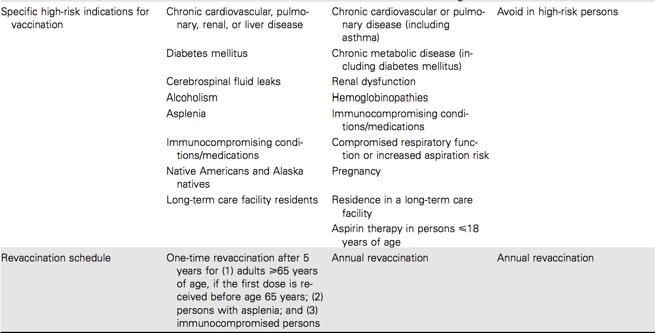
Vaccine Recommendations II

Slide 46
Serotypes in Available Pneumococcal Vaccines
PPV-23 – 1,2,3,4,5,6B,7F,8,9N,9V,10A,11A,12F,14,15B,17F,18C,19F,19A,20,22F,23F and 33F
  (23-valent pneumococcal polysaccharide vaccines for adults and children < 2years)
PCV-13 – 1,3,4,5,6A,6B,7F,9V,14,18C,19A,19F and 23F
  (Polysaccharide-protein conjugate vaccines, better tolerated in children and induce an immune response)
PCV-10 – 1,4,5,6B,7F,9V,14,18C,19F and 23F

Slide 47
Hospital Acquired Pneumonia (HAP)
Nosocomial pneumonia
Definition
A new episode of pneumonia occurring at least 2 days (48hrs) after admission to hospital
Occurs in 2-5% of all hospital admissions
Mortality is high ≈ 30%

Slide 48
HAP
Etiologic Agents (Organisms)
Gram negative bacteria
-Escherichia coli
-Pseudomonas
-Klebsiella species
Staph aureus including methicillin resistant staph aureus (MRSA)
Anaerobic organisms

Slide 49
Risk Factors I
Reduced host defences against bacteria
- Reduced immune defences e.g. diabetes , malignancy
- Reduced cough reflex( Post-operative)
- Disordered mucociliary clearance
- Bulbar or vocal chord palsy

Slide 50
Risk Factors II
Aspiration of nasopharyngeal or gastric secretions
- Immobility or reduced level of consciousness
- Vomiting, dysphagia, achalasia, severe reflux
- Nasogastric intubations

Slide 51
Risk Factors III
Bacteria introduced into the lower respiratory tract
- Endotracheal intubation/ tracheostomy
- Infected ventilators, nebulisers, bronchoscopes.
- Dental or sinus infections
Bacteremia
- Abdominal sepsis
- Intravenous cannula infections
- Infected emboli

Slide 52
Clinical Features
Cough
Fever
Sputum purulence
Breathlessness
Central cyanosis
Crepitations

Slide 53
Investigations
1) Chest radiograph – mottled appearance in both lung fields in the lower zones
2) Complete blood counts – neutrophil leucocytosis
3) Tracheal aspirates
4) Blood cultures

Slide 54
Treatment
Supportive treatment
- Physiotherapy
- Oxygen therapy
- Fluid support and monitoring
Specific therapy
IV antibiotics guided by culture results.
Gram negative coverage which includes
-3rd generation cephalosporin + an aminoglycoside
or
- imipenem
or
- a monocyclic β-lactam + flucloxacillin

Slide 55
2018 KNH Guidelines
Category 2
Piperacillin/Tazobactam or Ceftazidime
PLUS
Amikacin

Slide 56
2018 KNH Guidelines
Category 3
Imipenem/Cilastatin or Meropenem or Piperacillin/Tazobactam or Ceftazidime or Cefepime
PLUS
Amikacin
Vancomycin / Teicoplanin/Linezolid if MRSA is suspected.

Slide 57
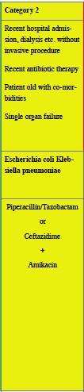

Slide 58
Prevention of HAP
Improved pulmonary toilet in post-op patients through frequent suctioning, incentive spirometry and non-cough suppressant analgesia
Handwashing
Appropriate sterilization and handling of devices and respiratory equipment
Proper placement of NG tubes
Appropriate volume and rate of oral and enteral feeding
Elevation of head of bed to 30 -45⁰

Slide 59
Aspiration Pneumonia / Suppurative Pneumonia
Definition
Pneumonia resulting from introduction of foreign objects or substances into the lower respiratory tract
Etiologic Agents (Organisms)
- Enterobacteriaceae
- Staphylococcus aureus
- Streptococcus pneumoniae
- Haemophilus influenza

Slide 60
Mechanisms for Aspiration and Suppurative Pneumonia
1) Primary bacterial pneumonias with pulmonary suppuration due to Staph. aureus and Klebsiella pneumoniae
2) Inhalation of septic material during operations on the nose, mouth or throat under general anaesthesia
3) Inhalation of vomitus
4) Bacterial infection of a pulmonary infarct or of a collapsed lobe

Slide 61
Risk Factors
Gross oral sepsis
Bulbar palsy
Vocal chord palsy
Achalasia
Oesophageal reflux disease
Alcoholics
IVDU – at risk of lung abscesses associated with endocarditis affecting the pulmonary and tricuspid valves

Slide 62
Clinical Features - Symptoms
Cough – productive of large amounts of sputum, fetid and bloodstained
Chest pain (pleuritic)
Sudden expectoration of copius amount of foul sputum occurs if abscess ruptures into a bronchus

Slide 63
Clinical Features - Signs
High fever
Digital clubbing may develop quickly in 10-14 days
Signs of consolidation
Pleural rub is common
Weight loss

Slide 64
Investigations
1)Chest radiograph
Homogenous lobar or segmental opacity consistent with consolidation or collapse
Large, dense opacity which may later cavitate and show a fluid level is the characteristic finding when a frank lung abscess is present
A preexisting emphysematous bulla may become infected and appears as a cavity containing an air-fluid level
2) Sputum examination and culture

Slide 65
Treatment
1) Supportive treatment – Physiotherapy to assist in drainage of large cavities
2) Specific treatment
Ceftriaxone(gram positive+ negative) + clindamycin (anaerobic)
Modify treatment according to microbiology results
Treat for 4-6 weeks
Removal of any obstructing endo-bronchial lesion is essential
Surgical intervention for abscesses that fail to resolve despite optimal medical therapy

Slide 66
Complications
Fibrosis
Bronchiectasis
Prevention
Good oral hygiene
Assess patients at risk of aspiration and nurse them with head of bed elevated between 30 – 45⁰

Slide 67
Pneumonia in The Immunocompromised Host
Defined as:-
Pneumonia in patients receiving immunosuppressive drugs and in those with diseases causing defects in cellular or humoral immune mechanisms
Etiologic Agents( Organisms)
Gram negative bacteria especially P. aeruginosa
Unusual organisms normally considered to be of low virulence or non-pathogenic

Slide 68
Risk Factors/ Etiologic Agents I
Neutropenia due to cytotoxic drugs, agranulocytosis or acute leukemia predisposes to pneumonia due to
- Staph aureus
- Gram negative bacteria
- Candida albicans
- Aspergillus fumigatus

Slide 69
Risk Factors/ Etiologic Agent II
T-cell defects due to lymphoma, CLL, immunosuppressive drugs, bone marrow transplant or splenectomy predisposes to pneumonia due to
- C. albicans
- Mycobacteria tuberculosis
- Pneumocystis carinii
- Cytomegalovirus
- Gram negative bacteria
- Staph aureus
- Strep pneumoniae
- H.influenza

Slide 70
Risk Factors/ Etiologic Agent III
Abnormalities in antibody production due CLL and myeloma predispose to pneumonia due to encapsulated organisms
- Strep.pneumonia
- H.influenza

Slide 71
Clinical Features
Fever
Cough
Breathlessness

Slide 72
Investigations
1) Chest radiograph
2) Sputum microscopy, culture and sensitivity. May require sputum induction using hypertonic saline in patients with dry cough
3) Bronchoscopy with broncho-alveolar lavage (BAL) for M/C/S
4) Lung biopsy

Slide 73
Treatment
Based on an established etiological diagnosis
Empirically
  broad spectrum antibiotic e.g. 3rd generation cephalosporin or a quinolone + an antipseudomonal penicillin(piperacillin-tazobactam, cefepime,imipenem or meropenem) + an aminoglycoside
If cause is PCP treat with high dose septrin

Slide 74


Slide 75
Prevention
Use of GCSF factors eg filgrastim(G-CSF) and sargramostim(GM-CSF) in patients with neutropenia

Slide 76
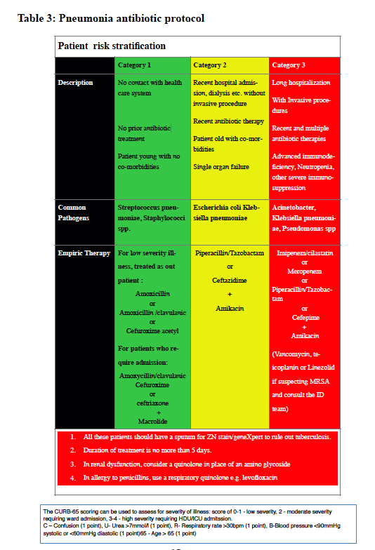

Slide 77
THANK YOU !

