Slide 1
INVESTIGATIONS IN CARDIOLOGY
DR. E. M. KARARI CARDIOLOGIST/LECTURER
DEPT OF MEDICINE
UNIVERSITY OF NAIROBI

Slide 2
INTRODUCTION
Investigations serve to confirm diagnosis
Do not replace clinical skills
Must be interpreted within the clinical context
Include CXR, ECG (resting and stress), ECHO, cardiac catheterization, coronary angiogram, myocardial perfusion scans MRI, CT scan, LAB tests
Always treat the patient not the result

Slide 3
CXR
Cardiac silhouette gives important information on size and state of heart
  Should occupy less than ½ of hemi thorax
  Know the chambers forming the borders
    LT – LV
    RT- RA
    LT UPPER BORDER – LA/ pulmonary bay, aortic knuckle
  Lung fields – help differentiate cardiac and respiratory causes of dyspnoea e.g, pulmonary oedema / pl. effusion
  Ribs – e.g, notching in COA

Slide 4
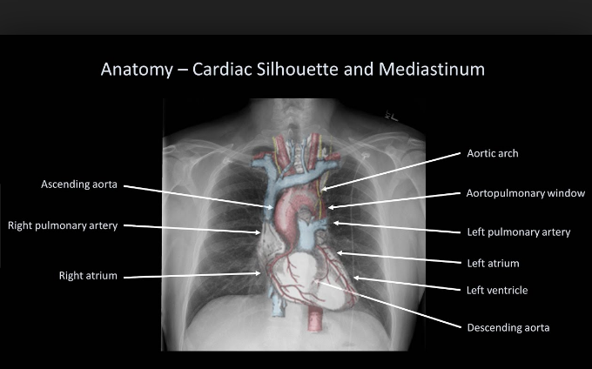

Slide 5
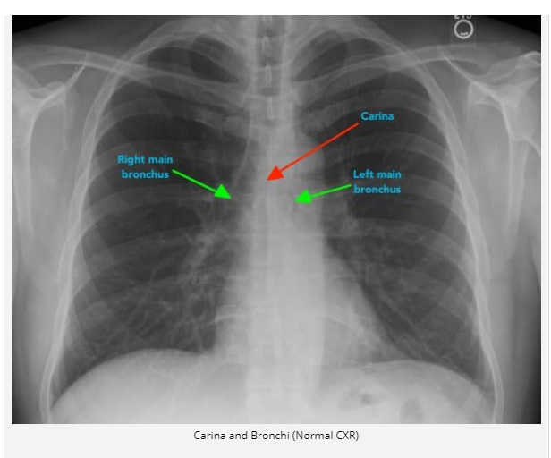
Notes:
‹#›

Slide 6
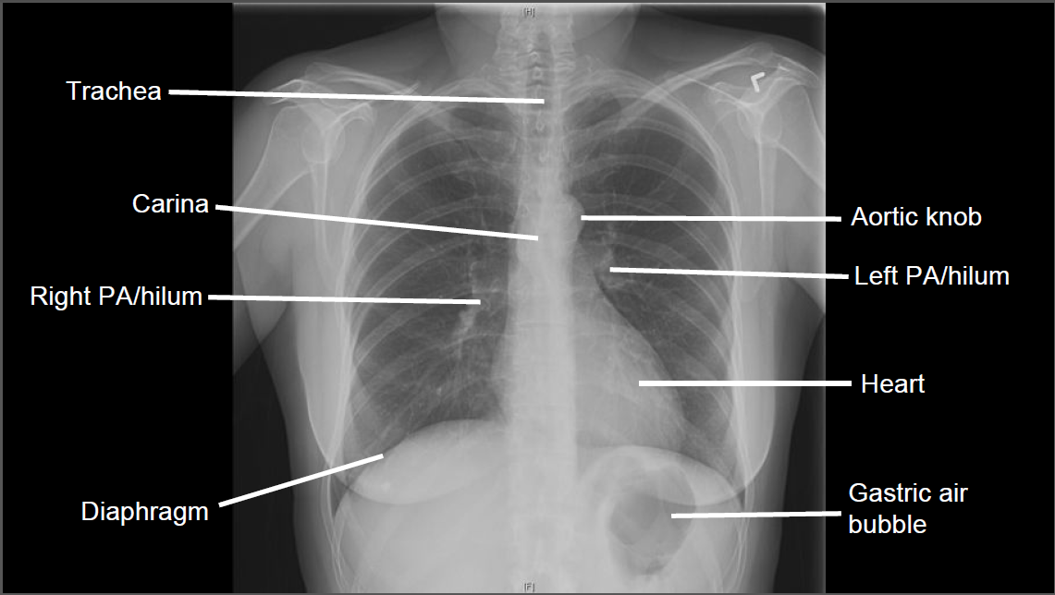

Slide 7
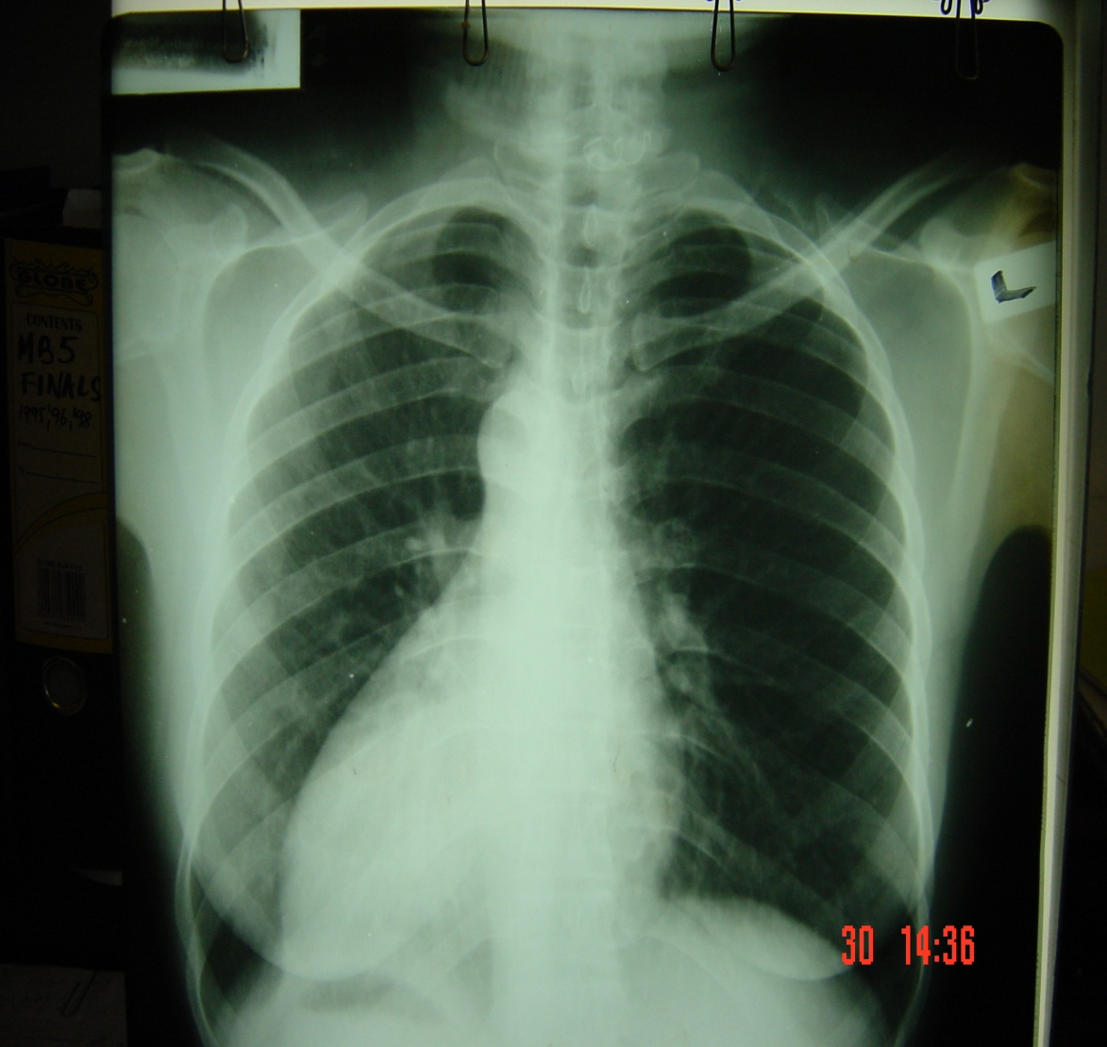
There is Dextrocardia
The patient has Situs inversus; see gastric bubble

Slide 8
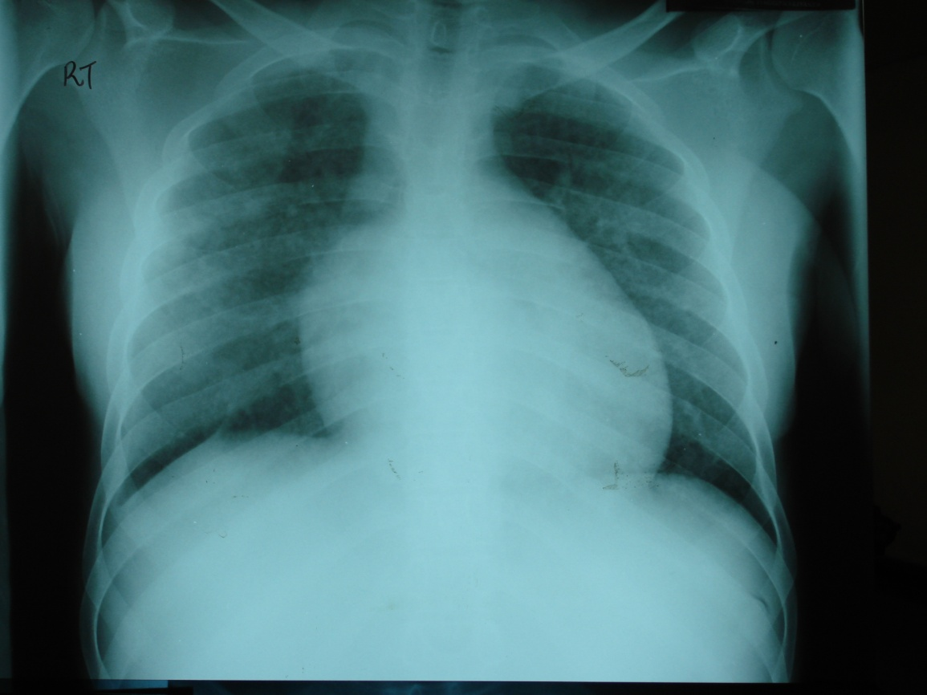
MASSIVE CARDIOMEGALLY
Differential diagnoses
include:
Dilated cardiomyopathy
Pericardial effusion

Slide 9


Slide 10
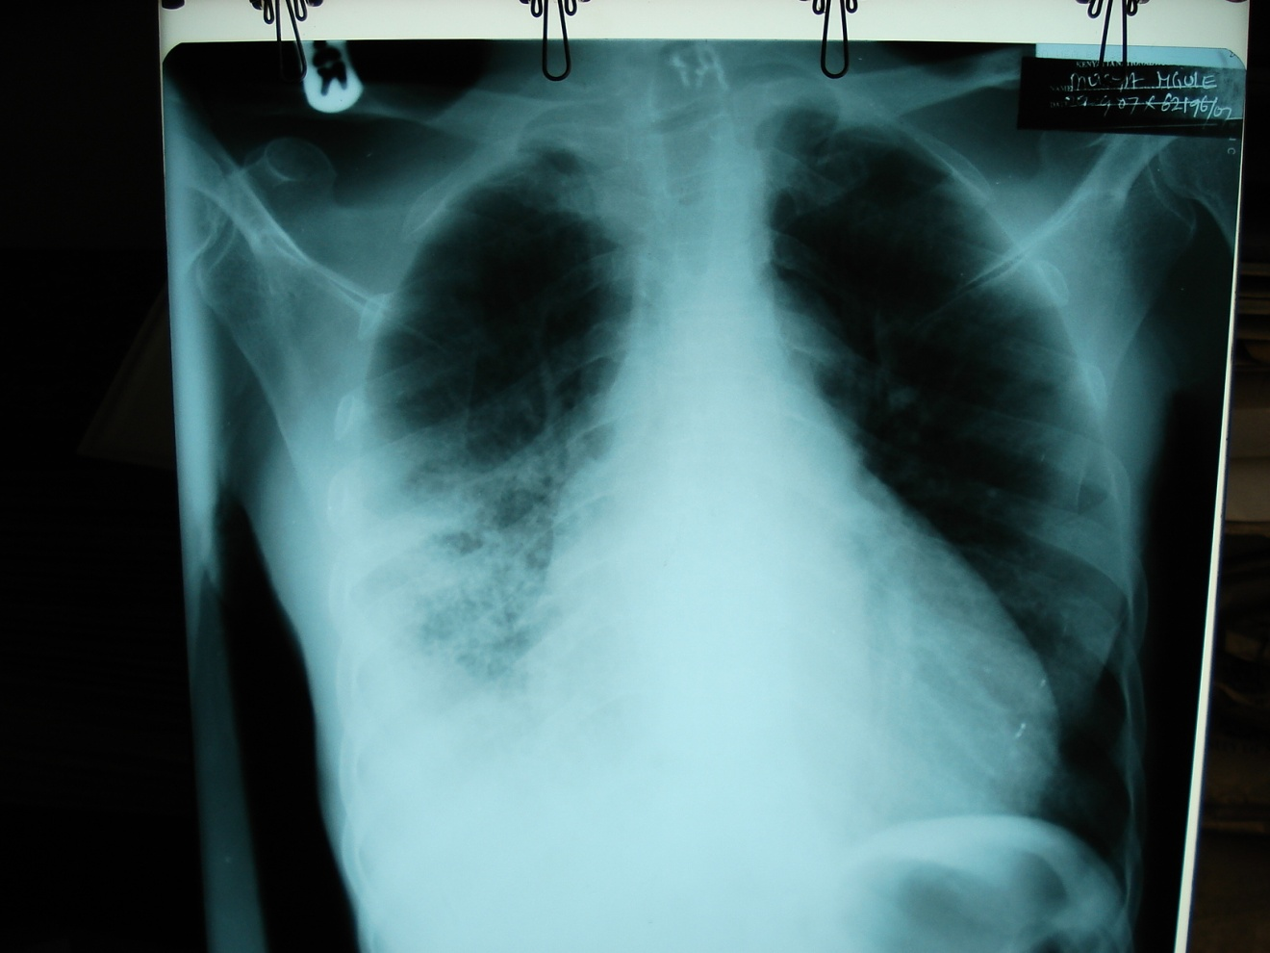
L
Cardiomegally
Right sided consolidation and effusion

Slide 11
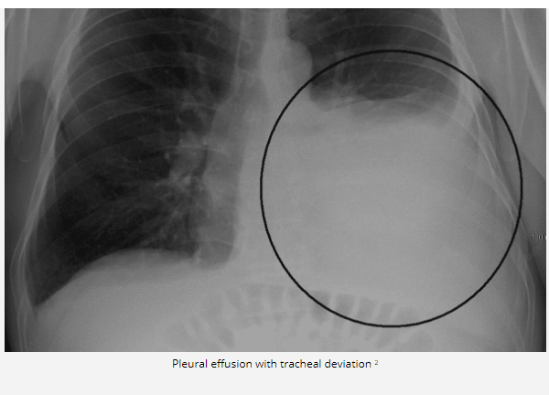

Slide 12
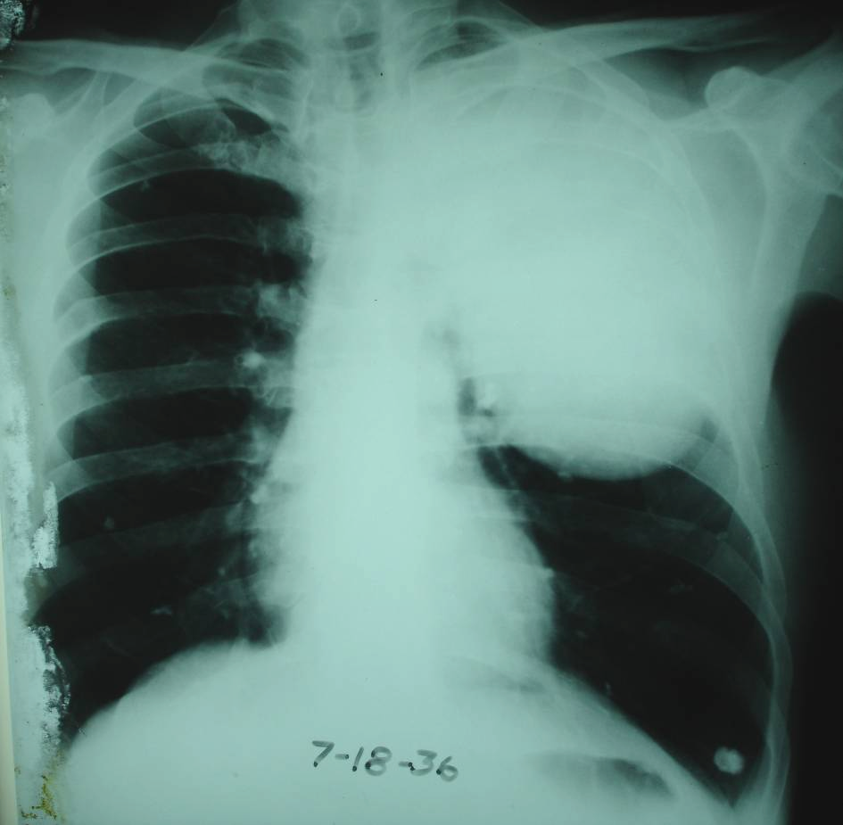
CXR of a Pastoralist from Lokichogio

Slide 13
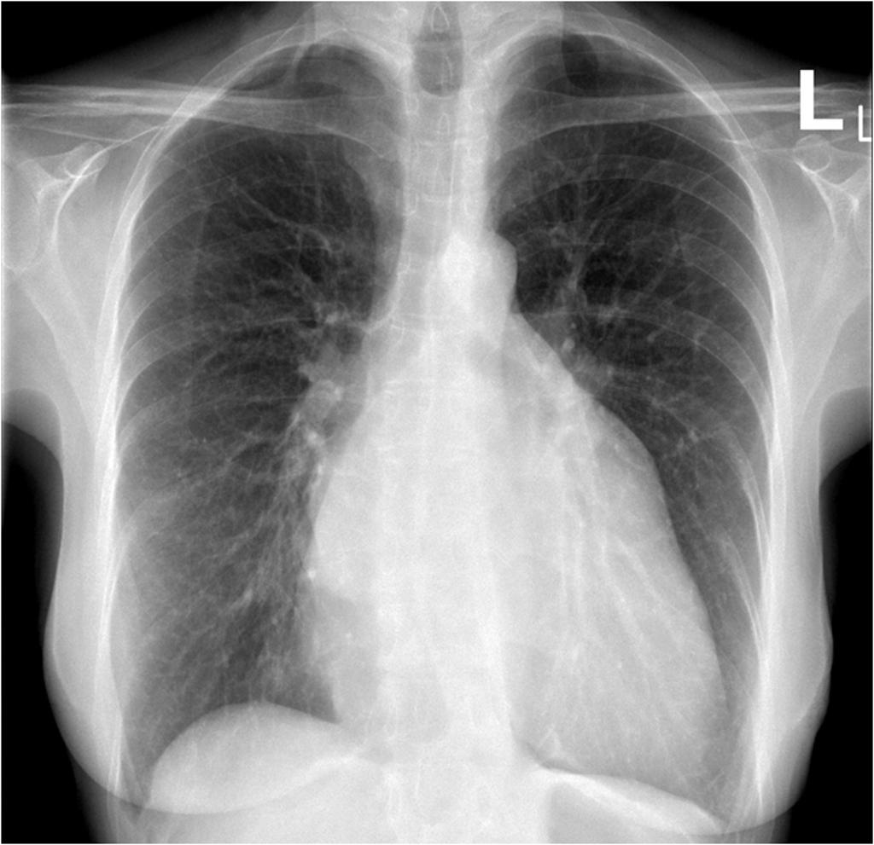
CXR of a 23 year female with chronic dyspnoea and orthopnoea. The most likely valvular lesion is
Aortic stenosis
Aortic regurgitation
Mitral regurgitation
Mitral stenosis
Tricuspid regurgitation

Slide 14
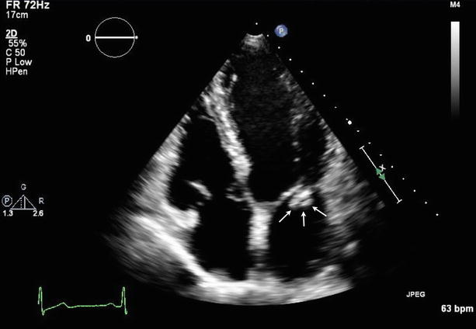
Echo of a 30 year old with rheumatic heart disease presenting with acute decompensated heart failure, fever and noted to have tipped splenomegally. Common complications of this condition include all the following except
Embolic stroke
Acute kidney injury
Pulmonary embolism
Anemia
Intractable heart failure

Slide 15
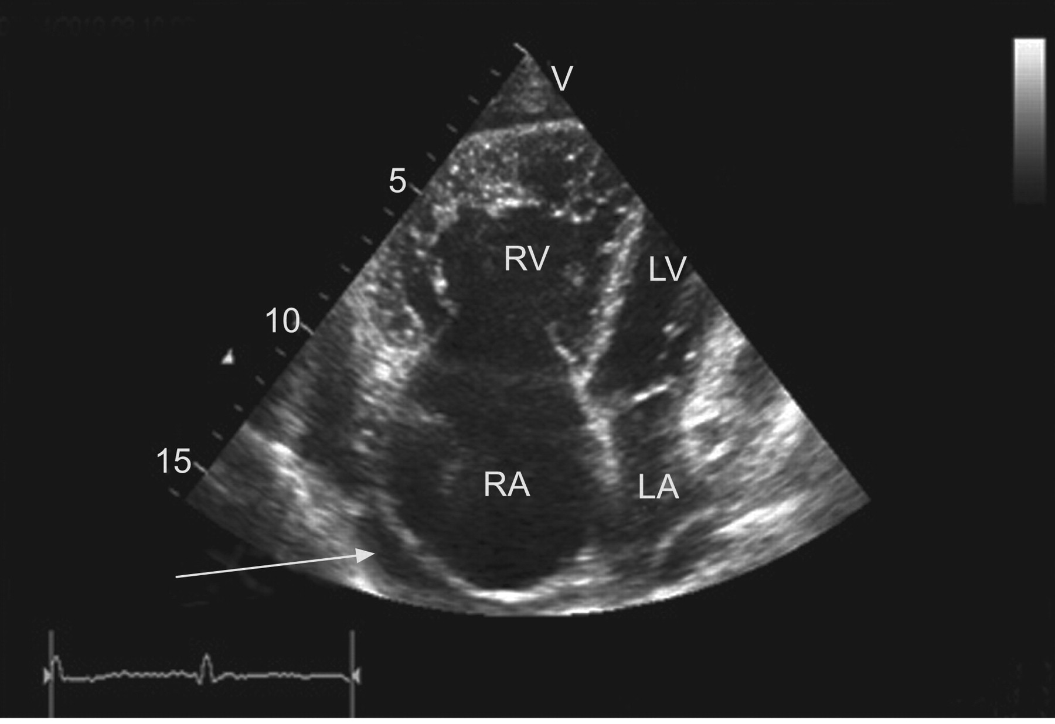

Slide 16
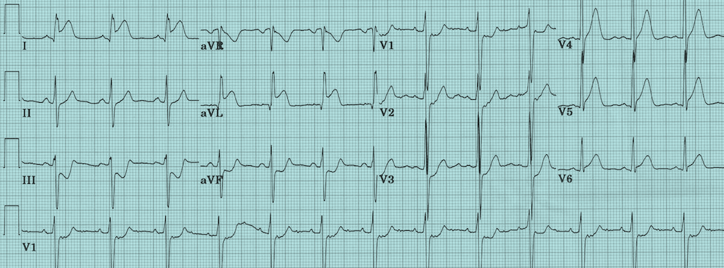
ECG of a 62 year old patient who’s presented with 3 hour chest pain and diaphoresis. The following drugs are indicated except
Asprin
Clopidogrel
Alteplase
Warfarin
Artovastatin
Notes:
D
‹#›

Slide 17
ECG of a 62 year old patient who’s presented with chest pain and diaphoresis. ECG indicative of
Inferior STEMI
Anterior STEMI
NSTEMI
Posterior STEMI
Lateral STEMI

Slide 18
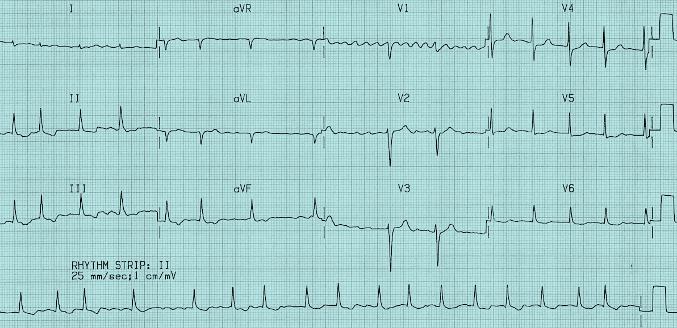
ECG of a 35 year old alcoholic patient presenting with heart failure.
The most appropriate drug for rate control in this patient is
Digoxin
Carvedilol
Atenolol
Amiodarone
Flecainide
Notes:
B
‹#›

Slide 19
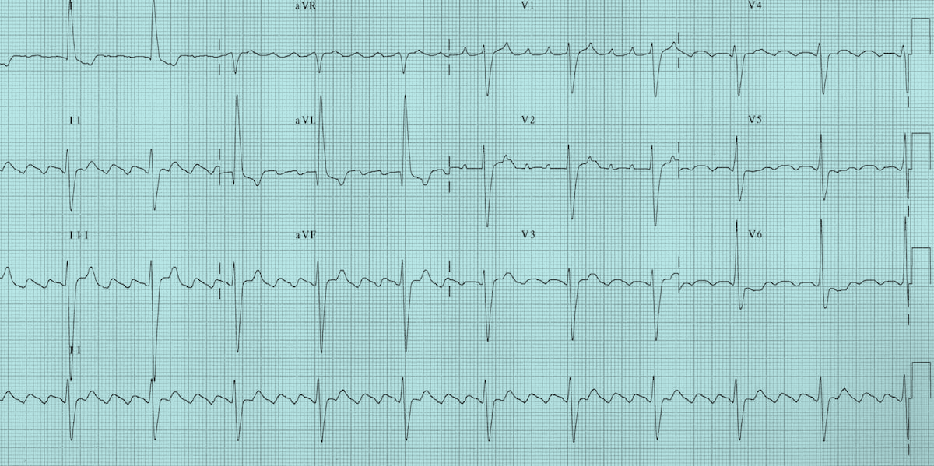
The rhythm is on the ECG shown is
Atrial fibrillation
Atrial flutter
Sinus tachycardia
Atrial tachycardia
Paroxysmal supraventricular tachycardia
Notes:
B
‹#›

Slide 20
ELECTROCARDIOGRAM
Very important
SAN, atrial tissue, AVN, His purkinje system, Lt/Rt bundles, ventricular tissue
Aids in diagnosis of
  Ischemic heart disease especially ACS
  Chamber enlargement
  Arrhythmias
  Electrolyte imbalance
  Pericardial disease - effusion
  Pulmonary thromboembolism

Slide 21
Analyzing ECG: Key questions
What’s the rhythm?
  Are P waves present?
  How is the P wave related to the
  QRS complex?
  Is every P wave followed by a QRS complex with a normal P–R interval?
What is the R-R interval?- heart rate
What is the axis?
Are ST Segments normal?

Slide 22
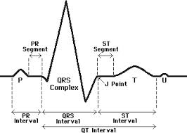

Slide 23
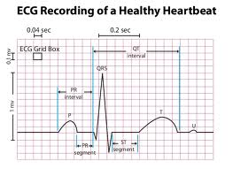

Slide 24
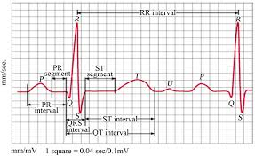

Slide 25
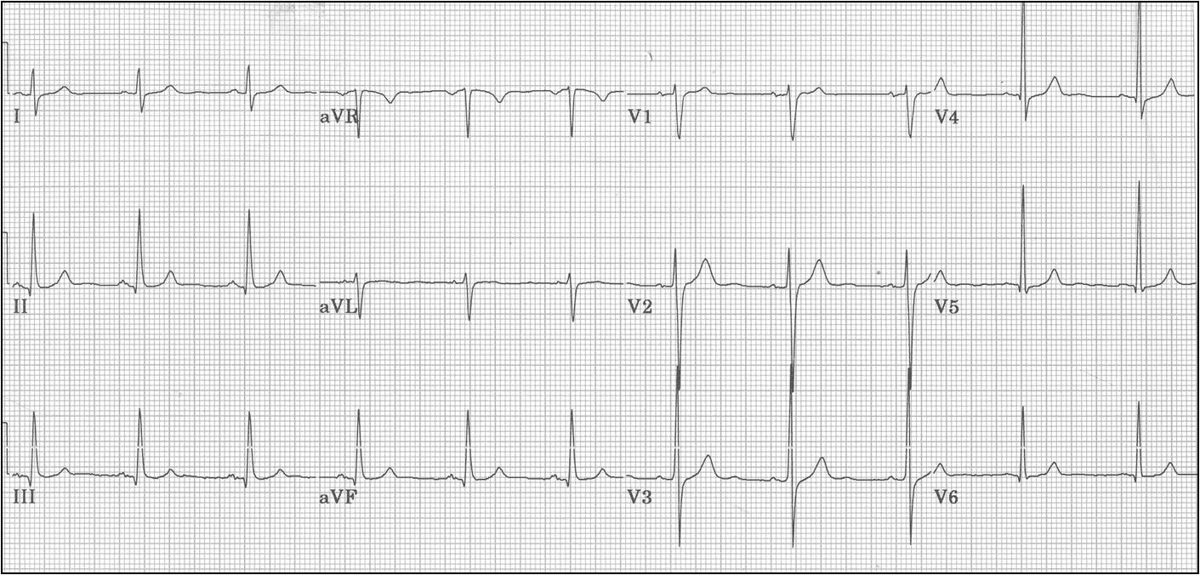
NORMAL ECG

Slide 26
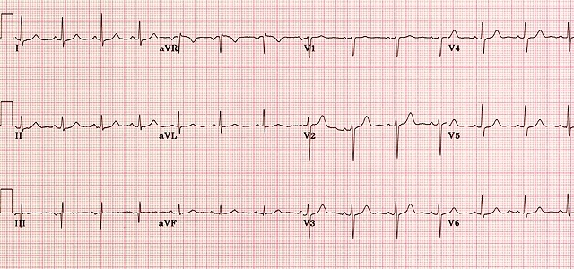

Slide 27

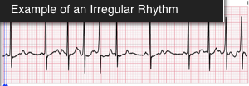
RYTHM

Slide 28
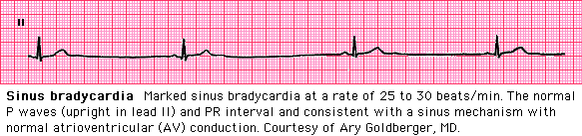
RATE -Sinus bradycardia

Slide 29
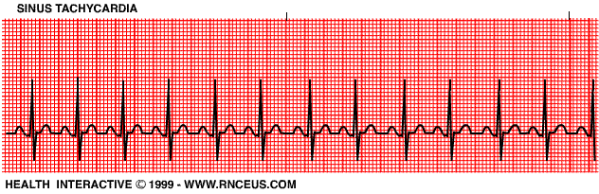

Slide 30
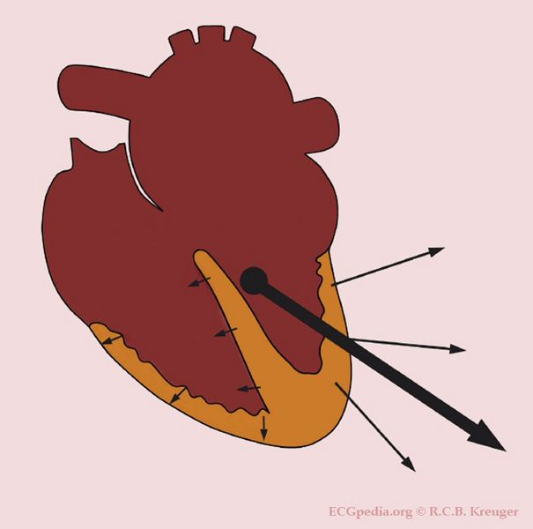
Axis

Slide 31
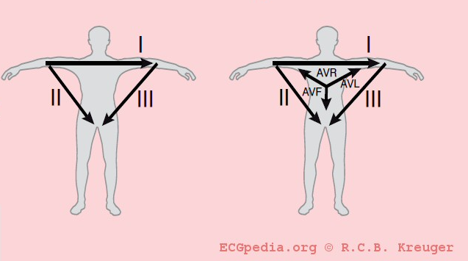
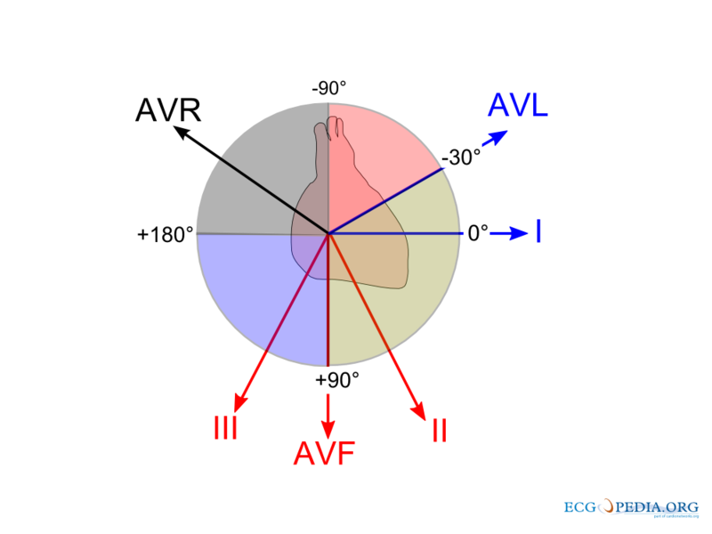
Axis

Slide 32
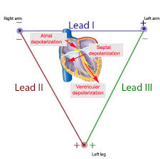
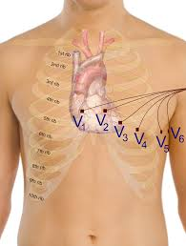
Lead Congruence n Axis

Slide 33
Axis Deviation
A left heart axis is present when the QRS in lead I is positive and negative in II and AVF. (between -30 and -90 degrees)
A right heart axis is present when lead I is negative and AVF positive. (between +90 and +180)
An extreme heart axis is present when both I and AVF are negative. (axis between +180 and -90 degrees). This is a rare finding.

Slide 34
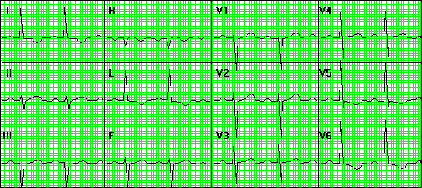
LAD, LVH, LV strain

Slide 35
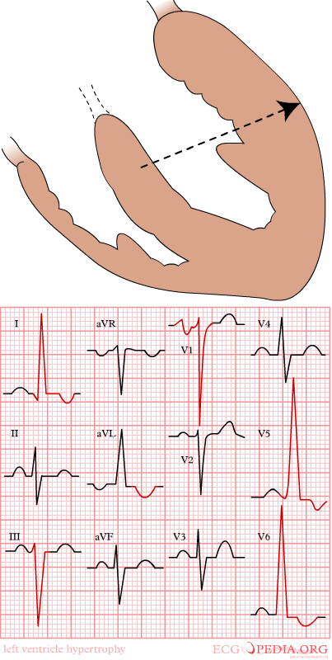
LVH Criteria
Sokolow-Lyon criterium
  R in V5 or V6 + S in V1 >35 mm.
Cornell-criterium
  R in aVL and S in V3 >28 mm in men
  R in aVL and S in V3 >20 mm in women

Slide 36
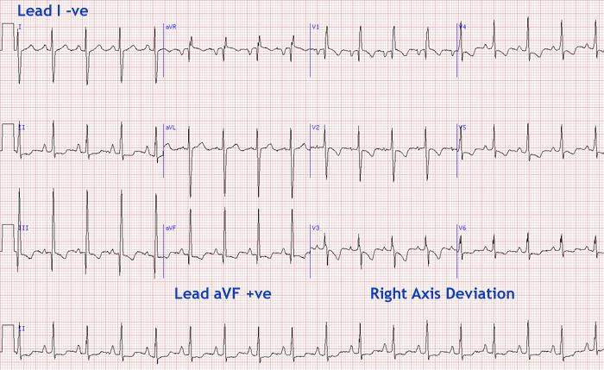
RAD, RVH

Slide 37
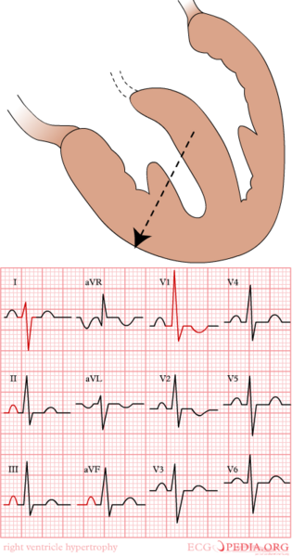
RVH Criteria
R/S ratio in V1 or V3R > 1, or R/S ratio in V5 or V6 <= 1
R wave in V1 >= 7 mm
R wave in V1 + S wave in V5 or V6 > 10.5 mm
rSR= in V1 with R'= > 10 mm
qR complex in V1
Secondary ST-T changes in right precordial leads

Slide 38
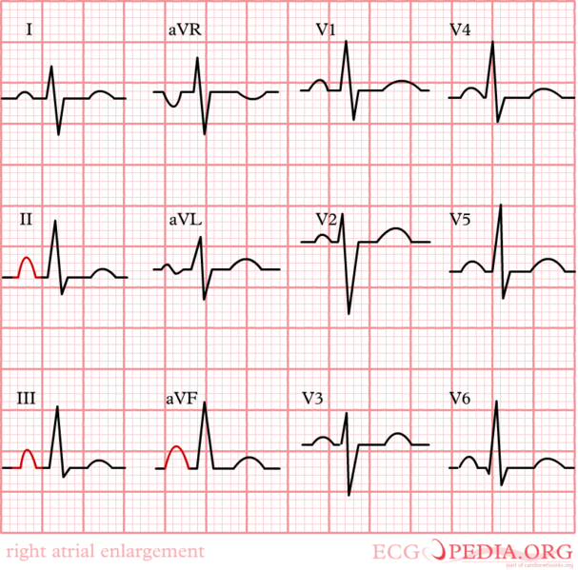
RAE
Right atrial enlargement is defined as either P >2.5 mm in II / III and / or aVF P >1.5 mm in V1.

Slide 39
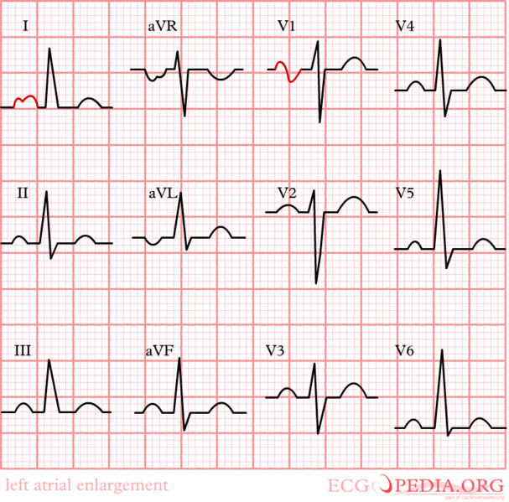
LAE
Either P wave with a broad (>0.04 sec or 1 small square) and deeply negative (>1 mm) terminal part in V1 P wave duration >0.12 sec in leads I and / or II

Slide 40
Arrhythmias
Diagnosis entirely based on ECG
Can arise from any part of the conduction system
Some are benign, few are fatal
Classified depending on origin
  Supraventricular
  Ventricular
Causes include
  Increased automaticity; ischaemia, chamber enlargement, heightened SNS activity
  Conduction abnormalities; degenerative disease/ischaemia at the AVN- Heart block
  Reentry e.g. WPW syndrome
Sinus nodal dysfunction

Slide 41
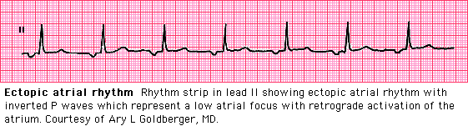
Atrial ectopic rythm

Slide 42
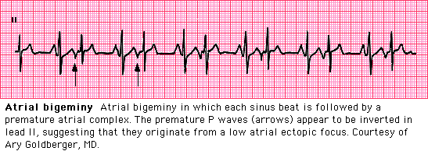
Atrial bigeminy

Slide 43
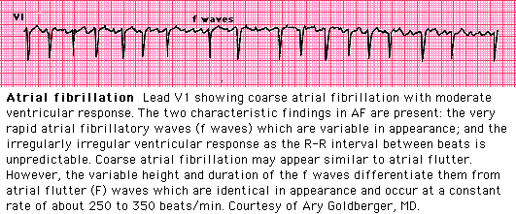
Atrial fibrillation

Slide 44
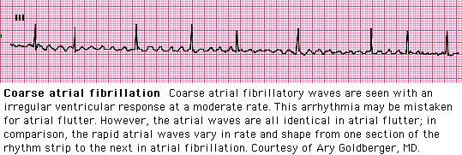
Atrial fibrillation

Slide 45
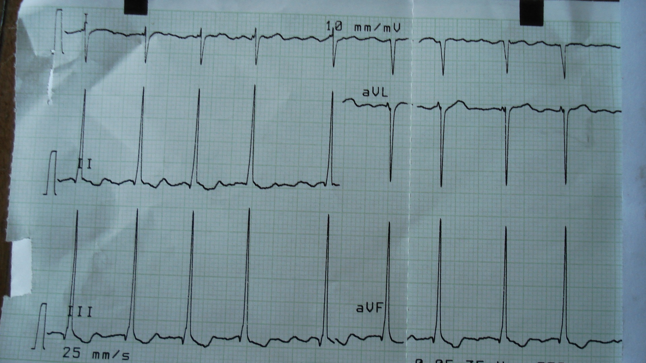
Atrial fibrillation

Slide 46
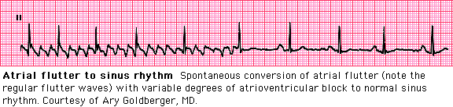
Atrial flutter

Slide 47
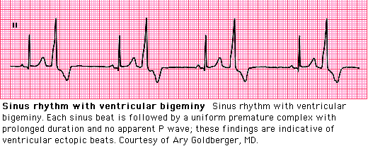
Ventricular bigeminy

Slide 48
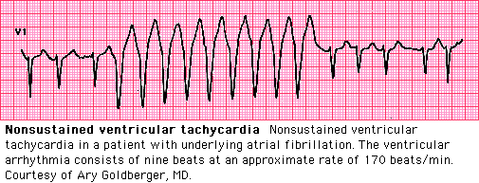
Ventricular tachycardia

Slide 49
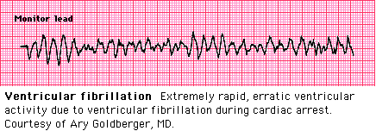
Ventricular fibrillation

Slide 50
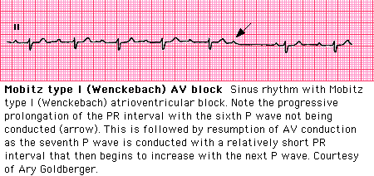
2nd degree heart block

Slide 51
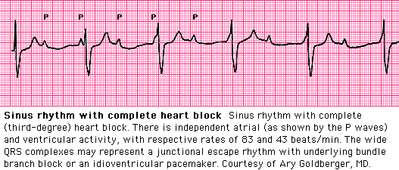
Complete heart block

Slide 52
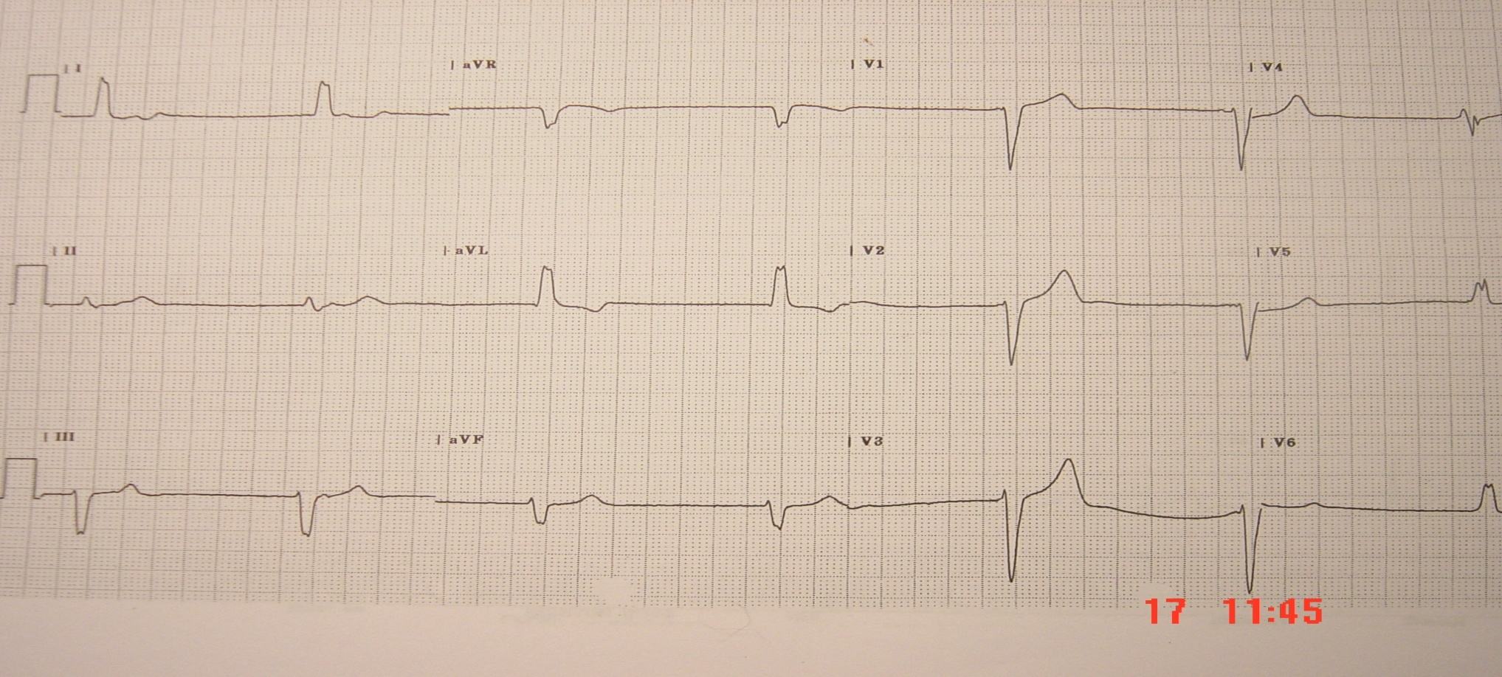
12 lead resting ECG tracing of a 37 year lady who presents with fatigue
Complete heart block
Permanent pacing is indicated
Notes:
‹#›

Slide 53
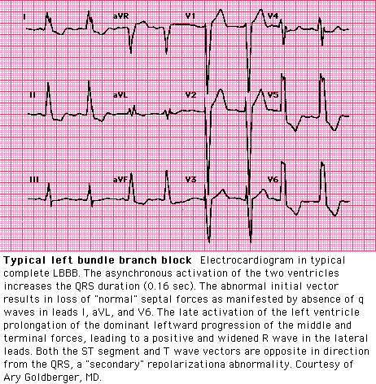
Left bundle branch block

Slide 54
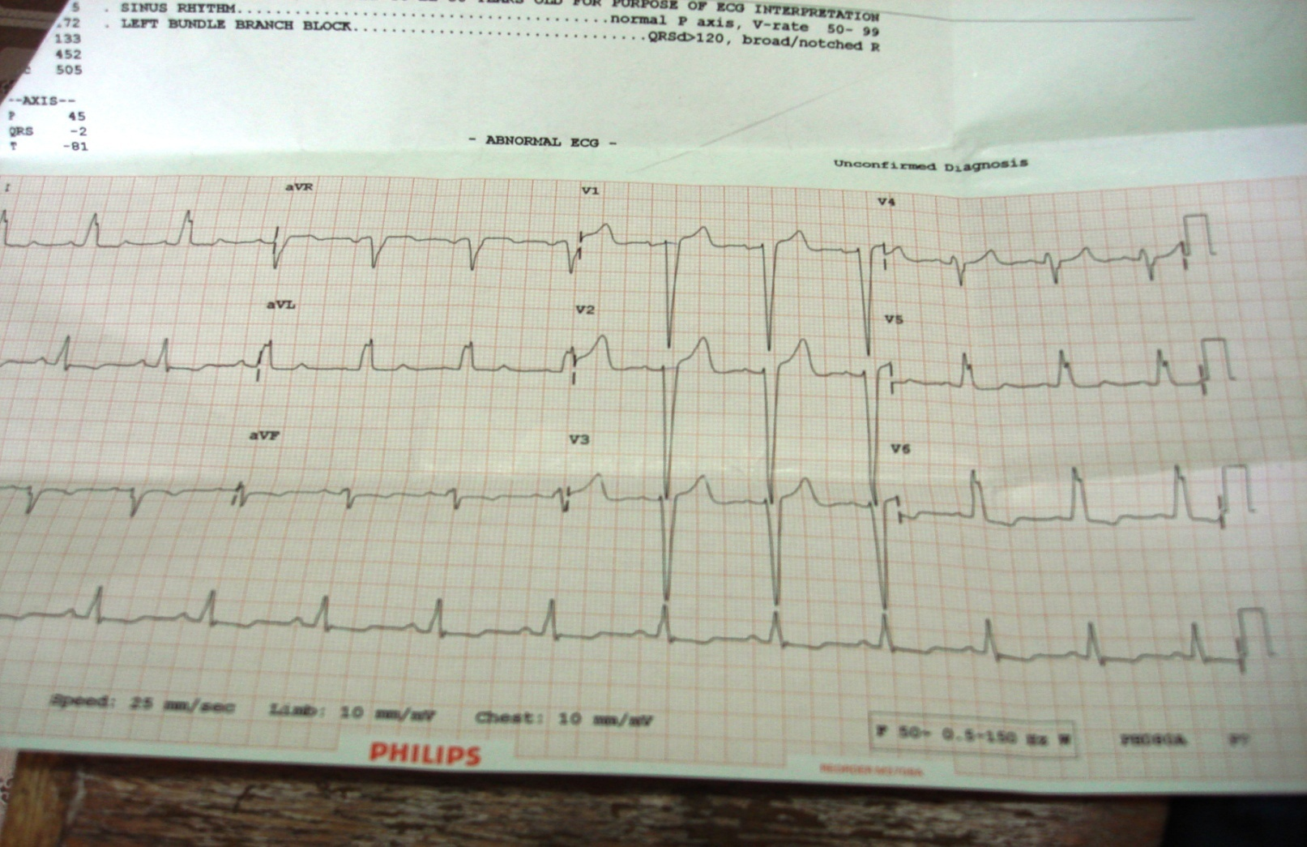
ECG of a 65 year patient with acute pulmonary edema.

Slide 55
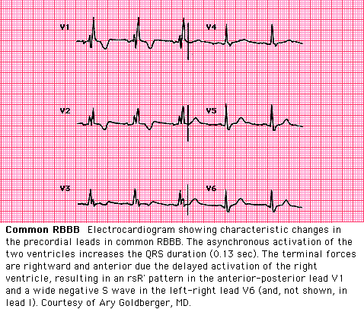
Right bundle branch block

Slide 56
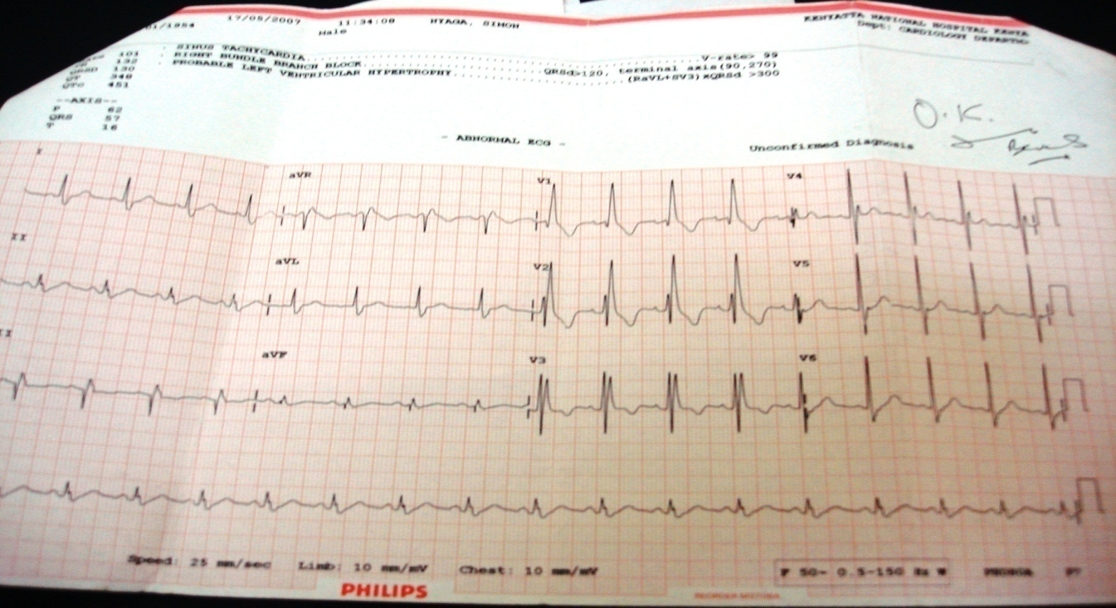
Shows right bundle branch block

Slide 57
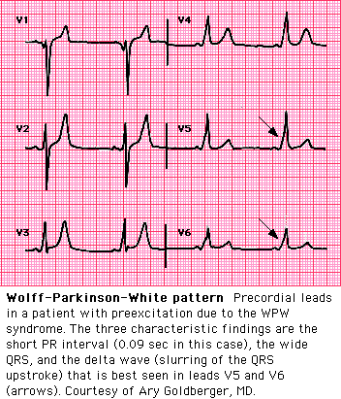
Wolff parkinson white syndrome

Slide 58

An ECG of a patient who presented with syncope.
  The patient has supraventricular tachycardia.
  Intravenous adenosine is the treatment of choice.
  Carotid sinus massage is useful.

Slide 59

Left ventricular hypertrophy

Slide 60

Right ventricular hypertrophy

Slide 61

Pericardial effusion

Slide 62

Ischemia

Slide 63

Ischaemia

Slide 64

Inferior and Right STEMI

Slide 65

Anterior STEMI

Slide 66


Slide 67

Hyperkalemia

Slide 68
Stress ECG
Diagnosis of CAD if suspected
Follow up post ACS to assess exercise tolerance and advice on life style changes
During myocardial perfusion scanning
Standard Bruce protocol
Pharmacological stress testing
  ? adenosine
Limitations; LBBB, limb amputation, clinical state of pt etc.

Slide 69
ECHOCARDIOGRAM
Visualizes the structure of the heart
Definitive in diagnosis of structural abnormalities of the heart
    Valvular heart lesions – stenosis/ regurgitation
    Cardiomyopathies – dilatation/hypertrophy
    Pericardial diseases – effusion, constriction
    Congenital abnormalities
    Diseases of the aorta
Key in planning and follow up of OHS

Slide 70

Echo set up

Slide 71

Normal 2D echo

Slide 72

Normal M mode echo

Slide 73

Hypertrophic cardiomyopathy

Slide 74

This 2D Echocardiographic finding is consistent with:
RV
Atrial myxoma.
Atrial thrombus
Notes:
‹#›
RA MASS AIDS WITH TR

Slide 75

LA thrombus

Slide 76

Pericardial effusion
←
←
Notes:
‹#›

Slide 77

Color Doppler of severe mitral regurgitation

Slide 78


Mitral stenosis

Slide 79

Aortic regurgitation and stenosis

Slide 80

Vegetations in infective endocarditis
→

Slide 81

ASD

Slide 82

Muscular VSD
L-R Shunt

Slide 83

Peri membranous VSD,
L – R shunt

Slide 84

PDA

Slide 85

Coarctation of aorta

Slide 86
Cardiac catheterization
Diagnosis of complex congenital heart disease when echo inconclusive, COA.
Assess pulmonary pressures before correction of VSD, ASD
Determine significance of shunting in ASD i.e pulmonary/systemic flow ratio
Diagnosis of restrictive cardiomyopathy vs constrictive pericarditis
Therapeutic; ASD closure, PBMV,
Assess LV systolic function, presence of LV thrombus during coronary angiography

Slide 87
Coronary angiography
Confirm, assess severity of CAD
Plan treatment of CAD
PTCA – percutaneous coronary angioplasty

Slide 88
LAB INVESTIGATIONS
Cardiac enzymes – Key in diagnosis of ACS
  Troponin I/T
  Creatnine phosphokinase – CK-MB
Others
  U/E/C
  RBS
  Lipid profile

