Slide 1
Management of Rheumatoid Arthritis

Slide 2
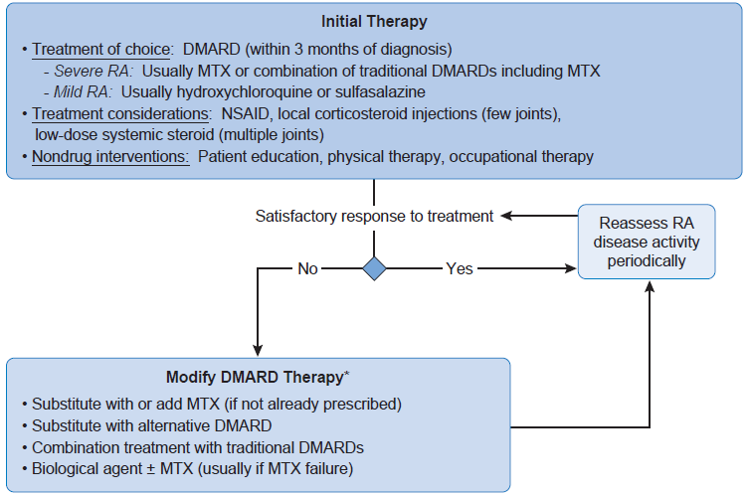

Slide 3
NSAIDs
Provide rapid pain relief and reduction of joint inflammation.
No NSAID of choice
Selection based on:
  Patient preference
  Convenience
  Cost
  Safety

Slide 4
NSAIDs
2 week trial at moderate dose on a scheduled basis (anti-inflammatory efficacy)
Non aspirin NSAIDs are preferred

Slide 5
NSAIDs
Differentiating properties:
  Indomethacin: CNS penetration (CNS A/E)
  Piroxicam: PUD, GIT bleeding
  Celecoxib, high dose ibuprofen, diclofenac: MI
  Naproxen: Best CVS safety
  Diclofenac, meloxicam, indomethacin: Thrombosis
  Aspirin: GIT toxicity

Slide 6
Traditional DMARDs
Every RA patient should receive DMARD
Initial selection based on:
  Disease activity (low, moderate-high)
  Prognostic findings
  Disease duration

Slide 7
Traditional DMARDs
MTX, LEF initially chosen (good clinical response)
Treat with at least one DMARD + NSAID + low dose oral corticosteroids (PRN)
NSAIDs + corticosteroid discontinue (disease remission)
DMARDs discontinuation - Rebound flare (indefinitely)

Slide 8
Hydroxychloroquine
1st line for mild to moderate RA
Add to MTX
Safe in pregnancy

Slide 9
Hydroxychloroquine
2/3rd respond favourably
Benefits within 4 months of therapy
Well tolerated
C/I: Renal impairment

Slide 10
Hydroxychloroquine
Most serious toxicity – retinal damage (rare)
Risk increased:
  High cumulative doses
  Increased age (>60 years)
  Liver disease
  Retinal disease

Slide 11
Hydroxychloroquine
Immediately stop therapy
Undergo ophthalmologic evaluation (retinal pigmentation)
Routine eye examination:
  High risk for retinal damage
  Renal dysfunction
  HCQ therapy for >10 years

Slide 12
Sulfasalazine
1st line for mild to moderate RA
Add to MTX
Safe in pregnancy
Effects apparent within a month
Clinical response after 3 months (adjust dose later)

Slide 13
Sulfasalazine
Adverse effects:
  GIT discomfort
  Dizziness
  Skin rashes
  Hematologic effects:
    Leukopenia, thrombocytopenia, agranulocytosis
    Routine CBC
  Hepatitis (rare, serious)
Minimize by starting low dose, weekly adjustment

Slide 14
Gold Compounds
Parenteral preparations:
  Gold sodium thiomalate (aqueous solution)
    Easier to administer
    Frequent side effects
  Aurothioglucose (oil suspension)
    Risk of nephrotoxicity

Slide 15
Gold Compounds
Auranofin:
  Oral
  Slow onset (6 months)
  Less efficacious
  Better tolerated

Slide 16
Gold Compounds - Toxicitiy
High rate of discontinuation
Thiomalate:
  Vasomotor reaction (nitritoid reaction)
    Nausea, weakness, flushing, tachycardia, syncope
  Transient stiffness, arthralgias, myalgias
  Skin eruptions, stomatitis
  Albuminuria

Slide 17
Gold Compounds - Toxicities
Aurothioglucose:
  Renal toxicity:
    Membranous nephropathy
    Nephrotic syndrome
    Interstitial nephritis
  Thrombocytopenia
  Aplastic anemia
Auronofin:
  Diarrhea

Slide 18
Methotrexate
Recommended as initial DMARD
Potent DMARD
Rapid onset (1 month)
High efficacy rate

Slide 19
Methotrexate - Dosing
Given orally as weekly dose
Increase dose after every 2 months if no response
If unresponsive:
  Maximum 25mg/week
  Give subQ or IM (more effective)
  Add/ Substitute another DMARD

Slide 20
Methotrexate – Adverse Effects
Common:
  GIT distress Dizziness
  Mucositis Mild alopecia
Severe:
  Myelosuppression
  Pneumonitis
  Hepatic fibrosis, cirrhosis
Renal dysfunction result in accumulation
Pregnancy X

Slide 21
Methotrexate – Folate/Folinic Acid
Folate supplementation reduces A/E (GIT distress, mucositis, LFT elevation)
Higher MTX dose (folate antagonist)
Folic acid:
  Simpler
  Inexpensive

Slide 22
Methotrexate – Drug Interaction
NSAIDs increase MTX concentration
Trimethoprim increase risk of myelosuppression
MTX + LEF increase risk of hepatitis

Slide 23
Leflunomide
Similar efficacy to MTX
Clinical response in 4 weeks
Can substitute/add to MTX

Slide 24
Leflunomide - Dosing
Active metabolite responsible for pharmacologic activity
Half life of 2 weeks (loading dose)

Slide 25
Leflunomide – Adverse Effects
Diarrhea
Rash
Alopecia
Hepatitis
Pregnancy X

Slide 26
Leflunomide - Elimination
2 years for metabolite to be undetectable
Cholestyramine enhances elimination:
  Planning family
  Hepatotoxicity
  Overdose
Alternative is activated charcoal

Slide 27
Minocycline
Useful adjunctive agent
Immunomodulatory and anti-inflammatory effects

Slide 28
Azathioprine
Approved for severe RA
Adverse Effects:
  GIT intolerance (most common)
  Myelosuppression
    Reversible
    Increased risk with renal failure
Allopurinol increase toxicity (decreases elimination)

Slide 29
D-Penicillamine
Outdated (lengthy dose titration, toxicity)
  6 months before therapeutic benefit
  Rash, stomatitis, dysgeusia
  Thrombocytopenia
  Proteinuria
  Renal toxicity
  Autoimmune syndromes (SLE, myasthenia gravis, polymyositis, Goodpasture syndrome)

Slide 30
Combination Therapy
Associated with improved outcomes
  Different pharmacological or site of action
  Lower doses of individual drugs

Slide 31
Combination Therapy
Examples;
  MTX + HCQ (mod – high)
  MTX + LEF (high)
  MTX + SSZ (poor prognosis)
  HCQ + SSZ (good prognosis)
  MTZ + HCQ + SSZ (poor prognosis)

Slide 32
Biologic Agents

Slide 33
Etanercept
Uses:
  Moderate - severe RA with/ without MTX
  Juvenile RA
  Ankylosing spondylitis
  Psoriatic arthritis, plaque psoriasis.
Soluble TNF receptor that binds TNF (inactivation)
Given subQ (response in 2 weeks)

Slide 34
Etanercept – Adverse Effects
Injection site reactions
URTI
Development of autoantibodies (ANA, dsDNA)
CHF exacerbation
Lymphoma
Serious infections (Immunosuppression)
  Sepsis
  TB, Mycobacterial
  Fungal

Slide 35
Infliximab, Adalimumab
Infliximab:
  Chimeric IgG antibody against TNF
  Used for:
    Crohn’s disease, ulcerative colitis
    Ankylosing spondylitis
    Psoriatic arthritis, plaque psoriasis
    Moderate – severe RA,
  Given IV
  Given with MTX to prevent antibodies to infliximab

Slide 36
Infliximab, Adalimumab
Adalimumab:
  Humanized IgG1 monoclonal antibody
  Given subQ

Slide 37
Infliximab, Adalimumab - Adverse Effects
Similar to etanercept
Antibodies to infliximab, adalimumab

Slide 38
Certolizumab, Golimumab
Similar efficacy
Certolizumab:
  Pegylated Fab portion
  Used for:
    Moderately to severely active RA
    Crohn’s disease
  Half life of 2 weeks (monthly)

Slide 39
Certolizumab, Golimumab
Golimumab:
  Human IgG1 monoclonal TNF α antibody
  binds to soluble & transmembrane TNF
  Used for:
    Moderate to severe active RA (with MTX)
    Psoriatic arthritis
    Ankylosing spondylitis.

Slide 40
Certolizumab, Golimumab – Adverse Effects
Well tolerarated
Similar safety profiles to other anti-TNF agents.
Certolizumab:
  Urinary tract infections

Slide 41
Anakinra
IL-1 receptor antagonist
Given daily subQ
Adverse Effects:
  Injection site reaction
  Neutropenia, severe infections
Not combined with anti-TNF
Less effective than anti-TNF

Slide 42
Abatacept
Selective costimulation inhibitor of T-cell activation
Not combined with TNF antagonists
Adverse Effects:
  Infections: pneumonia, cellulitis, UTI, pyelonephritis
  Malignancy
  Exacerbates COPD

Slide 43
Rituximab
Chimeric monoclonal antibody binds to CD20 on B cells
Adverse effects:
  Infusion reactions
    Premedicate with IV methylprednisolone
  Serious infections

Slide 44
Tocilizumab
Humanized anti-IL-6 receptor antibody
Not combined with anti-TNF
Adverse Effects:
  Severe infections: TB, pneumonia, herpes zoster
  GIT perforation (diverticulitis)
  Neutropenia, thrombocytopenia
  Increased liver enzymes, lipid abnormalities
  Hypertension

Slide 45
Corticosteroids
In unremitting disease
Lowest effective dose for shortest duration
Rapid onset of action
Taper down
Provide bridge therapy until DMARDs become effective.

Slide 46
Corticosteroids - Dosing
Give intermediate or short acting
Given BD (divided dose)
  Anti-inflammatory effect dampens after 12 hours
If OD, give in evening
  Proinflammatory surge at night

Slide 47
Steroid Induced Osteoporosis
Chronic therapy
Inhibits bone formation, enhances bone resorption
Prevention & Treatment:
  Ca²⁺, vitamin D (maintain Ca²⁺ balance)
  Bisphosphonates
  HRT
  Thiazide diuretics (hypercalciuria)

Slide 48
Intra-articular Steroids
Safe and effective
One or few joints (temporary flare)
Minimal systemic side effects
Immediate onset of action but short lived

