Slide 1
HIV and Opportunistic infections
EO

Slide 2
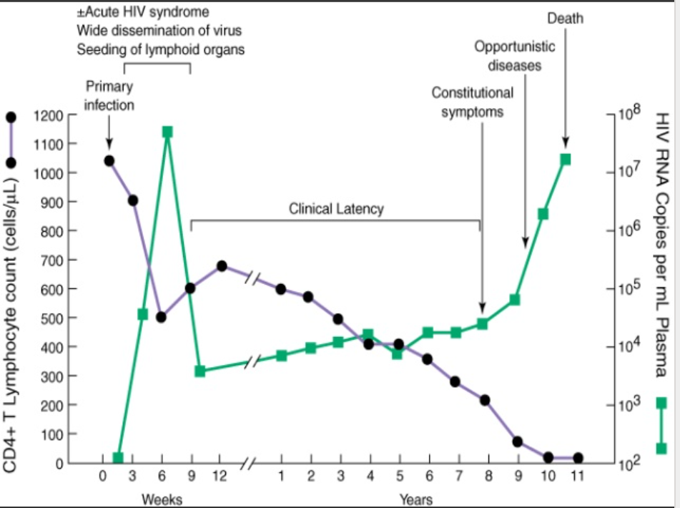
Natural History of HIV

Slide 3
Common OIs
Tuberculosis - Hx, S/S, Dx, Rx
Cryptococcal meningitis
Pneumocystis Jerivocii
Toxoplasmosis
Cytomegalovirus
Non-infectious - KS, lymphoma, cacx
Notes:
st

Slide 4
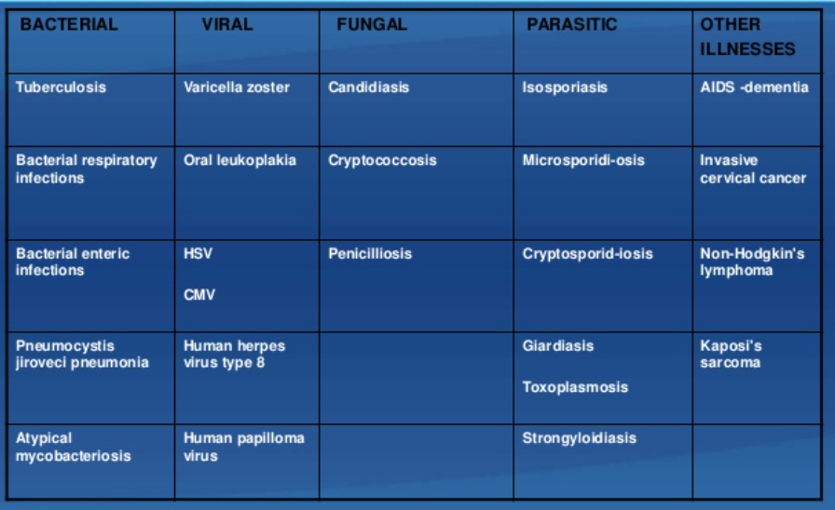
Opportunistic Diseases

Slide 5
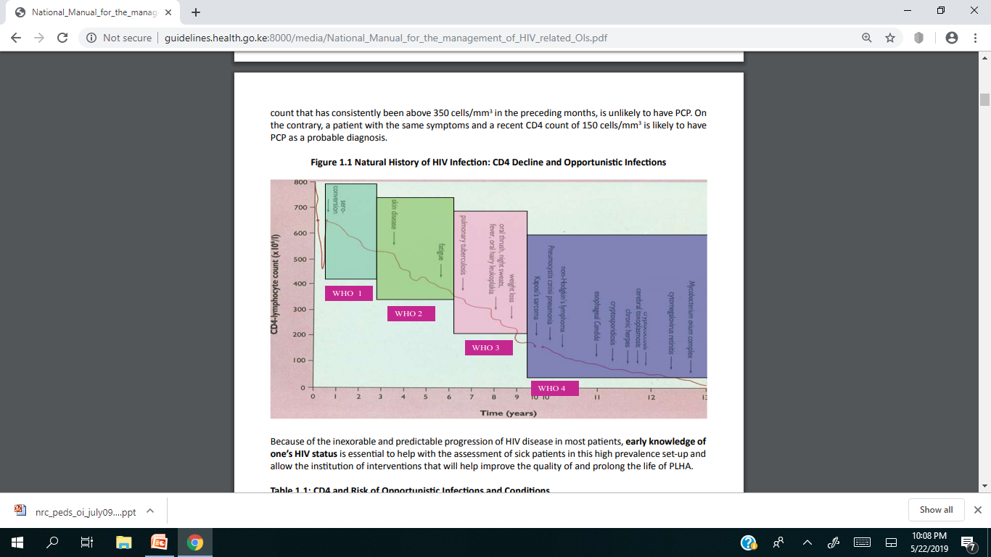

Slide 6
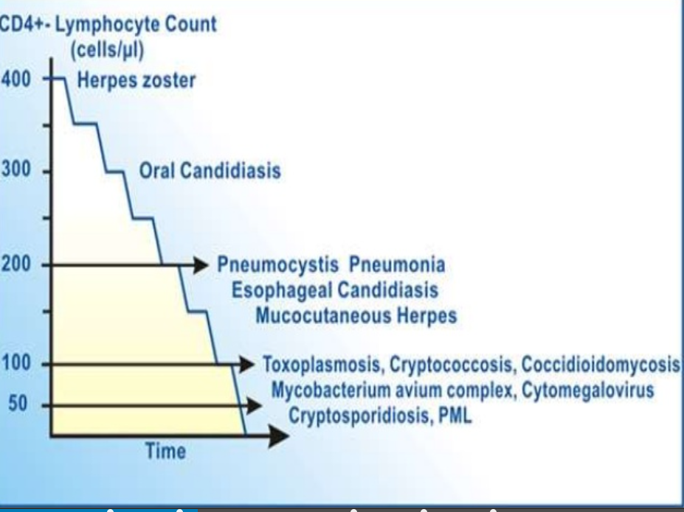

Slide 7
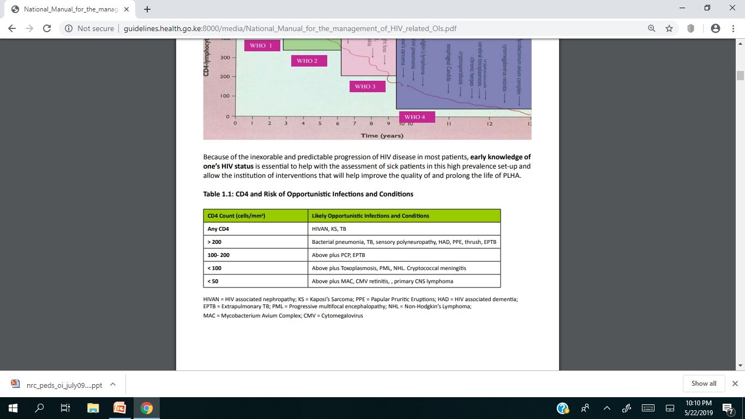

Slide 8
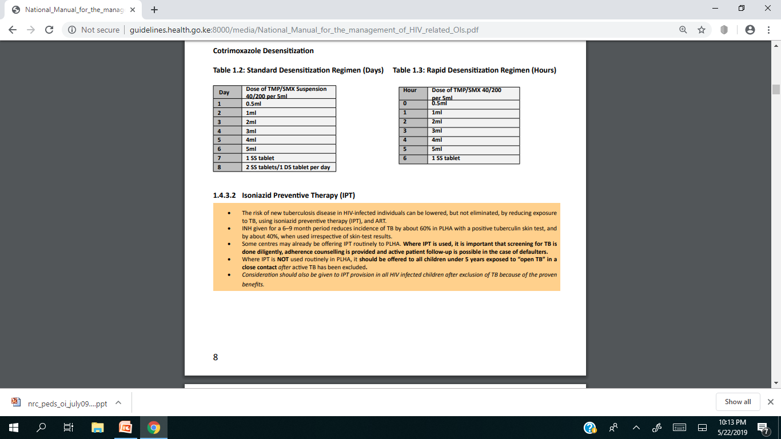

Slide 9
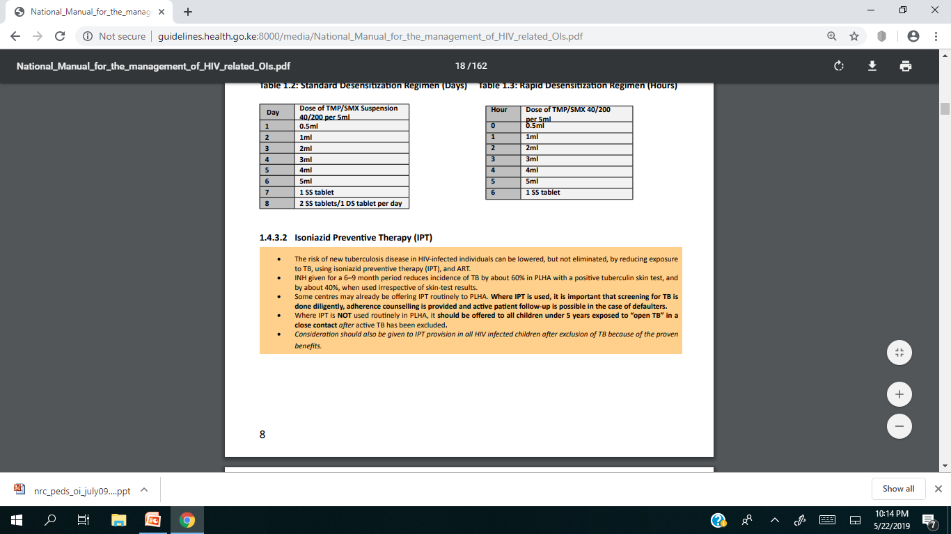
Isoniazid preventive therapy(IPT)

Slide 10
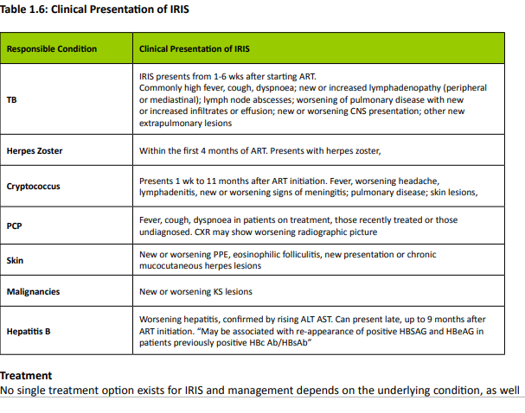

Slide 11
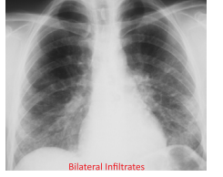
Pneumocystis Jerivocii pneumonia

Slide 12
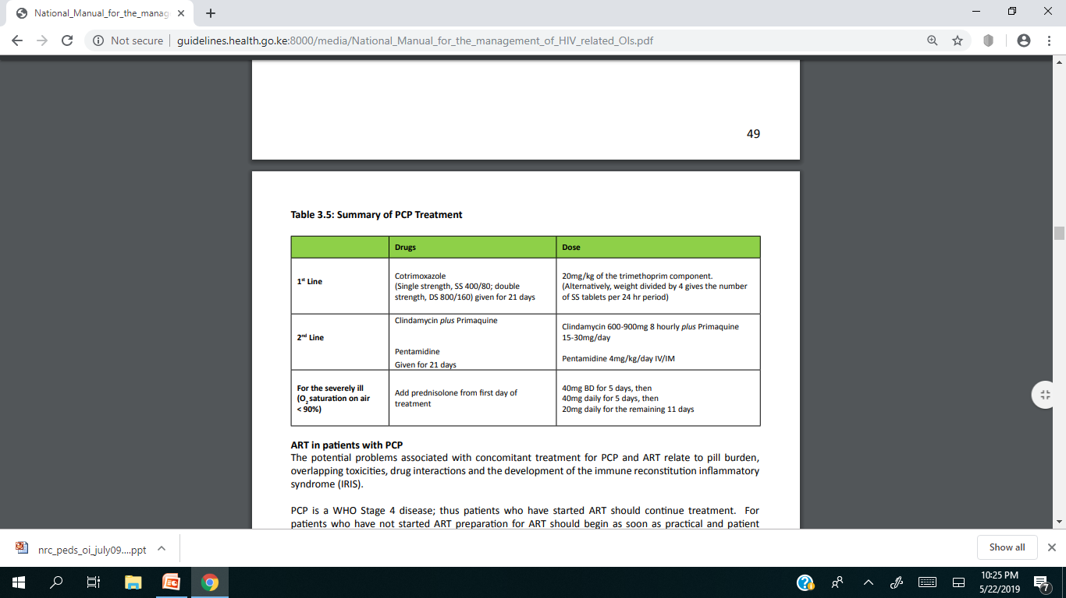

Slide 13
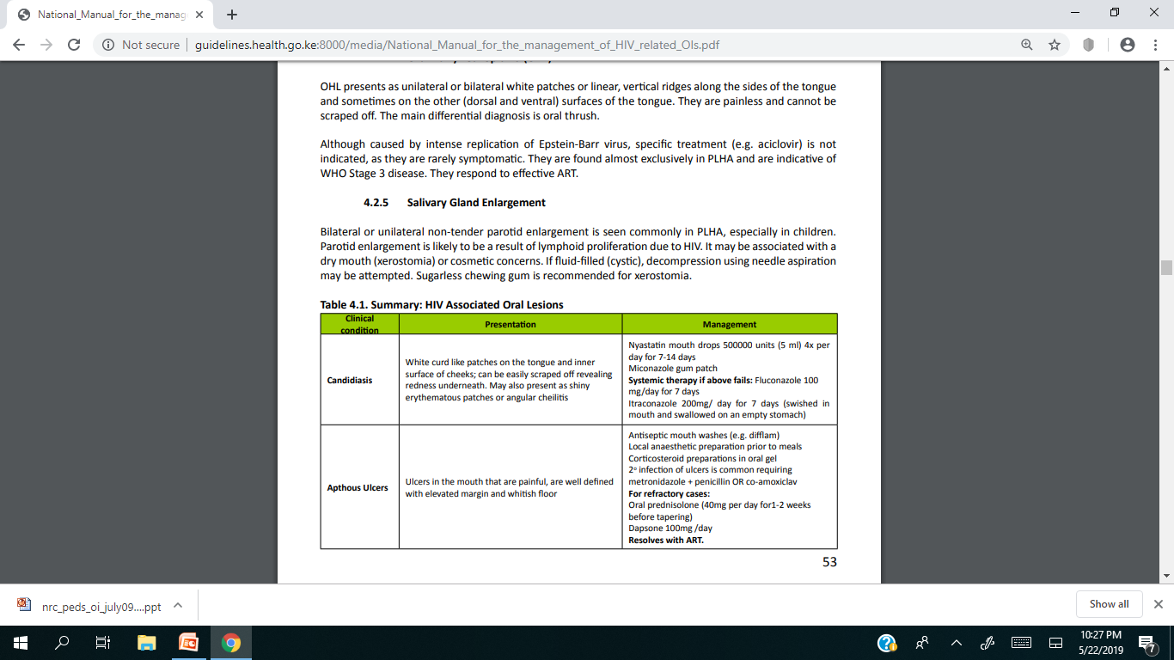
G IT

Slide 14
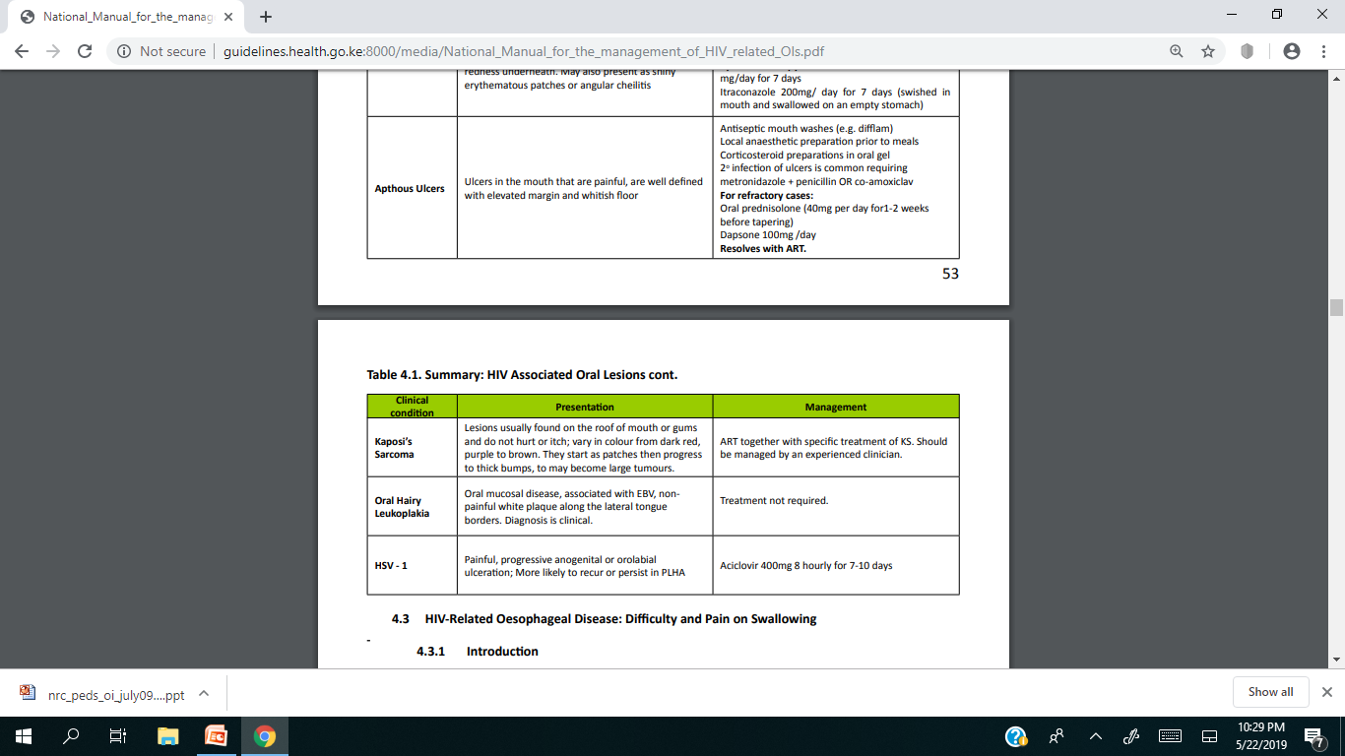

Slide 15
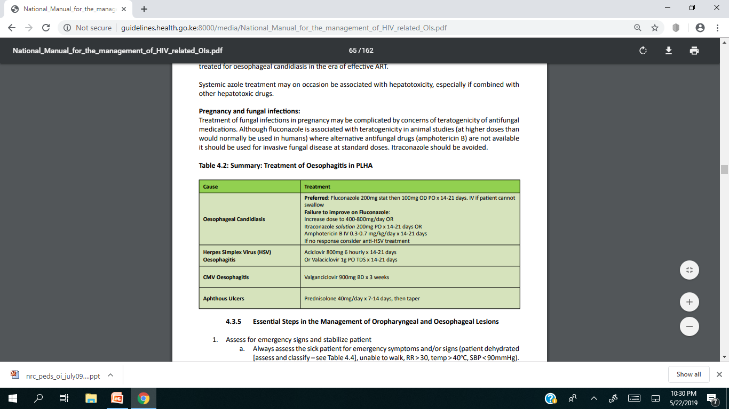

Slide 16
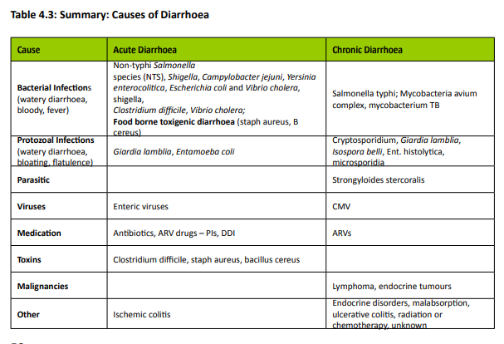

Slide 17
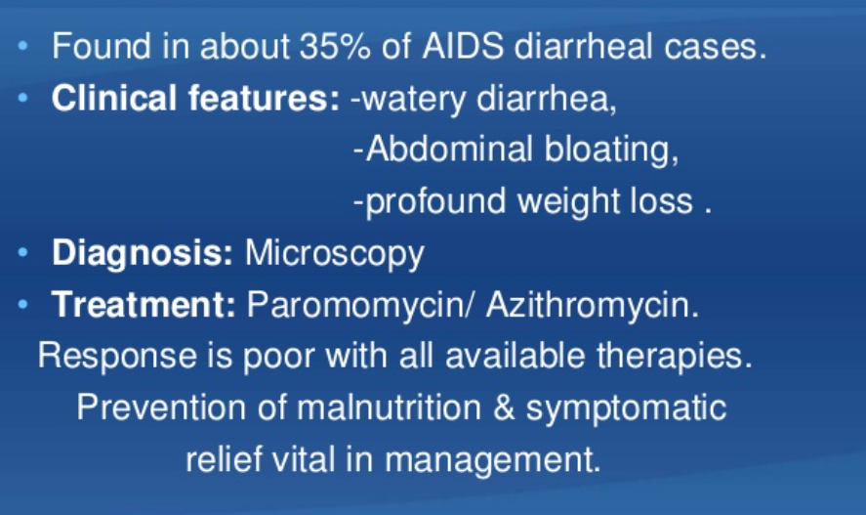
Cryptosporidiosis

Slide 18
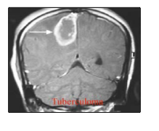
Tuberculoma

Slide 19
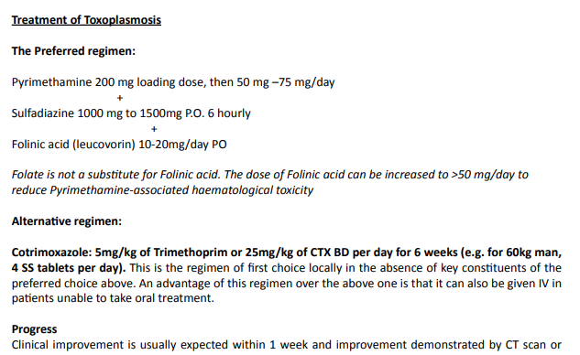
Toxoplasmosis

Slide 20
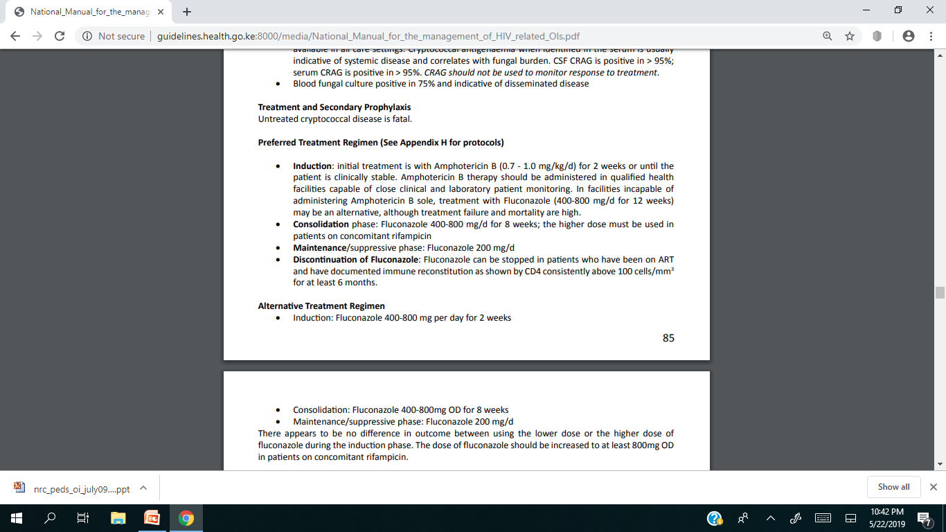
Cryptococcal meningitis

Slide 21
Review the other opportunistic diseases
Notes:
sesseases

