Slide 1
Treatment of VTE
Dr. Mohammed Ezzi
Lecturer
Medical Oncologist

Slide 2
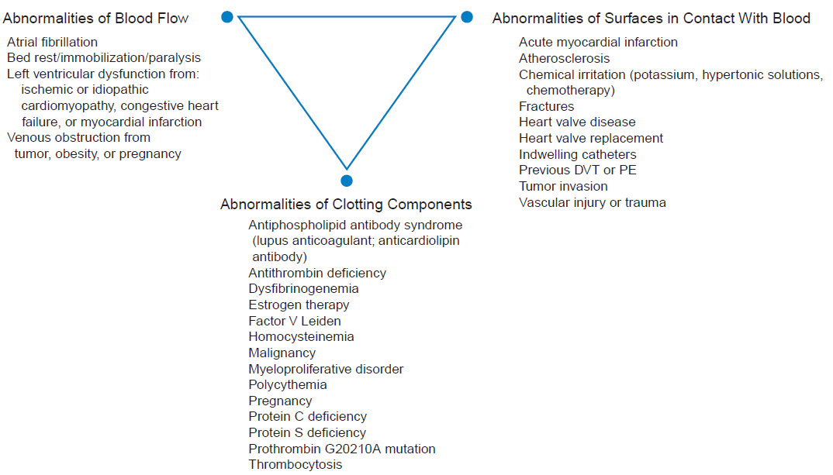

Slide 3
Hemostasis:
BV Injury
Tissue Factor
Neural
Blood Vessel
Constriction
Platelet
Activation
Coagulation
Activation
Primary hemostatic plug
Reduced
Blood flow
Plt-Fusion
Thrombin,
Fibrin
Stable Hemostatic Plug

Slide 4
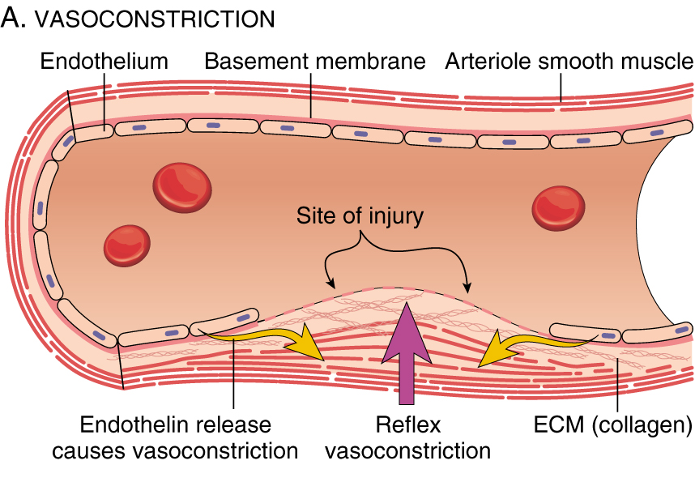

Slide 5
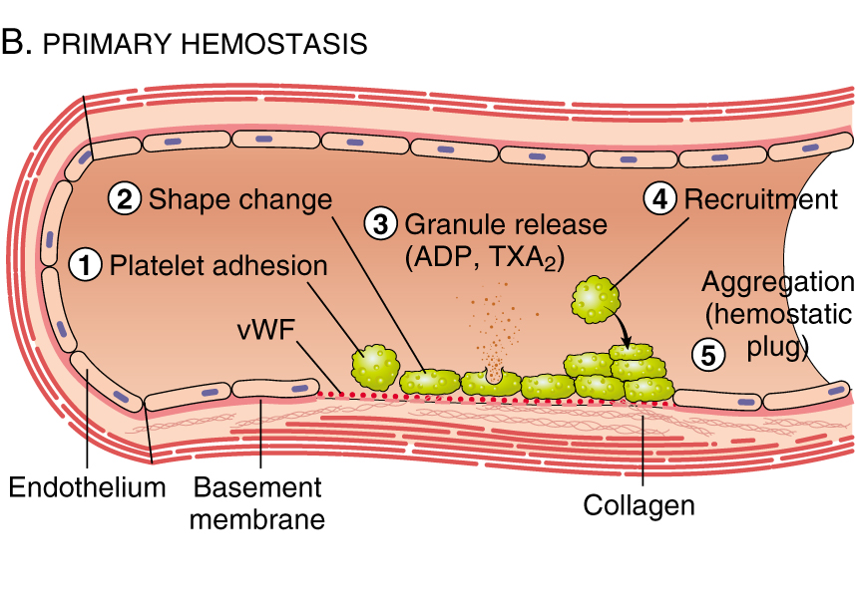

Slide 6
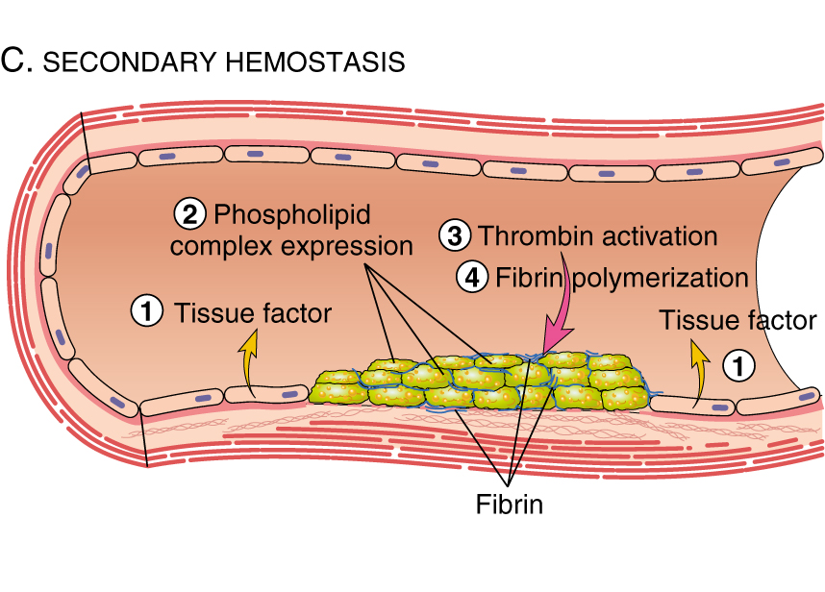

Slide 7
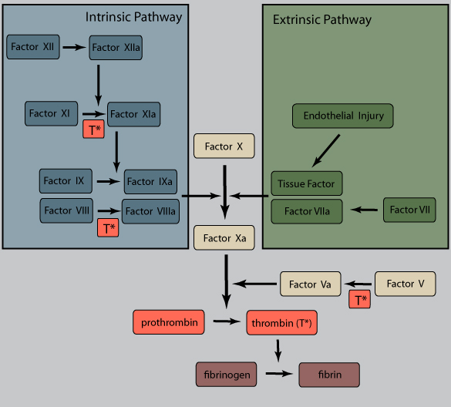
Coagulation Cascade

Slide 8
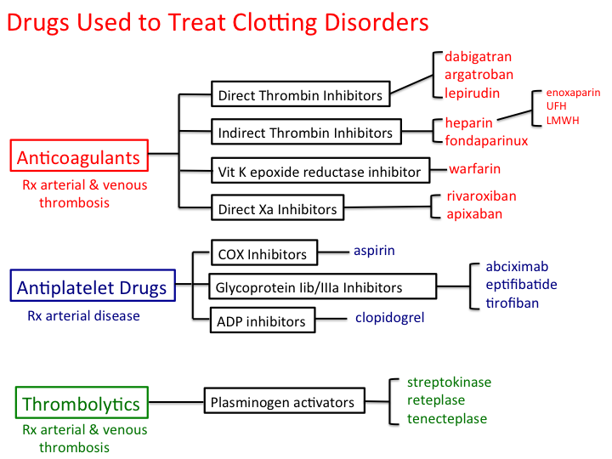
Classification

Slide 9
Ideal anticoagulant
High efﬁcacy to safety index
Predictable response (no need for lab)
Both parenteral and oral
Rapid onset of action
Safe antidote
No side effects
Minimal drug interaction

Slide 10
Initiation of Therapy
Prompt and optimal anticoagulant therapy
Treatment options:
  IV UFH loading followed by infusion
  SC UFH
  SC LMWH
  SC fondaparinux.

Slide 11
Heparin
Loading Dose
80 units/kg loading dose followed by 18 units/kg/hour infusion
  Faster therapeutic levels
  Relative resistance to anticoagulation during active clotting

Slide 12
Heparin
Dose Adjustment
Obtain aPTT 6 hours after bolus dose or infusion rate.
Dose adjust accordingly:
  High: reduce dose
  Low: increase dose

Slide 13
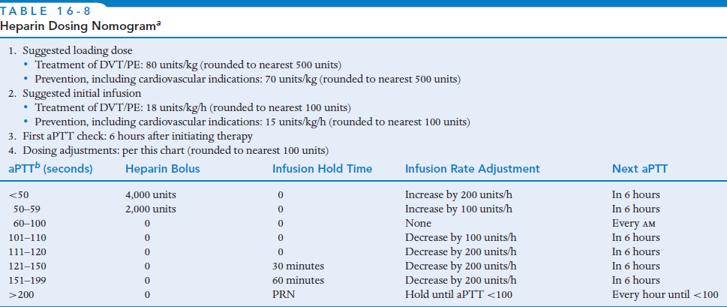

Slide 14
Heparin
Therapeutic Monitoring
Routine aPTT
  6 hours after any changes
  Once daily if stable dose
Evaluate for adverse reactions and treatment failure
Hb, Hct & PLT count every alternate day

Slide 15
Heparin
Duration of Therapy
Prolonged anticoagulation:
  Prevent recurrent thrombosis.
  Warfarin preferred (oral – started on day1)
Heparin for min. 5 days & INR ≥2 for 24 hours.
Five days:
  Elimination of II and X
  Full antithrombotic potential.

Slide 16
Heparin
Adverse Effects - Thrombocytopenia
Two types
  Heparin associated thrombocytopenia
    Direct effect
    Transient platelet sequestration
    Reversible

Slide 17
Heparin
Adverse Effects - Thrombocytopenia
  Heparin induced thrombocytopenia
    Immune mediated
    Heparin–antibody complex binds to platelets (aggregation)
    More with IV than SC
    Cause venous and arterial thrombosis
    Stop heparin, LMWH (now, future)
    Treatment (DTI - argatroban, lepirudin)

Slide 18
Heparin
Adverse Effects - Hemorrhage
Most common
Risk factors:
  Length of therapy
  Advanced age
  Comorbidities
  Concomitant antithrombotic therapy

Slide 19
Heparin
Adverse Effects - Others
Osteoporosis:
  Chronic treatment (6 months)
Hyperkalemia
  Inhibition of aldosterone synthesis
  DM & CKD (risk factors)
Hypersensitivity Reactions
  Generalized hypersensitivity reactions
  Priapism
  Alopecia

Slide 20
Heparin
Reversal of Effect
Discontinue heparin
Maintain fluid volume
Replace clotting factors - blood, FFPs, concentrate
Protamine:
  Forms inactive protamine–heparin complex.
  Rapid onset
  1 mg for 100IU of heparin (max 50mg)
  A/E: hypotension, anaphylaxis

Slide 21
Outpatient Treatment
Include
  LMWHs
  Fondaparinux
Given SC, no need for routine monitor
Treatment of uncomplicated DVT.
Dose adjustment in renal failure.

Slide 22
Warfarin
Transition from Injectable
Start on day 1 and continued for min. 3 months.
Why overlap?
  Half life >36 hours
  Elimination rate of clotting factors
  Initial procoagulant (inhibit Protein C, S)
  Adequate anticoagulation

Slide 23
Warfarin
Initiation
Complex – varying doses among individuals
Two methods:
  average daily dosing (4 to 5mg/day) – monitor and adjust
  10-mg initiation dose for 2 days then adjust

Slide 24
Warfarin
Intensity & Duration
INR of 2.0 to 3.0 is recommended:
  Maximal antithrombotic effect
  Minimal bleeding complication
Initial anticoagulation - prevent clot extension
Continued anticoagulation - prevent further clotting.

Slide 25
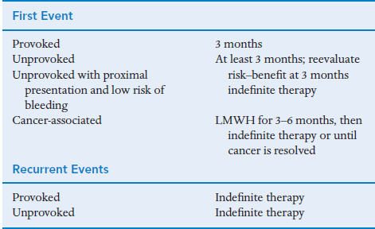
Warfarin
Intensity & Duration

Slide 26
Warfarin
Adverse Effects - Hemorrhage
Most common.
Risk factors:
  1st 3 months of therapy
  History of GI bleeding
  Comorbidities
  Concomitant antiplatelets, NSAIDs

Slide 27
Warfarin
Adverse Effects – Skin Necrosis
Rare but serious (5 days therapy)
Necrosis of breast, buttocks, penis
Extensive microvascular thrombosis (procoagulant)
Discontinue warfarin (then low dose warfarin)
Supplement with protein C (FFPs)
Adequate heparinization (prevention)

Slide 28
Warfarin
Adverse Effects – Purple Toe Syndrome
6 weeks into therapy
Painful discoloration of toes
Due to cholesterol microembolization
Discontinue warfarin (assoc. death)

Slide 29
Warfarin
Factors Influencing Dosing
Dietary Vit. K intake
  High concentrations:
    Green leafy vegetables
    Soy milk
    Vitamin supplements
    Green tea
    Tobacco

Slide 30
Warfarin
Factors Influencing Dosing
Comorbidities
  Diarrhea (reduce Vit. K absorption)
  Fever (catabolism of clotting factors)
  Heart failure, liver disease, ESRD (reduced metabolism)
  Hypothyroidism (reduced catabolism of factors)
  Hyperthyroidism (increased catabolism of factors)

Slide 31
Warfarin
Factors Influencing Dosing
Alcohol ingestion
  Chronic (induces metabolising enzymes)
  Acute (inhibits enzymes)

Slide 32
Warfarin
Factors Influencing Dosing
Genetic factors
  CYP2C9
  VKORC1

Slide 33
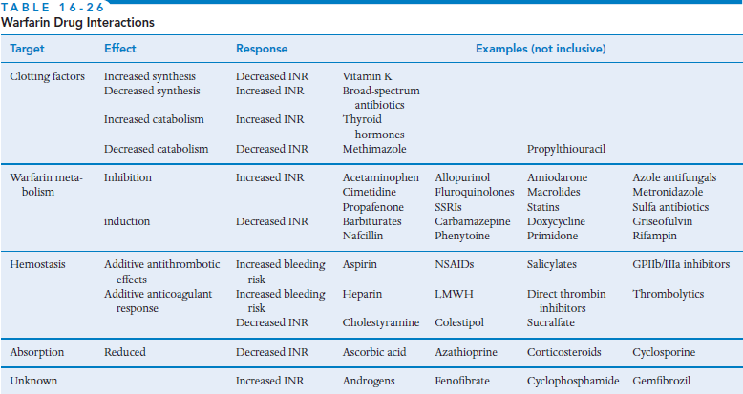
Warfarin
Factors Influencing Dosing
Concurrent Medications

Slide 34
Warfarin
Over-anticoagulation
Asymptomatic high INR:
  Withhold therapy
Minor bleed:
  Withhold therapy
  Low dose Vit K.
  Start at lower dose
Major bleed:
  FFPs, factor concentrates
  High dose Vit K.

Slide 35
Prevention
Low dose UFH
  Inactivates factor Xa, no effect on factor IIa
  aPTT is not prolonged
Alternatives:
  Fixed dose SC LMWH
  SC fondaparinux

