Slide 1
Cancer Chemotherapeutic Agents

Slide 2
Chemotherapy
Drugs that treat cancer cells
Cytotoxic therapy that is directed toward rapidly dividing cells

Slide 3
Classes of Chemotherapeutic Drugs
Cytotoxic/Conventional chemotherapeutic drugs
Hormonal chemotherapeutic drugs
Targeted chemotherapeutic drugs:
  Monoclonal antibodies
  Tyrosine kinase inhibitors
Immunomodulatory therapeutic drugs

Slide 4
Mechanism of Action
Cytotoxic Chemotherapy:
  Damage DNA (alkylating agents, platinum agents)
  Interfere with DNA synthesis (antimetabolite drugs)
  Inhibit cell division (antimitotic drugs)
Classified by their effect on cell cycle:
  Phase specific agents (schedule dependent)
  Phase nonspecific agents (dose dependent)

Slide 5
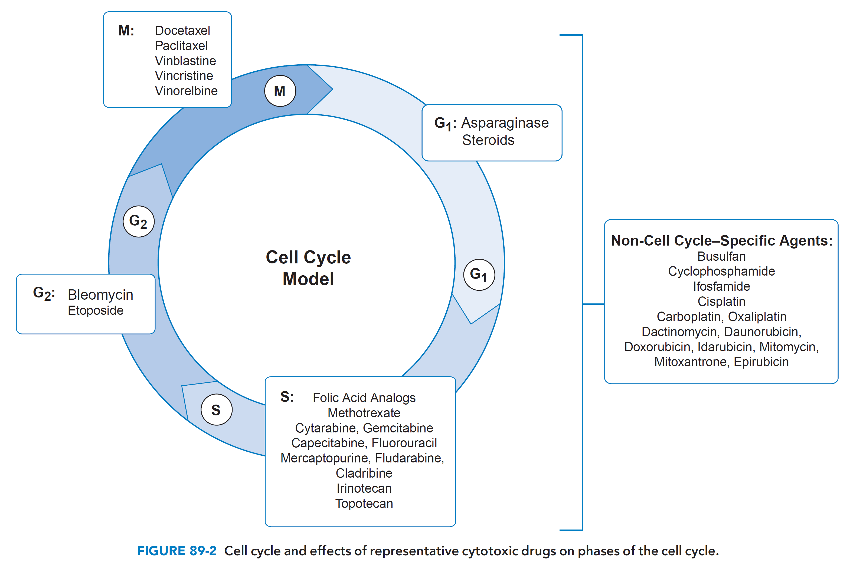

Slide 6
Factors Influencing Chemotherapy Response
Growth fraction
  Objective of successive chemotherapy cycles is further decrease in size of tumor mass
Dose intensity
Dose schedule
Drug resistance
Tumor site
Patient’s performance status

Slide 7
Dose Intensity
Chemotherapy dose per unit time (mg/m2/week)
Drug resistance can be overcome by escalating dose intensity:
  Increasing dose per cycle
  Shortening interval between cycles (dose dense treatment)
Limited by major dose related toxicity

Slide 8
Schedule Dependency
Given in cycles, with in-between recovery periods:
  Type of cancer
  Drugs used
Important determinant of response:
  Affects toxicities
  Pharmacokinetics of drug

Slide 9
Combination Chemotherapy
Most tumors show partial, short response to single-agent therapy
Broader coverage against resistant cell lines
Principles:
  Agents with demonstrable activity
  Different mechanisms of action
  No overlapping toxicities
  Used in optimal dose and schedule

Slide 10
Combination Chemotherapy
Primary chemotherapy – 1st line treatment
2nd line (salvage) chemotherapy – refractory to primary therapy
Consolidation – Additional chemotherapy to eradicate residual disease

Slide 11
Adjuvant Chemotherapy
Systemic chemotherapy after primary therapy (surgery, radiation)
Immediately follow primary therapy (low disease burden)

Slide 12
Neoadjuvant Chemotherapy
Therapy given before primary treatment (surgery, radiation):
  Reduce tumor mass
  Lessen amount of radical surgery
  Experience toxicities that may delay surgery
  May impair post-surgical healing

Slide 13
Targeted Agents
Two classes:
  Monoclonal antibodies
  Tyrosine kinase inhibitors.

Slide 14
Monoclonal Antibodies
Directed at specific receptors - block ligands from binding
Selectively target cancer pathways:
  EGFR (cetuximab)
  HER2/neu (transtuzumab)
  VEGF (bevacizumab)
Minimal toxicity to non-cancer cells

Slide 15
Tyrosine Kinase Inhibitors
Inhibit tyrosine kinase activation
  Imatinib mesylate (CML)
  Erlotinib (NSCLC)
  Sorafenib (HCC)
  Sunitinib (GIST)

Slide 16
Other Targeted Agents
Histone deacetylase (HDAC) inhibitors
  Romidepsin (T Cell lymphoma)
Proteasome inhibitor
  Bortezomib (MM)
mTOR inhibitors
  Everolimus (Breast Cancer)
Miscellaneous
  Thalidomide (MM)

Slide 17
Endocrine Therapy
Treat cancers which are hormone-sensitive:
  Blocking receptors
  Eliminating endogenous hormone

Slide 18
Endocrine Therapy
Androgens: Fluoxymesterone
Antiandrogens: Bicalutamide
Antiestrogens: Tamoxifen
Aromatase inhibitors: Anastrozole
Estrogens: Ethinylestradiol
GnRH: Goserelin

Slide 19
Biologic Response Modifiers
Substances that boost immune system to fight cancer:
  Monoclonal antibodies
  Vaccines
  Growth factors (interferon-α, interleukin 2)

Slide 20
Vaccines
Stimulate body’s immune response
  Sipuleucel-T (metastatic Prostate cancer)

Slide 21
INTERFERON-α
Anti-tumour activity by:
  Antiproliferative
  Immunomodulatory
  Induction of tumor cell antigens
  Differentiating
  Antiangiogenic

Slide 22
Interleukin 2
Anti-tumour activity by:
  Stimulation of T- and B-cell proliferation
  Lyse tumor cells

Slide 23
Administration – Systemic
IV route:
  Most common
  Bolus injection (<15 minutes)
  Short infusion (15 minutes to hours)
  Continuous infusion (24 hours to weeks)
Can be given oral, IM, S/C

Slide 24
Administration – Regional, Local
High concentration at site of tumor
Reduce systemic exposure (toxicity)
Does not target micrometastases
  Intrathecal or intraventricular
  Intravesicular
  Intraperitoneal
  Intrapleural
  Chemoembolization

Slide 25
Common, Acute Toxicities

Slide 26
Myelosuppression
Agent-related factors:
  Specific agent
  Dose intensity
  Dose density

Slide 27
Myelosuppression
Host factors:
  Age: Younger are better as have more cellular marrow
  Bone marrow reserve
  Prior chemo-radiotherapy
  Hepatorenal function: Ability to metabolize and excrete

Slide 28
Myelosuppression
Phase-specific cause rapid cytopenias with rapid recovery
Nitrosoureas: severe, delayed suppression (6 wk)
Most regimens given every 3 to 4weeks
Targeted therapies are not myelosupressive

Slide 29
Prevention of Neutropenia
Reduce dose of each agents (compromise response)
Prophylactic administration of colony stimulating factors
  G-CSF
  GM-CSF
Enhance neutrophil recovery after chemotherapy

Slide 30
Anaemia
Not dose-limiting toxicity
Cause anisocytosis, macrocytosis (inhibition of DNA synthesis)
  Antimetabolites
  Hydroxyurea
EPO ameliorate anemia, reduce transfusion
  Epoetin alfa, darbepoietin alfa
  Risk for thromboembolic events.

Slide 31
Coagulopathies
Due to:
  Chemotherapy-induced thrombocytopenia or thrombosis
  Treatment with asparaginase (inhibition of fibrinogen)

Slide 32
Thrombosis
Associated with antiangiogenic therapies:
  Thalidomide
  Lenalidomide
  Bevacizumab

Slide 33
GIT
Nausea, vomiting
Xerostomia
Mucositis, stomatitis
Esophagitis
Diarrhea
Constipation
Malabsorption

Slide 34
Dermatologic
Alopecia Hyperpigmentation
Radiation recall Photosensitivity
Nail changes Hand-foot syndrome
Acneiform rashes Hypersensitivity reactions
Extravasations

Slide 35
CNS
Acute Encephalopathy
Chronic Encephalopathic Syndrome
Cerebellar Neuropathy
Peripheral Neuropathy
Cranial Neuropathy
Arachnoiditis (Intrathecal Therapy)
Autonomic Neuropathy
SIADH

Slide 36
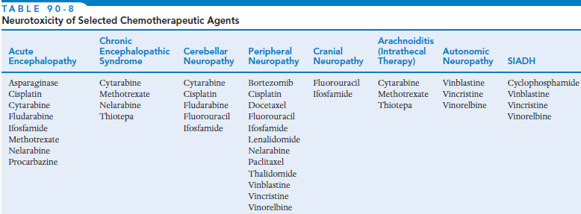
CNS

Slide 37
CVS
Cardiomyopathy
Arrhythmias
Hypertension
  Bevacizumab
Angina & Myocardial Infarction
  Fluorouracil

Slide 38
Renal
Nephrotoxicity: Cisplatin
Proximal tubule dysfunction
Proteinuria: Bevacizumab
Acute tubular obstruction: Methotrexate
Haemorrhagic Cystitis: Cyclophosphamide

Slide 39
Pulmonary
Bleomycin:
  Highest incidence
  Interstitial pneumonitis
  Pulmonary fibrosis
Less with chlorambucil, cyclophosphamide

Slide 40
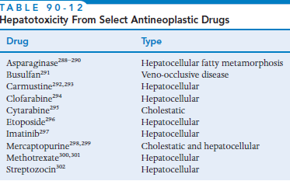
Liver

Slide 41
Long term Complications

Slide 42
Second Malignancies
AML
  After combination chemotherapy:
    Topoisomerase inhibitors (etoposide, anthracyclines)
    Alkylating agents (melphalan)
  Occur 1 to 3 years after chemotherapy
Superficial bladder cancer
  Daily oral cyclophosphamide

Slide 43
Infertility – Oogenesis
Gonadotoxic:
  Alkylating agents (most gonadotoxic)
  Vinblastine
  Etoposide
  Cisplatin

Slide 44
Infertility – Spermatogenesis
Progressive dose-related depletion of germinal epithelium (azoospermia):
  Alkylating agents (procarbazine is most gonadotoxic)
  Doxorubicin
  Vinblastine
  Cytarabine
  Cisplatin

Slide 45
Teratogenicity
Explicitly discouraged from conception
  Wait 2 years after completion before attempting to conceive

