Slide 1
Treatment of Hypertension
EO

Slide 2
Diagnosis
BP >140/>90 Repeated
115/75 mmHg optimum
Risk of CVS disease with increasing BP
Risk depend on race, sex ,age, smoking, ETOH, DM, Lipid levels, FH
Usually asymptomatic

Slide 3
Conventional definitions
Risk reduced at BP < 120/80 mmHg and increase with progressive rise
Severe HT ->210/120 , arteriolopathy
- malignant HT
- Target organ damage ( rapid)
- Renal failure,HTencephalopa-
thy, retinal changes, MAHA

Slide 4
Risk factors
Age
Race
Gender
Smoking
Hyperlipidaemia
Family history
Diabetes mellitus

Slide 5
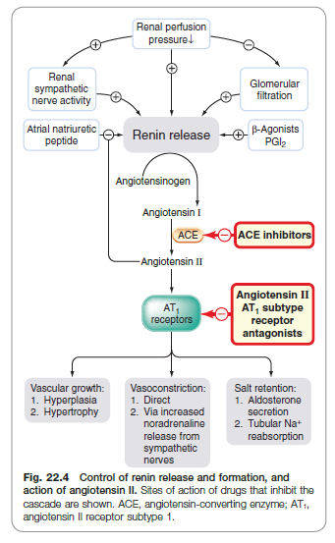

Slide 6
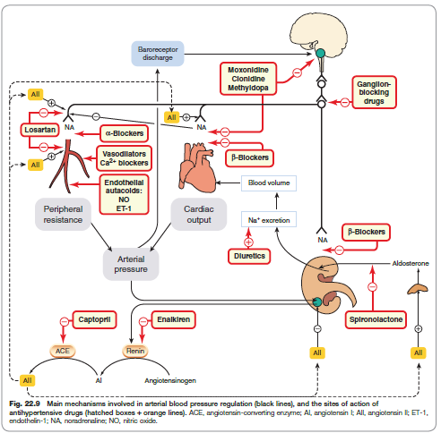

Slide 7
Target organ involvement
Kidney
Heart
Brain
Eyes
Blood vessels

Slide 8
Untreated hypertension - Risks
Coronary thrombosis
Cerebrovascular events - stroke
Renal failure

Slide 9
Complications
BP>140/90 mmHg.
Effects – Vessel, LVH , CVA , CAD , AMI
_Sudden death ,cardiac failure ,
_Renal insufficiency,Dissecting AA

Slide 10
Curable ?

Slide 11
Aetiogenesis
Primary(essential) – 90%
Secondary -10% -Renal artery stenosis
-Coarctation of the aorta
-Phaeochromocytoma
-Cushings syndrome
-Primary aldosteronism
-Kidney disease - polycystic
disease

Slide 12
Approach to care
Diastolic 85-94 mmHg - non-drug
Reduction to < 85mmHg confer > protection than 90mmHg
Lower levels desired in diabetes
Drugs used singly or in combination

Slide 13
Consideration
Exclude secondary cause
Severity
ADR s
Cost
Convenience
Complications
Comorbidity

Slide 14
Diuretics
Deplete Na+ and volume
Salt restriction
Reduction of Na+ coupled with eventual reduction of PVR
Indapamide is a non-thiazide sulfonamide diuretic with vasodilator effect

Slide 15
Diuretics
Amiloride inhibit smooth muscle contraction in response to stimuli
Adequate for mild to moderate HT and lower BP by 10-15 mmHg
Used in combination
Uses HT - thiazides,
- loop- CHF, RF add K+ sparing

Slide 16
ADRs
Hypokalaemia
Hypomagnesaemia
Hyperglycemia
Hyperuricaemia
Hyperlipidaemia
Renal cell ca

Slide 17
Centrally acting
Reduce sympathetic flow from the VMC in the brain stem
Methyldopa - analog of L-dopa converted to methyl dopa and methylepinephrine that replaces NE in the adrenergic vesicles which act as a false NT
Other agents include clonidine, guanabenz and guanfacine

Slide 18
Adrenoceptor antagonists
Propranolol- HT,IHD
Mild to moderate HT
Prevent reflex tarchycardia, reduce mortality in CCF
Act by β-blockade, inhibit renin production
Toxicity - bradycardia, B’asthma, diabetes, Peripheral vascular insufficiency

Slide 19
Vasodilators
Hydralazine, minoxidil ,nitroprusside ,
Best as combination
Hydralazine - dilates arterioles and veins, useful in severe HT
Diazoxide- HT emergencies

Slide 20
CA ++ CHANNEL BLOCKERS
Inhibit Ca++ influx in smooth muscle cell
Influx required for muscle contraction
Occurs thro’ ion channels
Influx results in muscle contraction and neurohormonal activation
Act largely on the L- type channel

Slide 21
RAAS
ACEI
ARBs

Slide 22
Hypertension
Urgency
Emergency -ά – adrenoceptor blocking drugs / labetolol

Slide 23
