Slide 1
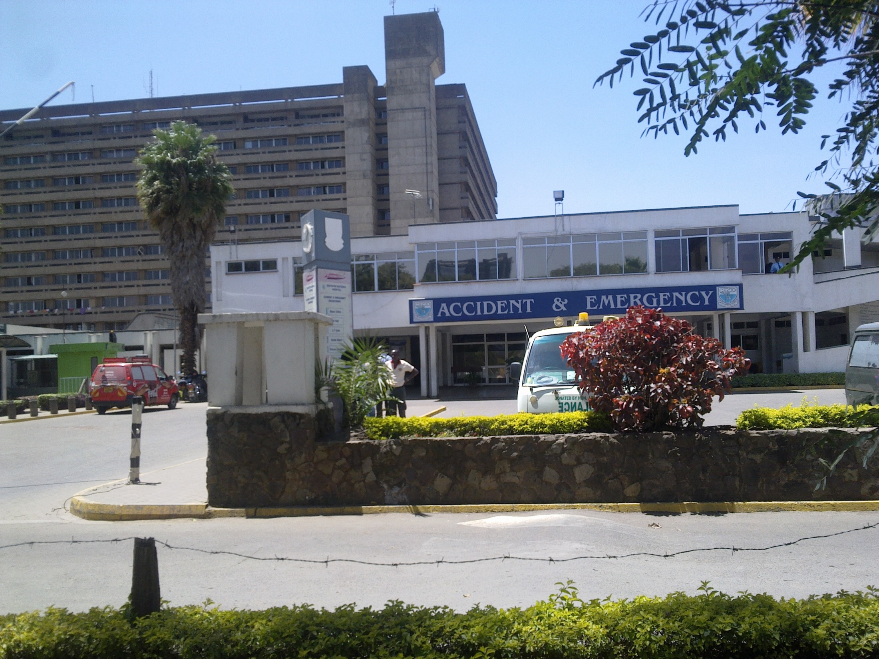
Anorectal Malformations
Dr F Osawa
U.O.N

Slide 2
Introduction
Definition:
Anorectal malformations (ARM) are a complex group of congenital anomalies involving the distal anus and rectum
Abnormalities:
1.Narrow anal passage
2.Misplaced anal opening
3.Membrane over anal opening
4.Rectum not connected to the anus
5.Rectum connected to part of urinary tract or reproductive system through a fistula
6.Absent anus

Slide 3


Slide 4


Slide 5
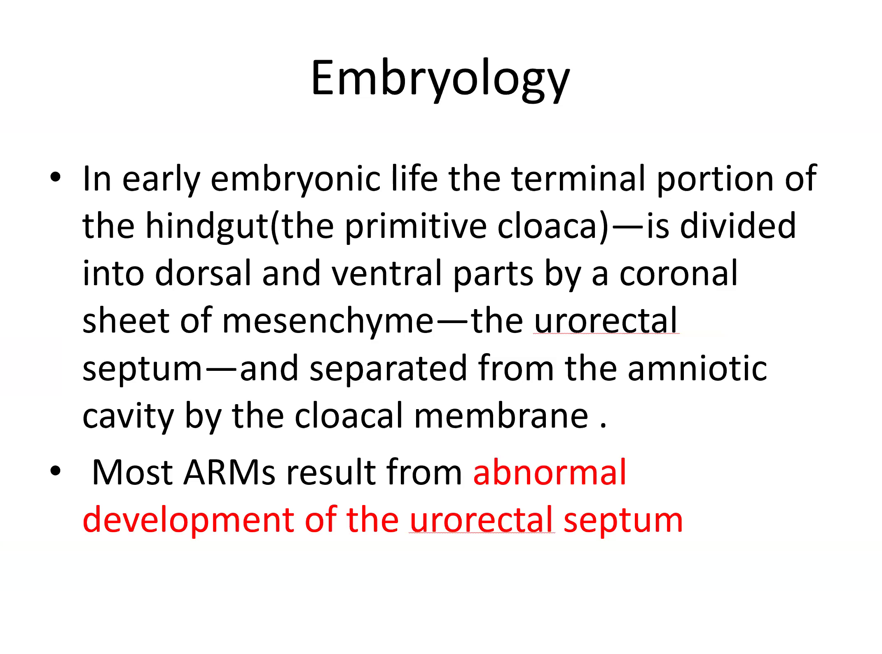

Slide 6
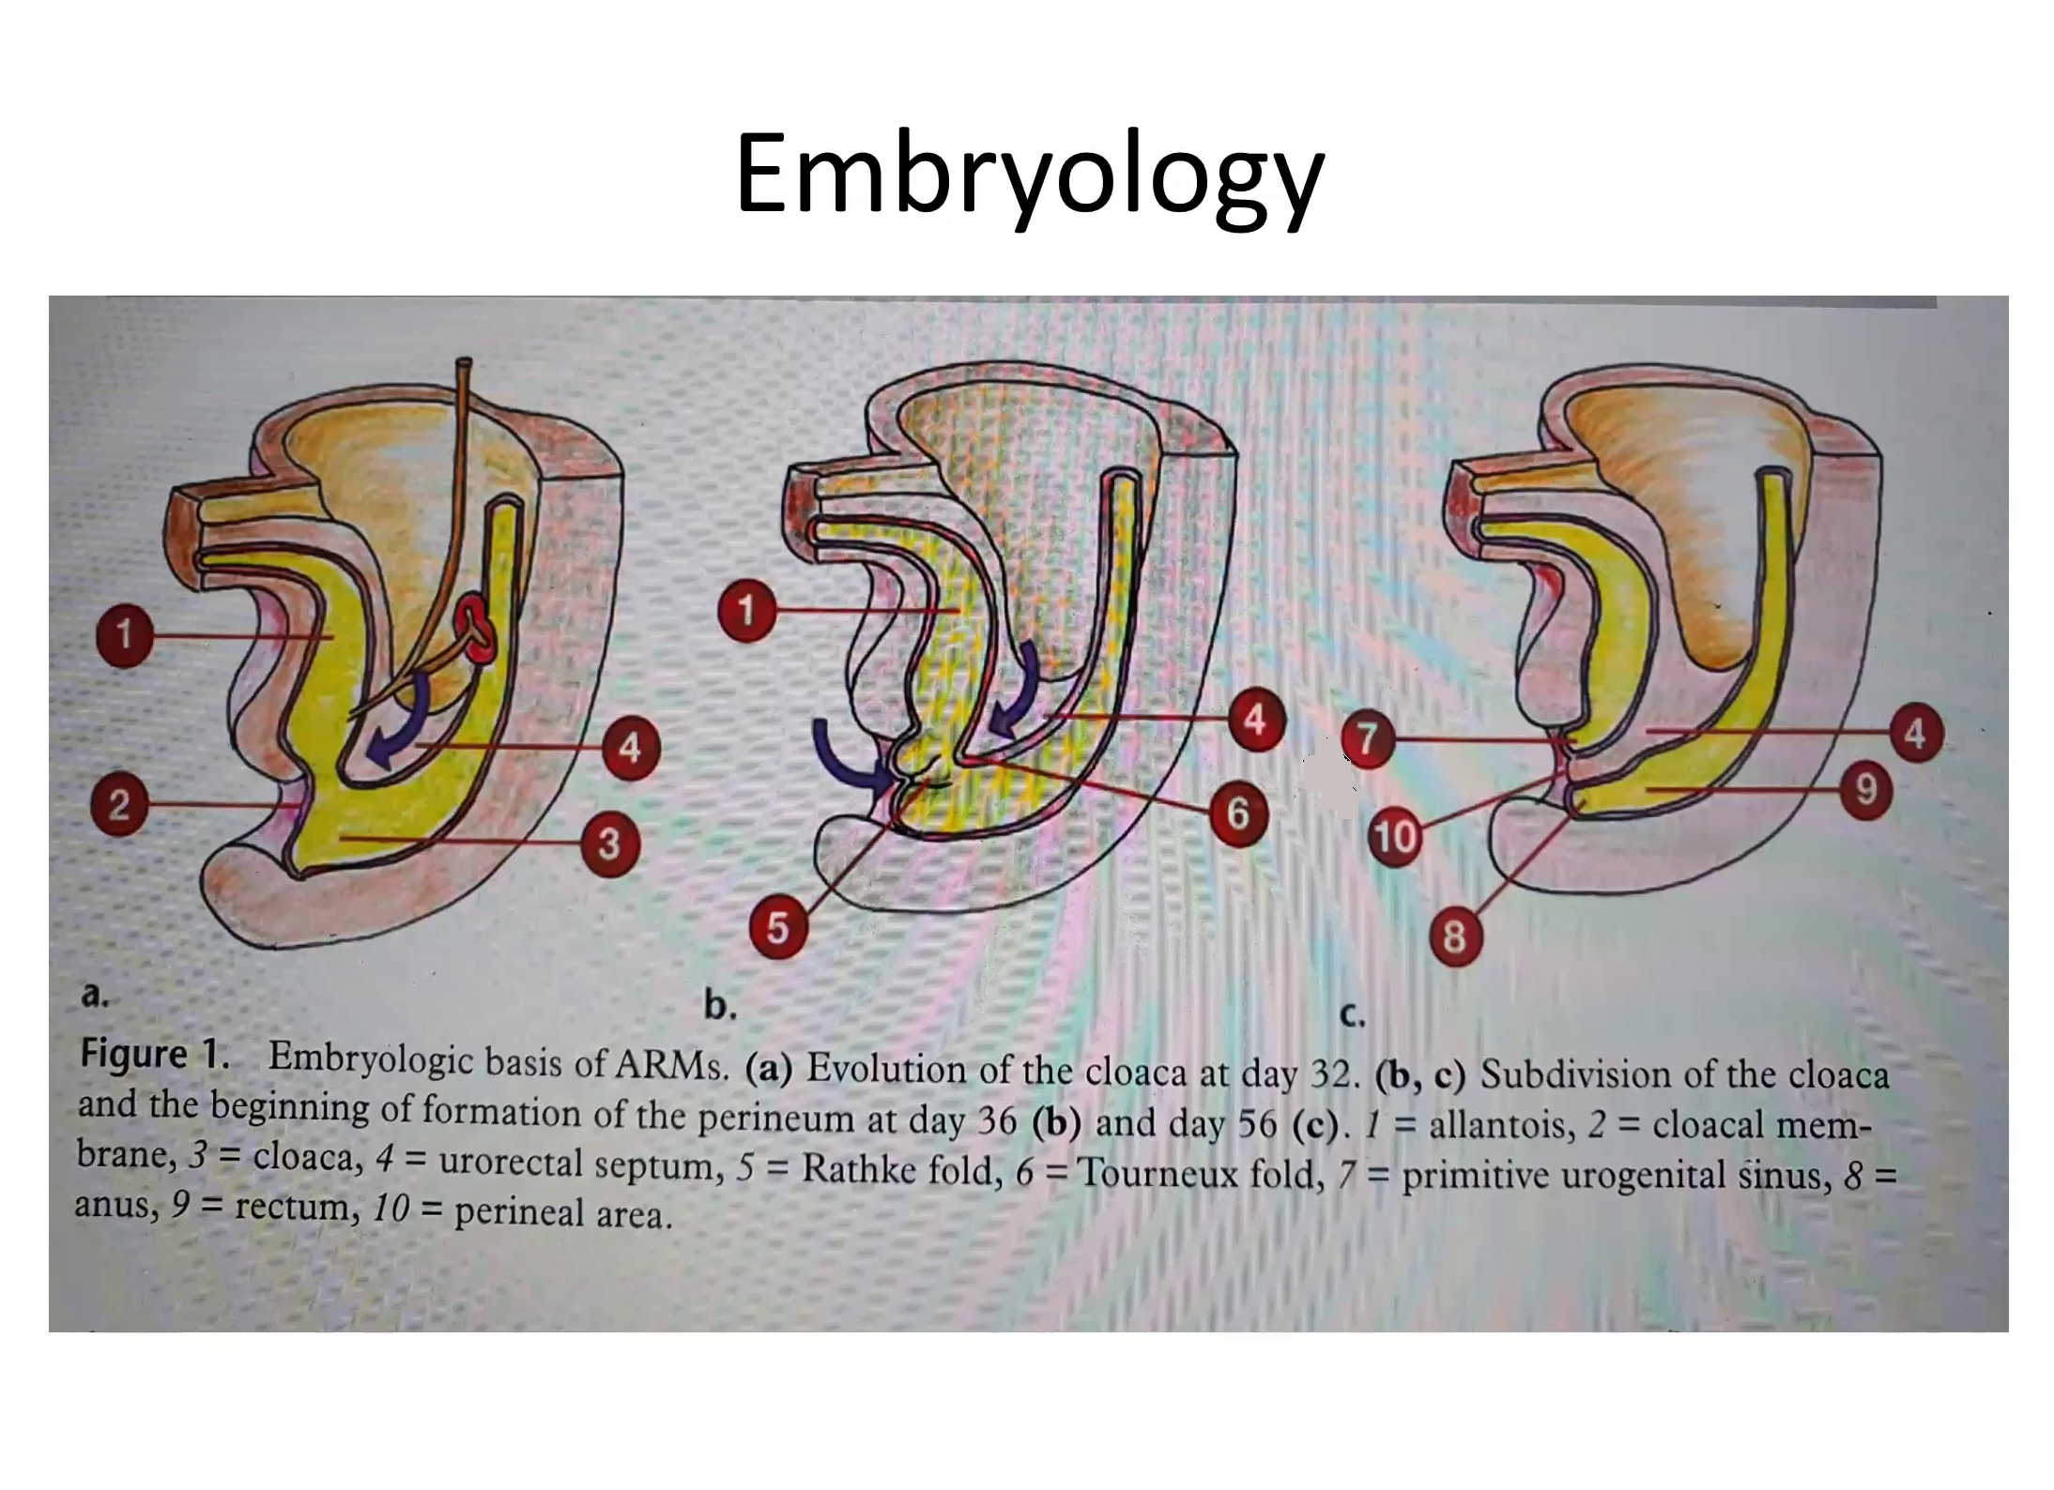

Slide 7


Slide 8
Classification
• Wingspread classification
• Pena classification
Based on the level in relation to the pelvic floor
High
Intermediate
low
Based on the location of the
fistula
Females-perineal fistula
-vestibular fistula (90%)
-persistent cloaca
-rectal atresia
-imperforate anus without a fistula
Males-perineal fistula
-vescical fistula
-urethral fistula (m.c recto-prostatic urethra fistula)
-rectal atresia
-imperforate anus without a fistula

Slide 9
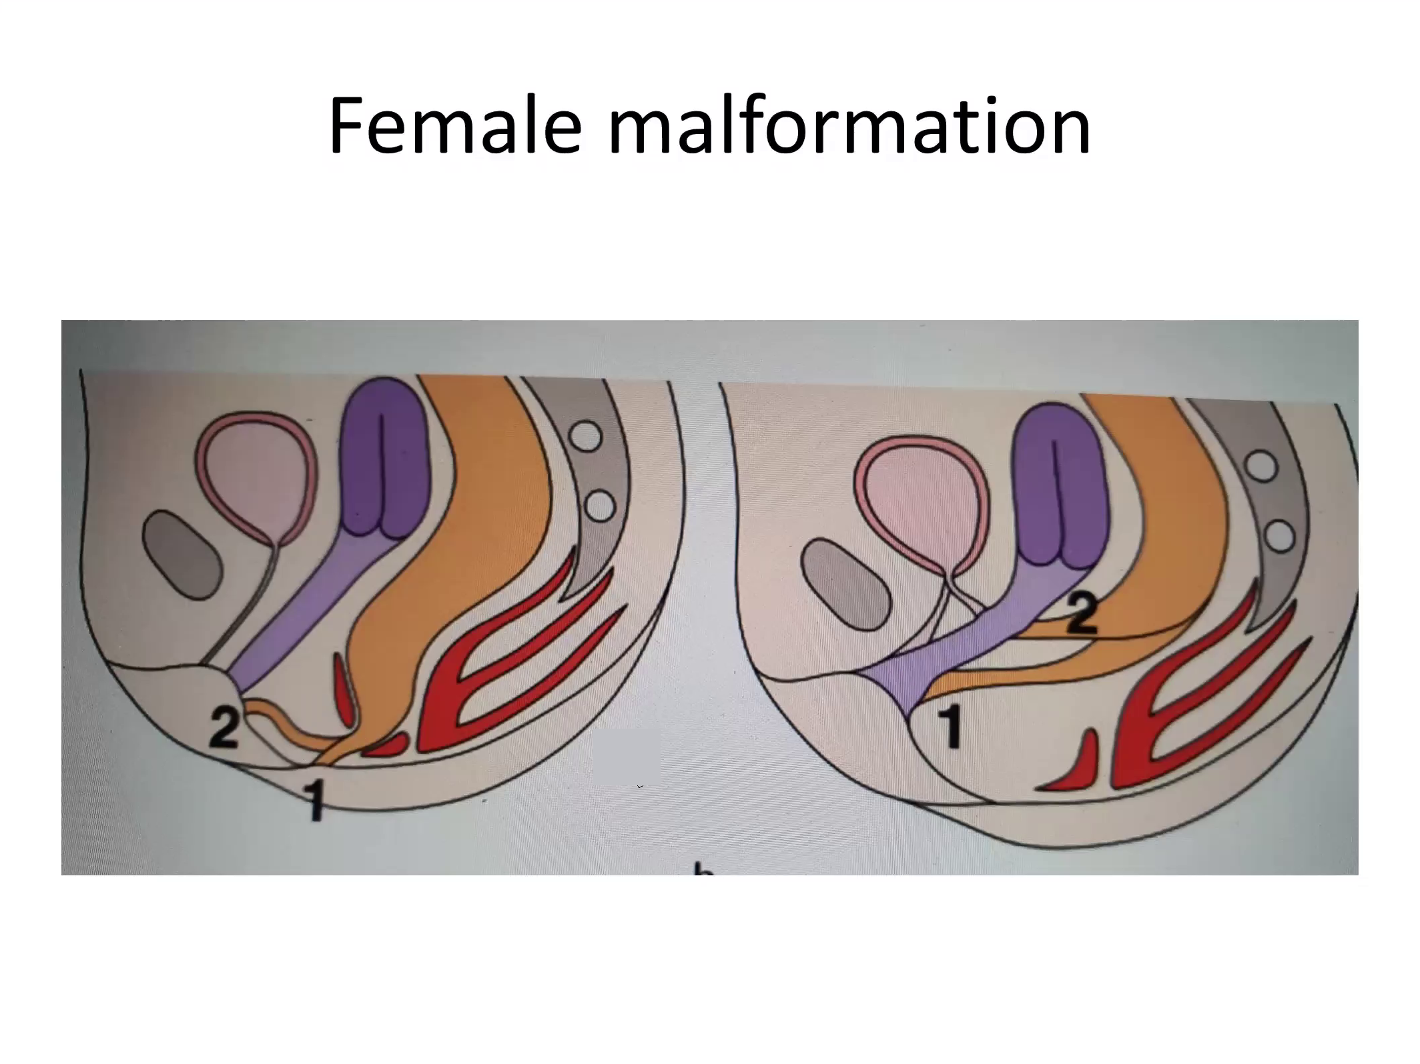

Slide 10
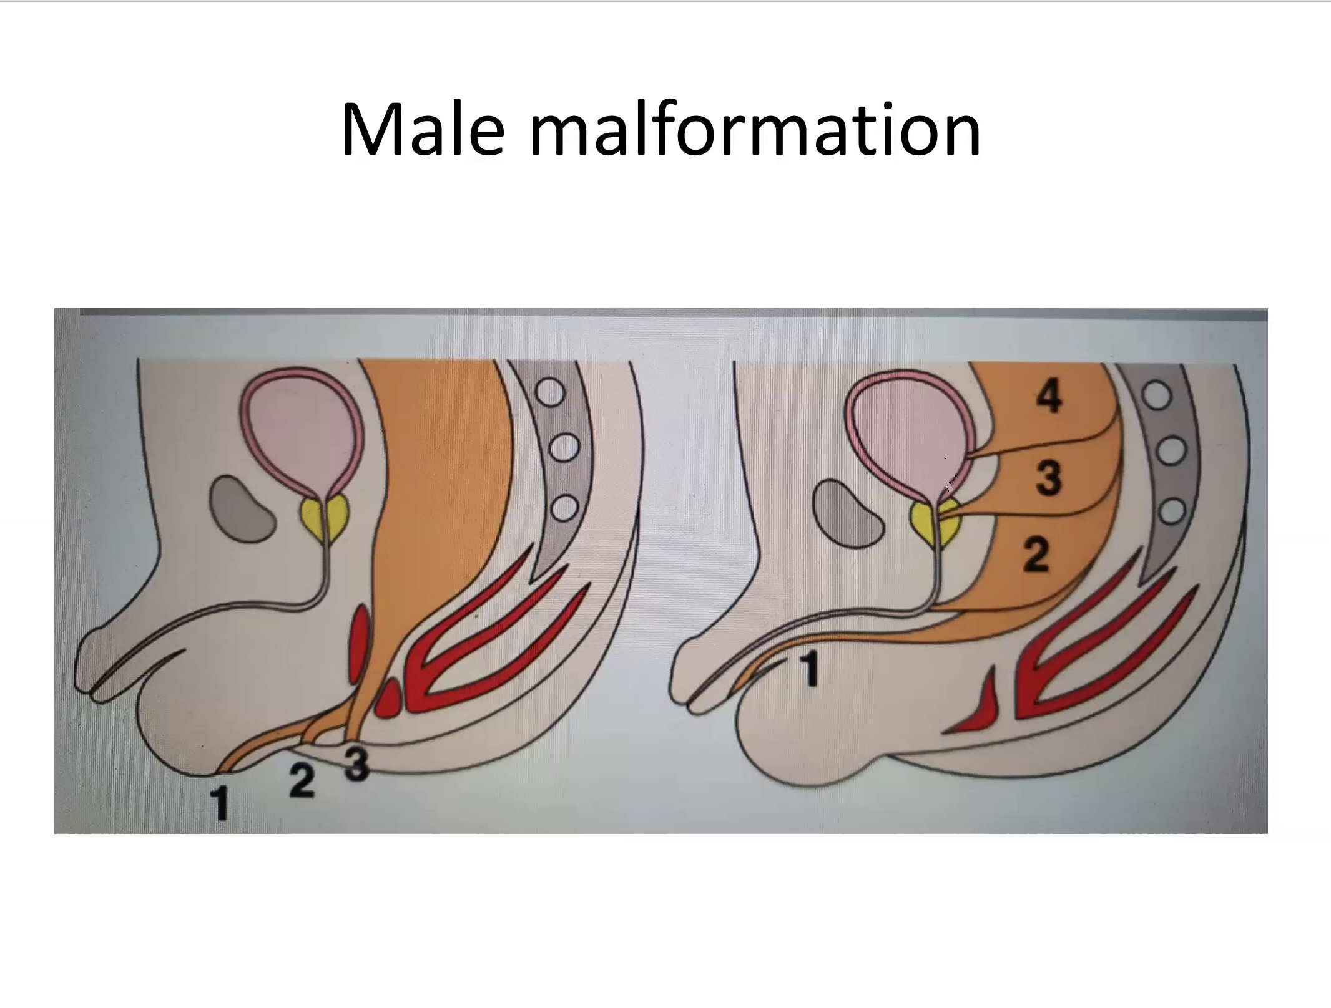

Slide 11
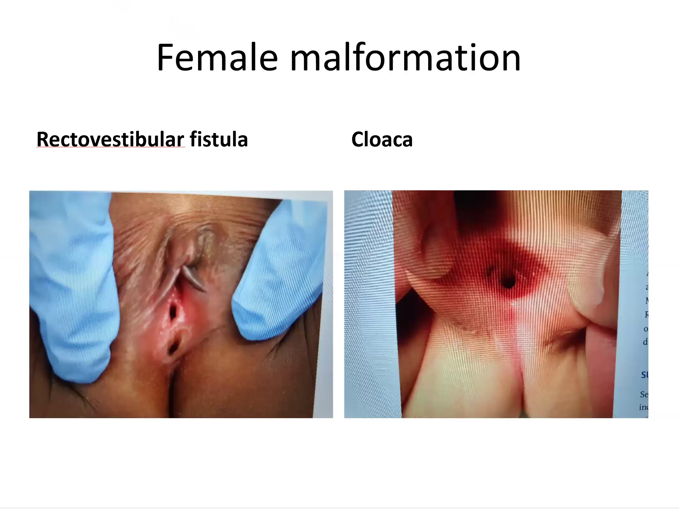

Slide 12
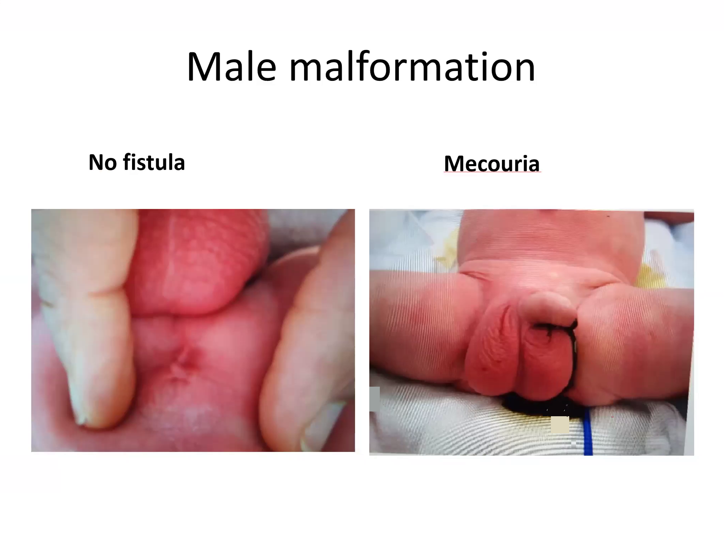

Slide 13
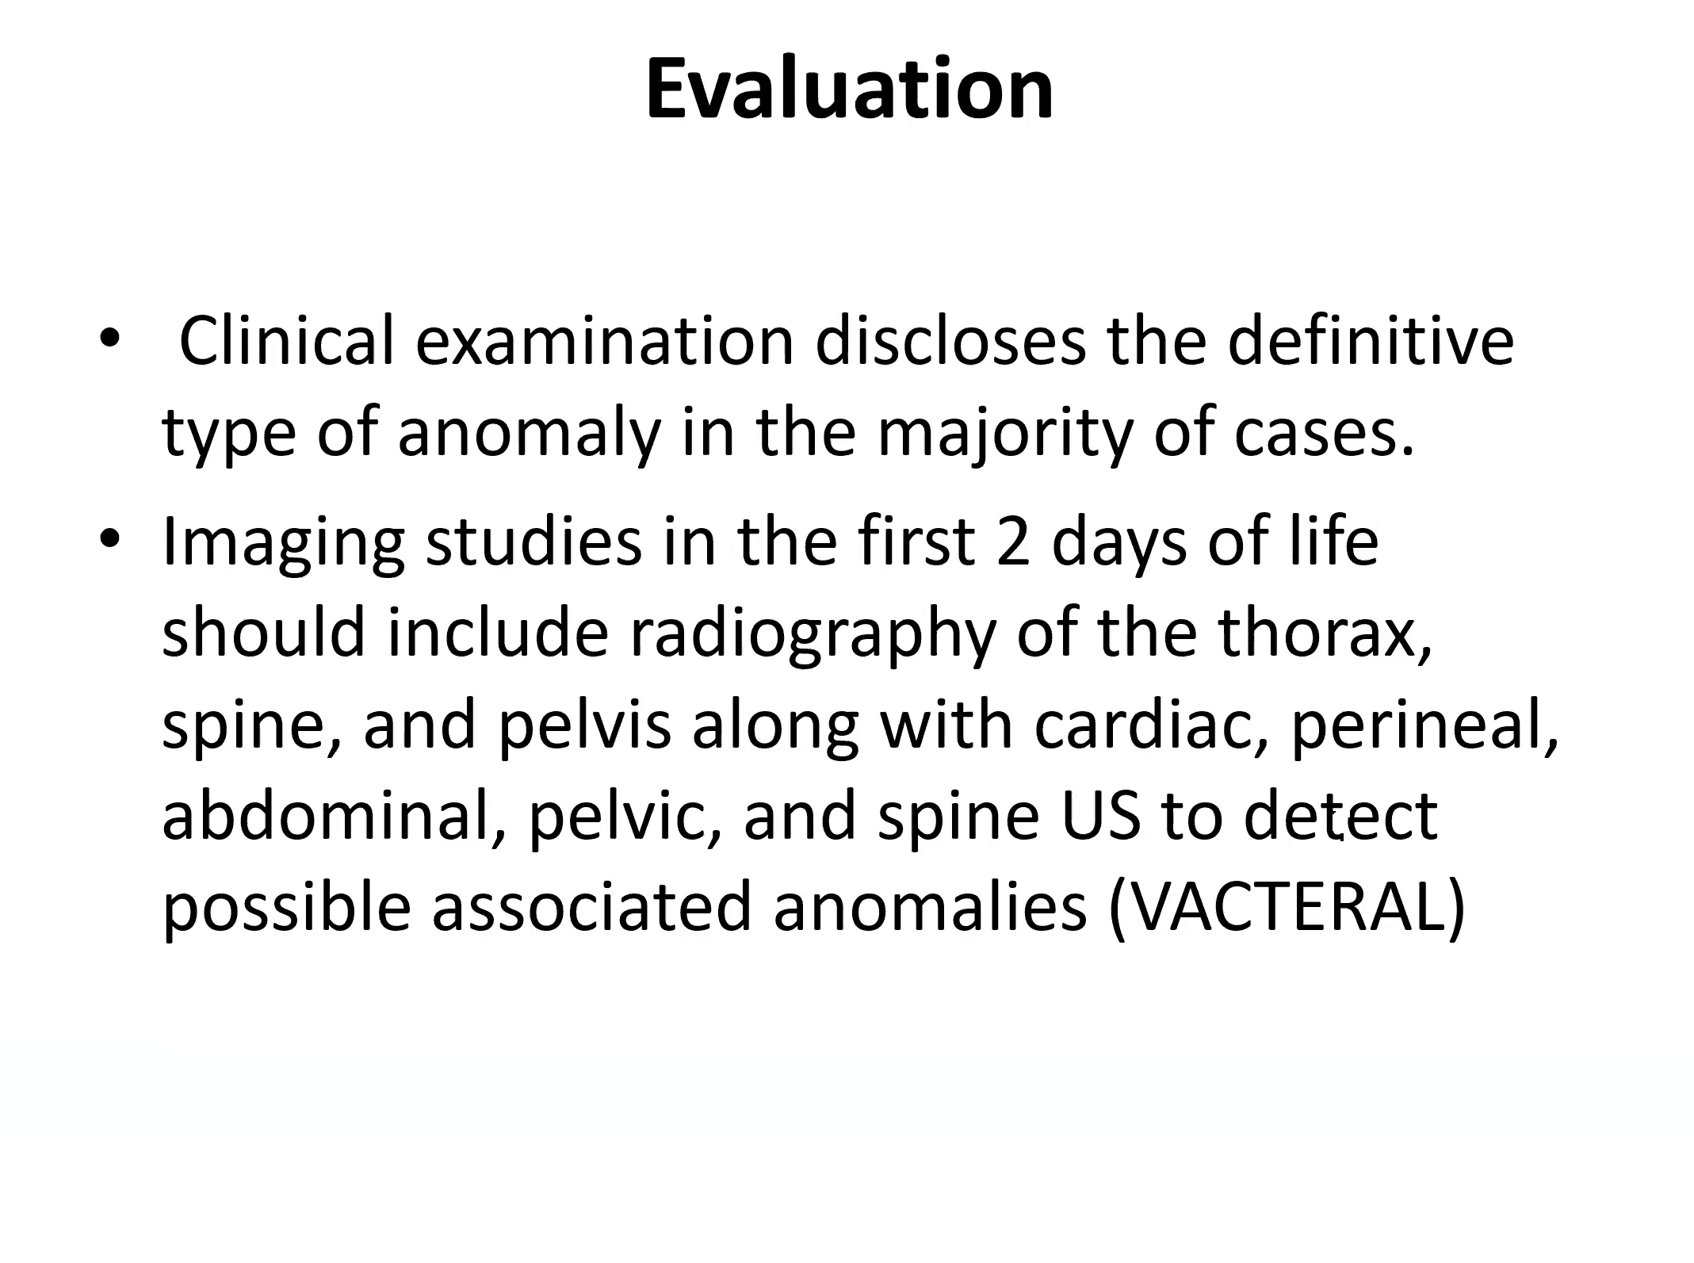

Slide 14
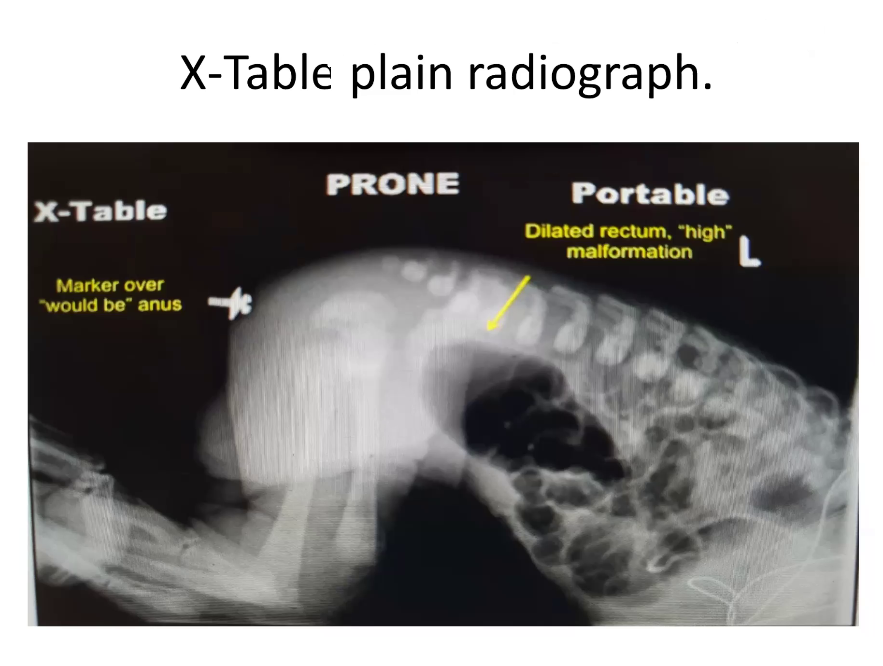

Slide 15
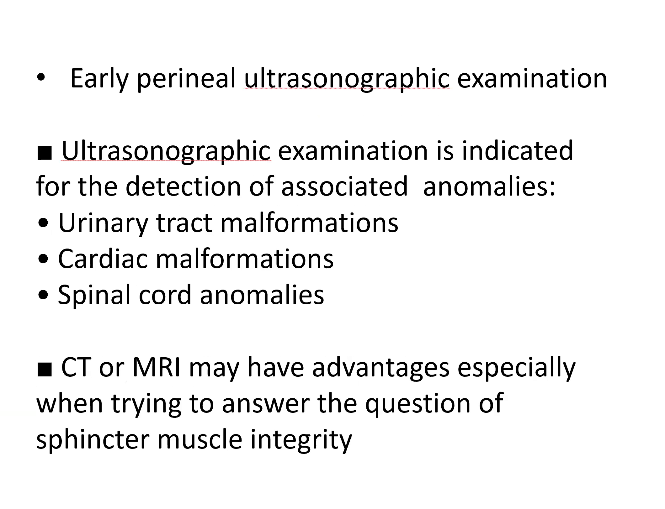

Slide 16
Operative strategy
Depends on the type of the anomaly, which has to be ascertained during the first 24 h of life.
Life-threatening associated anomalies that require urgent management (i.e., severe cardiac anomalies, obstructive uropathy, esophageal atresia, etc.) have to be ruled out.
Fashioning of sigmoid divided colostomy if indicated- less risk of stoma prolapse, better stool quality, easy to flush distal blind end.
Definitive surgery from 6 months of age.

Slide 17
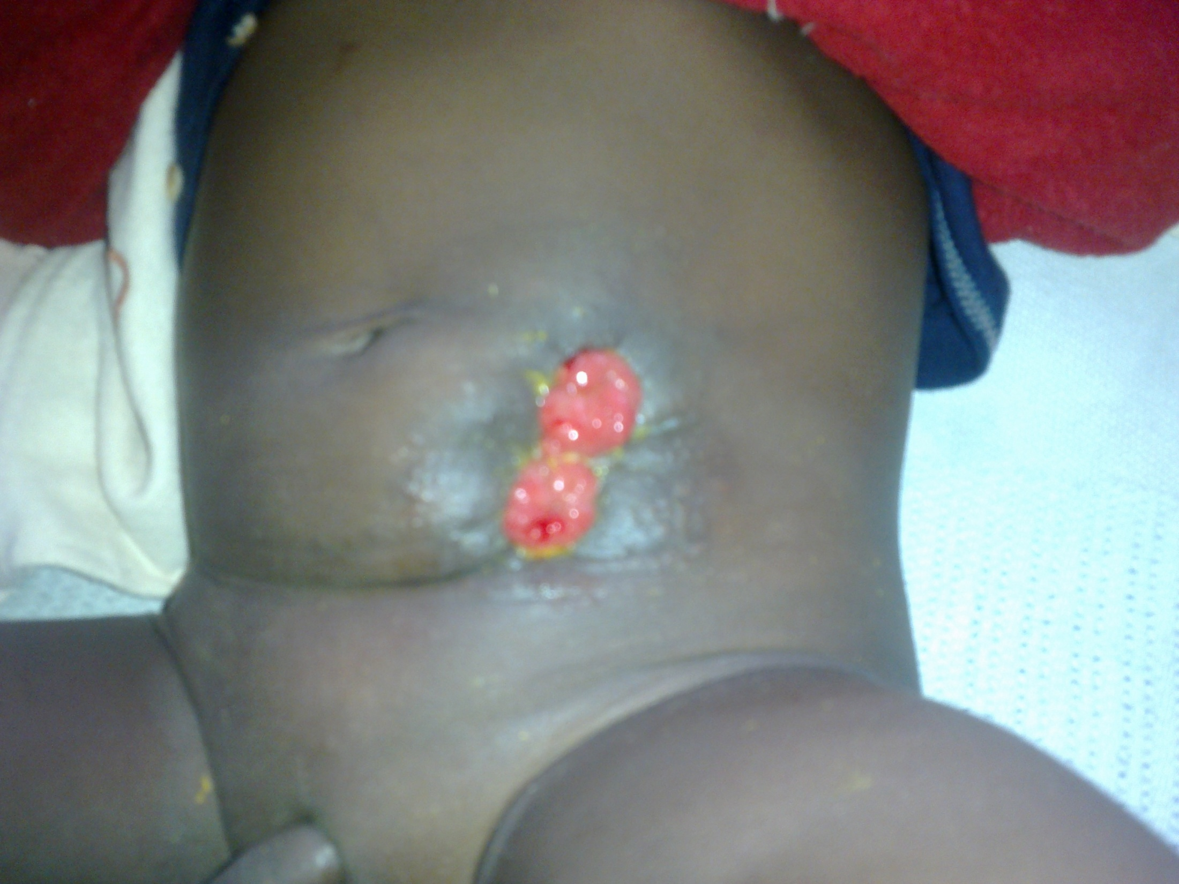
Divided Colostomy

Slide 18
Operative strategy
Colostomy needed
Colostomy not needed
• In males with:
– Rectourethral fistula
– Rectovesical fistula
– No fistula (if distance between rectum and skin is unclear or >1 cm)
– Rectal atresia
In females with:
-Persistent cloaca
-Rectovestibular fistula
-No fistula
-Rectal atresia
Perineal fistula
Covered anus
Males with bucket handle deformity
Anocutanious fistula

Slide 19
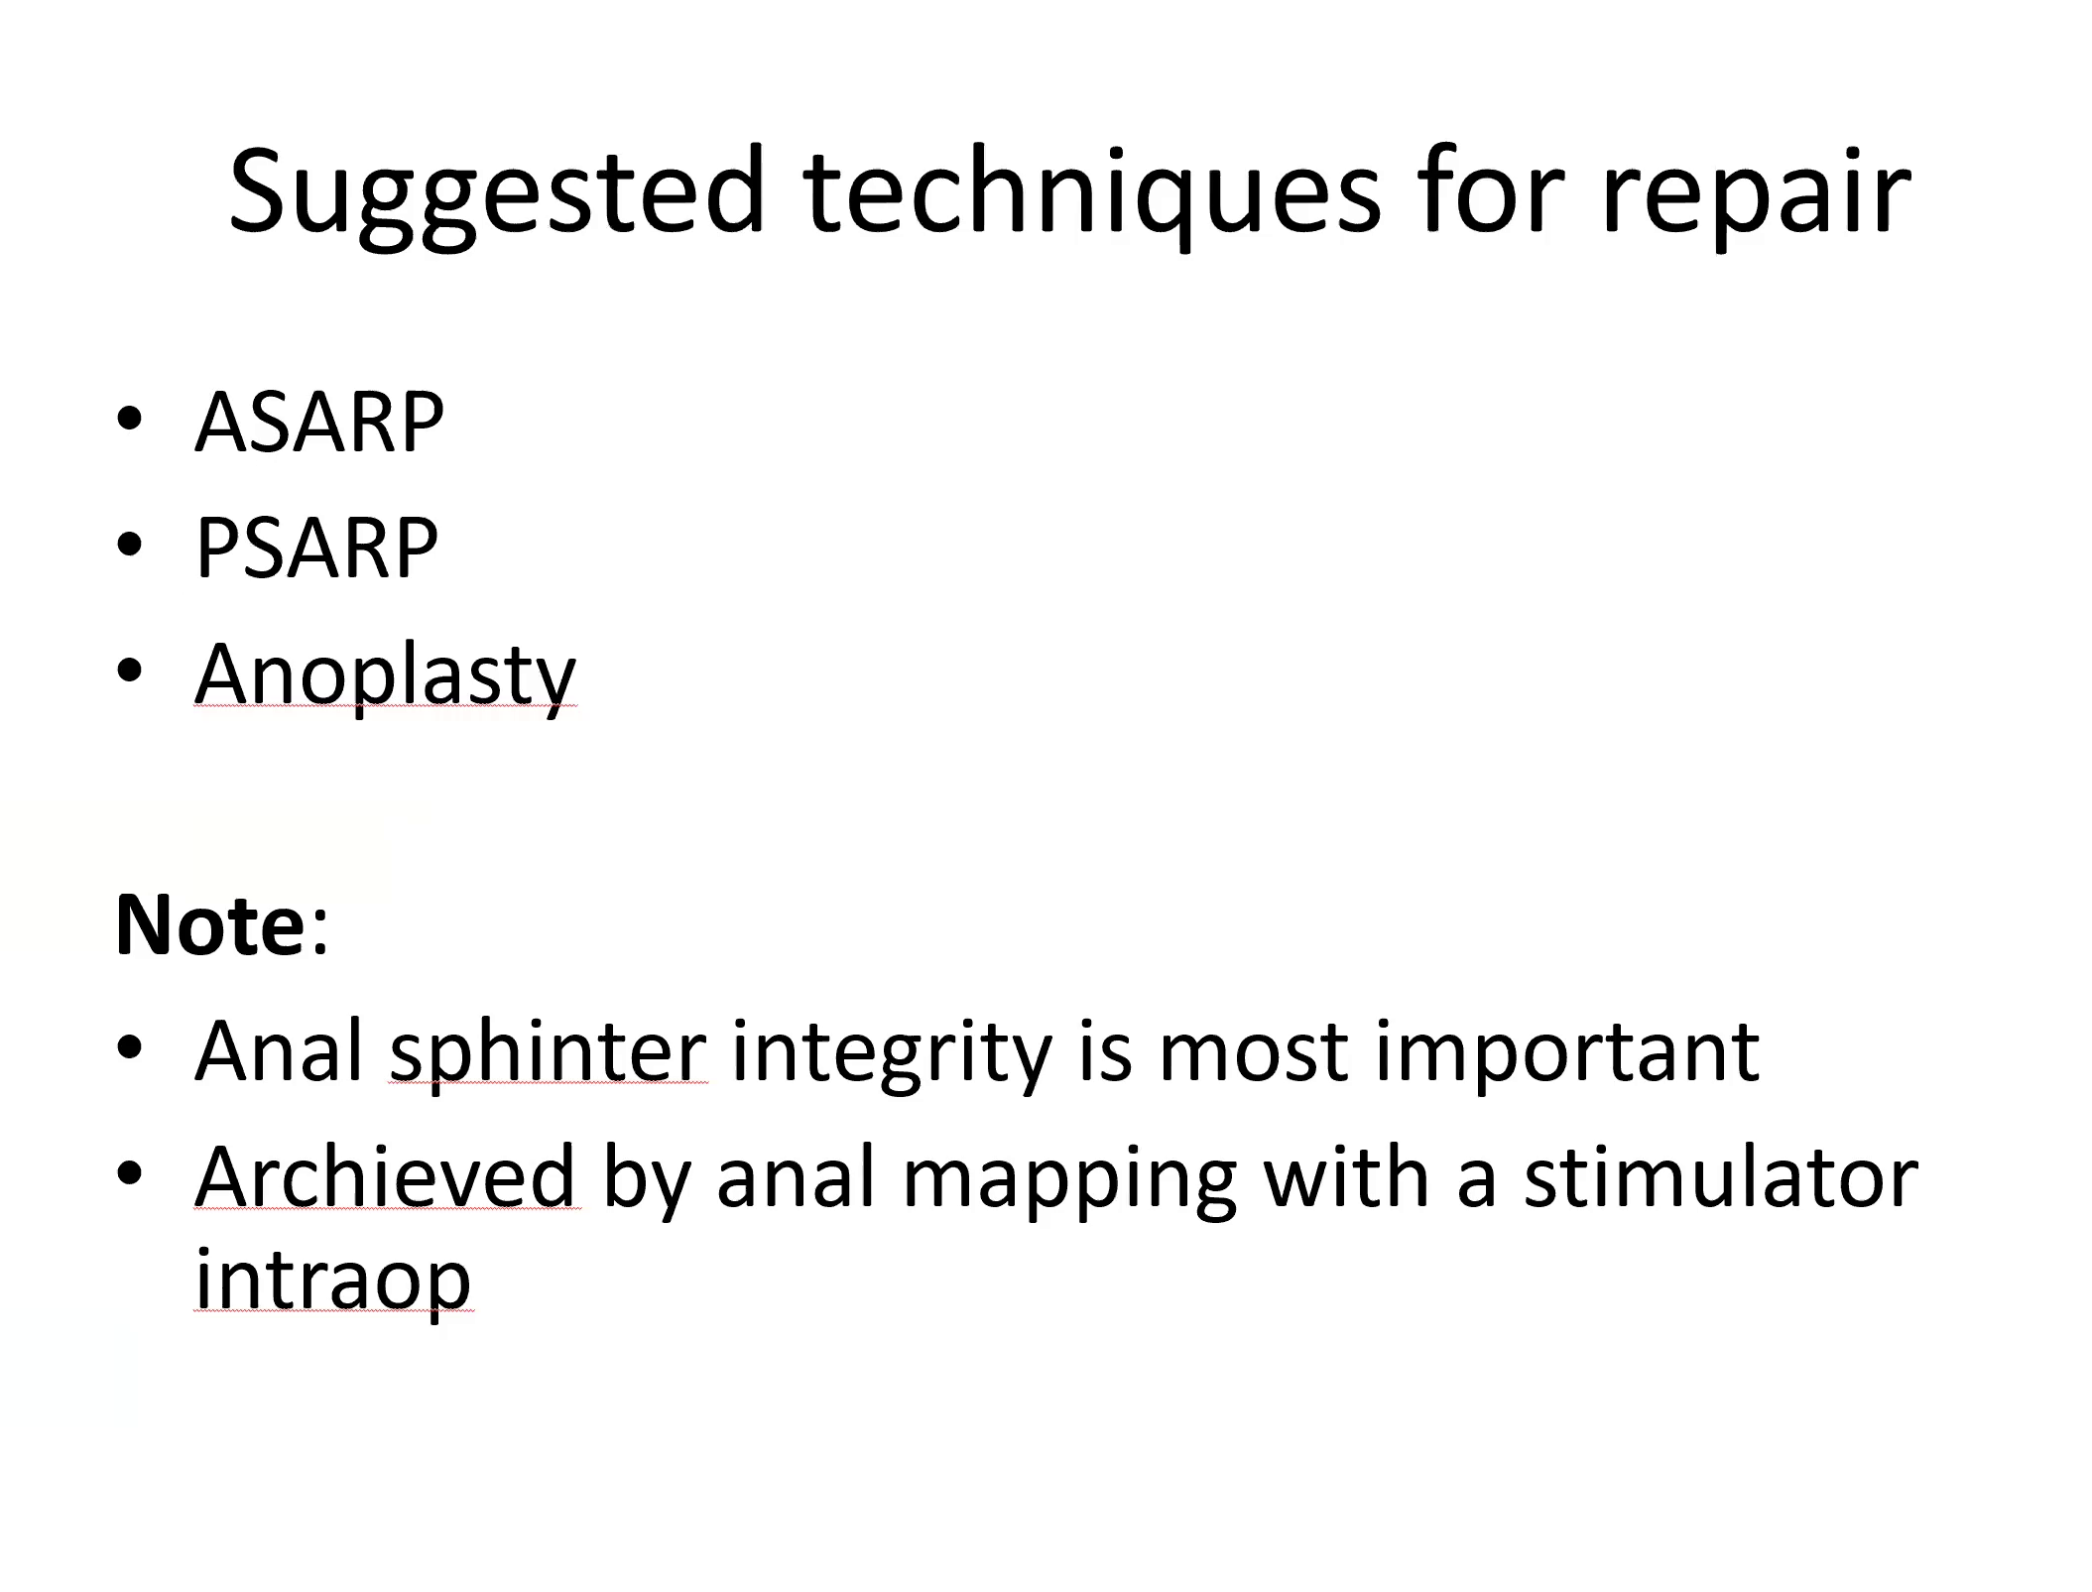

Slide 20
Postoperative care
■ Patients with standard PSARP have a bladder catheter for 3–5 days
■ Antibiotic prophylaxis
■ Anal dilatations with Hegar dilators are started 2 weeks postoperatively

Slide 21
• The colostomy is closed when the final size is reached
• The dilatations are continued after closure of the stoma for 4–6 weeks
• Patients require vigorous follow-up during the first 2 years of life

Slide 22
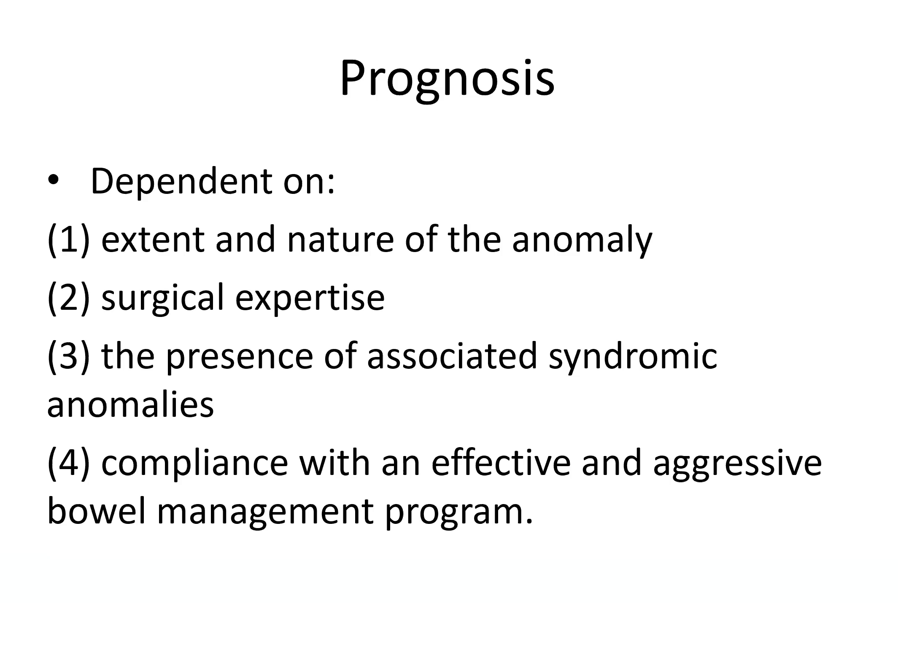

Slide 23
Long term concerns
Urinary incontinence
Fecal incontinence
Sexual Function and Fertility

Slide 24


