Slide 1
Gastric cancer
J W Githaiga
UON Department of Surgery

Slide 2
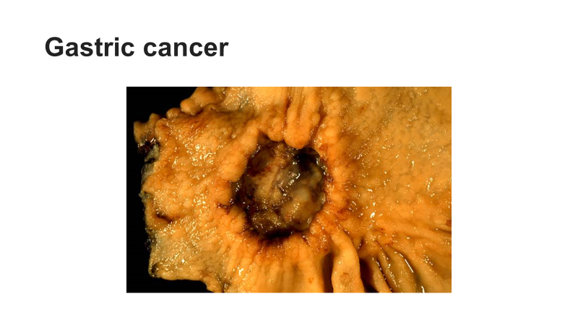

Slide 3
Globally, stomach cancer is the fifth leading cause of cancer and the third leading cause of death from cancer, making up 7% of cases and 9% of deaths.
Outcomes are often poor with a less than 10% five-year survival rate globally. This is largely because most people with the condition present with advanced disease. In the United States, five-year survival is 28%, while in South Korea it is over 65%, partly due to screening efforts.
In 2012, it newly occurred in 950,000 people and caused 723,000 deaths. Before the 1930s, in much of the world, including most Western developed countries, it was the most common cause of death from cancer. Rates of death have been decreasing in many areas of the world since then.

Slide 4
Signs and Symptoms
May be symptomatic or cause nonspecific symptoms) in early stages.
Heartburn
Upper abdominal pain
Nausea and loss of appetite
Weight loss
Jaundice

Slide 5
Vomiting.
Difficulty swallowing.
Altered blood in the stool.
Metastases in liver, lungs, bones, lining of the abdomen and lymph nodes.
Peritoneal metastatic spread may be evident as a palpable ovary on pelvic examination (Krukenberg tumor) or metastasis to the pouch of Douglas on rectal examination (Blummer's shelf sign).

Slide 6
Aetiology
Helicobacter pylori infection is a risk factor in 60 - 85% of gastric cancer , but only 2 % of people with H pylori infection develop cancer.
Smoking increases the risk of developing gastric cancer significantly, from 40% increased risk for current smokers to 82% increase for heavy smokers. Gastric cancers due to smoking mostly occur in the upper part of the stomach near the esophagus.
Alcohol consumption.
Diet; consumption of smoked foods, processed meats, salted foods and pickled vegetables. Nitrates and nitrites in cured/ baked meats can be converted by certain bacteria, including H. pylori, into nitrosamines which are carcinogenic. Fresh fruits and vegetables protective due to high levels of antioxidants.
Obesity associated with GERD.
About 10% of cases run in families, and between 1% - 3% of cases are due to inherited genetic syndromes such as hereditary diffuse gastric cancer associated with defect in CDH1 GENE that codes for E-Cadeherin.

Slide 7
Diabetes.
Pernicious anemia.
Chronic atrophic gastritis.
Menetrier's disease (hyperplastic, hypersecretory gastropathy).
Intestinal metaplasia.

Slide 8
Diagnosis
Laboratory work up: FBC- Anaemia-iron deficiency/macrocytic anemia; UE/C- electrolyte imbalances.
Endoscopy and Biopsy.
Barium meal.
CT Scan Abdomen- T,N,M Staging
Endoscopic Ultrasonography- T,N,M Staging.
Diagnostic/staging laparoscopy

Slide 9
Magnetic Resonance Imaging (MRI) has been known to be almost comparable to CT scan for staging of AGC and useful to confirm a liver metastasis in equivocal cases.
However, currently, MRI is limitedly used when the patients have an allergy to iodine contrast or renal failure due to motion induced artifacts, longer scanning times and a higher cost than CT scan.

Slide 10
Pathology
Gastric adenocarcinoma accounts for 90% of gastric tumours. This are epithelial tumours, originating from glandular epithelium of the gastric mucosa. Adenocarcinomas tend to invade the gastric wall, infiltrating the muscularis mucosae, the submucosa and then the muscularis propria.
Histologically, two major types of gastric adenocarcinoma (Lauren classification): intestinal type or diffuse type.
Intestinal type adenocarcinoma tumour cells form irregular tubular structures, with stratification, multiple lumens, reduced stroma. Often, associated with intestinal metaplasia in neighboring mucosa.

Slide 11
Intestinal type adenocarcinoma usually arises in the older population with an increased incidence in men and is frequently associated with chronic atrophic gastritis, intestinal metaplasia and Helicobacter pylori infection in neighboring mucosa.
They constitute approximately 60% of gastric carcinoma in high-risk population and occur frequently in the antrum as exophytic bulky lesions.

Slide 12
The sequence of changes in the stomach has been proposed that Helicobacter pylori infection or autoimmune gastritis → atrophic gastritis with intestinal metaplasia, -→dysplasia (adenoma) -→adenocarcinoma.
Diffuse type adenocarcinoma frequently occurs in younger patients, men = women.
Diffuse type adenocarcinoma (mucinous, colloid, linitis plastica or leather-bottle stomach) formed of discohesive and mucus secreting cells, described as signet-ring cell.
Other tumours include; Lymphomas 5% , Carcinoid and Gastrointestinal stromal tumors.

Slide 13
 | Intestinal adenocarcinoma | Diffuse adenocarcinoma
Age | Old age | Young age
Sex | M > F | M = F
Risk factors | Helicobacter pylori infection, high salt diet, and smoking | CDH1 gene mutation
Precursors | Adenoma or dysplasia | Tubule-neck dysplasia or signet ring cell carcinoma in situ
Surrounding gastric mucosa | Atrophic gastritis with intestinal metaplasia | Non-atrophic gastritis or no metaplastic mucosa
Common location | Antrum and angulus | Corpus and whole stomach
Gross feature | Exophytic lesion | Ulcerative lesion and linitis plastic
Microscopy | Well - developed tubular architecture | Discohesive cells or signet ring cells
Routes of cancer dissemination | Hematogenous spread | Direct invasion into the surrounding organs

Slide 14
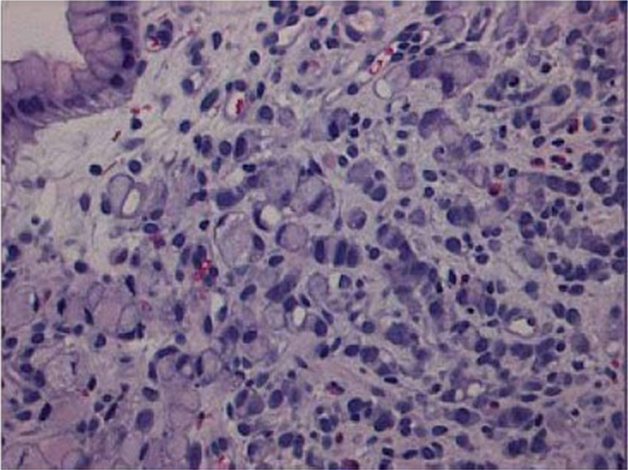
Signet cell gastric cancer

Slide 15
Staging-TNM(AJCC)
Once histological diagnosis of gastric cancer is made the next step is staging to establish extent of the disease.
Staging tests include; CT scan, a PET scan, endoscopic ultrasound and Laparoscopy.
Tumor marker; levels of carcinoembryonic antigen (CEA) and carbohydrate antigen (CA) correlate to extent of metastasis, especially to the liver, and may assist in monitoring treatment response.

Slide 16
Primary tumor (T)
TX - Primary tumor cannot be assessed
T0 - No evidence of primary tumor
Tis - Carcinoma in situ: intraepithelial tumor without invasion of the lamina propria
T1 - Tumor invades lamina propria, muscularis mucosae or submucosa
T1a - Tumor invades lamina propria or muscularis mucosae
T1b -Tumor invades submucosa

Slide 17
T2 - Tumor invades muscularis propria
T3 - Tumor penetrates subserosal connective tissue without invasion of visceral peritoneum or adjacent structures
T4 - Tumor invades serosa (visceral peritoneum) or adjacent structures
T4a - Tumor invades serosa (visceral peritoneum)
T4b - Tumor invades adjacent structures

Slide 18
Regional lymph nodes (N)
NX - Regional lymph node(s) cannot be assessed
N0 - No regional lymph node metastasis
N1 - Metastasis in 1-2 regional lymph nodes
N2 - Metastasis in 3-6 regional lymph nodes
N3 - Metastasis in seven or more regional lymph nodes
N3a - Metastasis in 7-15 regional lymph nodes
N3b - Metastasis in 16 or more regional lymph nodes

Slide 19
Distant metastasis (M)
M0 - No distant metastasis
M1 - Distant metastasis

Slide 20
Stage | T | N | M
0 | Tis | N0 | M0
IA | T1 | N0 | M0
IB | T1 | N1 | M0
 | T2 | N0 | M0
II A | T1 | N2 | M0
 | T2 | N1 | M0
 | T3 | N0 | M0
II B | T1 | N3 | M0
 | T2 | N2 | M0
 | T3 | N1 | M0
 | T4a | N0 | M0

Slide 21
 | T3 | N1,N2 | M0
IIIA | T4a | N2 | M0
 | T4b | N0 | MO
III B | T1, T2 | N3b | M0
 | T3 | N3a | M0
 | T4b | N1, N2 | M0
III C | T3, T4a | N3b | M0
 | T4b | N3a, N3b | M0
IV | Any T | Any N | M1

Slide 22
Early gastric carcinoma
Early gastric carcinoma (EGC) is defined as an invasive adenocarcinoma that involves only the mucosa or submucosa but not the muscularis propria, independent of lymph node status.
EGC represents approximately 20% of all newly diagnosed gastric cancers in Western countries, whereas in Northeast Asia (Japan and Korea), it accounts for over 50% of cases.
The difference in incidence may be due to a higher prevalence of gastric cancer with mass screening test, and widely adapted use of magnifying upper endoscopy with high-resolution images and chromoendoscopy in Northeast Asia.

Slide 23
The majority of patients with EGC are asymptomatic.
Some may present with non-specific upper abdominal symptoms such as heartburn or epigastric pain, so-called dyspeptic symptoms.
Weight loss, anorexia, anemia and hypoalbuminemia frequently found in patients with advanced gastric cancer are not commonly seen.
Dyspeptic symptoms may occur in up to 40% of the patients with EGC
Dyspeptic symptoms may be masked by the use of anti-acid drugs and proton pump inhibitors

Slide 24
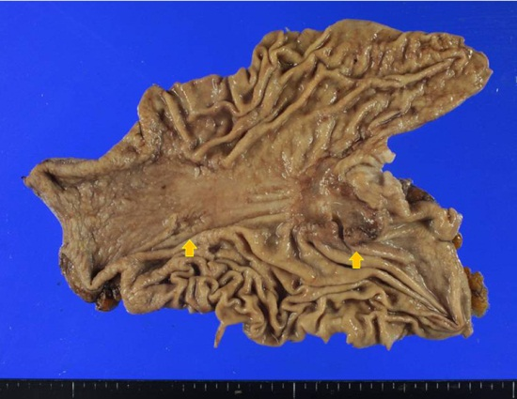
Most of Japanese series have reported more than 90% of 5 and 10 year survival rates for the patients with EGC.
In the Western, 5-year survival rates range from 68% to 92%. Diagnosis by ENDOSCOPY/ENDOSCOPIC US.

Slide 25
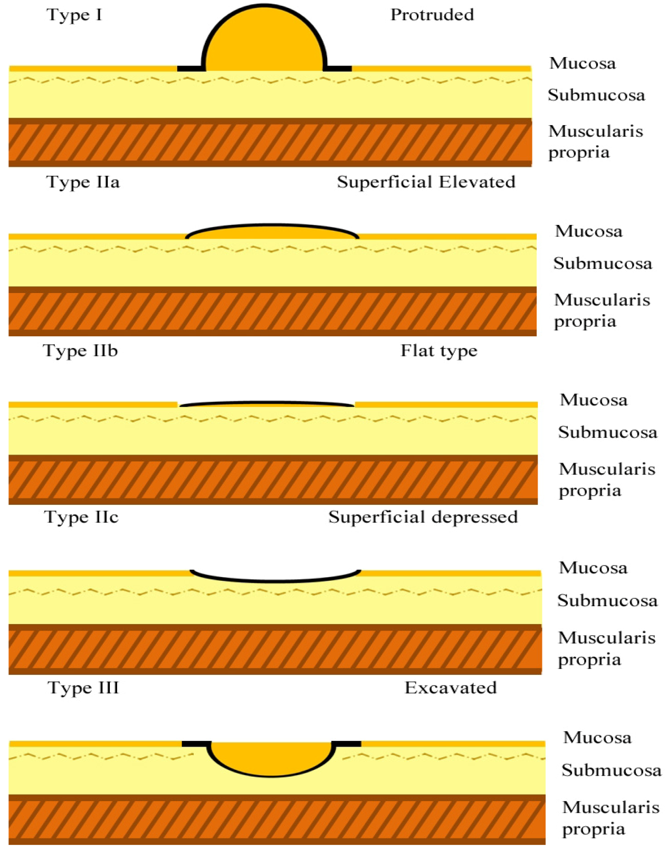
Bormann`s classification of gastric cancer

Slide 26
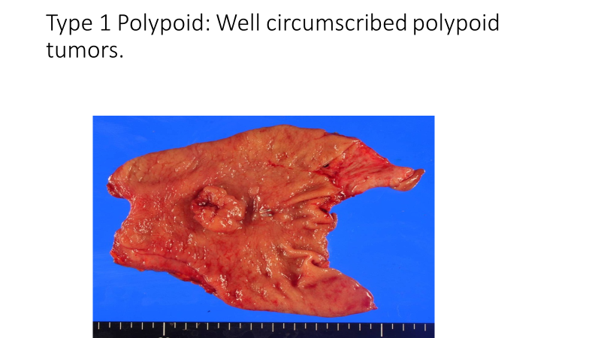

Slide 27
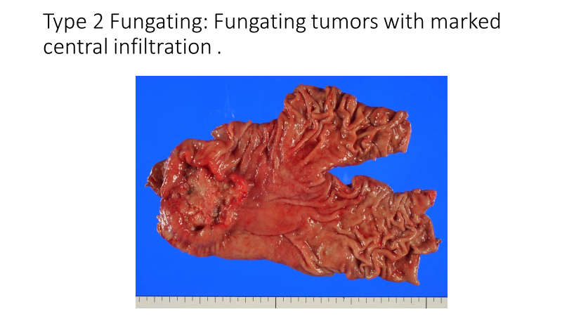

Slide 28
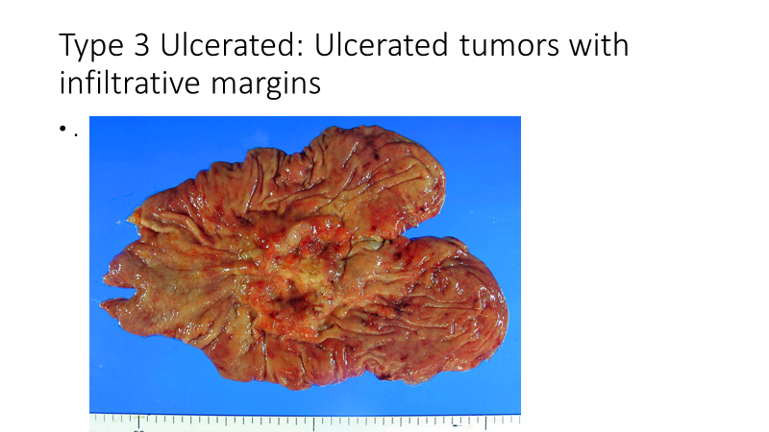

Slide 29
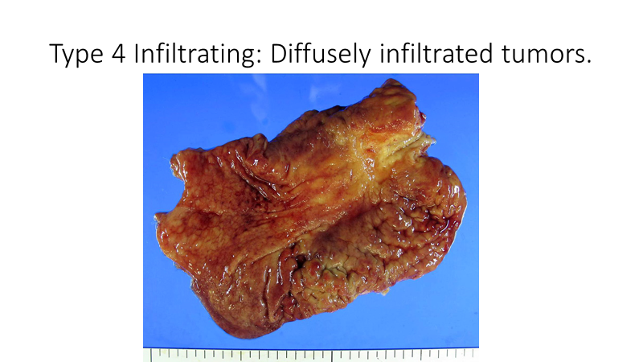

Slide 30
Management
Gastrectomy and lymphadenectomy
Endoscopic mucosal resection (EMR)
Indications for EMR;-
1. The lesions must be confined to the mucosa.
2. Smaller than or equal to 2 cm for superficially elevated type lesions.
3. Smaller than or equal to 1 cm for the flat and depressed type lesions.
4. No ulcer or ulcer scar.
5. No venous or lymphatic involvement.

Slide 31
Advanced gastric carcinoma
Men are more frequently affected than women (male: female ratio; 2:1).
The median age at diagnosis is 70 years of age.
The overall prognosis of AGCs is poor, with 5-year survival rate of 20%.
Median survival for metastatic or unresectable disease is approximately 8 to 10 months.
Management by adjuvant chemotherapy with cisplatin, 5-FU; neoadjuvant chemotherapy; HER-2 receptor (Trastuzumab/Herceptin); VEGF (bevacizumab/avastin)

Slide 32
THANK YOU

