Slide 1
INTESTINAL OBSTRUCTION
DR D.K. KIPTOON

Slide 2
OBJECTIVES
Define intestinal obstruction
Classify types of intestinal obstruction
Identify common causes of intestinal obstruction
Identify the cardinal symptoms of obstruction
Initial evaluation & resuscitation of patient with intestinal obstruction
Investigation of pt with obstruction
Management of intestinal obstruction

Slide 3
Definition
Failure of distal progression of intestinal content

Slide 4
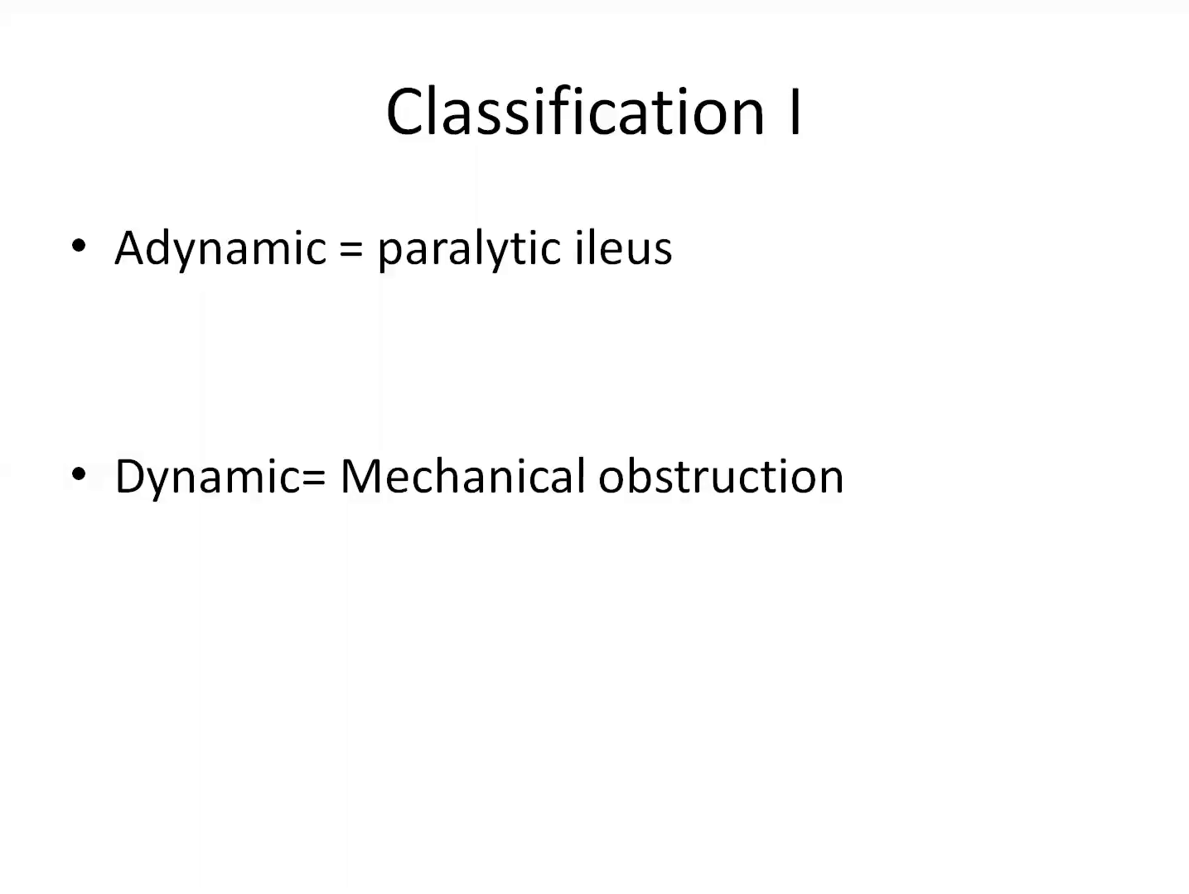

Slide 5
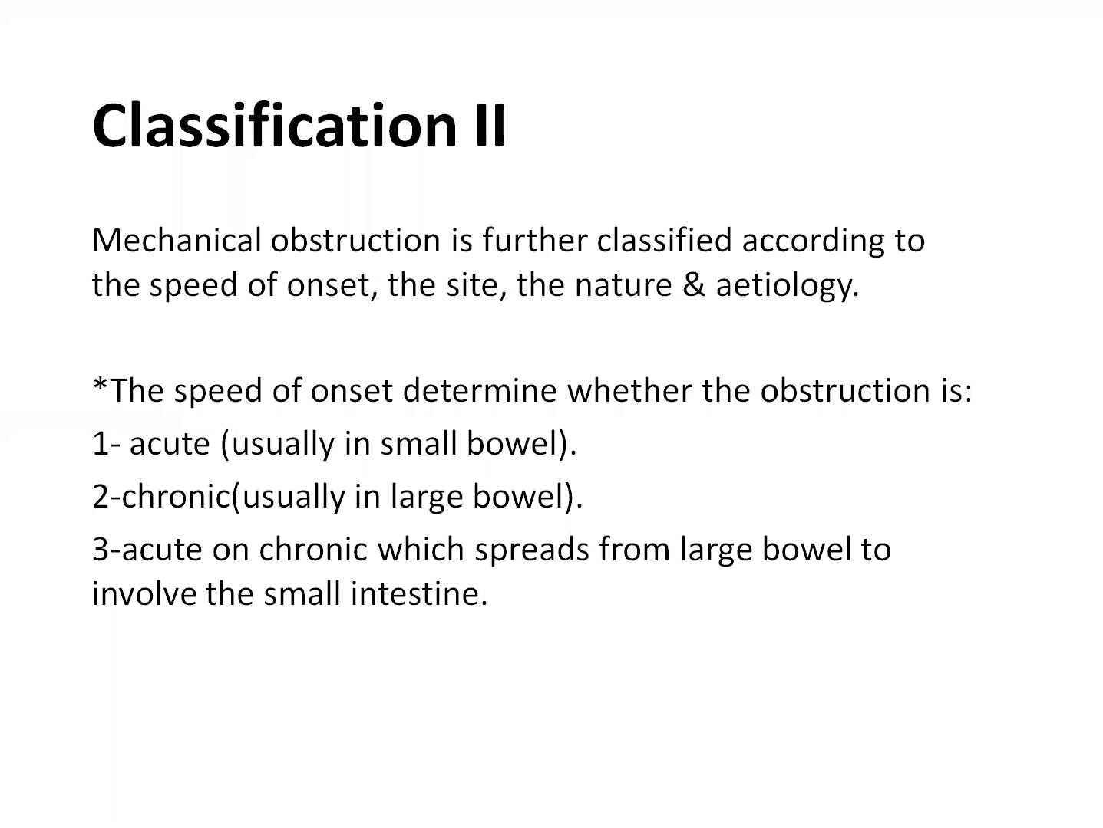

Slide 6
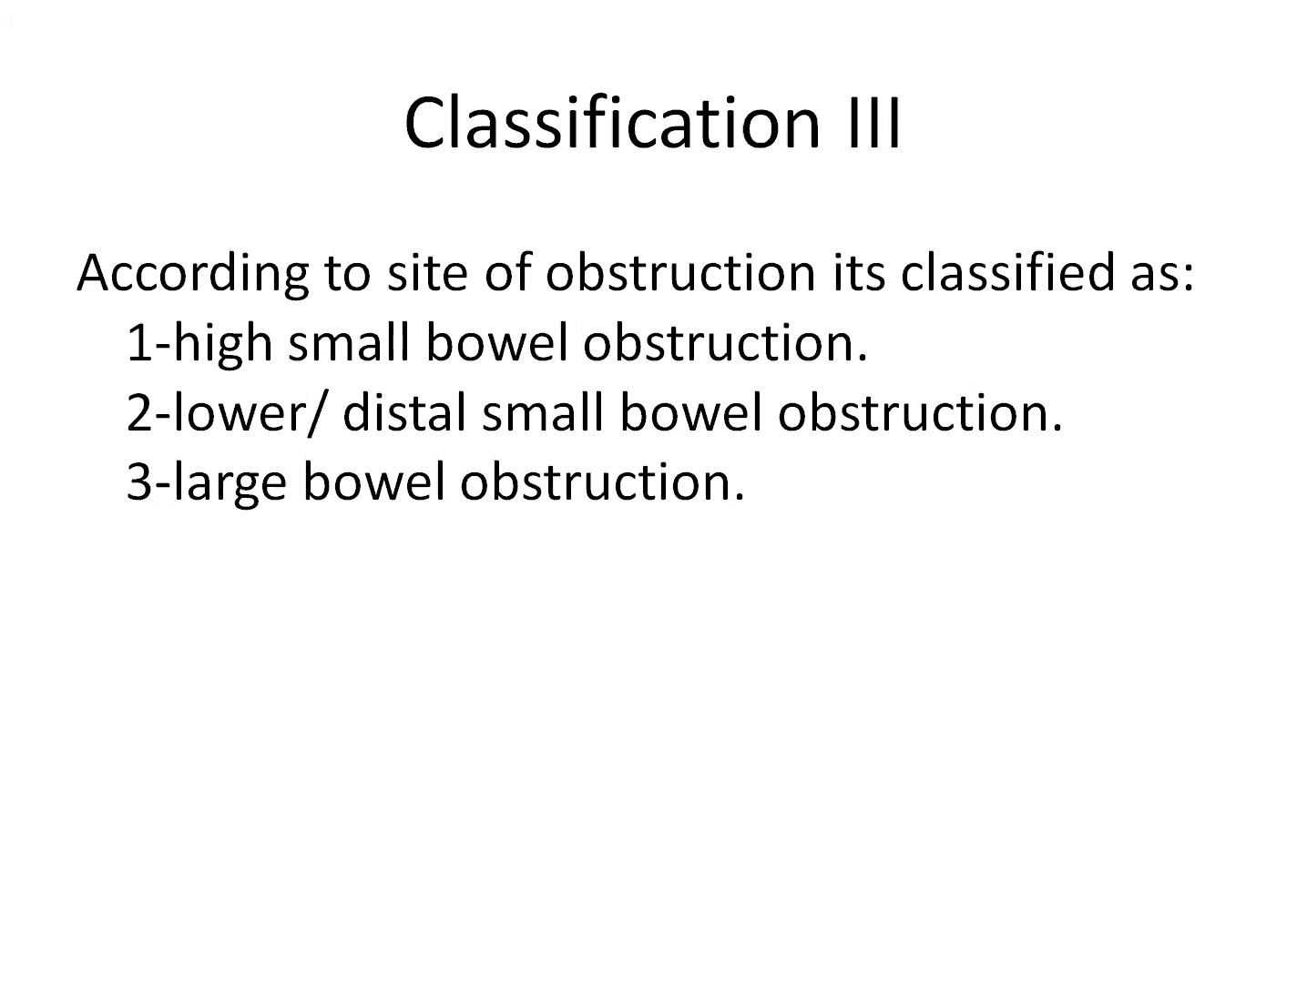

Slide 7
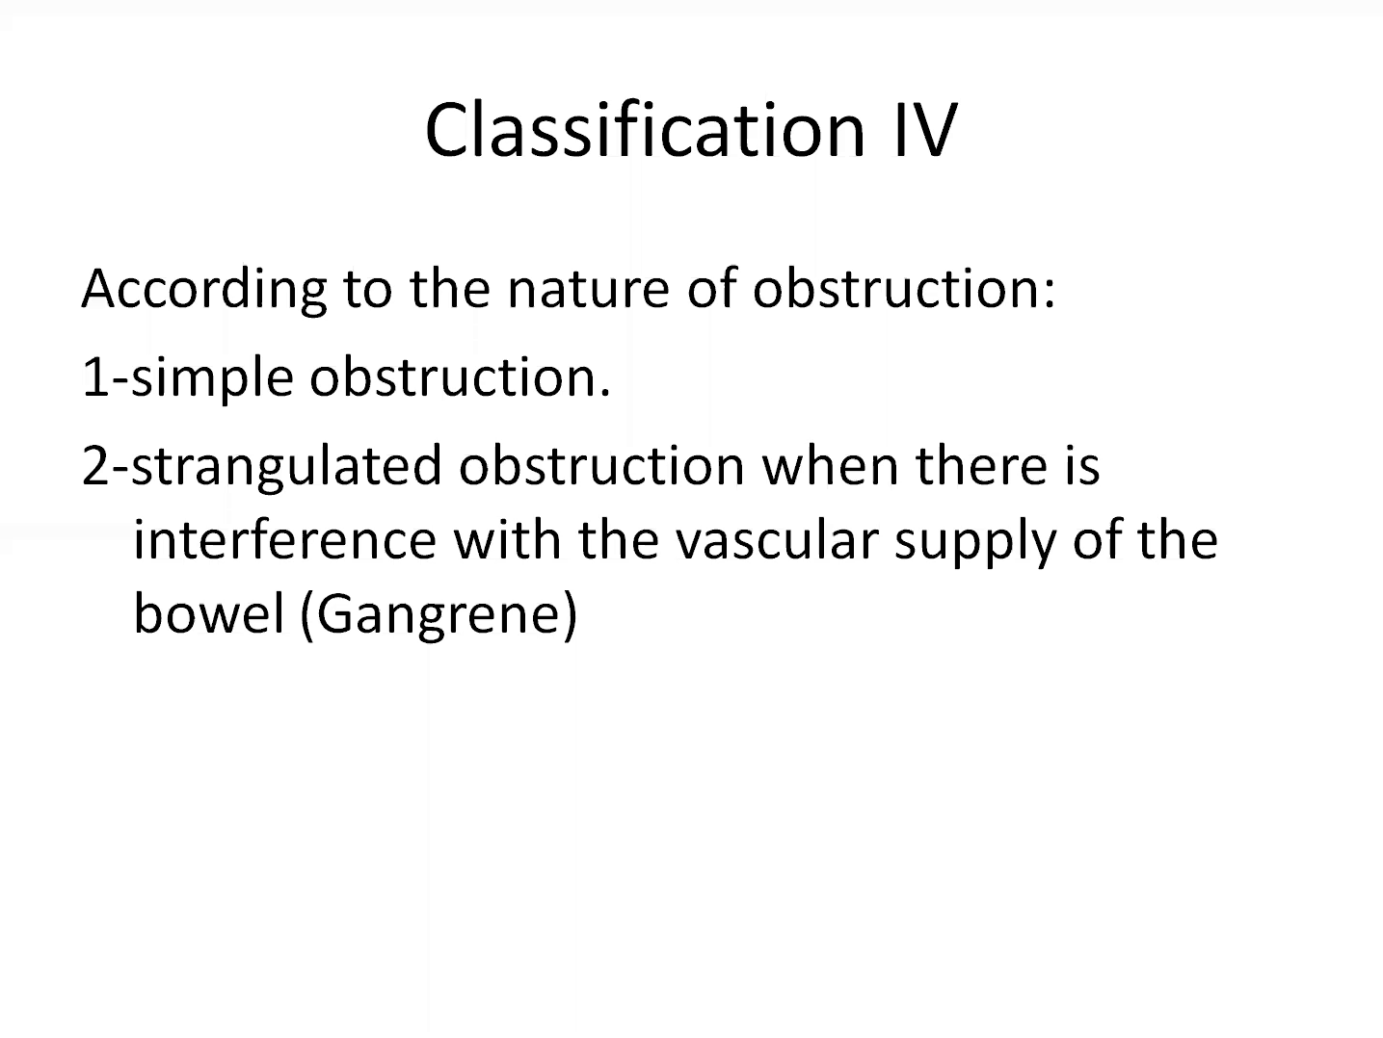

Slide 8
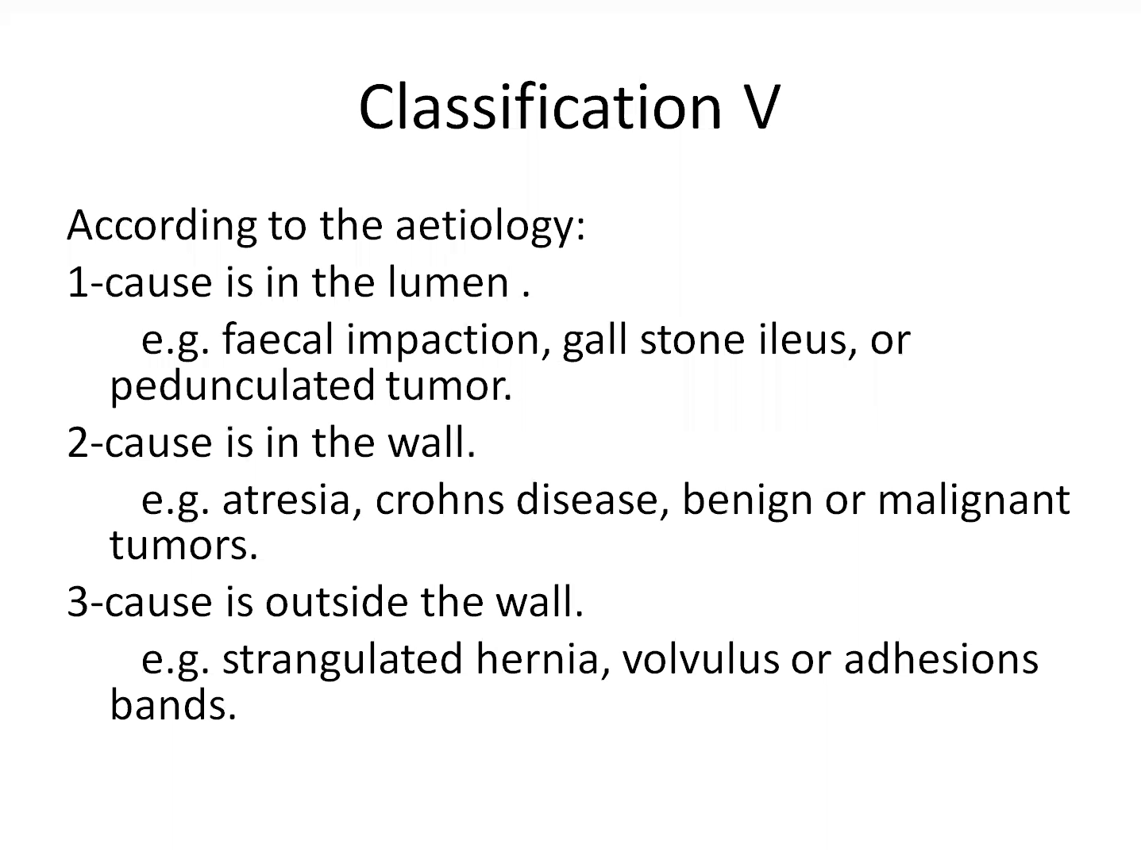

Slide 9
Paralytic ileus
Causes of Ileus
Post laparotomy
Metabolic and electrolyte derangements (e.g., hypokalemia, hyponatremia, hypomagnesemia, uremia, diabetic coma)
Drugs (e.g., opiates, psychotropic agents, anticholinergic agents)
Intra-abdominal inflammation
Retroperitoneal hemorrhage or inflammation
Intestinal ischemia
Systemic sepsis

Slide 10
Causes of intestinal obstruction
Adhesions or bands
Hernias
Volvulus
Tumours
Inflammatory strictures
Intussusception
Faecal impaction

Slide 11
Causes of intestinal obstruction
Bezoars (phytobezoar or trichobezoar)
Impacted worms
Foreign bodies (body packers)
Gallstone impaction or ileus
Congenital problems: annular pancreas, malrotation, Hirschsprung’s disease, etc
Mesenteric vessel occlusion

Slide 12
Pathophysiology of obstruction
Initially increased peristalsis proximal and distal to obstruction; leading to colicky abdominal pain and (sometimes) diarrhoea
Eventually stops and there is proximal dilation with gas and liquid (swallowed air plus GIT secretions)
Distally: constipation/obstipation

Slide 13
Pathophysiology of obstruction
Distension leads to increased intraluminal pressure with compression of bowel wall lymphatics leading to mucosal oedema
Increased hydrostatic pressure in the capillary beds results in massive third space loss of fluid, electrolytes and proteins into the intestinal lumen
Vomiting.

Slide 14
Pathophysiology of obstruction
Dehydration due to reduced oral intake, impaired absorption, fluid sequestered in obstructed loops & losses from vomiting
Metabolic & electrolyte imbalances
a) Metabolic acidosis
b) Hypokalaemia

Slide 15
Pathophysiology of obstruction
Bacterial proliferation in proximal bowel
Bacterial translocation from lumen into mesenteric nodes and resultant bacteraemia
Also release of bacterial toxins resulting in sepsis or endotoxaemia with shock

Slide 16
Pathophysiology of obstruction
Strangulation: mucosal ischaemia
Eventual necrosis in bowel wall with gas formation: pneumatosis intestinalis
Perforation
Peritonitis
Sepsis

Slide 17
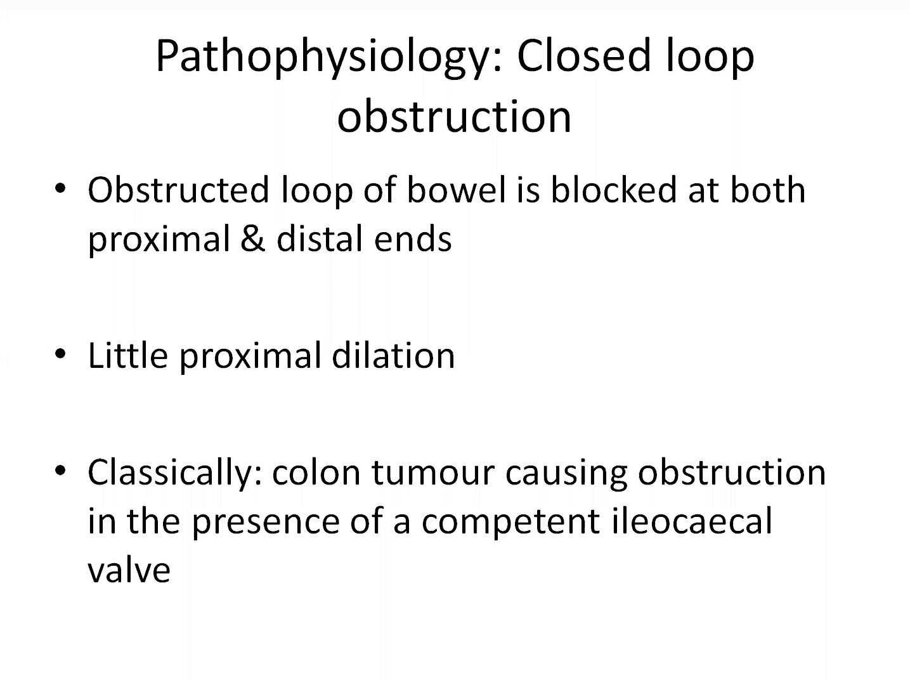

Slide 18
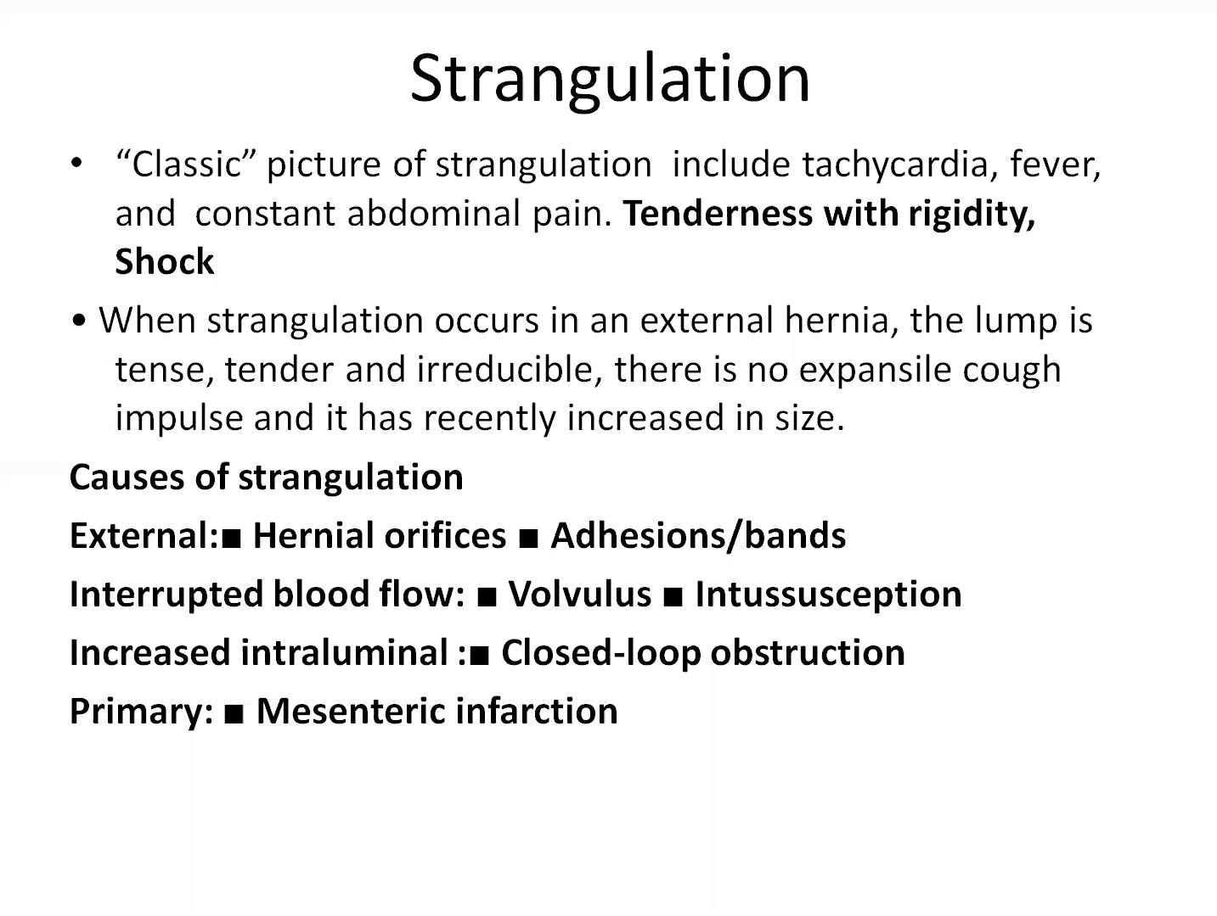

Slide 19
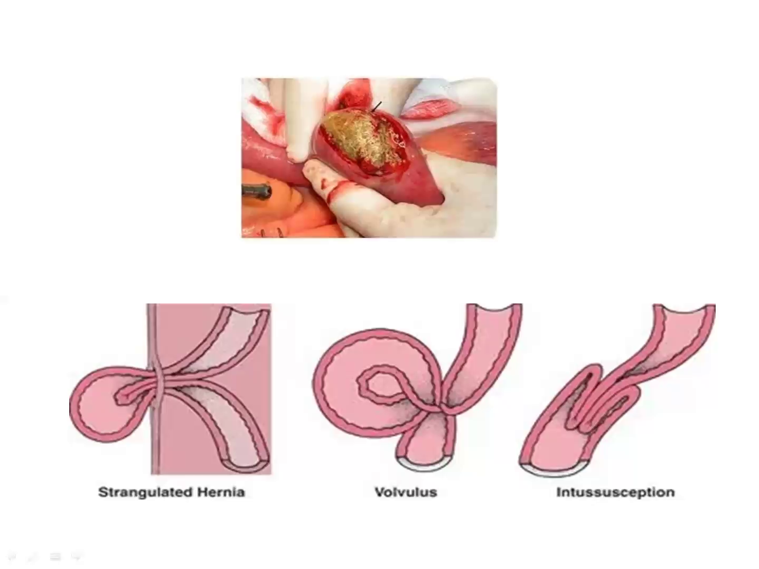

Slide 20
Clinical features
Pain- usually the first symptom, colicky
Distension- more in large bowel and distal small bowel obstruction
Obstipation (absolute constipation)
Vomiting- bilious or feculent. More in upper small bowel obstruction

Slide 21
Initial evaluation
Goals of initial evaluation:
  Distinguishing mechanical obstruction from ileus
  Determining the etiology of the obstruction
  Discriminating partial from complete obstruction
  Discriminating simple from strangulating obstruction
  Assess patient fitness for surgery

Slide 22
History
Onset of pain & vomiting
Colour/ contents of vomitus
Last normal bowel movement/ flatus
Micturition (hydration)
Previous abdominal surgery
Similar episodes in the past
Medications
Obstetric/gynae history
In children ask about ingestion of FB

Slide 23
Physical examination
General condition
Hydration status
Vital signs - BP, PR, T & RR
Nutrition
Pallor
Lymphadenopathy: Virchow’s, Sr. Mary Joseph, Irish’s node

Slide 24
Abdominal examination
INSPECTION
Distension & symmetry
Surgical scars
Hernia
Visible peristalsis
Sr. Mary Joseph nodule
Distended veins
Ascites

Slide 25
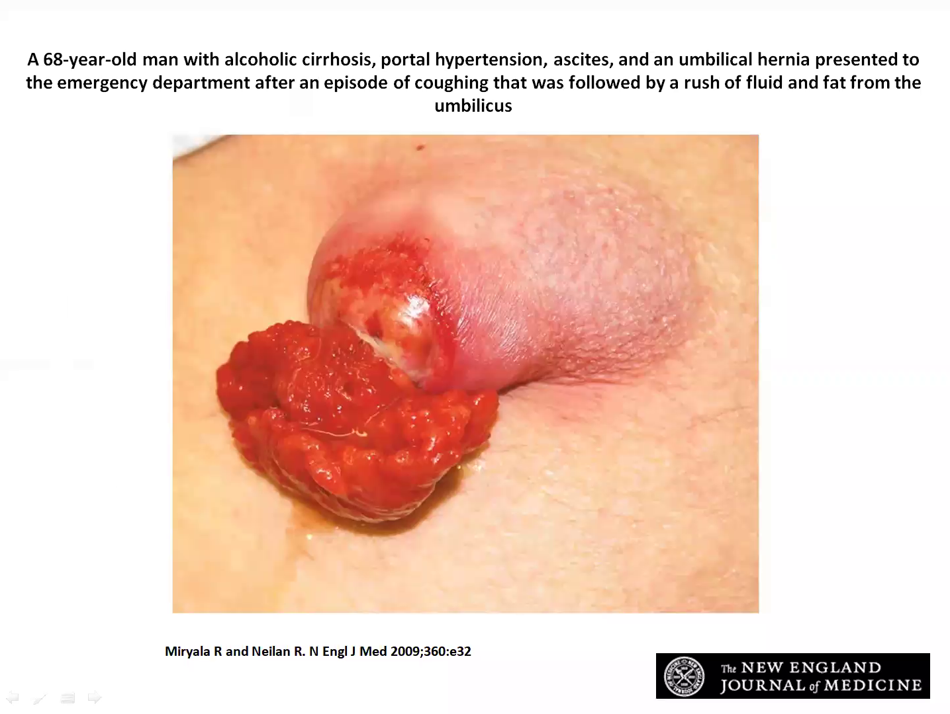

Slide 26
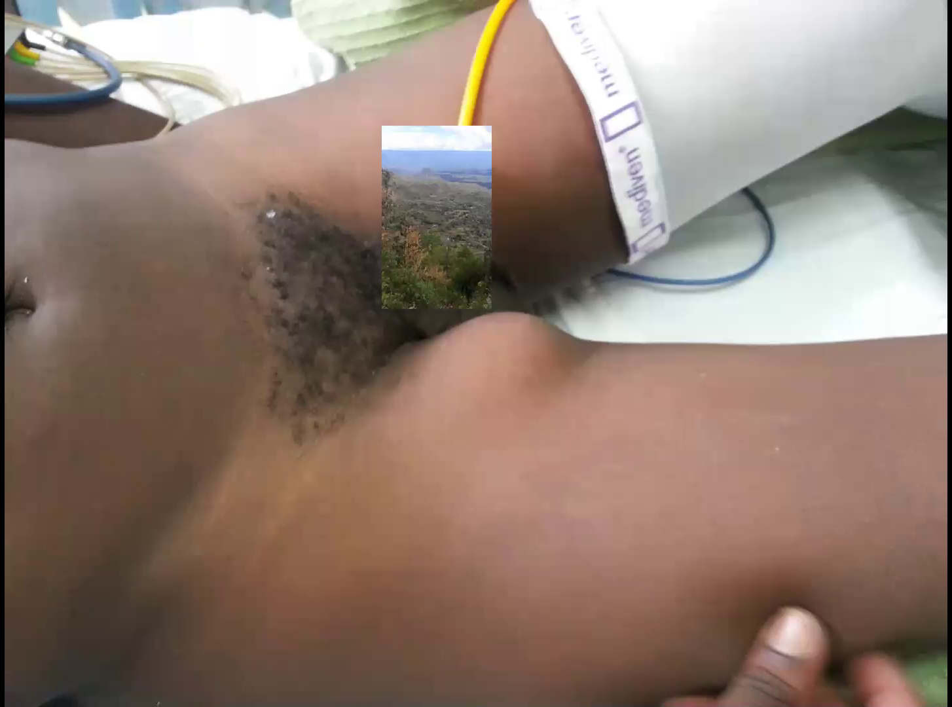

Slide 27
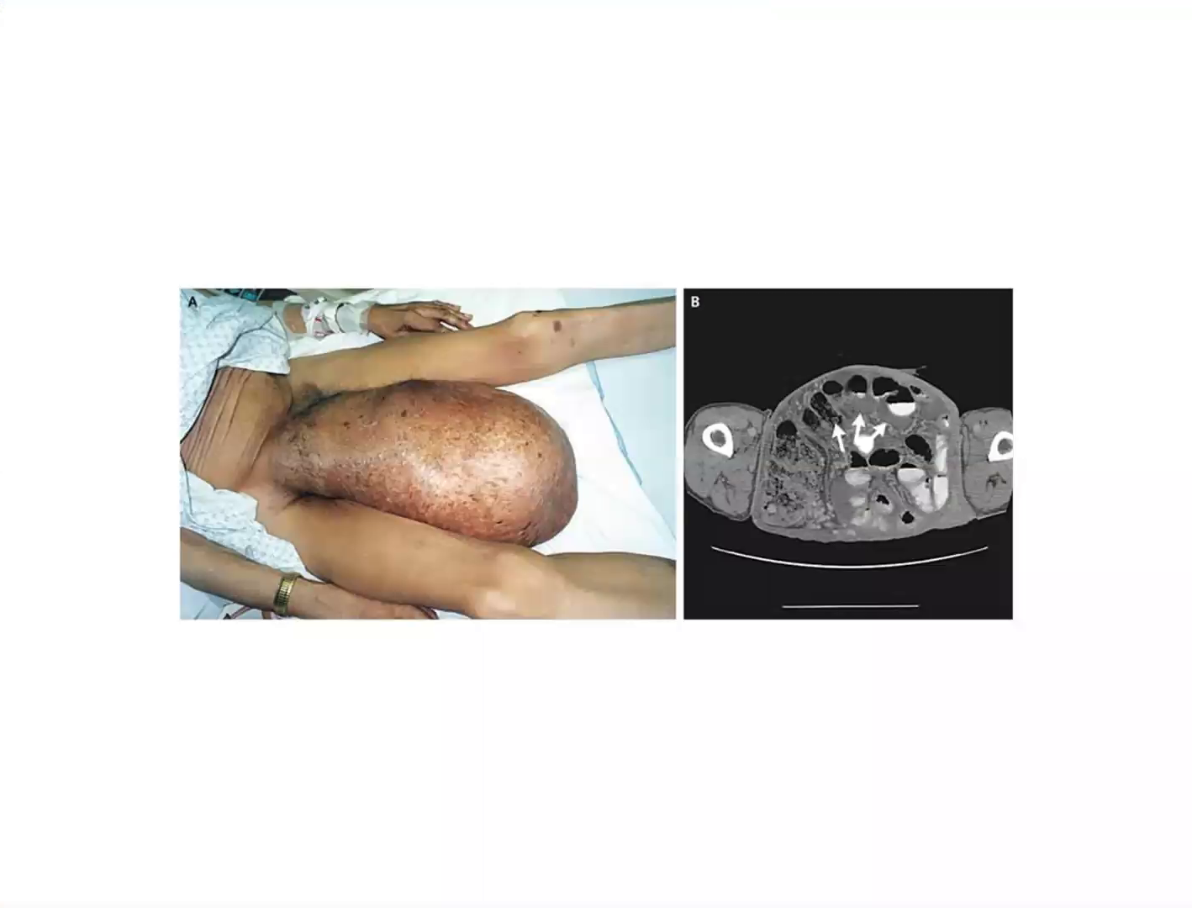

Slide 28
Abdominal examination
PALPATION- Tenderness, Masses
PERCUSSION- tympanic vs dull; fluid thrill
AUSCULTATION- presence, quality & quantity
DRE

Slide 29
DIGITAL RECTAL EXAMINATION
Perianal skin/ soiling
Sphincter tone
Rectal contents/ mass
Blummer’s shelf
Stool on examining finger
Blood on examining finger

Slide 30
Initial resuscitation
IVF- Hartmann’s soln/ Ringer’s lactate preferred
Decompress bowel- NGT/Flatus tube
Assess adequacy of rehydration- Foley catheter
Relieve pain
Antibiotics

Slide 31
Laboratory investigations
TBC
U/E/C
BGA
RBS

Slide 32
Imaging
Plain abdominal radiographs
Abdominal ultrasound- mainly useful in children when ??intussusception
Contrast enhanced radiographs
Contrast enhanced CT scan abdomen (CECT)

Slide 33
Plain x-ray
AP erect / Dorsal decubitus - air fluid levels
AP supine - pattern of bowel gas (valvulae conniventes, haustrae); free gas; Rigler’s sign
CXR - erect: free intraperitoneal gas

Slide 34
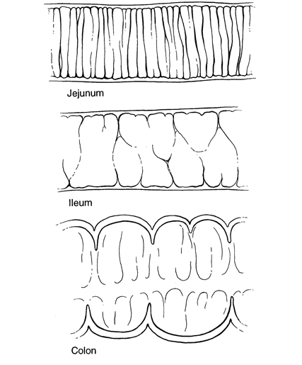
Small Bowel Gas Pattern
Centrally located
Soft tissue across entire lumen
Colon Gas Pattern
Peripheral Located
Mostly not overlapping
Haustra markings

Slide 35
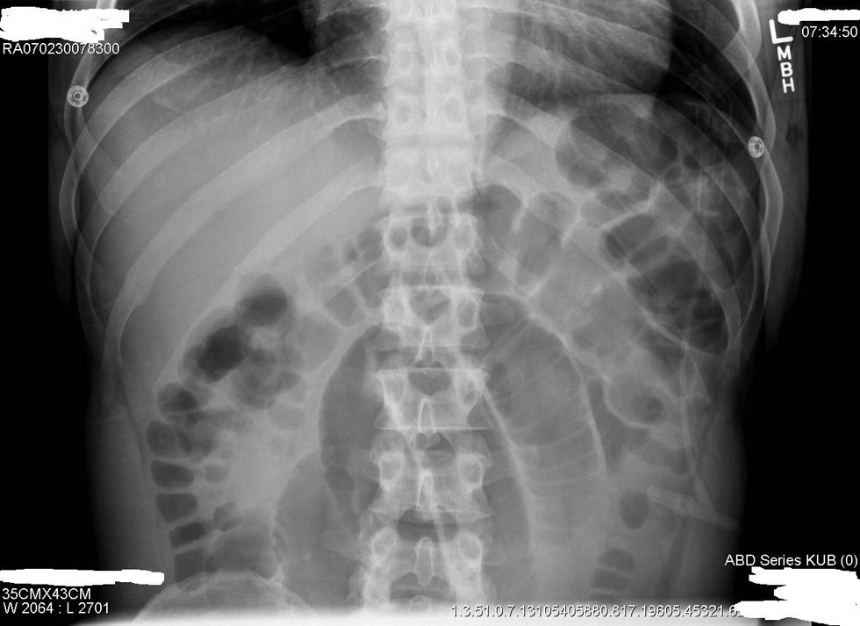
Valvulae Conniventes in Jejunum; Haustrae in Colon

Slide 36
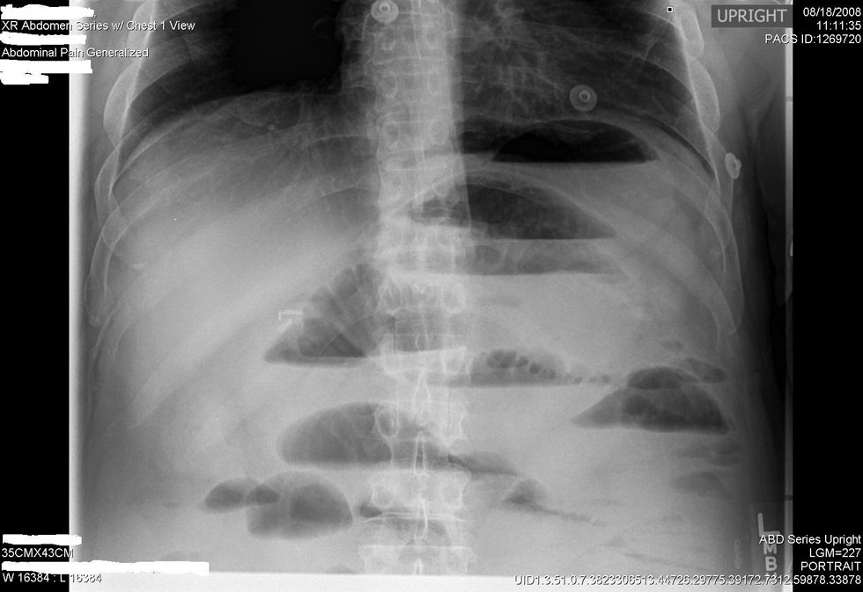
More than 3 Fluid Levels

Slide 37
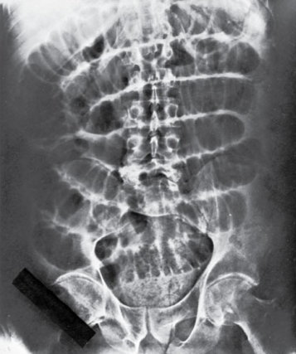
Flat Abdominal Film
Dilated Loops of Small Bowel
No Air in Colon or Rectum

Slide 38
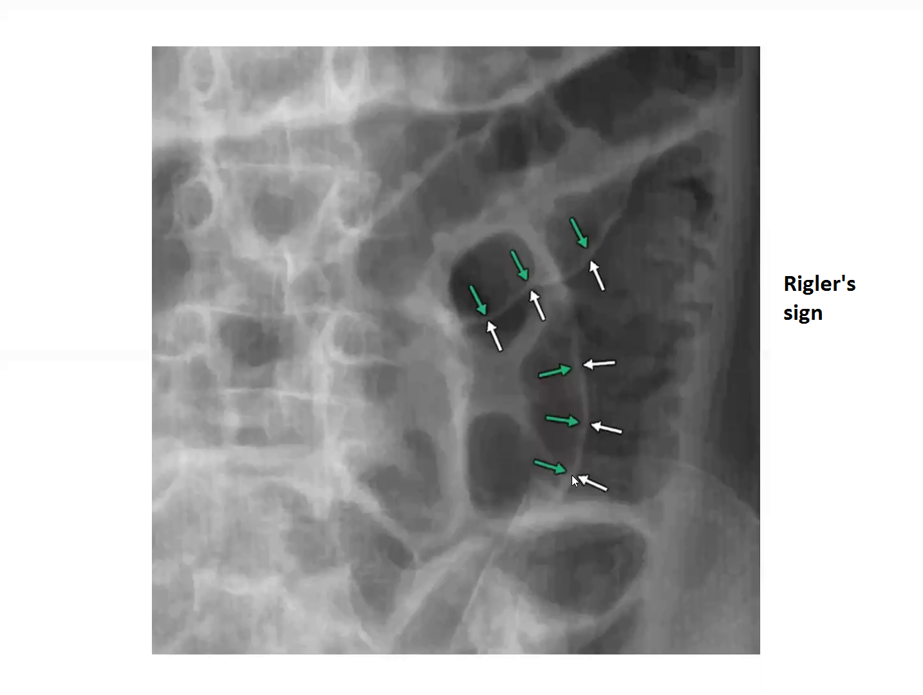

Slide 39
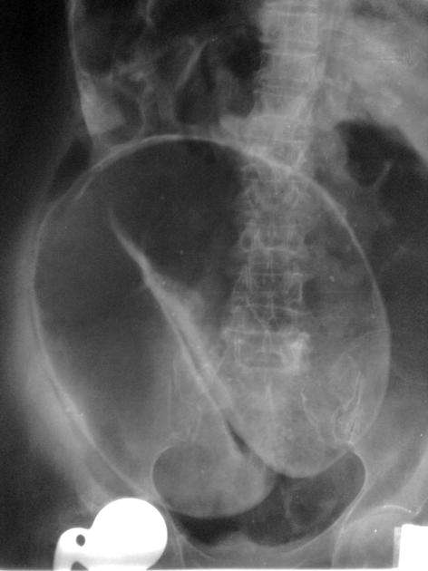
Coffee bean sign – Sigmoid volvulus with massively distended bowel loop (mesentery at centre, bean pointing towards left iliac fossa

Slide 40
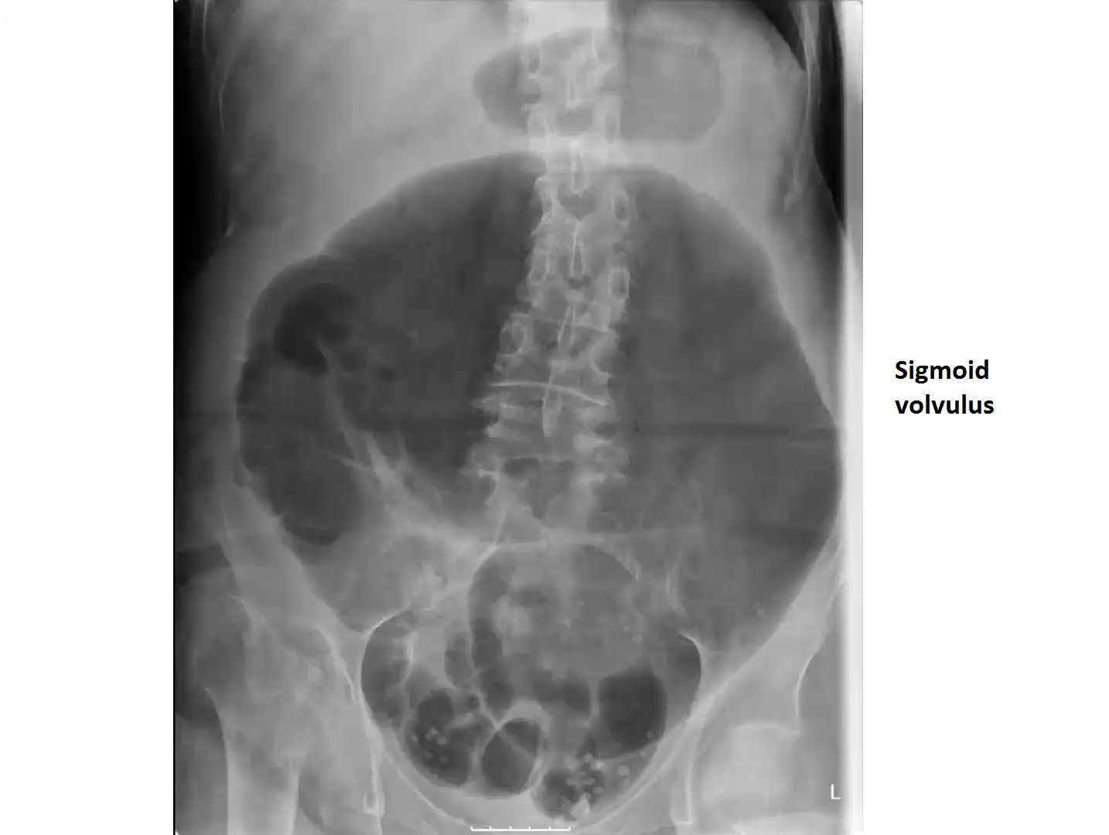

Slide 41
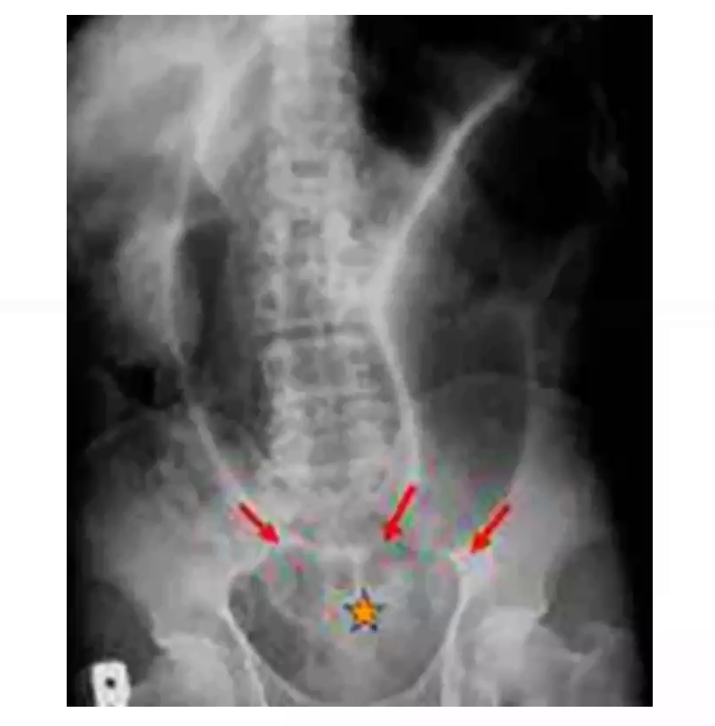
Sigmoid volvulus

Slide 42
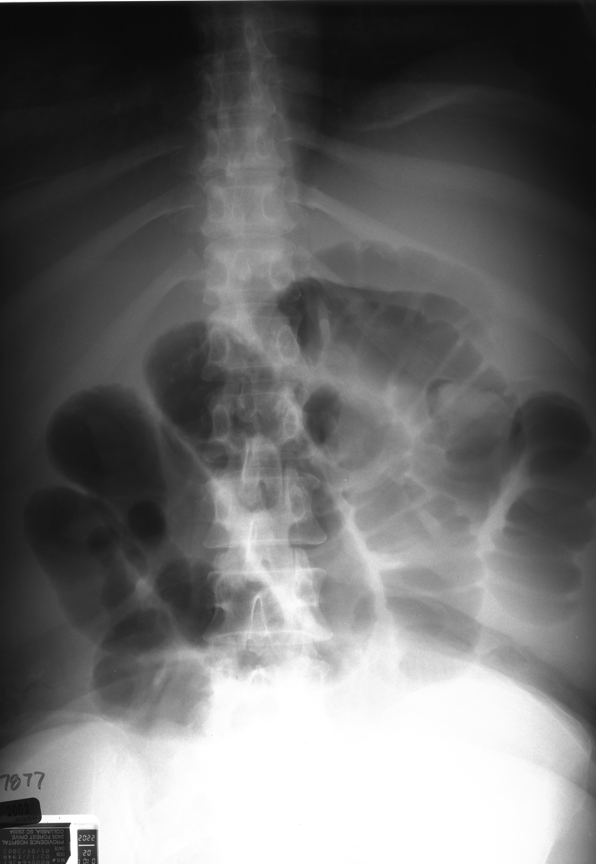
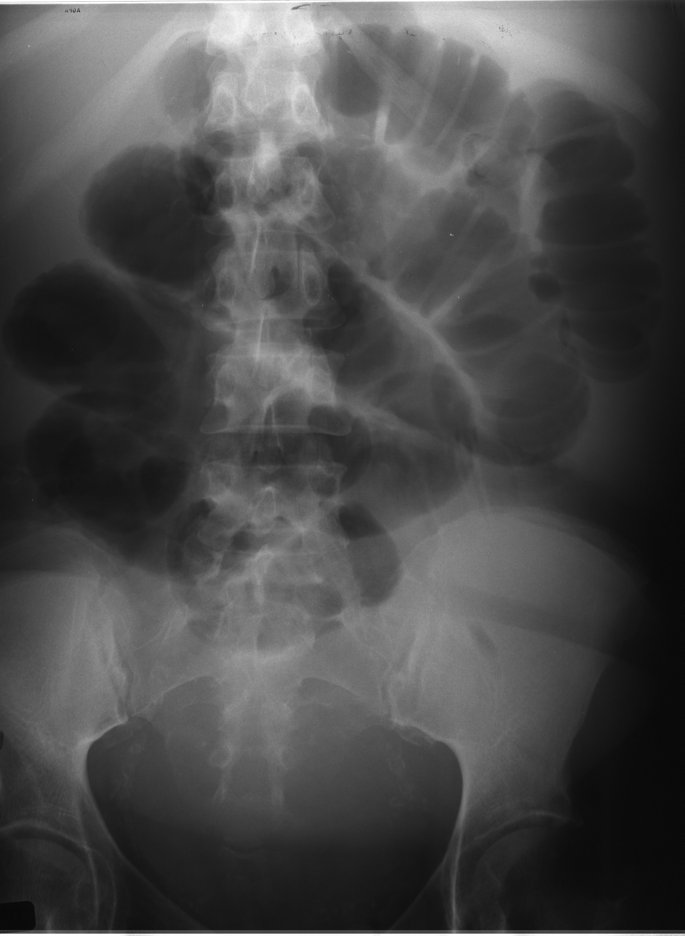
Small Bowel Obstruction

Slide 43
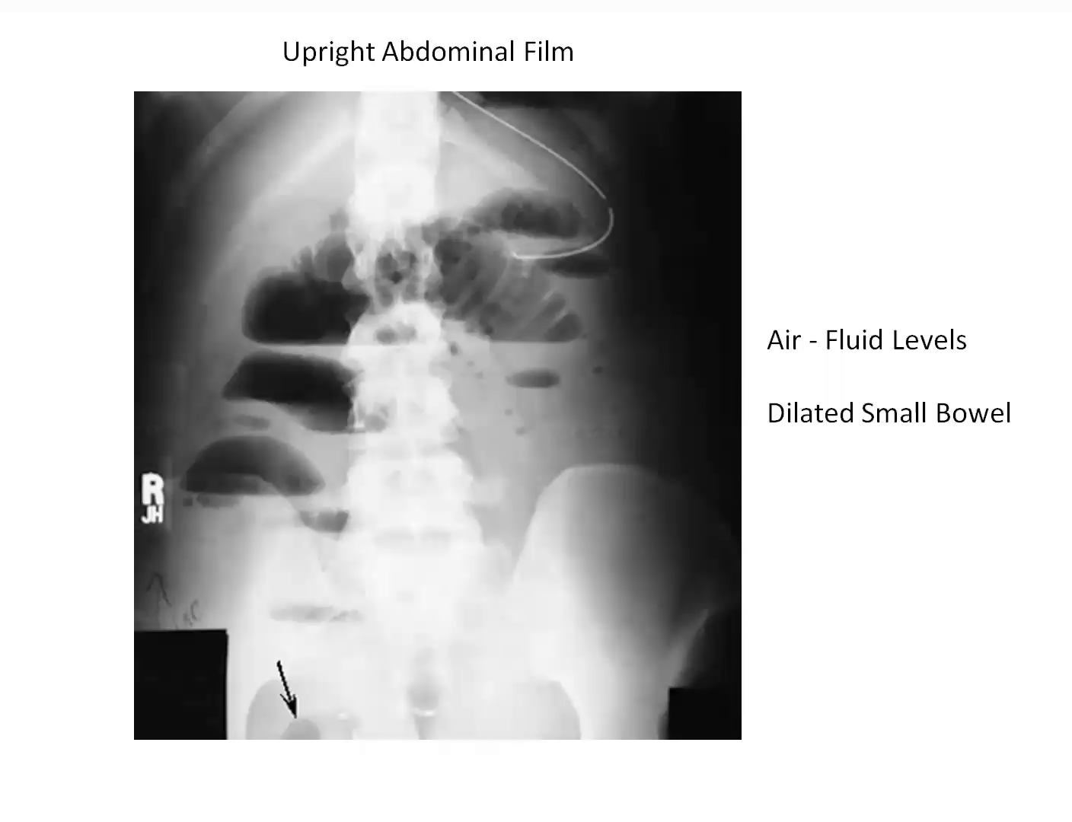

Slide 44
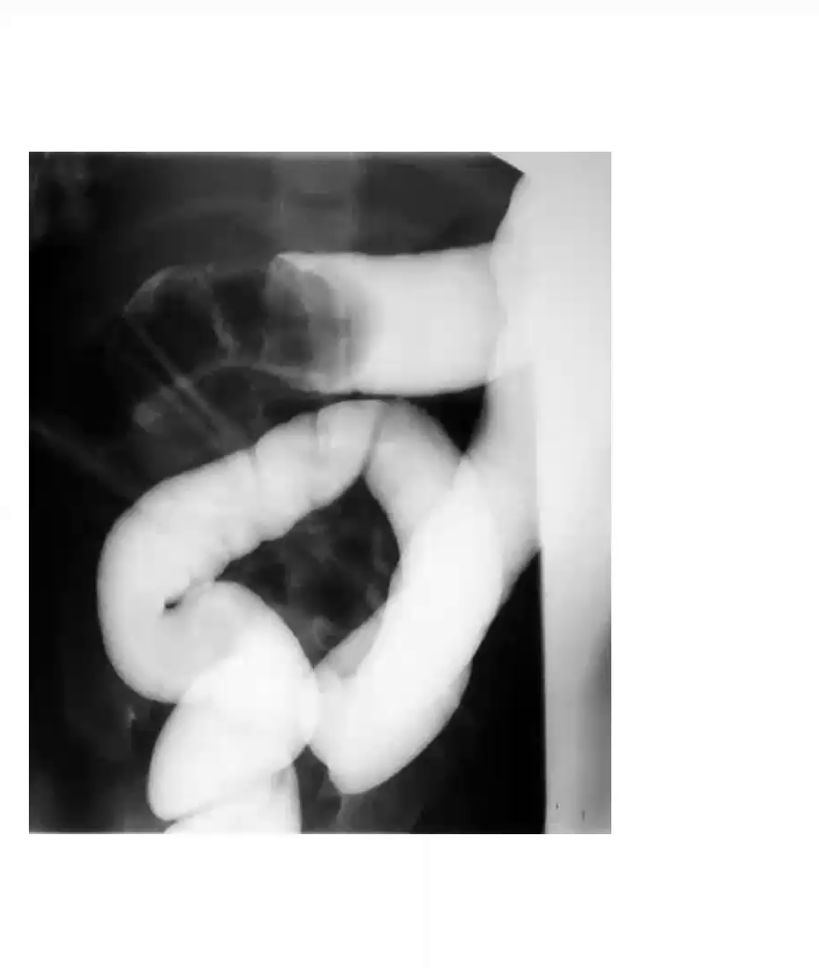

Slide 45
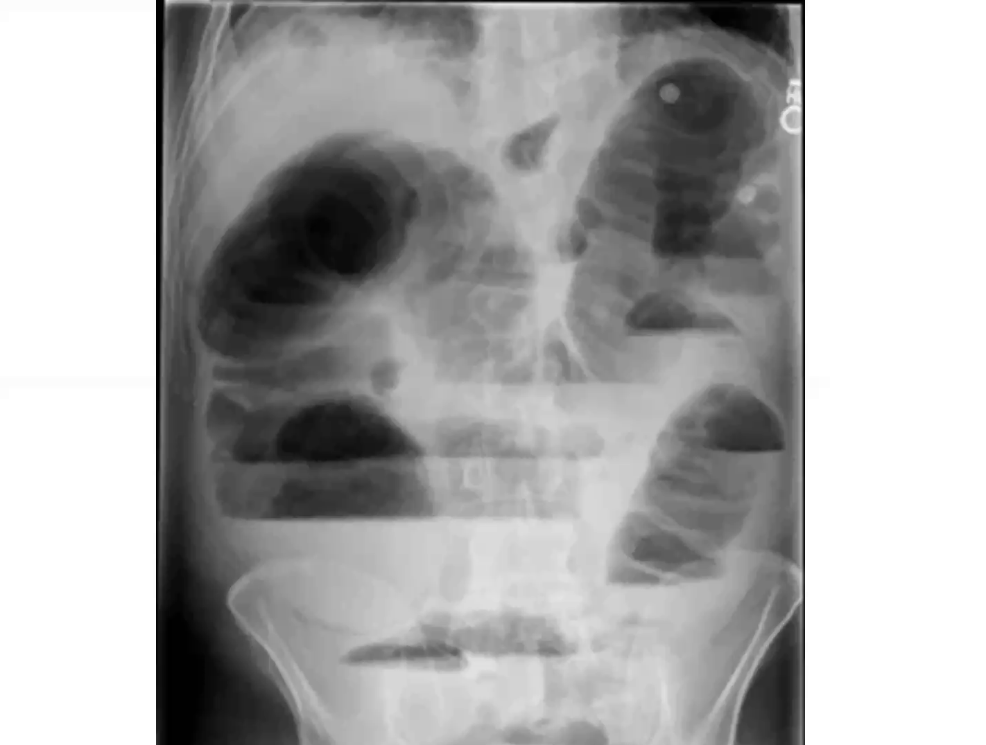

Slide 46
Computed Tomographic (CT) scanning
Study performed with both oral and IV contrast.
Findings:
  Discrete transition zone with dilation of bowel proximally and decompressed distally
  Intraluminal contrast that does not pass beyond the transition zone
  Colon containing little gas or fluid.
Strangulation:
Suggested by thickening of the bowel wall, pneumatosis intestinalis (air in the bowel wall), portal venous gas, mesenteric haziness, and poor uptake of intravenous contrast into the wall of the affected bowel.
Offers a global evaluation of the abdomen.
Important when intestinal obstruction represents only one possible diagnosis in all acute abdominal conditions.

Slide 47
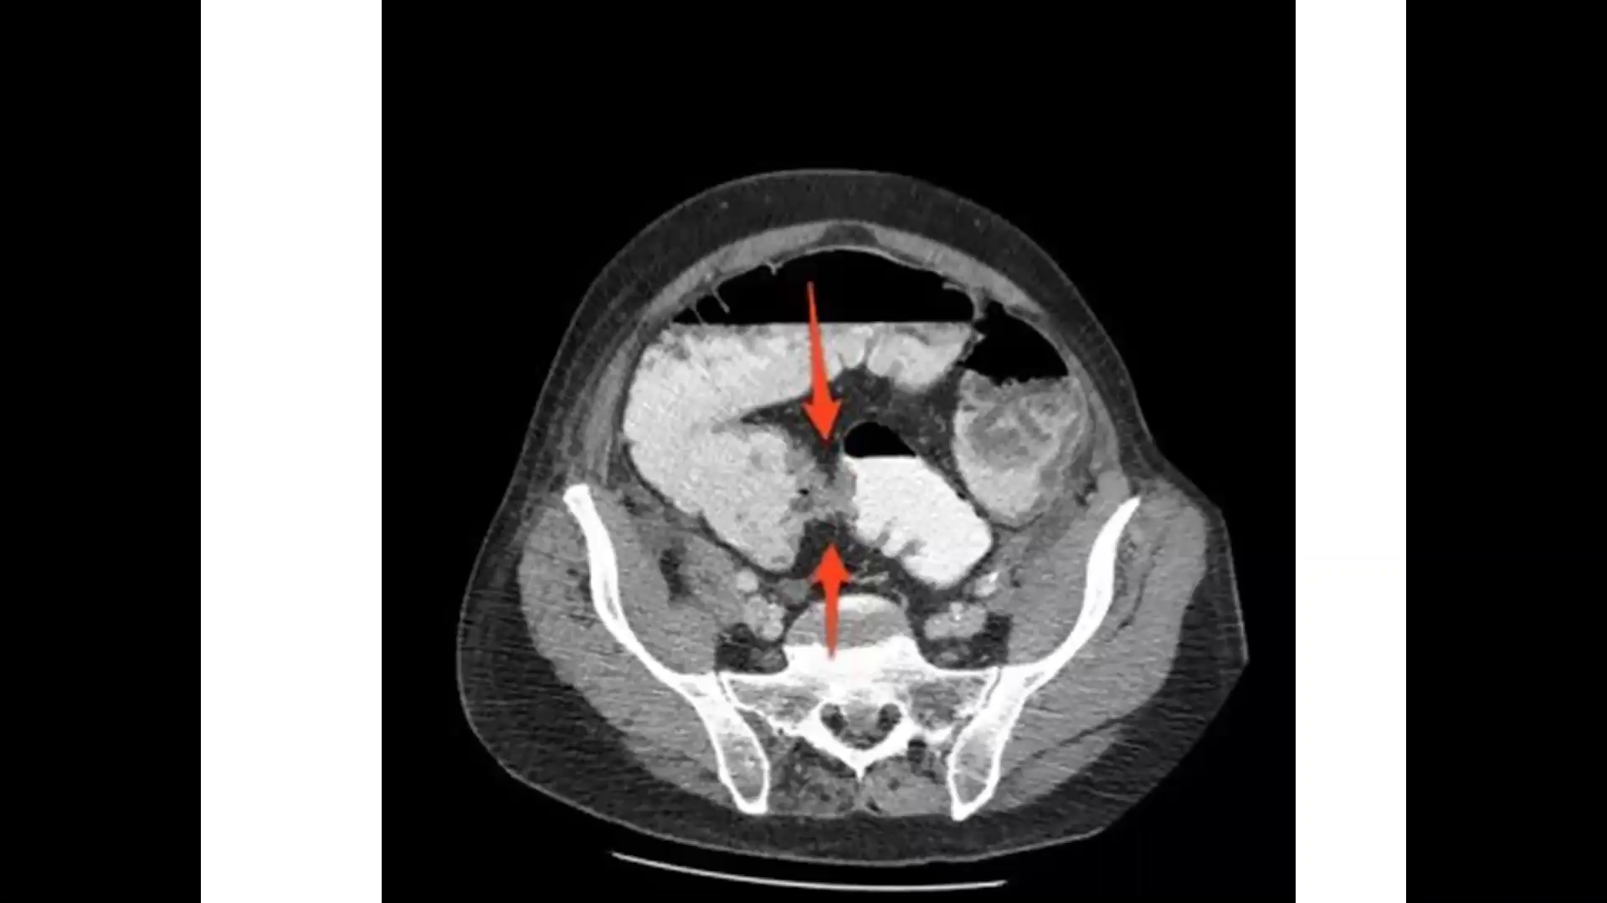
Red arrow shows an area of wall thickening and luminal narrowing at the pelvic brim with sigmoid; colonic tumor with bowel obstruction

Slide 48
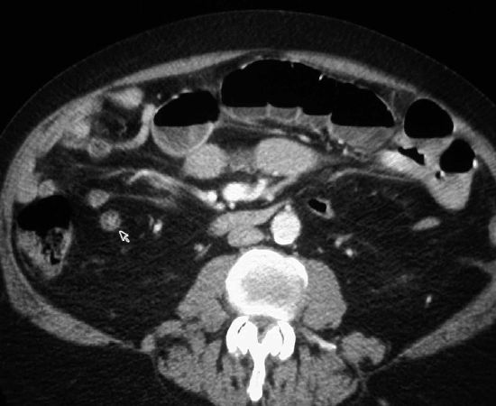
Dilated Loops of Small Bowel with Air-Fluid levels
Area of non-dilated small bowel.
Absence of Air in the Colon.

Slide 49
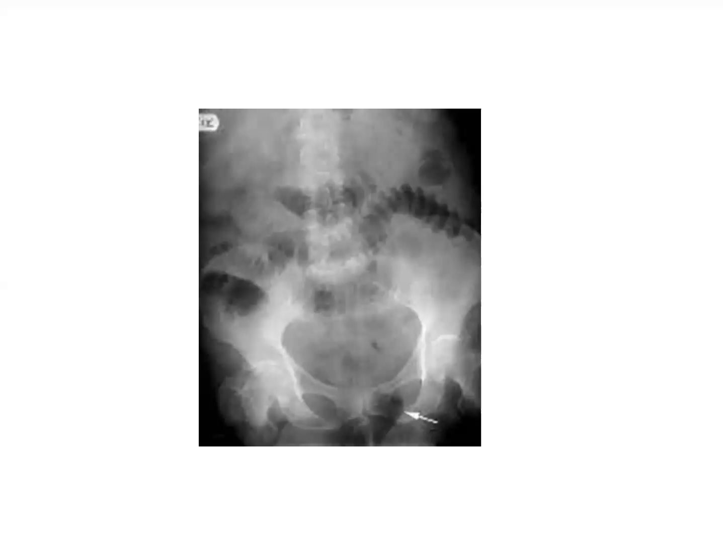
Femoral Hernia

Slide 50
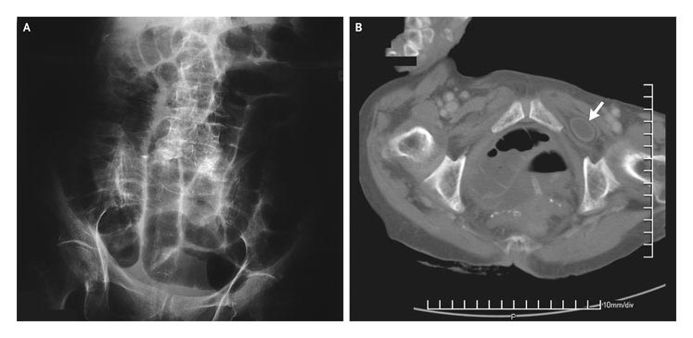
Femoral hernia arrow – bowel trapped in the femoral canal
Notes:
AP supine & CT- obturator hernia

Slide 51
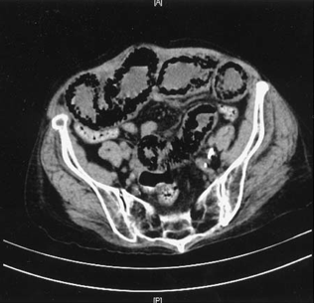
Pneumatosis Intestinalis
Dilated Loops of SB
Air in Wall of SB
No Air in Colon

Slide 52
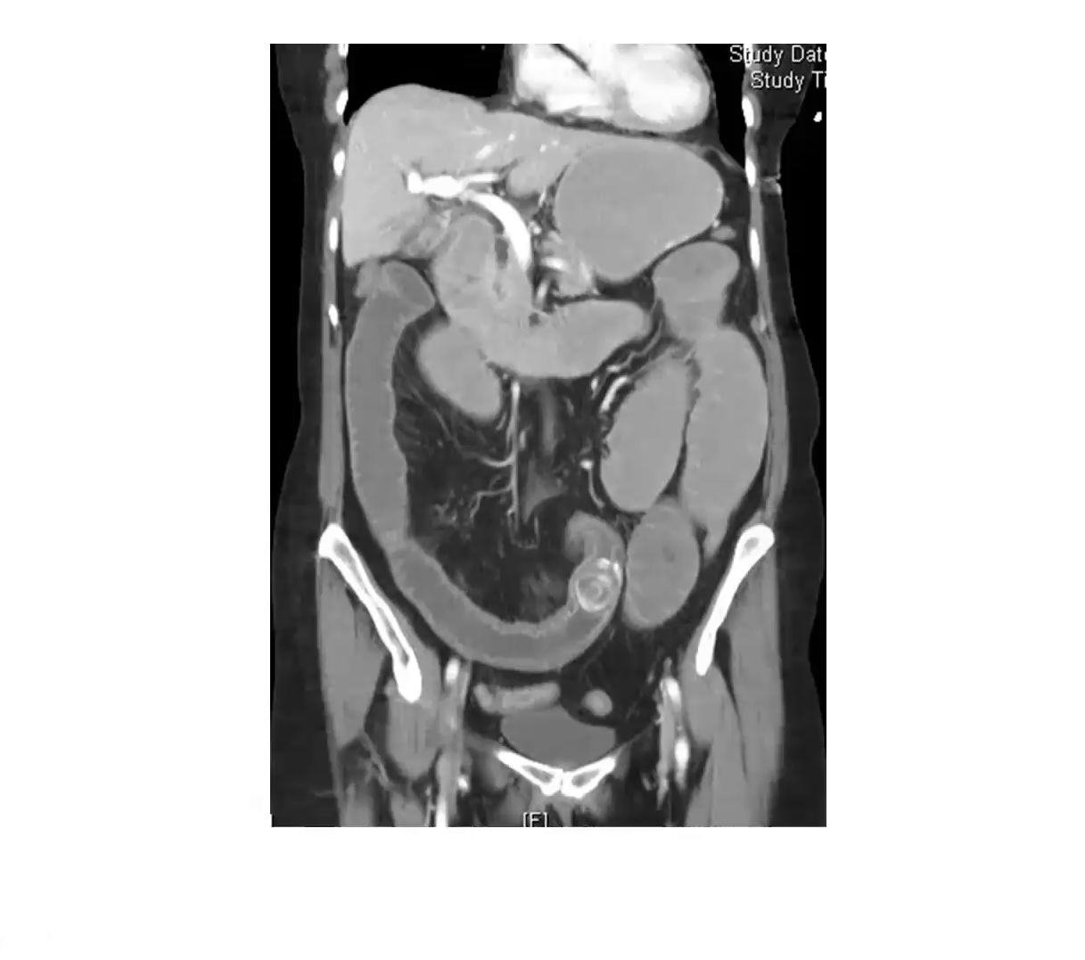
Gallstone ileus

Slide 53
Management of intestinal obstruction
Resuscitate as you evaluate
Definitive management principles

Slide 54
Resuscitation
IVF - Ringer’s lactate
NGT decompression ± Flatus tube
Foley catheter to assess output
Antibiotics
Pain Mx

Slide 55
Principles of Mx
Non-operative management for:
Ileus
Adhesions
Fecal impaction
Partial obstruction- investigate further b4 Sx

Slide 56
Non-operative management
Fluid and electrolyte replacement
NGT
Catheter
Regular monitoring (2-4 hourly)
Serial blood works
Serial abdominal Xrays

Slide 57
When to abandon conservative mx
Failure to improve after 24-48 hours
Increased abdominal pain, distension or tenderness
Change from non-feculent to feculent NGT effluent
Features of strangulation

Slide 58
Indications for emergency surgery
Peritonitis
Strangulation
Incarcerated hernia
Sigmoid volvulus

Slide 59
Take Home Points
Always start with ABC, resuscitation
  Includes IVF, Foley, NGT, monitor
DRE
DDX is simple:
  SBO: Adhesions, Bulges, Cancer, Crohn’s
  LBO: CANCER, Volvulus, Diverticulitis
Labs to assess dehydration & leukocytosis
Imaging to assess obstruction & etiology
If hypoTN/shock, “toxic”, or signs of strangulation or ischemia, resuscitate & OR stat
Otherwise NGT & treat etiology

Slide 60
Questions???

