Slide 1
PEPTIC ULCERS
Department of Surgery

Slide 2
Peptic ulcer
A disruption in the epithelium exposing muscularis mucosae
Usually in association with either excessive acid production or defective mucosal protective measures

Slide 3
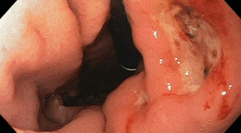
Endoscopic appearance

Slide 4
Sites
Duodenum
Stomach
Stomas
Oesophagus
Meckel’s diverticulum

Slide 5
Epidemiology
Occurs worldwide
Increasing incidence in older people due to NSAID use
Associated with Helicobacter pylori infection

Slide 6
Incidence:
Ulcer incidence is about 1% per year in H.P. positive people, a rate that is 6-10x higher than non-infected individuals.
NSAID use as well as HP infection rates increase with age. This may explain shifting trends in incidence.
Another factor is the prevalence of smoking.
Rates of smoking are declining in younger people, particularly men, possibly influencing the male to female ratio.
Previously a predominant male disease,currently with nearly comparable gender ratio in latest studies.

Slide 7
Historical Aspects:
Both gastric and duodenal ulcers are referred to as peptic.
Attention on causation is focused on acid and H.P infection.
Acid + pepsin is much more ulcerogenic than acid alone, thus the peptic label is still appropriate.
Gastric acid was long considered the primary cause for ulcers, but it is now understood that acid alone will rarely cause ulcer disease (except Zollinger-Ellison).
It is still true that ulcers will not occur in the absence of acid. The old dictum: “no acid, no ulcer” still stands.

Slide 8
Historical Aspects:
Gastric ulcers are more common in presence of low acid, indicating defective mucosal defense.
The most drastic change has been the recognition of the association between peptic ulcer disease and H.P. making some people conclude that ulcer disease is actually an infective disease.
Before the discovery of H2-receptor antagonists various anti-acids were used, but had to be used at frequent intervals in order to be affective.
In the 1980’s H2-RA became the drugs of choice because of better patient compliance and drug effectiveness.
With the discovery of Omeprazole, which blocks H/K exchange we have a drug that gives complete inhibition of acid secretion.

Slide 9
Location and Type of Ulcer:
Type 1: Primary gastric ulcer. Associated with diffuse antral gastritis.
Type 2: Gastric ulcers with duodenal ulcers, most likely secondary to duodenal ulcers.
Type 3: Prepyloric or channel ulcer.
Type 4: Proximal stomach or gastric cardia.
Acid hyper secretion common among type 2 and 3 ulcers. Type 1 an 4 pathophysiologycally the same.

Slide 10
Modified Johnson Classification
Type | Location | Acid Hypersecretion
I | Lesser curvature, incisura | No
II | Body of stomach, incisura, and duodenal ulcer (active or healed) | Yes
III | Prepyloric | Yes
IV | High on lesser curve, near gastroesophageal junction | No
V | Anywhere (medication induced) | No

Slide 11
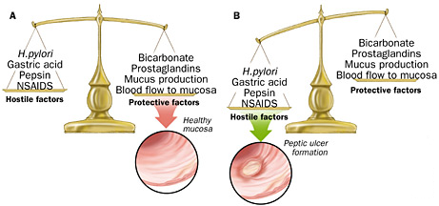
Peptic Ulcer Disease
Pathogenesis :
Protective factors vs. hostile factors

Slide 12
Peptic ulcer
Pathogenesis:
For both Duodenal & Gastric Ulcers:
  Infection with H. pylori:
    Decreases resistance of mucus layer from acid permeation (hydrophobicity)
    Increase acid secretion
    Slows duodenal emptying
    Reduced both duodenal and gastric bicarbonate secretion

Slide 13
Peptic ulcer
Pathogenesis:
  Effects of NSAIDs
    Decreases mucosal Prostagladin production
    Prostaglandin – inhibits acid secretion, stimulates mucus and HCO3 secretion and mucosal blood flow
  Zollinger-Ellison Syndrome (1%):
    Massive secretion of HCL due to ectopic gastrin production from non-beta islet cell tumor (gastrinoma)
    20% multiple, 2/3 malignant.
    Parietal cell mass is increased
    > gastrin 3-6 x the normal

Slide 14
Pathogenesis:
With the exception of ZE ,ulcer disease should be regarded as a reduction in normal mucosal defense. Considering the aggressive nature of acid /pepsin environment , ulcer disease is surprisingly uncommon.
Factors such as HP, NSAIDS disrupt these normal defense mechanisms. Smoking interferes with healing and secretory regulation.

Slide 15
Pathophysiology:
The first line of defense is mucus and bicarbonate secretion. It stabilizes the pH between the lumen and the surface epithelial cells. Mucus gel in patients with HP infection was found to be structurally weak. Duodenal mucus as well as bicarbonate secretion is reduced in patients who smoke.
The second line of defense is the intrinsic epithelial cell defense. The mucosal surface is a barrier to acid back diffusion thus maintaining normal intra cellular pH.

Slide 16
Pathophysiology:
The third line of defense is the rich mucosal blood flow. The blood provides a buffer for acid neutralization as well as adequate nutrition for the metabolic demand to maintain mucosal integrity.
Gastric mucosa has the ability to repair minor injury and therefore prevent progression to deep ulcers. Restitution has been evident within one hour.

Slide 17
Helicobacter pylori
Described in humans in the first decade of the 20th century
1983 -described in association with ulcer disease.
HP’s natural habitat is the human stomach. Without treatment infection is lifelong.
In developing countries most children are infected by the age of 10. In developed countries there is a clear age related increase.

Slide 18
Helicobacter pylori
Urease producing, gram negative bacillus
Infects mucosa of stomach > inflammatory response > gastritis > increased gastrin secretion > gastric metaplasia > damage to mucosa > ulceration

Slide 19
50% population infection rate
Chronic active gastritis 100%
DU 90%, GU 80%
10-20% with HP will develop PU, 4-10X
Type I/II, vacuolating toxin (Vac A) and
cytotoxin-associated protein (Cag A)
Cag A positive HP strains related to DU

Slide 20
Helicobacter pylori
Not known why most patients with HP do not develop ulcer disease.
HP resides in the stomach but causes duodenal ulcers probably by colonizing pockets of metaplastic gastric mucosa.
Rising cases of antibiotic resistance
Increased risk of developing gastric adenocarcinoma

Slide 21
Pathogenesis:NSAIDS
NSAIDs impair normal mucosal defense.
10-20% of patients will develop gastric ulcers and 4-10 % duodenal ulcers within 3 months of taking NSAIDS. Not all endoscopic ulcers are clinically symptomatic and trials generally overstate the risk.
NSAID users develop gastric ulcers twice as often as duodenal ulcers. (HP more duodenal).
NSAID ulcers not usually associated with gastritis as is the case with HP infection. When NSAID use is stopped these ulcers do not recur.

Slide 22
Pathogenesis: Acid
Adequate acid necessary for duodenal ulcers.
Remember “no acid, no ulcer” withstood the test of time.
Acid is an important co-factor in the developing of both duodenal and gastric ulcers.

Slide 23
Risk factors
HELICOBACTER PYLORI infection
Non Steroidal Anti-inflammatory Drugs
Steroid therapy
Smoking
Excess alcohol intake
Genetic factors
Zollinger Ellison syndrome – rare syndrome caused by gastrin-secreting tumour
Blood group O
Hyperparathyroidism
Stress

Slide 24
Complications
Gastric outlet obstruction
Perforation
Penetration
Bleeding

Slide 25
Clinical Presentation:
Patients present with dyspepsia, epigastric pain and or discomfort. Acid may irritate nerve endings or peristaltic waves passing the ulcer may cause discomfort.
But there is great overlap in symptoms with non ulcer dyspepsia.
20% of patients will present with serious complications without previous ulcer symptoms.
It is said that gastric ulcers present with pain during or soon after eating, whereas duodenal ulcer pain is relieved by food & is worse at night

Slide 26
Clinical Presentation:
Pain tends to be chronic and recurrent.
DU/GU can not be differentiated on clinical grounds alone.
Generally gastric ulcers affect older people whereas duodenal ulcers present in the young.
Other non specific symptoms are nausea, weight loss, heart burn, fatty food intolerance and bloating.
Melana stool alone more frequently associated with duodenal ulcers. Gastric ulcers present with hematemesis or melena in equal frequency.

Slide 27
Diagnosis
History & Physical examination
Endoscopy- OGD & biopsy
Tests for H. pylori: urease breath test, stool antigen test, antibody studies, stain biopsy for HP
Upper GIT contrast studies: Ba meal

Slide 28
Endoscopic appearance

Slide 29
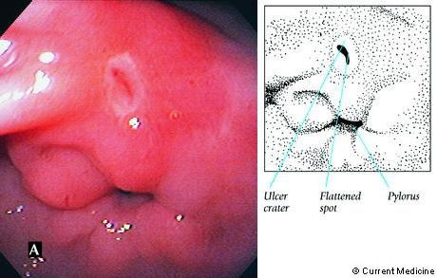
GI Bleeding

Slide 30
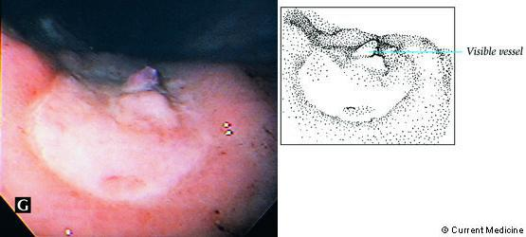
Ulcer with recent bleed

Slide 31
ALARM signs for epigastric pain
Chronic GI bleeding (melena/hematemesis)
Iron-deficiency anaemia
Progressive unintentional weight loss
Progressive dysphagia
Persistent vomiting
Epigastric mass
Patients aged 55 years and older with unexplained and persistent recent- onset dyspepsia alone

Slide 32
Management: lifestyle modification
Less stress
Regular diet
Quit smoking/ reduce alcohol
Avoid NSAID

Slide 33
Management: drugs
H pylori eradication
Gastric acid neutralizers- antacids
Antisecretory drugs: H2 receptor block/ PPI
Cytoprotectives

Slide 34

Management: drugs
H pylori eradication:
  Bismuth based triple therapy
    Bismuth + Tetracycline + Metronidazole
  Proton pump inhibitor based triple Rx
    PPI + Amoxicillin + Clarithromycin
Notes:
H pylori therapy fails in as many as 20% of patients

Slide 35
Management: drugs
Gastric acid neutralizers
Rapid onset of action
Frequent dosing

Slide 36
Management: antisecretory drugs
H2 blockers: cimetidine, ranitidine & famotidine
PPIs: Omeprazole & Pantoprazole

Slide 37
Management: cytoprotective drugs
Sucralfate (aluminium hydroxide + sucrose)
Bismuth based preparations
Misoprostil

Slide 38
Management
Surgical indications
  Intractibility (after medical therapy)
  Hemorrhage
  Obstruction
  Perforation
  Relative: continuous requirement of steroid therapy/NSAIDs

Slide 39
Gastric outlet obstruction
Long history of peptic ulcer disease
Vomiting
Weight loss
Dehydration
Succussion splash
Visible Peristalsis
Hypochloraemic alkalosis & paradoxical aciduria

Slide 40
Vomiting –loss of HCl
HYPOCHLORAEMIC ALKALOSIS
Renal Excretion of HCO₃ with Na⁺ deficit
Aldosterone secretion & Na⁺ conservation
Renal loss of K⁺ and H⁺
PARADOXICAL ACIDURIA

Slide 41
Investigations
Laboratory investigations
Hypochloraemic alkalosis;
Hyponatremia;
Hypokalaemia
Imaging
Plain x-ray
Barium meal

Slide 42
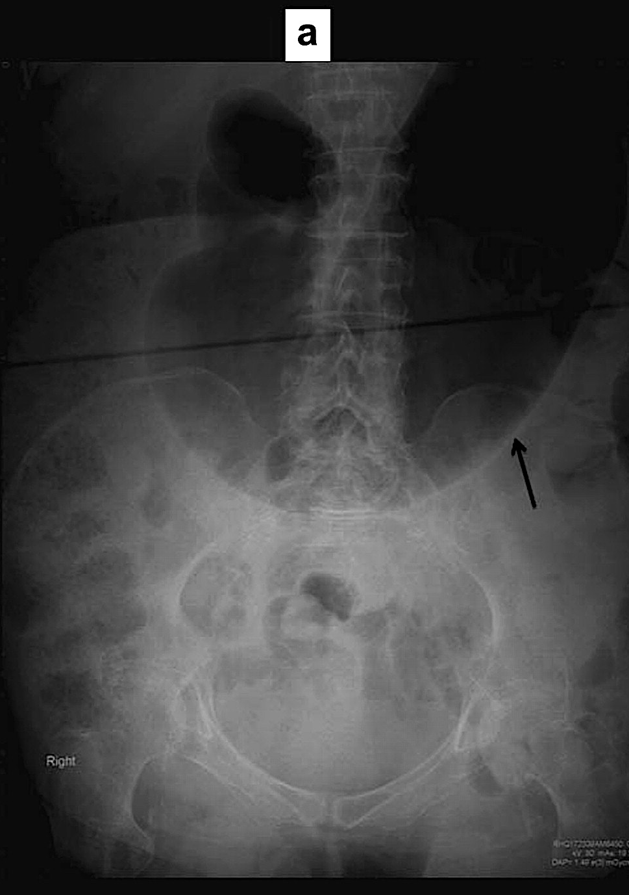

Slide 43
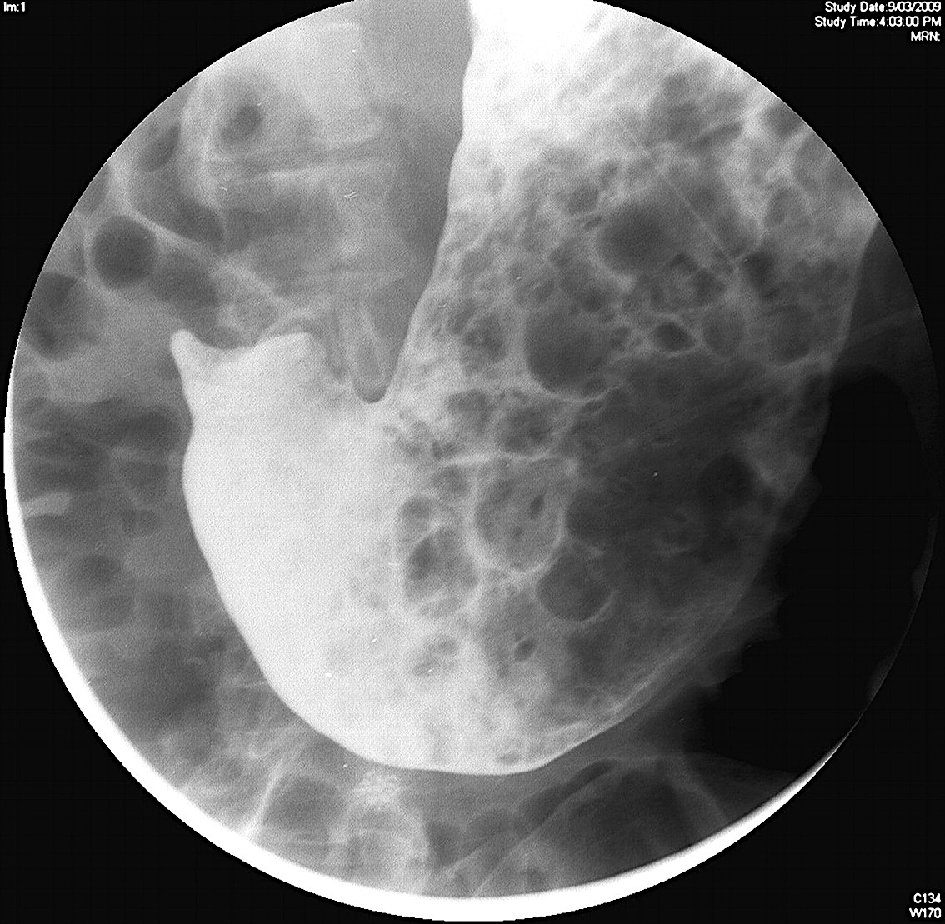

Slide 44
Other investigations
Saline load test
Endoscopy

Slide 45
Saline load test
700 ml normal saline infused over 3-4 minutes
Tube clamped for 30 minutes
Stomach aspirated
Recovery of >350 ml indicates obstruction

Slide 46
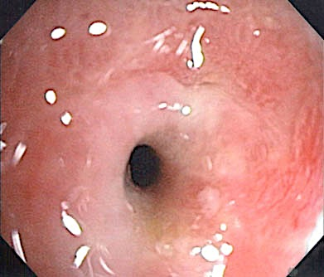

Slide 47
Treatment
Correction of metabolic abnormalities
Dealing with the mechanical problem

Slide 48
Correction of metabolic derangements
Rehydrate with isotonic saline
Give potassium supplements

Slide 49
Treatment
Medical treatment
  Gastric lavage and suction (5-7 days)
Surgical treatment
  Truncal vagotomy with gastrojejunostomy
  Endoscopic treatment
  Balloon dilatation

Slide 50
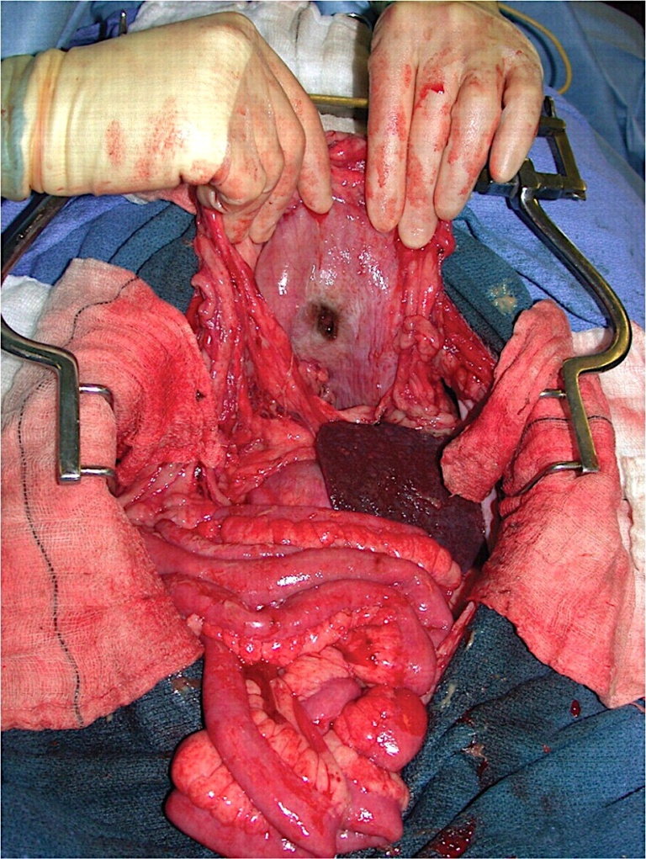
Perforation of peptic ulcer

Slide 51
Perforated DU
Most perforated ulcers are anterior
Reasons: no overlying protective viscera & no major vessels

Slide 52
Presentation
Severe pain
Vomiting
Dehydration
Distress with shallow rapid breaths
Rigidity
Tympanic note over liver
Absent bowel sounds

Slide 53
Investigations
Laboratory investigations
Leucocytosis ; raised serum amylase
High levels of amylase in aspirated fluid
Imaging
Gas under diaphragm
Escape of contrast material from the lumen

Slide 54
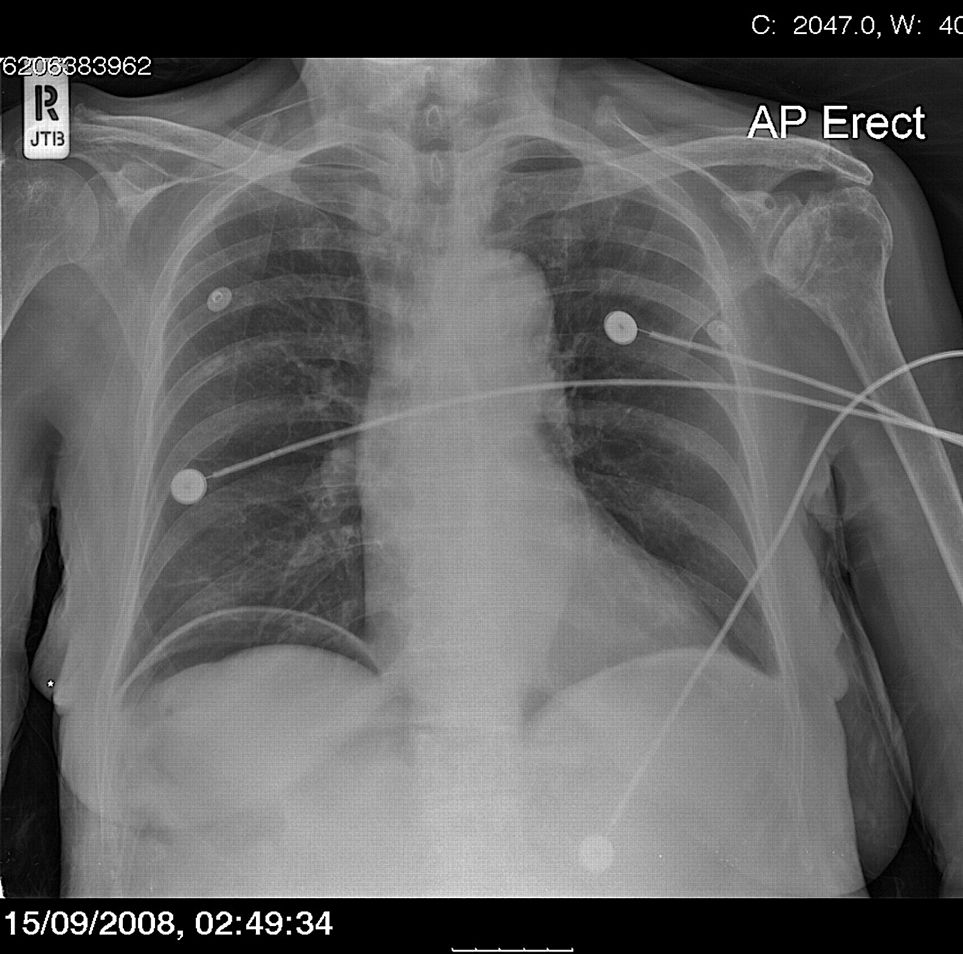
Air under the diaphragm – Perforated viscus

Slide 55
Management
Resuscitate
Nasogastric tube
IV fluids
Antibiotics
Graham patch

Slide 56
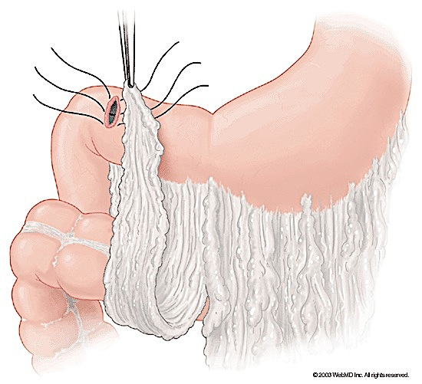

Slide 57
Bleeding peptic ulcer
Usually a posterior ulcer
Presents with haematemesis & shock
May have malena stool

Slide 58
Causes of upper GI bleed
Peptic ulcer
Acute gastritis
Esophageal varices
Mallory-Weiss syndrome
Oesophagitis

Slide 59
Management of upper GI bleed
Resuscitation: ABC
Assess shock and replace blood loss
Emergency care
Definitive management

Slide 60
Initial Management
Assess shock & replace blood loss
Pulse | BP | Urine output | Haematocrit | Blood aspirated
Stop bleeding by ice-water lavage
History & physical examination
Upper GI Endoscopy
(within 1-2 hours of admission)

Slide 61
Endoscopic treatment
INDICATIONS
Active bleeding
Visible vessel in ulcer base
OPTIONS
Sclerotherapy (epinephrine/ ethanol)
Heat probe or electrocautery
Laser

Slide 62
Indications for Emergency surgery for bleeding DU
Intractable shock on admission
Ongoing bleeding requiring further transfusion to maintain hematocrit
Failed endoscopic management

Slide 63
Management
Surgical indications
  Intractibility (after medical therapy)
  Hemorrhage
  Obstruction
  Perforation
  Relative: continuous requirement of steroid therapy/NSAIDs

Slide 64
Surgical procedures for PUD
Highly selective Vagotomy
Vagotomy & drainage procedure
Partial gastrectomy

Slide 65
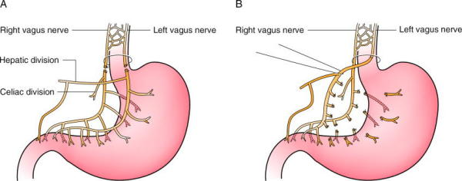
Vagotomy

Slide 66
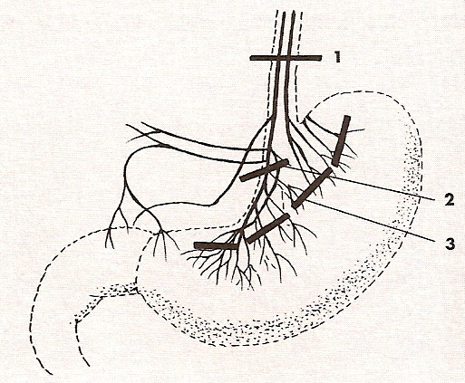
Zeman, M. et al., Speciální chirurgie, ISBN 80-7262-260-9, 2004
Vagotomy

Slide 67
Partial gastrectomies
Billroth I: end-to-end gastroduodenostomy
Billroth II: end-to-side gastrojejunostomy
duodenal stump closed
Roux-en-Y reconstruction

Slide 68
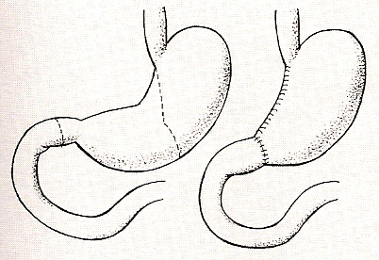
Zeman, M. et al., Speciální chirurgie, ISBN 80-7262-260-9, 2004
Billroth I

Slide 69
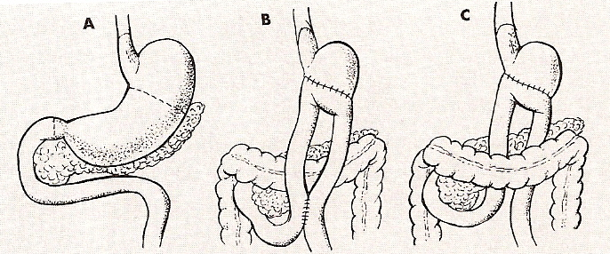
Zeman, M. et al., Speciální chirurgie, ISBN 80-7262-260-9, 2004
Billroth II

Slide 70
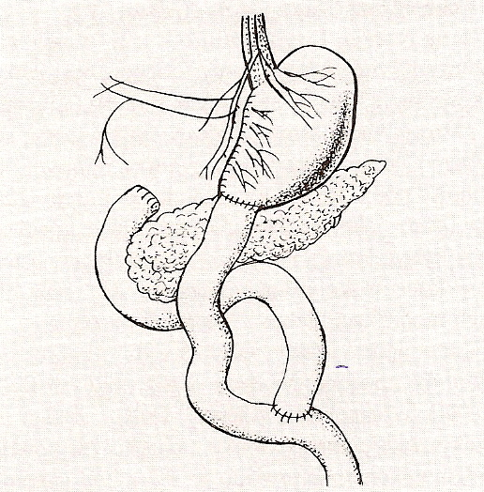
Zeman, M. et al., Speciální chirurgie, ISBN 80-7262-260-9, 2004
Gastro-jejunostomy (Roux-en-Y)

Slide 71
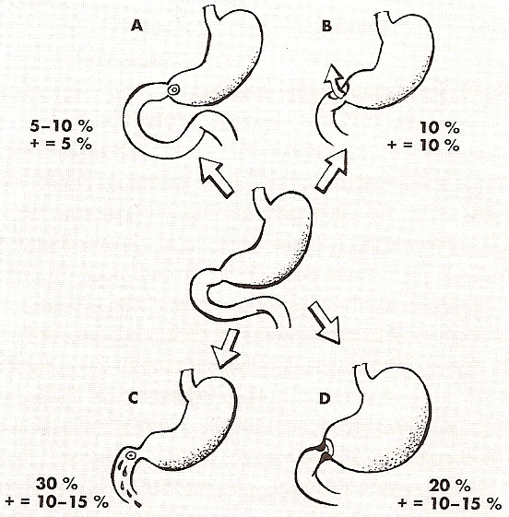
Zeman, M. et al., Speciální chirurgie, ISBN 80-7262-260-9, 2004
A – penetration B – perforation
C – bleeding D - stenosis

Slide 72
Further reading
Complications of gastrectomy: early and late dumping syndromes
Emergency management of acute upper GI bleed

Slide 73
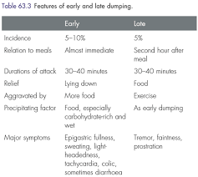

Slide 74
Thank you!

