Slide 1
Acute Abdomen 6th years
Dr Ojuka

Slide 2
Introduction
The acute abdomen characterised by the any sudden, spontaneous, nontraumatic, severe abdominal pain of less than 24 hours duration.
The acute abdomen requires rapid and specific diagnosis because some of the causes demand urgent operative intervention.
Can be surgical or non-surgical entity.
Clinical evaluation remain the mainstays of determining the correct diagnosis and initiating proper and timely therapy.
The diagnoses associated with an acute abdomen vary according to age and gender.
Notes:
The term acute abdomen refers to signs and symptoms of abdominal pain and tenderness, a clinical presentation that often requires emergency surgical therapy. This challenging clinical scenario requires a thorough and expeditious workup to determine the need for operative intervention and to initiate appropriate therapy. Many diseases, some of which are not surgical or even intra-abdominal,¹ can produce acute abdominal pain and tenderness. Therefore, every attempt should be made to make a correct diagnosis so that the chosen therapy, often a laparoscopy or laparotomy, is appropriate. Despite improvements in laboratory and imaging studies, history and physical examination remain the mainstays of determining the correct diagnosis and initiating proper and timely therapy.

Slide 3
Objectives 1
Be able to define and differentiate visceral, parietal, and referred pain when evaluating a patient for abdominal pain.
Be able to use patient age, gender, and comorbidities to guide the creation of an appropriate differential diagnosis for abdominal pain.
Be able to obtain a detailed clinical history when evaluating a patient with abdominal pain.
In addition, be able to perform an appropriate physical examination, including rectal, genital, and pelvic examinations

Slide 4
Objectives-2
When evaluating a patient with abdominal pain, be able to establish a relevant differential diagnosis.
Given a patient with abdominal pain, be able to order relevant laboratory and imaging studies
Based on a working diagnosis for acute or chronic abdominal pain, be able to determine the need for emergent, urgent, or elective operation if surgery is indicated. Be able to select nonoperative treatment when appropriate
When caring for a patient with either acute or chronic abdominal pain, be able to identify the patient better served immediately with nonsurgical therapy. Also, be able to manage a patient in the preoperative period and prepare a patient for surgery should he or she need it.

Slide 5
Non-surgical
Endocrine and metabolic
    Uremia
    Diabetic crisis
    Addisonian crisis
    Acute intermittent porphyria
    Hereditary Mediterranean fever
Hematological causes
    Sickle cell crisis
    Acute leukemia
    Other blood dyscrasias
Toxin and drugs
    Lead poisoning
    Other heavy metal poisoning
    Narcotic withdrawal
    Black widow spider poisoning

Slide 6
Surgical
Hemorrhage
      Spontaneous rupture of spleen
      Solid organ trauma
      Malory-Weis syndrome
      Hemorrhagic pancreatitis
      Aortoduodenal fistula after aortic vascular graft
      Intestinal ulceration
      Arteriovenous malformation of gastrointestinal tract
Infection
      Appendicitis
      Cholecystitis
      Hepatic abscess
      Diverticular abscess
      Psoas abscess

Slide 7
Surgical
Perforation
      Boerhaave syndrome
      Perforated gastrointestinal ulcer
      Perforated gastrointestinal cancer
      Perforated diverticulum
Blockage
      Adhesion induction small or large bowel obstruction
      Sigmoid volvulus
      Caecal volvulus
      Incarcerated hernias
      Inflammatory bowel disease
      Gastrointestinal malignant neoplasm
      Intussusception
Ischemia
      Buerger disease
      Mesenteric thrombosis or embolism
      Ovarian torsion
      Testicular torsion
      Strangulated hernia

Slide 8
Anatomy
Abdominal pain is conveniently divided into visceral and parietal components.
Visceral pain tends to be vague and poorly localized to the epigastrium, periumbilical region, or hypogastrium, depending on its origin from the primitive foregut, midgut, or hindgut .
It is usually the result of distention of a hollow viscus.
Parietal pain corresponds to the segmental nerve roots innervating the peritoneum and tends to be sharper and better localized.

Slide 9
Physiology
Visceral pain is usually dull and poorly localized. It is typically the result of distention of a hollow viscus. An example is early-stage appendicitis.
Parietal pain is usually sharp and is localized more easily. It is generally the result of irritation of nerve roots innervating the peritoneum. An example is late-stage appendicitis.
Referred pain is pain felt at a site distant from the source of painful stimuli. For example, liver pathology can present as right shoulder pain as a result of diaphragmatic irritation.

Slide 10
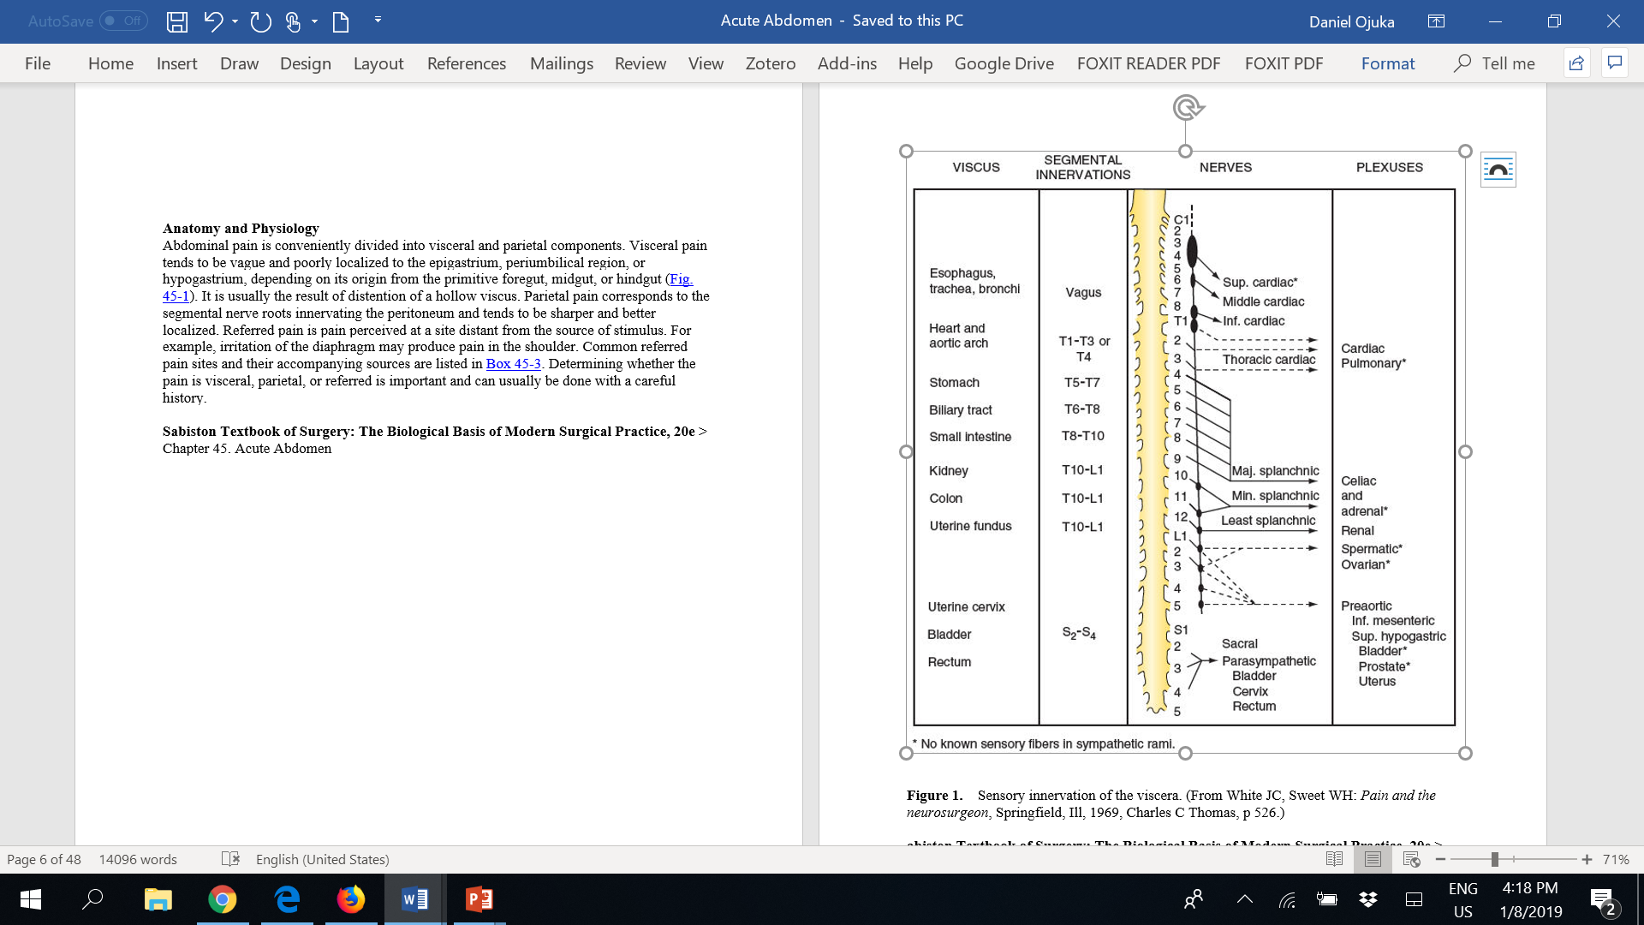

Slide 11
Anatomy
Referred pain is pain perceived at a site distant from the source of stimulus.
For example, irritation of the diaphragm may produce pain in the shoulder.
Common referred pain sites and their accompanying sources are listed in Determining whether the pain is visceral, parietal, or referred is important and can usually be done with a careful history.

Slide 12
Referred pain
Site | Source
Right shoulder | Liver
 | Gall bladder
 | Right Hemidiaphragm
Left shoulder | Spleen
 | Heart
 | Tail of pancrease
 | Left hemidiaphragm
Scrotum and testicles | Ureter

Slide 13
Pathophysiology
Introduction of bacteria or irritating chemicals into the peritoneal cavity can cause an outpouring of fluid from the peritoneal membrane.
The peritoneum responds to inflammation by increased blood flow, increased permeability, and the formation of a fibrinous exudate on its surface.
The bowel also develops local or generalized paralysis.
The fibrinous surface and decreased intestinal movement cause adherence between the bowel and omentum or abdominal wall and help to localize inflammation.

Slide 14
Pathophysiology
As a result, an abscess may produce sharply localized pain with normal bowel sounds and gastrointestinal function, whereas a diffuse process, such as a perforated duodenal ulcer, produces generalized abdominal pain with a quiet abdomen.
Peritonitis may affect the entire abdominal cavity or a portion of the visceral or parietal peritoneum.
Peritonitis is peritoneal inflammation from any cause.
It is usually recognized on physical examination by severe tenderness to palpation, with or without rebound tenderness, and guarding.

Slide 15
Classification
Primary
    Primary peritonitis occurs more commonly in children and is most often due to pneumococcus or hemolytic streptococcus.
    Adults with end-stage renal disease on peritoneal dialysis can develop infections of their peritoneal fluid, with the most common organisms being gram-positive cocci.
    Adults with ascites and cirrhosis can develop primary peritonitis, and in these cases the organisms are usually Escherichia coli and Klebsiella
Secondary
    Peritonitis is usually secondary to an inflammatory insult, most often gram-negative infections with enteric organisms or anaerobes.
    It can result from non-infectious inflammation, a common example being pancreatitis.
Tertiary
    Occur following surgery or intervention for secondary/primary peritonitis

Slide 16
History
A detailed and organized history is essential to formulating an accurate differential diagnosis and subsequent treatment regimen.
Modern advancements in imaging cannot and will never replace the need for a skilled clinician's careful history and bedside examination.
The history must focus not only on the investigation of the pain complaints but also on past problems and associated symptoms as well.
Questions should be open ended whenever possible and structured to disclose the onset, character, location, duration, radiation, and chronology of the pain experienced.
Pain identified with one finger is often much more localized and typical of parietal innervation or peritoneal inflammation compared with an area of discomfort illustrated with the palm of the hand, which is more typical of the visceral discomfort of bowel or solid organ disease.
Notes:
It is tempting to ask a question such as, Is the pain sharp? or Does eating make it worse? This specific yes or no style can speed up the history taking by not allowing the patient to narrate, but it stands to miss vital details and potentially to skew the responses. A much better questioning style would be, How does the pain feel to you? or Does anything make the pain better or worse? Often, additional information can be gained by observing how the patient describes the pain that is experienced.

Slide 17
History
The intensity and severity of the pain are related to the underlying tissue damage.
Sudden onset of excruciating pain suggests conditions such as intestinal perforation and arterial embolization with ischemia, although other conditions, such as biliary colic, can be manifested suddenly as well.
Pain that develops and worsens during several hours is typical of conditions of progressive inflammation or infection, such as cholecystitis, colitis, and bowel obstruction.
The history of progressive worsening versus intermittent episodes of pain can help differentiate infectious processes that worsen with time compared with the spasmodic colicky pain associated with bowel obstruction, biliary colic from cystic duct obstruction, or genitourinary obstruction .
Equally important as the character of the pain is its location and radiation.

Slide 18
History
Tissue injury or inflammation can trigger both visceral and somatic pain.
Solid organ visceral pain in the abdomen is generalized in the quadrant of the involved organ, such as liver pain across the right upper quadrant of the abdomen.
Small bowel pain is perceived as poorly localized periumbilical pain, whereas colon pain is centred between the umbilicus and the pubic symphysis.
As inflammation expands to involve the peritoneal surface, parietal nerve fibres from the spine allow focal and intense sensation.
This combination of innervation is responsible for the classic diffuse periumbilical pain of early appendicitis that later shifts to become an intense focal pain in the right lower abdomen at McBurney point.
Pain may also extend well beyond the diseased site.
Notes:
If clinicians focus on the character of the current pain and do not thoroughly investigate its onset and progression, they will miss these strong historical clues. The liver shares some of its innervation with the diaphragm and may create referred pain to the right shoulder from the C3-C5 nerve roots. Genitourinary pain is another source of pain that commonly has a radiating pattern. Symptoms are primarily in the flank region originating from the splanchnic nerves of T11-L1, but pain often radiates to the scrotum or labia through the hypogastric plexus of S2-S4.

Slide 19
History
Activities that exacerbate or relieve the pain are also important.
Associated symptoms can be important clues to the diagnosis.
The past medical history can potentially be more helpful than any other single part of the patient's evaluation.
A history of medications as well as the gynaecologic history of female patients is also important.
The gynaecologic health, and specifically the menstrual history, is crucial in evaluation of lower abdominal pain in a young woman.
Notes:
Eating will often worsen the pain of bowel obstruction, biliary colic, pancreatitis, diverticulitis, or bowel perforation. Food can provide relief from the pain of nonperforated peptic ulcer disease or gastritis. Clinicians will often recognize that they are evaluating peritonitis during the history. Patients with peritoneal inflammation will avoid any activity that stretches or jostles the abdomen. They describe worsening of the pain with any sudden body movement and will realize that there is less pain if their knees are flexed. The car ride to the hospital can be agonizing, with the patient feeling every bump along the way. Nausea, vomiting, constipation, diarrhea, pruritus, melena, hematochezia, and hematuria can all be helpful symptoms if they are present and recognized. Vomiting may occur because of severe abdominal pain of any cause or as a result of mechanical bowel obstruction or ileus. Vomiting is more likely to precede the onset of significant abdominal pain in many medical conditions, whereas the pain of an acute surgical abdomen is manifested first and stimulates vomiting through medullary efferent fibers that are triggered by the visceral afferent pain fibers. Constipation or obstipation can be a result of either mechanical obstruction or decreased peristalsis. It may represent the primary problem and require laxatives and prokinetic agents or merely be a symptom of an underlying condition. A careful history should include whether the patient is continuing to pass any gas or stool from the rectum. A complete obstruction is more likely to be associated with subsequent bowel ischemia or perforation related to either massive distention or a closed loop of small bowel that can occur. Diarrhea is associated with several medical causes of acute abdomen, including infectious enteritis, inflammatory bowel disease, and parasitic contamination. Bloody diarrhea can be seen in these conditions as well as in colonic ischemia. Previous illnesses or diagnoses can greatly increase or decrease the likelihood of certain conditions that would otherwise not be highly considered. Patients may, for example, report that the current pain is very similar to the kidney stone passage they experienced a decade prior. On the other hand, a prior history of appendectomy, pelvic inflammatory disease, or cholecystectomy can significantly shape the differential diagnosis. During the abdominal examination, all scars on the abdomen should be accounted for by the medical history obtained. Medications can both create acute abdominal conditions and mask their symptoms. Although a thorough discussion of the impact of all medications is beyond the scope of this chapter, several common drug classes deserve mention. High-dose narcotic use can interfere with bowel activity and lead to obstipation and obstruction. Narcotics also can contribute to spasm of the sphincter of Oddi and exacerbate biliary or pancreatic pain. Clearly, they also may suppress pain sensation and alter mental status, which can impair the ability to accurately diagnose the condition. Nonsteroidal anti-inflammatory agents are associated with an increased risk of upper gastrointestinal inflammation and perforation, whereas steroid medications can block protective gastric mucus production by chief cells and reduce the inflammatory reaction to infection, including advanced peritonitis. Immunosuppressant agents as a class both increase a patient's risk of acquiring a variety of bacterial or viral illnesses and also blunt the inflammatory response, diminishing the pain that is present and the overall physiologic response. Anticoagulants are much more prevalent in our emergency patients as the population ages. These drugs may be the cause of gastrointestinal bleeds, retroperitoneal hemorrhages, or rectus sheath hematomas. They also can complicate the preoperative preparation of the patient and be the cause of substantial morbidity if their use goes unrecognized. Finally, recreational drugs can play a role in patients with an acute abdomen. Chronic alcoholism is strongly associated with coagulopathy and portal hypertension from liver impairment. Cocaine and methamphetamine can create an intense vasospastic reaction that can cause life-threatening hypertension as well as cardiac and intestinal ischemia.
The likelihood of ectopic pregnancy, pelvic inflammatory disease, mittelschmerz, or severe endometriosis is heavily influenced by the details of the gynecologic history.
Very little has changed in the technique or goals of history taking since Zachary Cope first published his classic paper on the diagnosis of acute abdominal pain in 1921.
5 An exception is the application of computers to the "art" of history taking, which has been extensively studied in Europe.6-10 Data were collected by physicians on detailed standardized forms during history and physical examinations and entered into computers programmed with a medical database of diseases and their associated signs and symptoms. The computer-generated diagnosis based on mathematical probabilities was as much as 20% more accurate than physicians left to their own methods. Statistically significant improvement was identified in timely laparotomy, shortened hospital stays, and reduced need for surgery and hospitalization.6 However, statistically significant improvement in accuracy and efficiency has been realized without computer assistance if similar standardized forms are used for data collection. This has also been observed in the settings of trauma and critical care.

Slide 20
Physical examination
An organized and thoughtful physical examination is critical to the development of an accurate differential diagnosis and the subsequent treatment algorithm.
The physical examination should always begin with a general inspection of the patient to be followed by inspection of the abdomen itself.
Patients with peritoneal irritation will experience worsened pain with any activity that moves or stretches the peritoneum.
Notes:
Despite newer technologies including high-resolution computed tomography (CT) scanning, ultrasound, and magnetic resonance imaging (MRI), the physical examination remains a key part of a patient's evaluation and must not be minimized. A skilled clinician will be able to develop a narrow and accurate differential diagnosis in most of his or her patients at the conclusion of the history and physical examination. Laboratory and imaging studies can then be used to further confirm the suspicions, to reorder the proposed differential diagnosis, or, less commonly, to suggest unusual possibilities not yet considered.

Slide 21
Physical examination
These patients will typically lie very still in the bed during the evaluation and often maintain flexion of their knees and hips to reduce tension on the anterior abdominal wall.
Disease states that cause pain without peritoneal irritation, such as ischemic bowel or ureteral or biliary colic, typically cause patients to continually shift and fidget in bed while trying to find a position that lessens their discomfort.
Other important clues, such as pallor, cyanosis, and diaphoresis, may be observed during the general inspection as well

Slide 22
Physical examination
Abdominal inspection should address the contour of the abdomen, including whether it appears distended or scaphoid and whether a localized mass effect is observed.
Special attention should be paid to all scars present; if they are surgical in nature, they should correlate with the past surgical history provided.
Fascial hernias may be suspected and can be confirmed during palpation of the abdominal wall.
Evidence of erythema or edema of skin may suggest cellulitis of the abdominal wall; ecchymosis is sometimes observed with deeper necrotizing infections of the fascia or abdominal structures, such as the pancreas.

Slide 23
Physical examination
Auscultation can provide useful information about the gastrointestinal tract and the vascular system. Bowel sounds are typically evaluated for their quantity and quality.
A quiet abdomen suggests an ileus, whereas hyperactive bowel sounds are found in enteritis and early ischemic intestine.
The pitch and pattern of the sounds are also considered.
Mechanical bowel obstruction is characterized by high-pitched tinkling sounds that tend to come in rushes and are associated with pain.
Far-away echoing sounds are often present when significant luminal distention exists.

Slide 24
Physical examination
Bruits heard within the abdomen reflect turbulent blood flow within the vascular system.
These are most frequently encountered in the setting of high-grade arterial stenoses of 70% to 95% but can also be heard if an arteriovenous fistula is present.
The clinician can also subtly test for the location and degree of pain during the auscultatory examination by varying the position and amount of pressure applied with the stethoscope.
These data can then be compared with the findings during palpation and evaluated for consistency.
Even though few patients will intentionally try to deceive the physician, some may exaggerate their pain complaints so as not to be disregarded or taken lightly.

Slide 25
Physical examination
Percussion is used to assess for gaseous distention of the bowel, free intra-abdominal air, degree of ascites, or presence of peritoneal inflammation.
Hyperresonance, commonly referred to as tympany to percussion, is characteristic of underlying gas-filled loops of bowel.
In the setting of bowel obstruction or ileus, this tympany is heard throughout all but the right upper quadrant where the liver lies beneath the abdominal wall.
If localized dullness to percussion is identified anywhere other than the right upper quadrant, an abdominal mass displacing the bowel should be considered.
When liver dullness is lost and resonance is uniform throughout, free intra-abdominal air should be suspected.
.

Slide 26
Physical examination
This air rises and collects beneath the anterior abdominal wall when the patient is in a supine position.
Ascites is detected by looking for fluctuance of the abdominal cavity.
A fluid wave or ripple can be generated by a quick firm compression of the lateral abdomen.
The resulting wave should then travel across the abdominal wall.

Slide 27
Physical examination
Movement of adipose tissue in the obese abdomen can be mistaken for a fluid wave.
False-positive examinations can be reduced by first pressing the ulnar surface of the examiner's open palm into the midline soft tissue of the abdominal wall to minimize any movement of the fatty tissue while generating the wave with the opposite hand.
Peritonitis is also assessed by percussion.
Older, traditional writings teach a technique of deep compression of the abdominal wall followed by abrupt release.

Slide 28
Physical examination
This practice is excruciating in the setting of peritoneal inflammation and can create significant discomfort even in its absence.
More sensitive and reliable methods can and should be used.
Firmly tapping the iliac crest, the flank, or the heel of an extended leg will jar the abdominal viscera and elicit characteristic pain when peritonitis is present

Slide 29
Physical examination
The final major step in the abdominal examination is palpation.
Palpation typically provides more information than any other single component of the abdominal examination.
In addition to revealing the severity and exact location of the abdominal pain, palpation can further confirm the presence of peritonitis as well as identify organomegaly or an abnormal mass lesion.
Palpation should always begin gently and away from the reported area of pain.

Slide 30
Physical examination
If considerable pain is induced at the outset of palpation, the patient is likely to voluntarily guard and continue to do so, limiting the information obtained.
Involuntary guarding, or abdominal wall muscle spasm, is a sign of peritonitis and must be distinguished from voluntary guarding. T
To accomplish this, the examiner applies consistent pressure to the abdominal wall away from the point of maximal pain while asking the patient to take a slow, deep breath.
In the setting of voluntary guarding, the abdominal muscles will relax during the act of inspiration; if guarding is involuntary, they remain spastic and tense.

Slide 31
Physical examination
Pain, when focal, suggests an early or well-localized disease process; diffuse pain on palpation is present with extensive inflammation or late presentations.
If pain is diffuse, careful investigation should be carried out to determine where the pain is greatest.
Even in the setting of extreme contamination from perforated peptic ulcers or colonic diverticula, the site of maximal tenderness often points to the underlying source.

Slide 32
Physical examination
Numerous unique physical findings have come to be associated with specific disease conditions and are well described as examination "signs"
Murphy sign of acute cholecystitis results when inspiration during palpation of the right upper quadrant results in sudden worsening of pain because of descent of the liver and gallbladder toward the examiner's hand.
Several signs help to localize the site of underlying peritonitis, including the obturator sign, the psoas sign, and Rovsing sign. Others, such as Fothergill sign and Carnett sign, help distinguish intra-abdominal disease from that of the abdominal wall.

Slide 33
Physical examination
Digital rectal examination needs to be performed in all patients with acute abdominal pain, checking for the presence of a mass, pelvic pain, or intraluminal blood.
A pelvic examination should be included in all women in evaluating pain located below the umbilicus.
Gynecologic and adnexal processes are best characterized by a thorough speculum and bimanual evaluation.

Slide 34
Laboratory studies
A number of laboratory studies are considered routine in the evaluation of a patient with an acute abdomen.
They help confirm that inflammation or an infection is present and also aid in the elimination of some of the most common nonsurgical conditions.
A complete blood count with differential is valuable as most but not all patients with an acute abdomen will have either a leukocytosis or bandemia.
Serum electrolyte, blood urea nitrogen, and creatinine measurements will assist in evaluating the effect of such factors as vomiting and third space fluid losses.
.

Slide 35
Laboratory studies
In addition, they may suggest an endocrine or metabolic diagnosis as the cause of the patient's problem.
Serum amylase and lipase determinations may suggest pancreatitis as the cause of the abdominal pain, but levels can also be elevated in other disorders, such as small bowel infarction and duodenal ulcer perforation.
Normal serum amylase and lipase levels do not exclude pancreatitis as a possible diagnosis because of the effects of chronic inflammation on enzyme production and timing factors.
Liver function tests including total and direct bilirubin, serum aminotransferase, and alkaline phosphatase are helpful in evaluating potential biliary tract causes of acute abdominal pain.

Slide 36
Laboratory studies
Lactate levels and arterial blood gas determinations can be helpful in diagnosis of intestinal ischemia or infarction.
Urine testing, such as urinalysis, is helpful in the diagnosis of bacterial cystitis, pyelonephritis, and certain endocrine abnormalities, such as diabetes and renal parenchymal disease.
Urine culture, although it can confirm a suspected urinary tract infection and direct antibiotic therapy, is not available in time to be helpful in the evaluation of an acute abdomen.

Slide 37
Laboratory studies
Urinary measurements of human chorionic gonadotropin can either suggest pregnancy as a confounding factor in the patient's presentation or aid in decision making about therapy.
The fetus of a pregnant patient with an acute abdomen is best protected by providing the best care to the mother, including an operation if indicated.
Stool testing for occult blood can be helpful in the evaluation of these patients but is nonspecific. Stool for ova and parasite evaluation as well as culture and toxin assay for Clostridium difficile can be helpful if diarrhea is a component of the patient's presentation

Slide 38
Helpful Laboratory Studies in the Acute Abdomen
Hemoglobin
White blood cell count with differential
Electrolyte, blood urea nitrogen, and creatinine concentrations
Urinalysis
Urine human chorionic gonadotropin
Amylase and lipase levels
Total and direct bilirubin concentration
Alkaline phosphatase
Serum aminotransferase
Serum lactate levels
Stool for ova and parasites
C. difficile culture and toxin assay

Slide 39
Imaging studies
Improvements in imaging techniques, especially multidetector CT scans, have revolutionized the diagnosis of the acute abdomen.
The most difficult diagnostic dilemmas of the past, appendicitis in young women and ischemic bowel in the elderly, can now be diagnosed with much greater certainty and speed
This has resulted in more rapid operative correction of the problem with less morbidity and mortality.
Despite its usefulness, CT is not the only imaging technique available and is also not the first step in imaging for most patients.
Notes:
In addition, none of the imaging techniques take the place of a careful history and physical examination.

Slide 40
Imaging studies
Plain radiographs continue to play a role in imaging in patients with acute abdominal pain.
Upright chest radiographs can detect as little as 1 mL of air injected into the peritoneal cavity.
Lateral decubitus abdominal radiographs can also detect pneumoperitoneum effectively in patients who cannot stand.
As little as 5 to 10 mL of gas may be detected with this technique.
These studies are particularly helpful in patients suspected of having a perforated duodenal ulcer as about 75% of these patients will have a large enough pneumoperitoneum to be visible.
This obviates the need for further evaluation in most patients, allowing laparotomy with little delay.

Slide 41
Imaging studies
Plain films also show abnormal calcifications.
    Approximately 5% of appendicoliths,
    10% of gallstones,
    90% of renal stones contain sufficient amounts of calcium to be radiopaque.
    Pancreatic calcifications seen in many patients with chronic pancreatitis are visible on plain films, as are the calcifications in abdominal aortic aneurysms, visceral artery aneurysm, and atherosclerosis in visceral vessels.
Upright and supine abdominal radiographs are helpful in identifying gastric outlet obstruction and obstruction of the proximal, mid, or distal small bowel.
They can also aid in determining whether a small bowel obstruction is complete or partial by the presence or absence of gas in the colon.
Colonic gas can be differentiated from small intestinal gas by the presence of haustral markings from the taeniae coli in the colonic wall.

Slide 42
Imaging studies
Obstructed colon appears as distended bowel with haustral markings.
Associated distention of small bowel may also be present, especially if the ileocecal valve is incompetent.
Plain films can also suggest volvulus of either the cecum or sigmoid colon.
Cecal volvulus is identified by a distended loop of colon in a comma shape with the concavity facing inferiorly and to the right.
Sigmoid volvulus characteristically has the appearance of a bent inner tube with its apex in the right upper quadrant

Slide 43
Imaging studies
Abdominal ultrasonography is extremely accurate in detecting gallstones and in assessing gallbladder wall thickness and the presence of fluid around the gallbladder.
It is also good at determining the diameter of the extrahepatic and intrahepatic bile ducts.
Its usefulness in detecting common bile duct stones is limited.
Abdominal and transvaginal ultrasonography can aid in the detection of abnormalities of the ovaries, adnexa, and uterus

Slide 44
Imaging studies
Ultrasound can also detect intraperitoneal fluid.
The presence of abnormal amounts of intestinal air in most patients with an acute abdomen limits the ability of ultrasonography to evaluate the pancreas or other abdominal organs.
There are important limits to the value of ultrasonography in the diagnosis of diseases that are manifested as an acute abdomen.
Ultrasound has been found to be clinically inferior to CT scanning for the diagnosis of appendicitis

Slide 45
Image studies
In addition, ultrasound images are more difficult for most surgeons to interpret than are plain radiographs and CT images.
Many hospitals have radiologic technologists available at all times to perform CT, but this is often not the case with ultrasonography.
As CT has become more widely available and less likely to be hindered by abdominal air, it is becoming the secondary imaging modality of choice in the patient with an acute abdomen, following plain abdominal radiographs

Slide 46
Imaging studies
A number of studies have demonstrated the accuracy and utility of CT of the abdomen and pelvis in the evaluation of acute abdominal pain.
Many of the most common causes of the acute abdomen are readily identified by CT scanning, as are their complications.
A notable example is appendicitis.
Plain films and even barium enemas add little to the diagnosis of appendicitis; however, a well-performed CT scan is highly accurate in this disease.

Slide 47
Imaging studies
Prior experience suggested that optimal CT imaging for appendicitis should include intravenous, oral, and rectal contrast agents.
Most recently, a large retrospective review of more than 9000 patients from 56 hospitals representing both urban and rural practices found no added diagnostic accuracy with the addition of enteral contrast material.
Operative findings correlated with the CT observations 90% of the time whether or not enteral contrast material was used.
It is equally important that an experienced radiologist, accustomed to reading abdominal CT scans, interpret the study to maximize the sensitivity and specificity of the examination

Slide 48
Imaging studies
A prospective study from The Netherlands illustrated the variability of CT interpretation in the diagnosis of appendicitis.
Three blinded groups of radiologists read CT scans of patients suspected of having appendicitis.
    All patients then underwent exploratory laparoscopy; 83% of patients were found to have appendicitis at surgery.
    Radiology group A was made up of radiology residents on call and trained in CT interpretation.
    Group B were on-call staff radiologists. Group C was represented by expert abdominal radiologists.
    For group A, B, and C radiologists, the sensitivity of CT scanning for the diagnosis of acute appendicitis was 81%, 88%, and 95%, respectively; the specificity was 94%, 94%, and 100%; and the negative predictive value was 50%, 68%, and 81%.
    Differences between groups A and C were statistically significant.14 CT is also excellent in differentiating mechanical small bowel obstruction from paralytic ileus and can usually identify the transition point in mechanical obstruction.
    Some of the most difficult diagnostic dilemmas, including acute intestinal ischemia and bowel injury after blunt abdominal trauma, can often be identified by this method.

Slide 49
Imaging studies
Traumatic small bowel injuries can be a challenging clinical diagnosis.
Associated abdominal wall, pelvic, or spinous injuries can be significant distracters that compromise an otherwise careful history and physical examination.
In addition, many patients suffering a blunt abdominal trauma will have altered mental states from coexisting closed head injuries or from intoxicating substances.
When a bowel injury is suspected, optimal CT scanning uses both oral and intravenous contrast agents.
Zissin and colleagues reported an overall sensitivity of 64%, specificity of 97%, and accuracy of 82% when diagnosing small bowel injury after blunt trauma using dual contrast CT scanning.
Keys to the diagnosis include bowel wall thickening, any gas outside the lumen of the intestine, or a moderate to large amount of intraperitoneal fluid without visible solid abdominal organ injury.

Slide 50
Intra-abdominal pressure
An elevated intra-abdominal pressure can be a symptom of an acute abdominal process or it can be the cause of the process.
Abnormally increased intra-abdominal pressures diminish the blood flow to abdominal organs and decrease venous return to the heart while increasing venous stasis.
Increased pressure in the abdomen can also press upward on the diaphragm, thereby increasing peak inspiratory pressures and decreasing ventilatory efficiency.
Risk of esophageal reflux and pulmonary aspiration has also been associated with abdominal hypertension.
It is important to consider the possibility of abdominal hypertension in any patient who presents with a rigid or significantly distended abdomen.

Slide 51
Intrabdominal pressure
Normal intra-abdominal pressure is considered to be 5 to 7 mm Hg for a relaxed individual of average body build lying in a supine position.
Obesity and elevation of the head of the bed can increase the normal resting abdominal pressure.
Morbid obesity has been shown to increase "normal pressures" by 4 to 8 mm Hg; elevating the head of the bed to 30 degrees raises the pressure by 5 mm Hg on average.
Pressures are most commonly measured through the bladder by pressure transducer attached to a Foley catheter.

Slide 52
Intrabdominal pressure
Pressure readings are obtained at the end-expiration after instillation of 50 mL of saline into an otherwise empty bladder.
Abnormally elevated pressures are those above 11 mm Hg and are graded 1 to 4 by severity.
Abdominal hypertension grades 1 and 2 can most always be treated adequately with medical interventions focusing on maintaining euvolemia, gut decompression with nasogastric tubes or laxatives and enemas, withholding of enteral feedings, catheter aspiration of ascitic fluid, abdominal wall relaxation, and judicious use of hypotonic intravenous fluids.
Grades 3 and 4 often require surgical decompression by laparotomy with open packing of the abdomen if the severe hypertension and organ dysfunction do not respond promptly to aggressive medical intervention.

Slide 53
Intrabdominal pressure
 | MESENTERIC PRESSURE | CO | CVP | PIP | GFR | PERFUSION | TREATMENT
Normal pressure | 5-7 mm Hg | ↔ | ↔ | ↔ | ↔ | ↔ | None
Grade 1 hypertension | 12-15 mm Hg | ↔ | ↔/↑ | ↔/↑ | ↓ | ↓ | Maintain euvolemia
Grade 2 hypertension | 16-20 mm Hg | ↓ | ↑* | ↑ | ↓ | ↓ | Nonsurgical decompression
Grade 3 hypertension | 21-25 mm Hg | ↓↓ | ↑↑* | ↑↑ | ↓↓ | ↓↓ | Surgical decompression
Grade 4 hypertension | >25 mm Hg | ↓↓↓ | ↑↑* | ↑↑ | ↓↓↓ | ↓↓↓ | Surgical decompression; reexplore

Slide 54
Diagnostic laparoscopy
A number of studies have confirmed the utility of diagnostic laparoscopy in patients with acute abdominal pain.
The purported advantages include high sensitivity and specificity, ability to treat a number of the conditions causing an acute abdomen laparoscopically, decreased morbidity and mortality, decreased length of stay, and decreased overall hospital costs.
It may be particularly helpful in the critically ill, intensive care patient, especially if a laparotomy can be avoided.
Diagnostic accuracy is high, and reports show the accuracy ranges between 90% and 100%, with the primary limitation being recognition of retroperitoneal processes.
This compares favourably with other diagnostic studies showing superiority to peritoneal lavage, CT scanning, or ultrasound of the abdomen.
Because of advances in equipment and increased availability, this technique is being used with greater frequency in these patients

Slide 55
Differential diagnosis
The differential diagnosis for acute abdominal pain is extensive.
Conditions range from the mild and self-limited to the rapidly progressive and fatal.
All patients must therefore be seen and evaluated immediately on presentation and reassessed at frequent intervals for changes in condition.

Slide 56
Differential diagnosis
Although many "acute abdomen" diagnoses will require surgical intervention for resolution, it is important to keep in mind that many causes of acute abdominal pain are medical in etiology
Development of the differential diagnosis begins during the history and is further clarified during the physical examination.
Refinements are then made with the assistance of laboratory analysis and imaging studies so that typically, one or two diagnoses rise above the rest

Slide 57
Differential diagnosis
To be successful, this process requires a comprehensive knowledge of the medical and surgical conditions that create acute abdominal pain to allow individual disease features to be matched to patient demographics, symptoms, and signs.
Certain physical examination, laboratory, and radiographic findings are highly correlated with surgical disease
At times, some patients will be too unstable to undergo comprehensive evaluations that require transportation to other departments, such as radiology.

Slide 58
Differential diagnosis
In this setting, peritoneal lavage can provide information suggesting pathologic processes requiring surgical intervention.
The lavage can be performed under local anesthesia at the patient's bedside.
A small incision is made in the midline adjacent to the umbilicus, and dissection is carried down to the peritoneal cavity.

Slide 59
Differential diagnosis
A small catheter or intravenous tubing is inserted, and 1000 mL of saline is infused.
A sample of fluid is then allowed to siphon back out into the empty saline bag and is then analyzed for cellular or biochemical anomalies.
This technique can provide sensitive evidence of hemorrhage or infection as well as of some types of solid or hollow organ injury.

Slide 60
Findings associated with surgical disease in acute abdomen
Physical examination | Abdominal compartment pressures >30 mm Hg
 | Worsening distention after gastric decompression
 | Involuntary guarding or rebound tenderness
 | Gastrointestinal hemorrhage requiring >4 units of blood without stabilization
 | Unexplained systemic sepsis
 | Signs of hypoperfusion (acidosis, pain out of proportion to examination findings, rising liver function test results)

Slide 61
Findings associated with surgical disease in acute abdomen
Radiological Findings | Massive dilation of intestine
 | Progressive dilation of stationary loop of intestine (sentinel loop)
 | Pneumoperitoneum
 | Extravasation of contrast material from bowel lumen
 | Vascular occlusion on angiography
 | Fat stranding or thickened bowel wall with systemic sepsis

Slide 62
Findings associated with surgical disease in acute abdomen
Diagnostic peritoneal lavage 1litre | >250 white blood cells per milliliter of aspirate
 | >300,000 red blood cells per milliliter of aspirate
 | Bilirubin level higher than plasma level (bile leak) within aspirate
 | Presence of particulate matter (stool)
 | Creatinine level higher than plasma level in aspirate (urine leak)

Slide 63
Decision making
Patients having emergency or life-threatening surgical disease are taken for immediate laparotomy; urgent diagnoses allow time for stabilization, hydration, and preoperative preparation as needed.
The remaining acute abdominal patients are grouped as those with surgical conditions that sometimes require surgery, those with medical diseases, and those who as yet remain unclear.
Hospitalized patients who do not go urgently to the operating room must be reassessed frequently and preferably by the same examiner to recognize potentially serious changes in condition that alter the diagnosis or suggest development of complications.
Notes:
Patients having emergency or life-threatening surgical disease are taken for immediate laparotomy; urgent diagnoses allow time for stabilization, hydration, and preoperative preparation as needed.
The remaining acute abdominal patients are grouped as those with surgical conditions that sometimes require surgery, those with medical diseases, and those who as yet remain unclear.
Hospitalized patients who do not go urgently to the operating room must be reassessed frequently and preferably by the same examiner to recognize potentially serious changes in condition that alter the diagnosis or suggest development of complications.

Slide 64
Preoperative management
Although the goal of every surgeon is to make the correct diagnosis preoperatively and to have planned the best possible surgical procedure before entering the operating suite, it must be emphasized that a clear diagnosis will not be able to be developed in every patient.
Surgeons must always be willing to accept uncertainty and commit to abdominal exploration when examination findings warrant.
Laboratory and imaging studies, although helpful, should never replace the bedside clinical judgment of an experienced surgeon.

Slide 65
Preoperative management
Patients are far more likely to be seriously or fatally harmed by delay of surgical treatment to perform confirmatory tests than by misdiagnoses discovered at operation.
Laparoscopy has proved to be a valuable tool when the diagnosis is unclear.
The presence of surgical disease can be confirmed in all but the most hostile abdominal environments, and as the surgeon's experience grows, more and more conditions are able to be treated laparoscopically as well.
Even when conversion to open technique is required, laparoscopic evaluation facilitates more accurate positioning of the laparotomy incision, thereby reducing its length

Slide 66
Preopertative management
Patients with an acute abdomen vary greatly in their overall state of health at the time the decision to operate is made.
Regardless of the patient's severity of illness, all patients require some degree of preoperative preparation. Intravenous access should be obtained and any fluid or electrolyte abnormalities corrected.
Nearly all patients will require antibiotic infusions. The bacteria common in acute abdominal emergencies are gram-negative enteric organisms and anaerobes.

Slide 67
Preoperative management
Infusions of antibiotics to cover these organisms should be begun once a presumptive diagnosis is made.
Patients with generalized paralytic ileus or vomiting benefit from nasogastric tube placement to decrease the likelihood of vomiting and aspiration.
Foley catheter bladder drainage to assess urine output, a measure of adequacy of fluid resuscitation, is indicated in most patients.

Slide 68
Preoperative management
Preoperative urine output of 0.5 mL/kg/hr, systolic blood pressure of at least 100 mm Hg, and a pulse rate of 100 beats/min or less are indicative of an adequate intravascular volume.
A common electrolyte abnormality requiring correction is hypokalemia.
Preoperative acidosis may respond to fluid repletion and intravenous bicarbonate infusion.
judgment.

Slide 69
Preoperative management
Acidosis due to intestinal ischemia or infarction may be refractory to preoperative therapy.
Placement of a central venous catheter may facilitate resuscitation and allow accelerated correction of potassium concentration.
Significant anemia is uncommon, and preoperative blood transfusions are usually unnecessary.

Slide 70
Preoperative management
However, most patients should have blood typed and crossmatched and available at operation.
There is an inherent uncertainty in the operation that will be required in these patients, and having crossmatched blood available avoids transfusion delay if unexpected intraoperative events occur.
The need for preoperative stabilization of patients must be weighed against the increased morbidity and mortality associated with a delay in the treatment of some of the surgical diseases that are manifested as an acute abdomen.

Slide 71
Preoperative management
The underlying nature of the disease process, such as infarcted bowel, may require surgical correction before stabilization of the patient's vital signs and restoration of acid-base balance can occur.
Resuscitation should be viewed as an ongoing process and continued after the surgery is completed.
Deciding when the maximum benefit of preoperative therapy in these patients has been achieved requires good surgical

Slide 72
Atypical presentation
Pregnancy
Pediatrics
Critically ill patient
Immunocompromised patient
Morbid obesity

Slide 73
Pregnancy
Acute abdominal pain in the pregnant patient creates several unique diagnostic and therapeutic challenges.
Special emphasis must be placed on the possibility of gynecologic and surgical diseases when acute abdominal pain develops during pregnancy because of their frequency and morbidity if left unrecognized.
Laparoscopy has had a major impact on the diagnosis and treatment of the gravid woman with acute abdominal pain and is now routinely employed for many clinical situations.

Slide 74
Pregnancy
Although case reports of fetal demise after laparoscopic surgery continue to be reported, its safety has been considered equal or superior to an open surgical approach in all trimesters of pregnancy.
A retrospective study and meta-analysis did call into question the safety of laparoscopic appendectomy compared with laparotomy, highlighting the need for more research into this area.
The greatest threat facing the pregnant patient with acute abdominal pain is the potential for delayed diagnosis.

Slide 75
Pregnancy
Delays in receiving surgical treatment have proved far more morbid than the operations themselves.
Delays occur for several reasons.
Many times, symptoms are attributed to the underlying pregnancy, including abdominal pains, nausea, vomiting, and anorexia.

Slide 76
Pregnancy
Pregnancy can also alter the presentation of some disease processes and make the physical examination more challenging because of the enlarged uterus in the pelvis.
The appendix rises out of the pelvis to within a few centimeters of the right anterolateral costal margin late in the third trimester
Laboratory studies such as white blood cell counts and other chemistries are also altered in pregnancy, making recognition of disease more difficult

Slide 77
Pregnancy
In addition, physicians may hesitate to perform typical imaging studies, such as plain abdominal films or CT scans, because of concern over radiation exposure to the developing fetus.
The lack of radiologic information can take a physician out of his or her diagnostic routine and cause extra emphasis to be placed on other modalities, such as vital signs and laboratory studies, which can confuse or underestimate the existing condition.
Finally, physicians naturally tend to be more conservative in treating pregnant patients.

Slide 78
Pregnancy
First trimester miscarriage rates from nonobstetric surgeries have been reported to be as high as 38%, but most reports place the surgical miscarriage rate similar to spontaneous first trimester miscarriage rates of 8% to 16%.
Without controls, it is unclear if some of the increased miscarriage rates noted are secondary to the disease or the surgery itself.
Surgery has not been associated with increased stillbirths and congenital abnormalities.

Slide 79
Pregnancy
Abdominal surgery has been associated with an increased incidence of preterm labor in both the second and third trimesters of pregnancy, with the highest incidence in the third trimester.
It is thought that preterm labor is less in the second trimester because of less uterine manipulation.
Intraoperative care during pregnancy is focused on optimal care of the mother.
If the fetus is previable, fetal heart tones should be measured before and after the surgery.
If the fetus is viable, fetal heart sounds should be measured throughout the surgery with a provider capable of performing an emergent cesarean section readily available.

Slide 80
Pregnancy
Appendicitis is the most common nonobstetric disease requiring surgery, occurring in 1/1500 pregnancies.
Its symptoms typically consist of right lateral abdominal pain, nausea, and anorexia, yet "typical" presentations account for only 50% to 60% of cases.
Fever is uncommon unless the appendix is perforated with abdominal sepsis.
.

Slide 81
Symptoms are sometimes attributed to the underlying pregnancy, and a high index of suspicion must be maintained.
Laboratory studies can also be misleading. Leukocytosis as high as 16,000 cells/μL is common in pregnancy, and labor can increase the count to 21,000 cells/μL.
Many authors have suggested that a neutrophil shift of more than 80% is suggestive of an acute inflammatory process such as appendicitis, yet others have observed that only 75% of patients with proven appendicitis had a shift, whereas as many as 50% of patients with a shift and pain were found to have a normal appendix.

Slide 82
Scoring systems have been advocated that assign numerical scores to certain symptoms, signs, and laboratory values to predict the likelihood of appendicitis.
Although systems such as the Modified Alvarado Scoring System help predict the need for surgical intervention, they have not been validated in a model of pregnancy.
Ultrasound has been relied on as the first imaging tool in many centers. Graded compression ultrasound has been shown to have a sensitivity of 86% in the nonpregnant patient.

Slide 83
In a case series of 42 pregnant women with suspected appendicitis, graded compression ultrasound was found to be 100% sensitive, 96% specific, and 98% accurate.
Three women were excluded from the analysis because of a technically inadequate examination due to advanced gestational age (>35 weeks).
Helical CT scanning has been established as a valuable tool for evaluation of the nonpregnant patient and shows promise as a second-line study in pregnancy.

Slide 84
Compared with traditional CT scans, helical CT can provide a much faster study with radiation exposures of approximately 300 mrad to the fetus.
MRI now plays an important role in the diagnosis as well.
MRI is not only capable of demonstrating the normal appendix, but it can also recognize an enlarged appendix, periappendiceal fluid, and inflammation.
The sensitivity and specificity reported in a retrospective review of 148 patients suspected of having acute appendicitis were 100% and 93%, respectively

Slide 85
Pregnancy
The added difficulties in evaluating the pregnant patient with right lower quadrant abdominal pain have resulted in a significantly higher negative appendectomy rate compared with nonpregnant peers in the past.
Although this diagnostic error rate would be unacceptable in a typical young healthy woman, it is widely accepted because of the fetal mortality suffered when appendicitis progresses to perforation before surgery.
Perioperative fetal loss associated with appendectomy for early appendicitis is 3% to 5%, whereas it climbs to more than 20% in the setting of perforation.
With modern imaging, especially MRI, negative appendectomies have decreased without an associated increase in perforations.36,37

Slide 86
Pregnancy
The second and third most common surgical diseases seen in pregnancy are biliary tract disorders and bowel obstructions.
Surgery for biliary disease occurs in 1 to 6/10,000 pregnancies.
Symptoms of pain, nausea, and anorexia are the same as in nonpregnant patients.
Even though the elevated estrogen levels should be more lithogenic, the incidence of disease is similar to that in nongravid women.
With few exceptions, the evaluation and treatment during pregnancy are similar to the evaluation and treatment of all patients with biliary disease.
Ultrasound is the diagnostic test of choice. Alkaline phosphatase is elevated secondary to elevated estrogen, and normal values must be adjusted.

Slide 87
Pregnancy
Laparoscopic cholecystectomy is the preferred technique for cholecystectomy.
Many studies have suggested laparoscopic cholecystectomy for all symptomatic disease secondary to high antepartum and postpartum recurrence and complications regardless of trimester.
Still, most surgeons try to treat simple biliary colic with conservative management in the first and third trimesters and plan elective laparoscopic cholecystectomy for the second trimester or the postpartum period to minimize fetal risk.
Gallstone pancreatitis and acute cholecystitis should be managed more carefully. Gallstone pancreatitis has been associated with fetal loss as high as 60%.
If a woman does not respond quickly to conservative treatment with hydration, bowel rest, analgesia, and judicious use of antibiotics, further evaluation should be performed as surgery may be indicated.

Slide 88
Pregnancy
Bowel obstructions are much less common, occurring in approximately 1 to 2/4000 pregnancies; the underlying cause is adhesions in two thirds of cases.
Volvulus is the second most common cause, occurring in 25% of cases compared with only 4% of the nonpregnant population.
Signs and symptoms are typical but must not be attributed to "morning sickness.“
.Colicky abdominal pain with rapid abdominal distention should key the clinician to the diagnosis

Slide 89
Pregnancy
.
Three periods during gestation are associated with an increased risk of obstruction and correlate with rapid changes in uterine size.
The first is from 16 to 20 weeks when the uterus grows beyond the pelvis; the second is from 32 to 36 weeks when the fetal head descends; and the third is in the early postpartum period.
The evaluation should be the same as for any patient, and there should be no hesitation to obtain abdominal radiographs if the situation warrants.
As with other acute inflammatory processes in the abdomen, the maternal and fetal morbidity is most affected by delayed definitive treatment

Slide 90
Pediatric
Strategies for diagnosis of the acute abdomen in the pediatric population are the same as for adults.
Appendicitis remains one of the primary causes of the acute abdomen in this age group.
Although bowel obstructions and gallstone disease are seen, these entities are far less frequent than in adults.
Intussusception should be maintained in the differential diagnosis, especially for those younger than 3 years.

Slide 91
Pediatric
Gastroenteritis, perforations from foreign body ingestion, food poisoning, Meckel's diverticulitis, and C. difficile colitis are also potential causes.
Presentations and examination findings are similar to those of adult patients.
The primary challenge to making the correct diagnosis lies in obtaining an accurate history.
Children will often be poor historians because of age, fear, or their general ability to describe their experience.

Slide 92
Pediatric
A thorough history must therefore be also obtained from the child's parents as well. Diagnostic testing choices as well as treatments may be influenced by the age of the patient.
Clinicians may be less inclined to perform studies that deliver ionizing radiation to young children.
A retrospective study of 1228 children with suspected appendicitis evaluated the use of ultrasound as a first-line tool, with CT scanning used as an adjunct for equivocal studies.
This study showed that CT scanning was avoided in more than half of patients while maintaining a negative appendectomy rate of 8.1%.

Slide 93
Pediatric
Finally, there is a growing experience in treating early appendicitis nonoperatively with antibiotics.
A recent prospective nonrandomized study of 77 children with appendicitis found the immediate and 30-day success rates of nonoperative treatment to be 93% and 90%.
Of the three patients who failed to respond to medical management, none progressed to perforated or complicated appendicitis.
Children in the medically managed group were found to return to school 2 days sooner, had 14 fewer disability days, but incurred an 18-hour longer hospitalization on average

Slide 94
Critically ill patient
The critically ill patient with a potential acute abdomen is a difficult challenge for intensivists and surgeons alike.
Many of the underlying diseases and treatments encountered in the intensive care unit can predispose to acute abdominal disease.
At the same time, unrecognized abdominal illness can be responsible for patients lingering in a critical state.

Slide 95
Critically ill patient
Critically ill patients are often unable to appreciate symptoms to the same degree as healthy peers because of nutritional or immune compromise, narcotic analgesia, or antibiotic use.
Many of these patients have an altered mental status or are intubated and cannot provide detailed information to their providers.
Cardiopulmonary bypass has been associated with several acute abdominal illnesses.
Mesenteric ischemia, paralytic ileus, Ogilvie syndrome, stress peptic ulceration, acute acalculous cholecystitis, and acute pancreatitis have all been linked to the low-flow state of cardiopulmonary bypass, and incidence appears tied to the length of the cardiac procedure.

Slide 96
Critically ill patient
Vasoactive medications and ventilator support have also been linked to hypoperfusion and similar abdominal processes.
When an acute abdominal complication occurs in an intensive care unit patient, it has a dramatic effect on outcome.
Intensivists should maintain a high index of suspicion for the development of intra-abdominal disease and consult with surgeons early to maximize recovery potential.
Surgeons must then work to exclude the possibility of abdominal disease using all of the methods described in this chapter as well as bedside ultrasound, paracentesis, or mini-laparoscopy so that early surgical intervention can be appropriately undertaken.

Slide 97
Immunocompromised patient
Immunocompromised patients have variable presentations with acute abdominal diseases.
The variability is highly correlated to the degree of immunosuppression.
There is no reliable test for determining the degree of immunosuppression experienced by a given patient, so estimates are made by associations with certain disease states or medications.
Mild to moderate compromise is experienced by the elderly, the malnourished, diabetics, transplant recipients on routine maintenance therapy, cancer patients, renal failure patients, and HIV patients with CD4 counts above 200/mm3.

Slide 98
Immunocompromised patient
Although patients in this group have the same types of illnesses and infections as their immunocompetent peers, they still can present in an atypical fashion.
Abdominal pain and systemic signs and symptoms are often tied to the development of inflammation.
These patients may not be able to mount a full inflammatory response and therefore may experience less abdominal pain, have delayed development of fever, and have a blunted leukocytosis.
Severely compromised patients typically include transplant recipients having received high-dose therapy for rejection in the past 2 months, cancer patients on chemotherapy especially with neutropenia, and HIV patients with CD4 counts below 200/mm3.

Slide 99
Immunocompromised patient
These patients present very late in their course, often with little or no pain, no fever, and vague constitutional symptoms followed by an overwhelming systemic collapse.
Pseudomembranous colitis has traditionally been associated with recent broad-spectrum antibiotic use, although it is increasingly seen in immunocompromised patients with diseases such as lymphoma, leukemia, and AIDS.
Clinical manifestations commonly include diarrhea, dehydration, abdominal pain, fever, and leukocytosis, yet immunocompromised patients may fail to exhibit many of these findings because of their inability to mount a normal inflammatory response.
Imaging studies such as CT of the abdomen become increasingly important in making early, accurate diagnoses when presentations are atypical

Slide 100
Immunocompromised patient
CT scans are useful in patients with complicated colitis without obvious operative indications.
CT scans are useful to evaluate for megacolon, ileus, ascites, perforation, and colon wall thickening
These findings, when present, can greatly assist the clinician with forming the diagnosis of colitis.
However, up to 14% of patients with proven pseudomembranous colitis will have had normal findings on CT examination, and therefore the diagnosis should not be ruled out solely on the basis of a negative scan.
Early surgical consultation has been shown to decrease mortality.

Slide 101
Immunocompromised patient
In addition, these patients may suffer from atypical infections, including peritoneal tuberculosis, fungal infections including aspergillus, endemic mycoses, and a variety of viral infections including cytomegalovirus and Epstein-Barr virus .
When an abdominal infection does occur, it is less likely to be walled off as a localized infection because of the lack of inflammatory reaction.
All severely immunocompromised patients require prompt and thorough evaluation for any persistent abdominal complaints.
All patients requiring hospitalization should receive a surgical consult to aid in timely diagnosis and treatment.
High-resolution CT scanning can be of great benefit in these patients, but a low threshold for laparoscopy or laparotomy should be maintained for those with equivocal diagnostic test results and persistent symptoms that remain unexplained.

Slide 102
Morbid obesity
Morbid obesity creates numerous challenges to the accurate diagnosis of acute abdominal processes.
Many authors describe alterations in the signs and symptoms of peritonitis in the morbidly obese.
Findings of overt peritonitis are often late and usually ominous, leading to sepsis, organ failure, and death.

Slide 103
Morbid obesity
Abdominal sepsis is a much more subtle diagnosis in this population and may be associated only with symptoms such as malaise, shoulder pain, hiccups, or shortness of breath.
Physical examination findings can also be difficult to interpret.
Severe abdominal pain is not common, and less specific findings, such as tachycardia, tachypnea, pleural effusion, and fever, may be the primary observation.
.

Slide 104
Morbid obesity
Appreciation of distention or intra-abdominal mass is also difficult because of the size and thickness of the abdominal wall
Abdominal imaging is also adversely affected by obesity.
Plain abdominal radiographs can require multiple images to view the entire abdomen, and clarity is reduced.

Slide 105
Morbid obesity
CT and MRI scanning may be impossible to perform as a patient's girth or weight exceeds the size of the scanning aperture or the weight limit of the mechanized bed.
In these settings, a high index of suspicion and low threshold for surgical exploration must be maintained.
Laparoscopy is a valuable tool in these patients

Slide 106
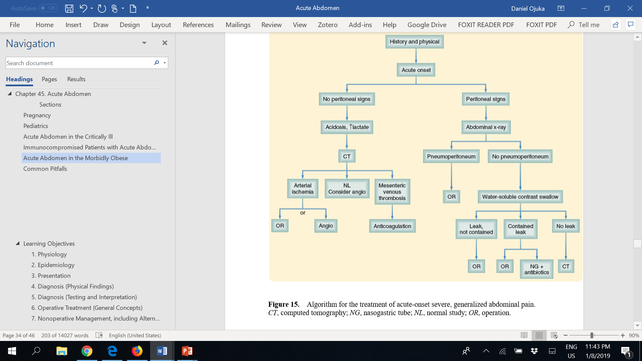

Slide 107
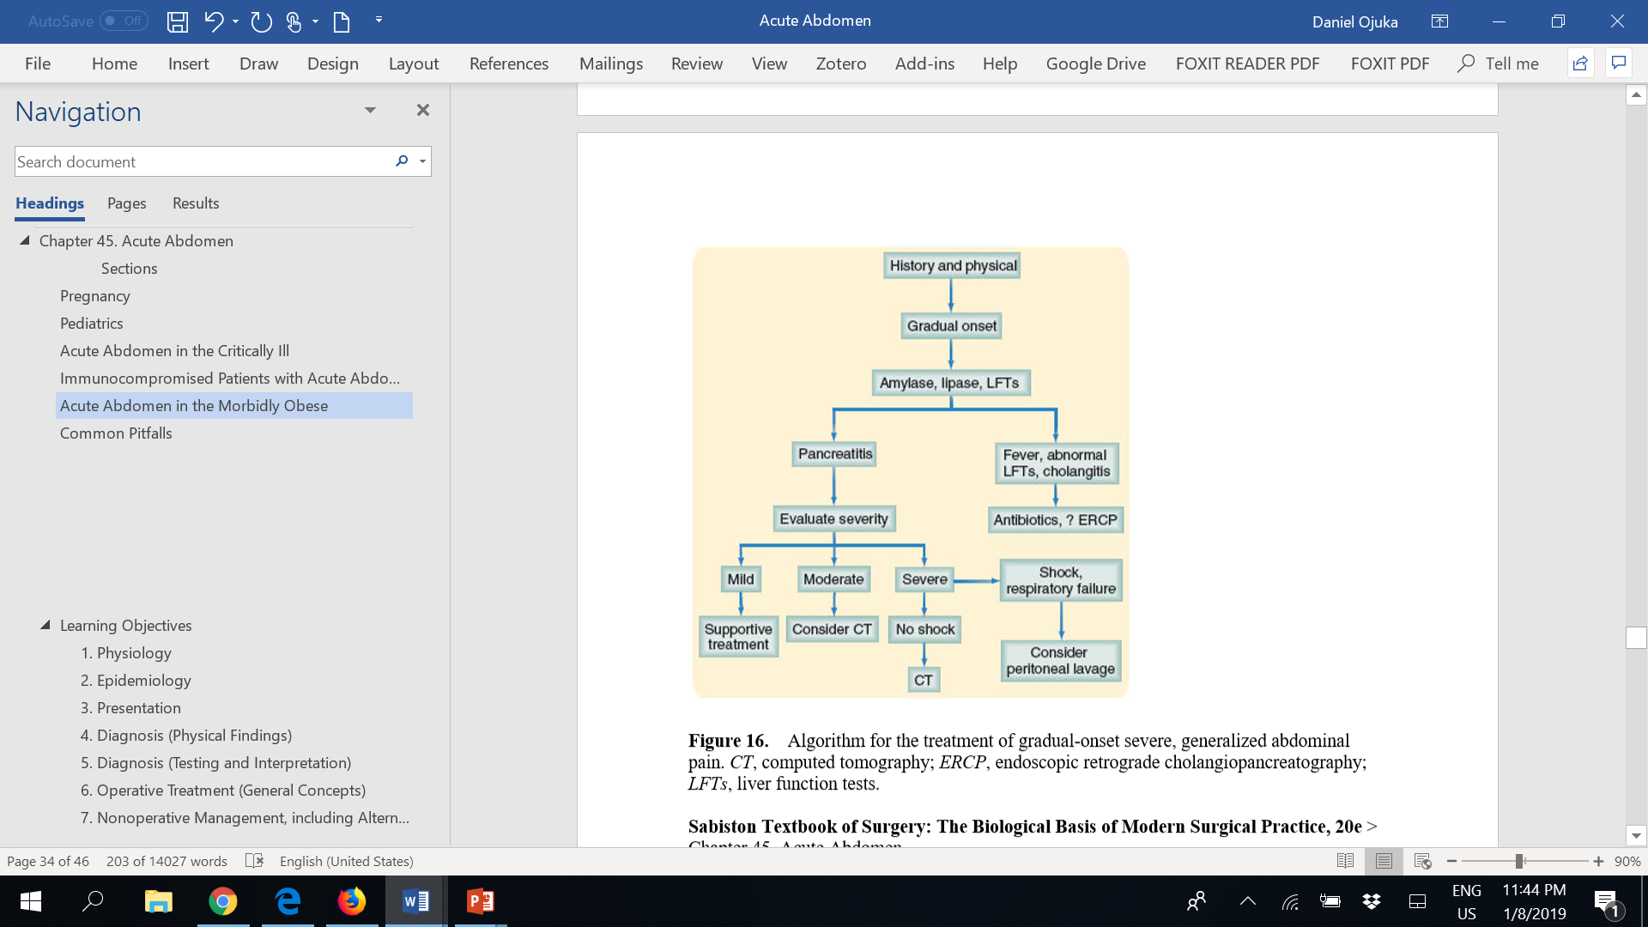

Slide 108
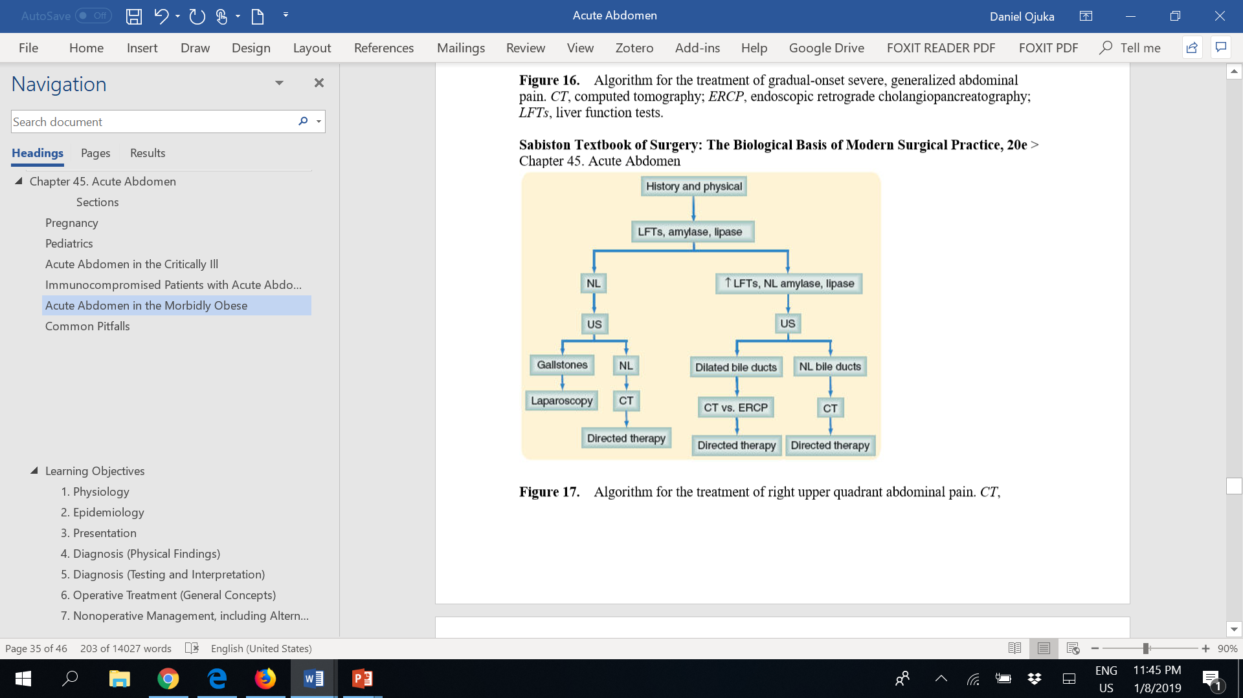

Slide 109
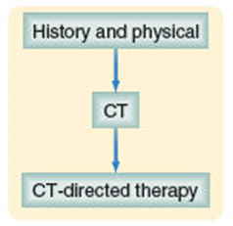
Algorithm for the treatment of left upper quadrant abdominal pain. CT, computed tomography.

Slide 110
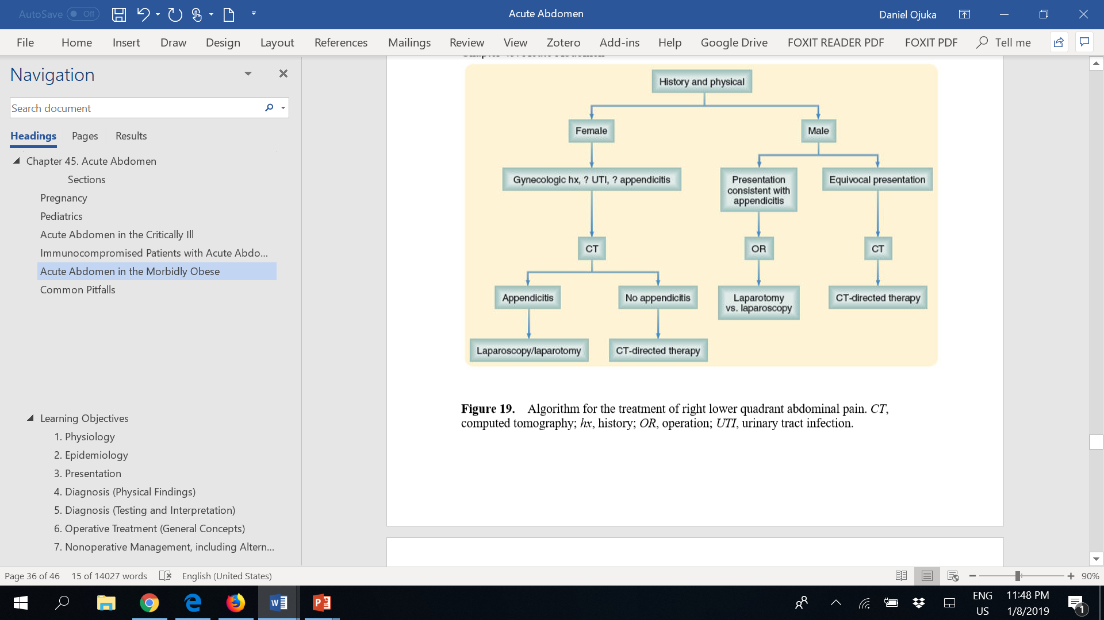

Slide 111
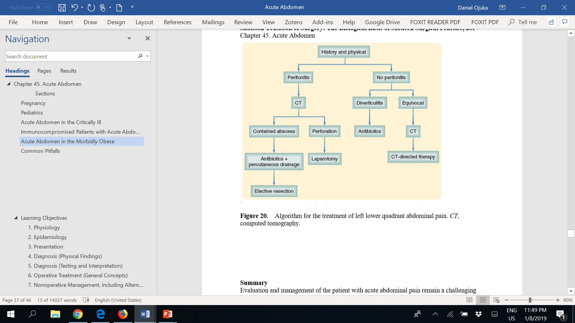

Slide 112
Pitfalls
Failure to thoroughly examine and document findings
Failure to perform a rectal or vaginal examination when appropriate
Failure to evaluate for hernias, including the scrotal region
Failure to conduct a pregnancy test or to consider pregnancy in the diagnosis

Slide 113
Pitfalls
Failure to reassess the patient frequently while developing a differential diagnosis
Failure to reconsider an established diagnosis when the clinical situation changes
Failure to recognize immune compromise and to appreciate its masking effect on the historical and examination findings
Allowing a normal laboratory value to dissuade a diagnosis when there is cause for clinical concern

Slide 114
Pifalls
Failure to consult colleagues when appropriate
Failure to take age- and situation-specific diagnoses into consideration
Failure to make specific and concrete follow-up arrangements when monitoring a clinical situation on an outpatient basis
Hesitancy to go to the operating room without a firm diagnosis when the clinical situation suggests surgical disease

Slide 115
Summary
Evaluation and management of the patient with acute abdominal pain remain a challenging part of a surgeon's practice.
Whereas advances in imaging techniques, use of algorithms, and computer assistance have improved the diagnostic accuracy for the conditions causing the acute abdomen, a careful history and physical examination remain the most important part of the evaluation.
Even with these tools at hand, the surgeon must often make the decision to perform a laparoscopy or laparotomy with a good deal of uncertainty as to the expected findings.
Increased morbidity and mortality associated with a delay in the treatment of many of the surgical causes of the acute abdomen argue for an aggressive and expeditious surgical approach.

