Slide 1
CNS IMAGING -
HYDROCEPHALUS
DR. KIBOI – CONSULTANT NEUROSURGEON

Slide 2
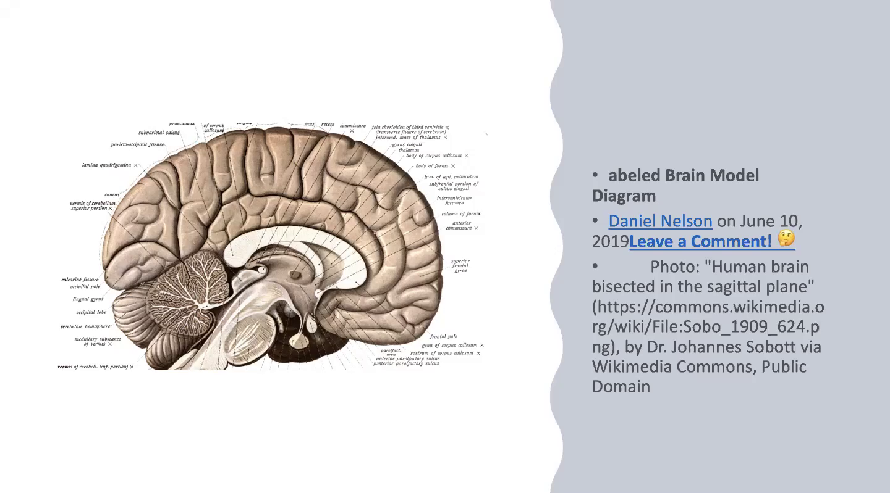

Slide 3
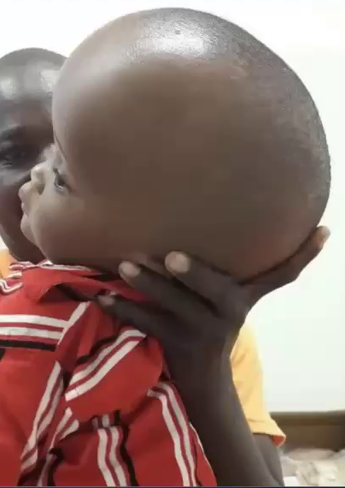
Hydrocephalus
Causes:-
Infections: Meningitis (viral, tubercular)
Tumors in posterior fossa: medulloblastoma (roof of 4th ventricle) and ependymoma (ependymal lining of 4th ventricle)
Congenical (Aqueductal stenosis)
Signs and Symptoms:
Fontanelles: bulging/sunken
Sutural diastases: open/closed
Engorged veins, increased vascular marking
Bossing of the forehead: frontal bossing
Sunset eyes: upward gazing difficult
Transillumination in anterior fontanelles
Cracked pot sign during percussion
Head circumference: Occipitofrontal circumference against age
Vomiting, failure to thrive, irritability (high-pitched cry), opistothonus (backward arching of head, neck and spine – increased ICP)

Slide 4
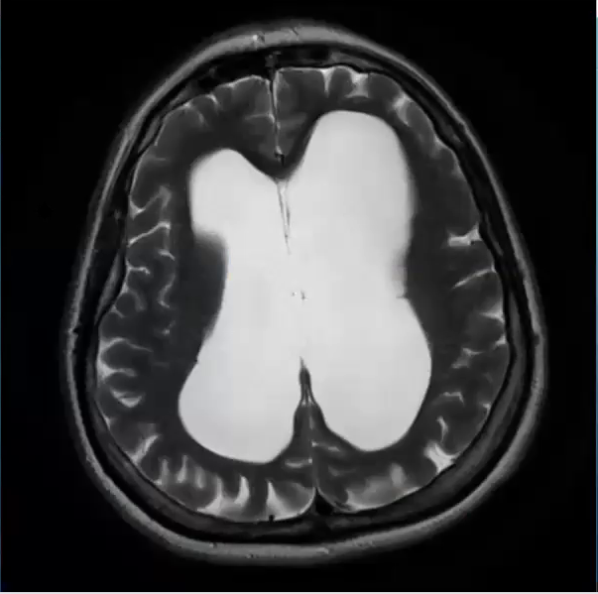
MRI
CSF seepage
Evan’s Ratio: Ratio of maximum width of the frontal horns of the lateral ventricles and the maximum internal diameter of the skull at the same level in axial CT and MRI images; if it’s greater than 0.3 suggests hydrocephalus

Slide 5
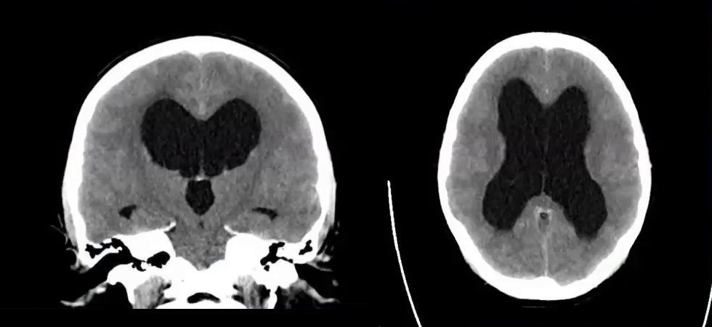

Slide 6
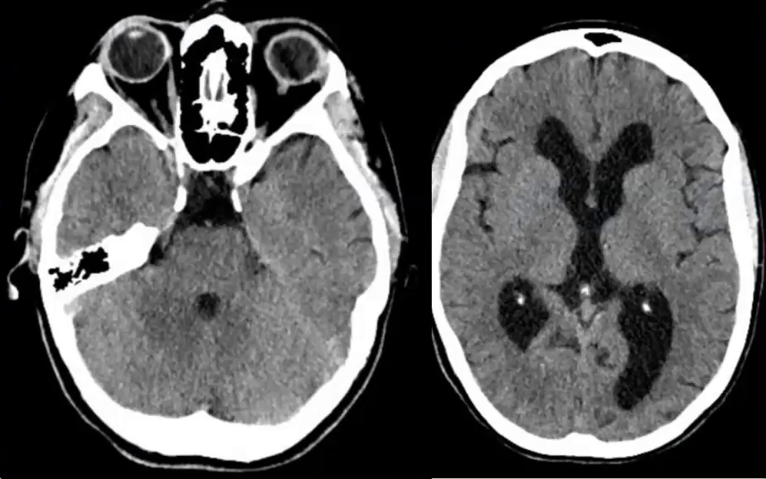
The left shows congenital aqueductal stenosis – managed through Endoscopic third ventriculostomy

Slide 7
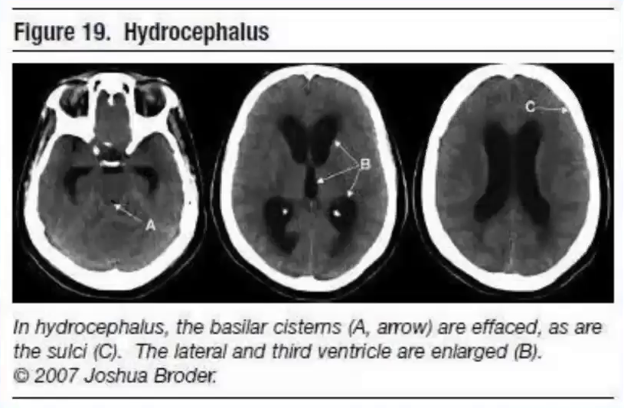

Slide 8
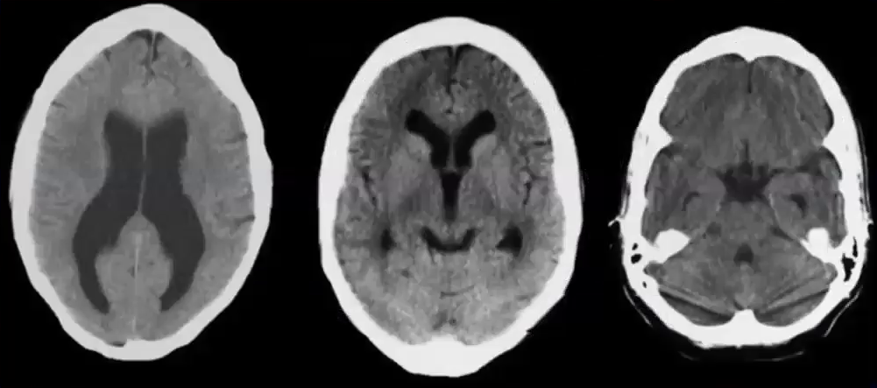

Slide 9
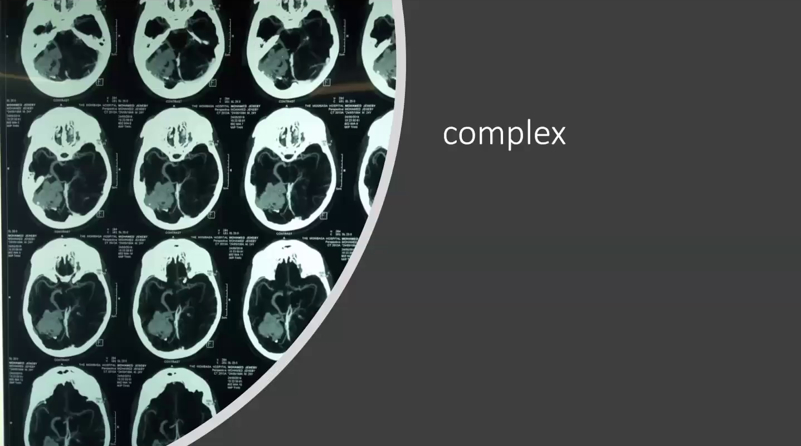
Hydranencephaly

Slide 10
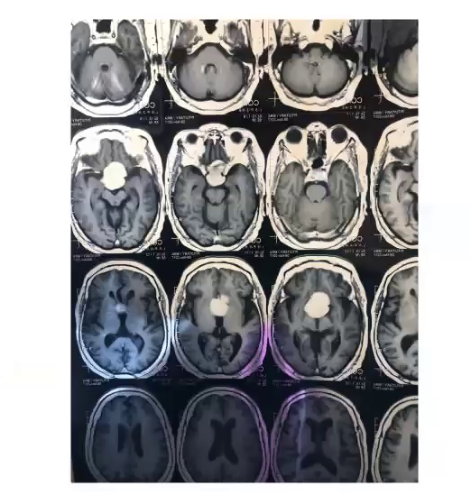
Tumors in the 3rd ventricles (colloid cysts)

Slide 11
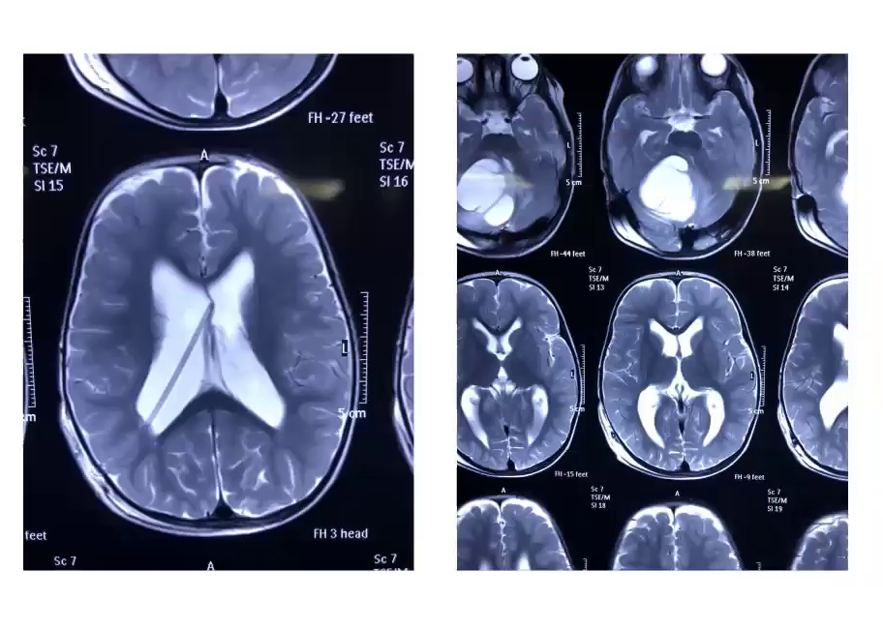
Cerebellar tumors

Slide 12
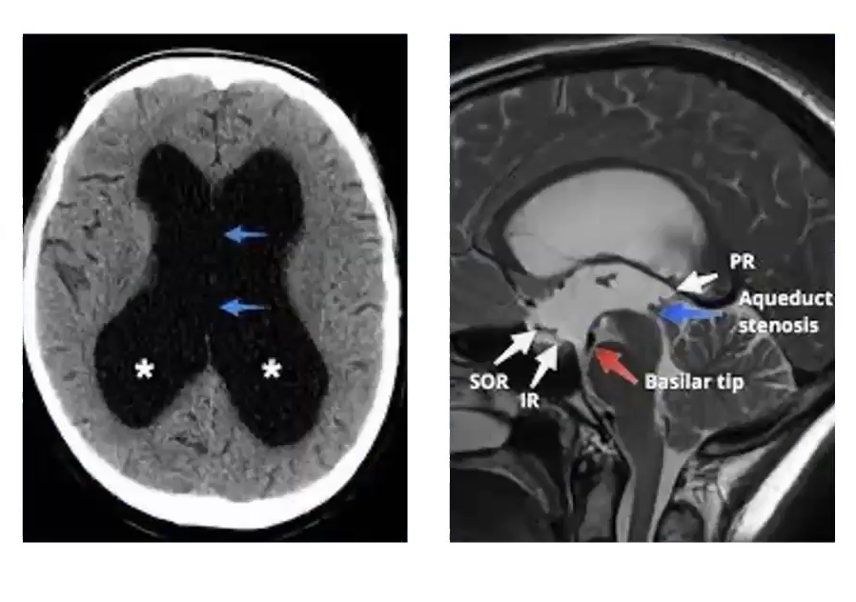

Slide 13
Complications of hydrocephalus
Intraoperative: anaesthesia-related, over draining CSF leads to subdural hematoma
Postoperative: atelectasis, fever, epilepsy/convulsions, hypoxic brain damage, scalp bleeding, tumor bleeding
Shunt-related: jugular damage (passing the shunt), ventriculitis, peritonitis, fistula in abdomen, shunt malfunction, shunt blockage (infections: streptococcal, staphylococcal), slit ventricle (over drainage by shunt), shunt perforation, shunt migration

