Slide 1
0BSTRUCTIVE UROPATHY
By Prof. Peter Ndaguatha
Defination – renal dysfunction secondary to impairment or
blockage of urinary flow along the urinary system.
- Structural impedance to urine flow causing pathophysiologic changes.
Classification:
Acute-unilateral / bilateral
Chronic- unilateral /bilateral

Slide 2
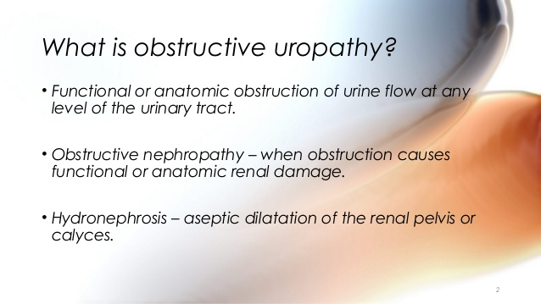

Slide 3
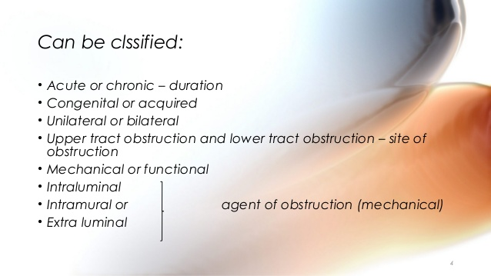

Slide 4
CAUSES
1. Intrinsic- stones,Tumours, Prostatic Enlargement
2. Extrinsic-Retroperitoneal masses, adjacent pathologies.

Slide 5
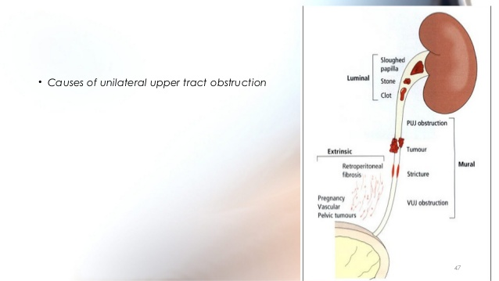

Slide 6
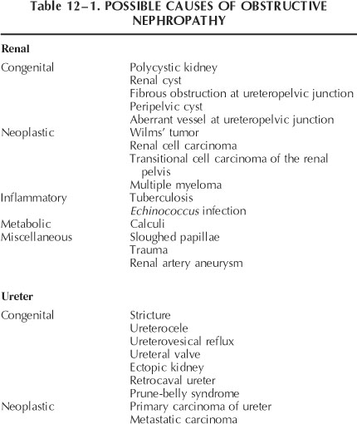

Slide 7
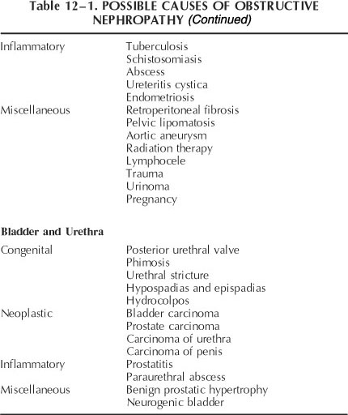

Slide 8
Sequalae of obstruction
Increased intraluminal pressure
Urinary stasis
Infection
Stone formation
Loss of renal function.

Slide 9
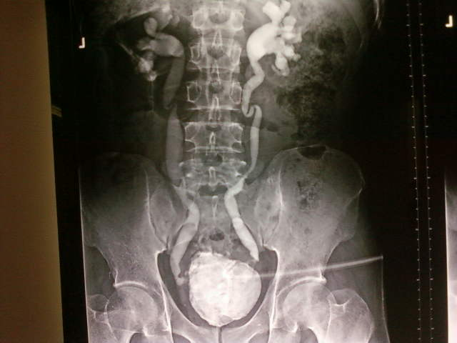
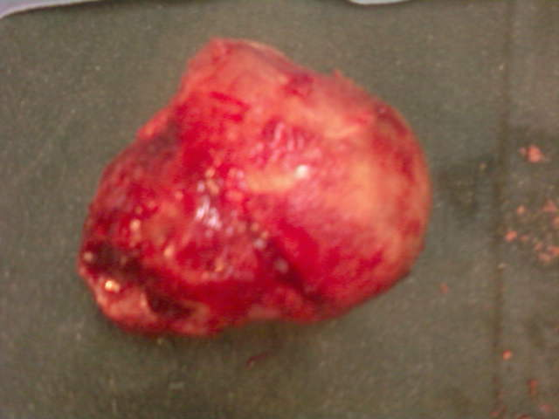
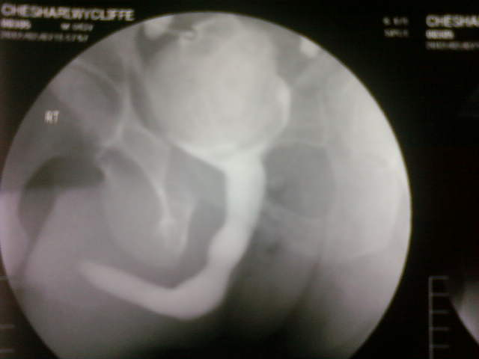
Pathophysiology

Slide 10
Pathological cosequences
Level of obstruction –Infravesical
-prevesical
.Degree of obstruction – complete
-partial

Slide 11
Pathogenesis (patholophysiology)1
The changes in the various segments in the urinary tract, depending on the obstructive severity and duration
1. Urethral changes: dilatation, diverticulum
2. Vesical changes: trabeculation, residual urine,
diverticula
3. Ureteral changes: distention, dilatation and lengthening

Slide 12
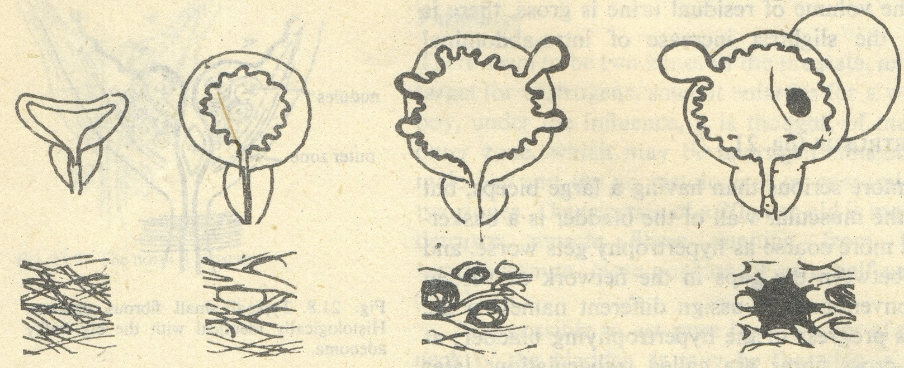

Slide 13
Pathogenesis (patholophysiology)2
4. Pelvicalyceal changes: first shows evidence of hyperactivity and hypertrophy and then progressive dilatation and stony,rounding of the fornices ,followed by flattening of the papillae and finally clubbing of the minor calyces.
5. Renal Parenchymal Changes:compression, ischemic atrophy.

Slide 14
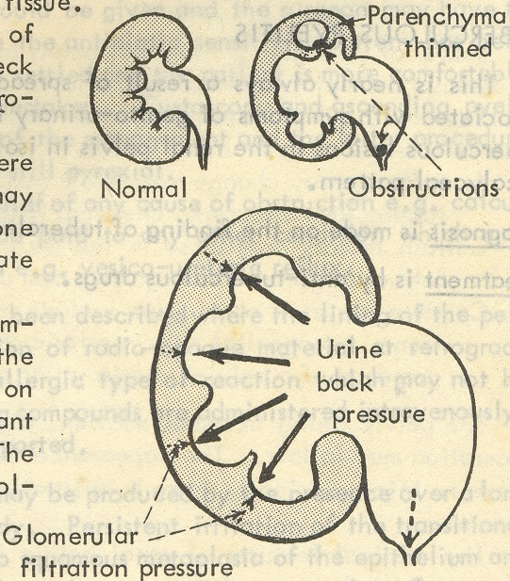
The result of renal pelvis-obstruction

Slide 15
Clinical findings
1.Symptoms and signs:
infravesical obstruction :difficulty of voiding,weak stream ,diminished flow rate,terminal dribbling,burning ,frequency.
Supravesical obstruction :renal pain or renal colic,if gradually--asymptomatic or enlarged kidney.

Slide 16
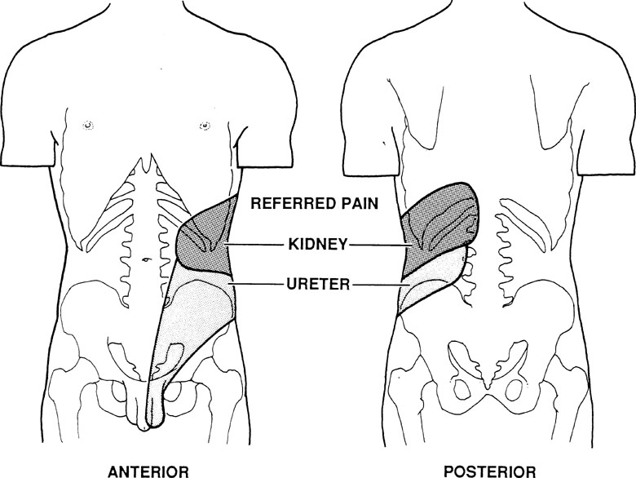
Diagnosis:- Hx and Px
Main factors to be considered
History
-Flank pain
-fever
-LUTS
- AUR
- other factors (Haematuria,UTI,advanced in age, wt loss, previous urethral instrumentation )
- Do not forget Neurologic diseases,eg MS, spinal cord injury
Physical examination
- lymphadenopathy,
- Costovertebral angle
tenderness
- Distended abdomen,
?palpable bladder, hydronephrotic
kidneys.
- DRE( BPE/ PCA)

Slide 17
Diagnosis :- Hx and Px contd
Other factors
Urinary incontinence
Pelvic or abdominal malignancy
Pelvic / mass on internal examination
Meatal stenosis

Slide 18
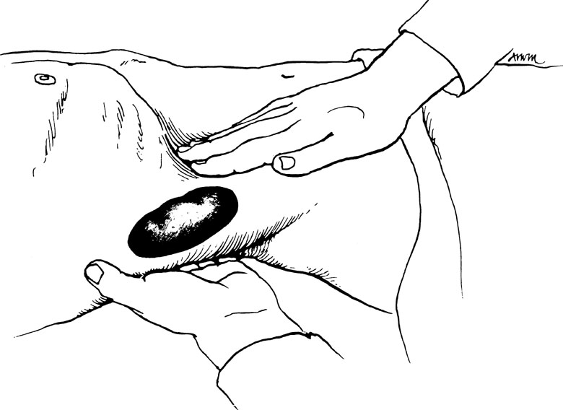
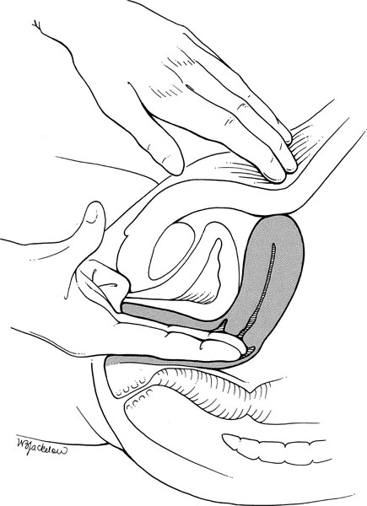
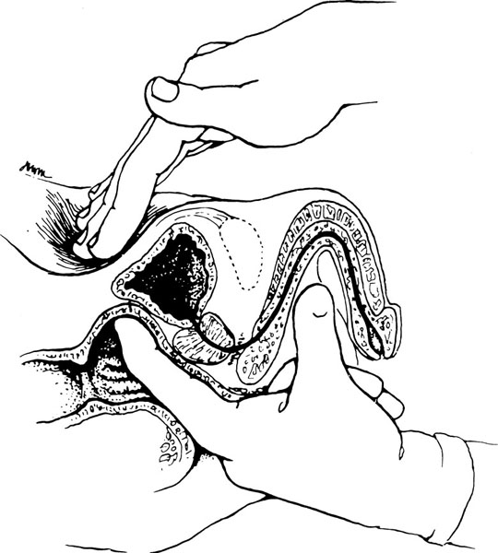

Slide 19
Diagnostic Tests
i)Urine -Dip stick
- microscopy and C/S
ii) Blood - TBC
- U/E, serum creatine
iii) Imaging – U/S
- IVU
- CTU

Slide 20
Clinical findings
3. X-Ray findings
I.V.U , RGP , Ureterograms , Urethrogram :-
localizing the site of obstruction
demonstrate the extent of the obstructed segment
anatomic changes
functional changes

Slide 21
Clinical findings
4. Special Examination
Instrumental calibration of sites of obstruction is also valuable
isotope renography
ultrasonic examination shows hydronephrosis and residual urine
Urinary flow rate
CT urograms.

Slide 22
Treatment
Preliminary drainage above the obstruction is sometimes needed to improve kidney function.
Occasionally, permanent drainage and diversion by cutaneous ureterostomy, ileal or colonic loop diversion, or permanent nephrostomy are required.

Slide 23
Treatment
1.bladder drainage by a catheter
2.urethral stricture- urethrotomy or urethroplasty
3.urethral valves must be ruptured
4.BPH or obstructing bladder tumors require surgical removal
5.impacted stones must be removed
6. Impaction deal with cause.

Slide 24
Prognosis
The prognosis depends on the cause, site, duration, and degree of kidney demage and renal decompensation. In general, relief of obstruction leads to improvement in kidneys,especially those destroyed by inflammatory scarring.

Slide 26
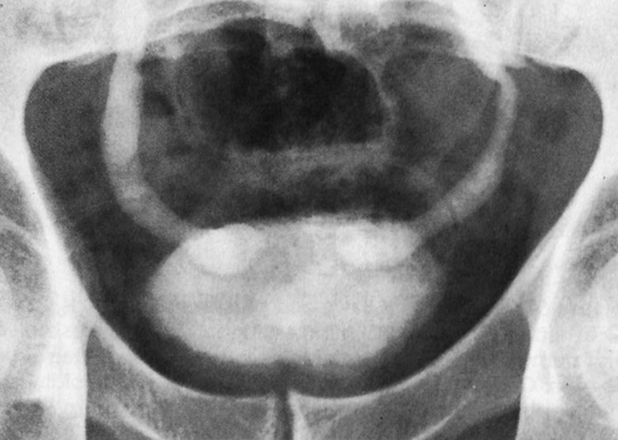
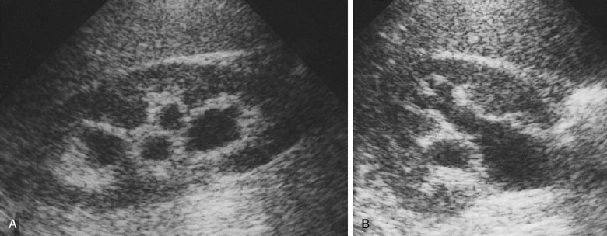
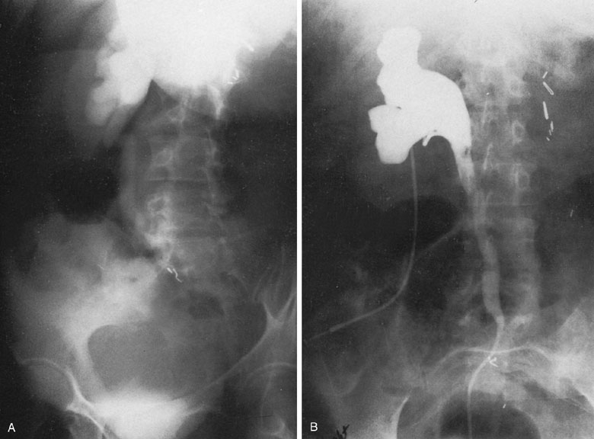
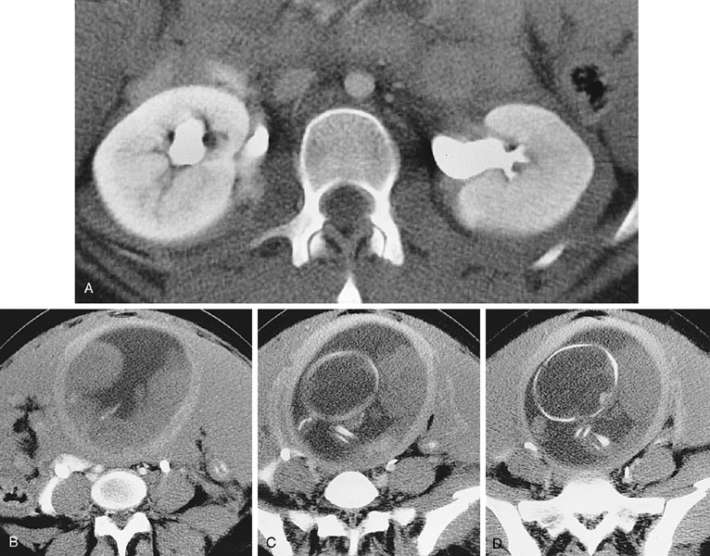

Slide 27
Other Tests to consider
PSA,
Tumour markers e.g., CEA,Ca125
CT abdomen and pelvis
Renograms eg DMSA,DTPA,MAG3
MRU.
TC 99m tagged
i) Diethylenetriaminepenta-acetic acid (DTPA).
ii) Mercapto acetyl triglycine (MAG3)
iii) Dimercaptosuccinic acid (DMSA)

Slide 28
Treatment Options

Slide 29
ACUTE OBSTRUCTION
Urolithiasis Unilateral /bilateral with signs of sepsis
Urolithisis Unilateral / bilateral without signs of sepsis
-analgesia and hydration
-nephrostomy or ureteric stent
-antibiotics
<5mm consevative –analgsia + hydration
>5 but<10mm –trial of passage with analgesia and rehydration
- α-blockers
- active stone
removal
. >10mm –analgesia and rehygration
- nephrostomy or ureteric
stent or active stone removal.

Slide 30
Acute obstruction without stones
Unilateral
Bilateral
Ureteric stent
Analgesia
Antibiotics
Treatment of the underlying cause
Nephrostomy
Urethral catheter
SPC
Treatment of the underlying cause
Antibiotics
NB BPE/BPH
.α-blockers
. 5-α-reductase
inhibitor

Slide 31
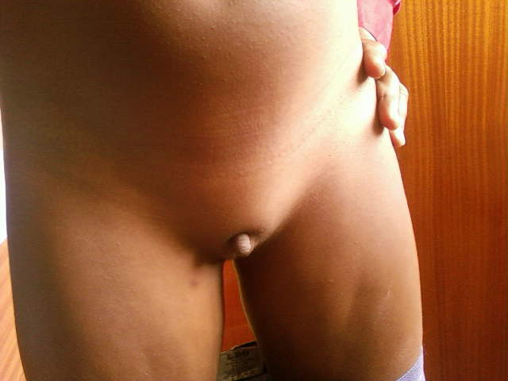
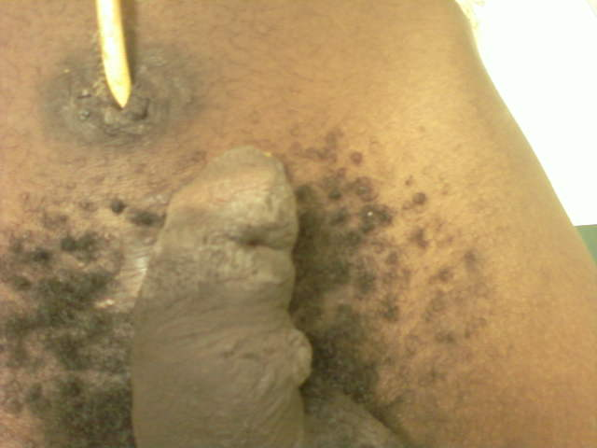

Slide 32
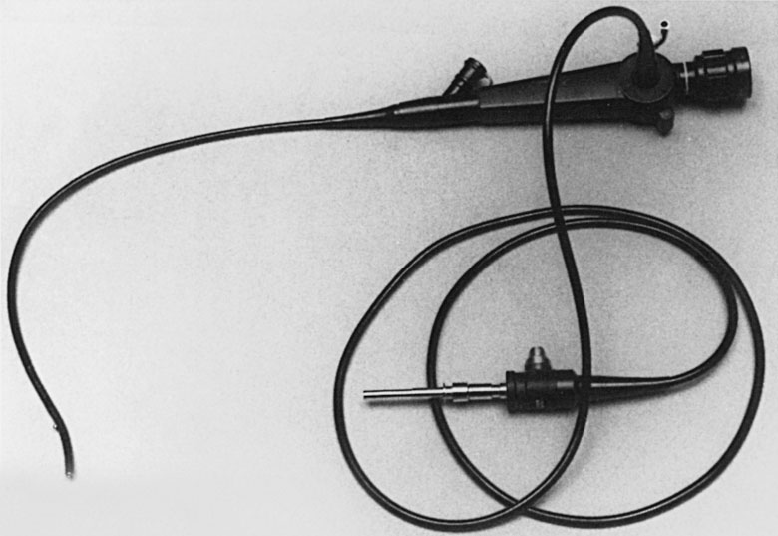

Slide 33
Other pathologies
Treat the causes.
-Renal masses
- PUJ
- Retroperitoneal fibrosis
- UVJ
- Bladder Tumours
- BOO etc.

